Slide 1
Imputation Using (Zero/Constant) Values
Dropping these columns : Unnamed: 0 , problem_ID , change_request
Zero or Constant imputation it replaces the missing values with either zero or any constant value you specify .
In our dataset has ? And -100 missing values , so we can replacing it as 0 constant value .
Ordinal Encoding for date columns : opened_time, created_at , updated_at
For e.g: converting date-time into day_ordinal , Keeps the semantical information of the variable.
Date Day_ordinal
07-03-2016 11:04 7
07-03-2016 09:25 7
07-03-2016 09:11 7
30-03-2016 09:20 30
30-03-2016 08:20 30

Slide 2
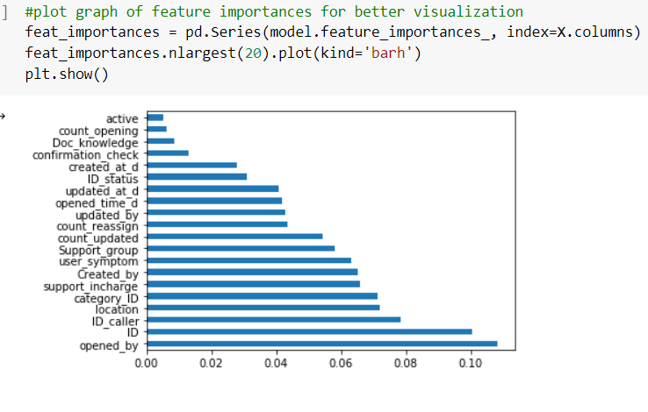
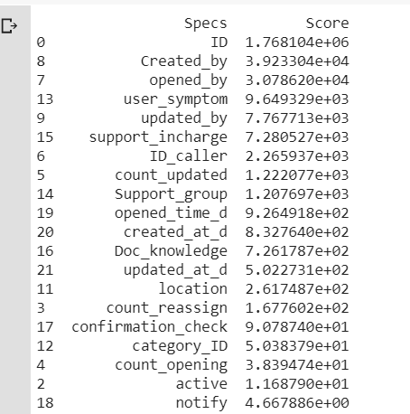
Feature Selection
Univariate Selection
Feature Importance
strongest relationship with the output variable using SelectKBest and chi2 test
Use ExtraTreesClassifier : plot top 20
Dropped ID_status , type_contact from Trainig dataset.

Slide 3
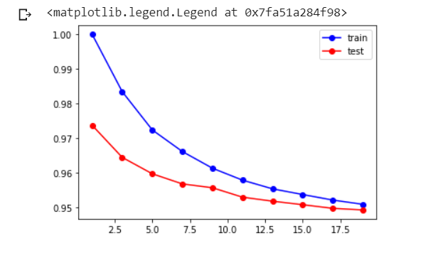
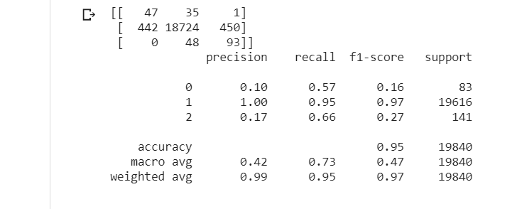
Stratified Sampling
Our output feature has discrete format, so we apply stratified sampling to train dataset and split into 80 and 20 percentage.
K-Nearest Neighbors
Select k value as 15 and build model on train_x, train_y values and get 95% accuracy

Slide 4
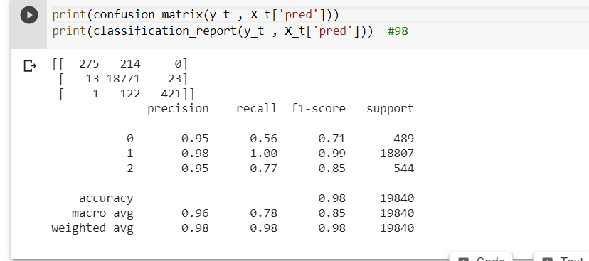
Random Forest
build model on train_x, train_y and get 98% accuracy
precision , recall and f1-score values better than knn

Slide 5
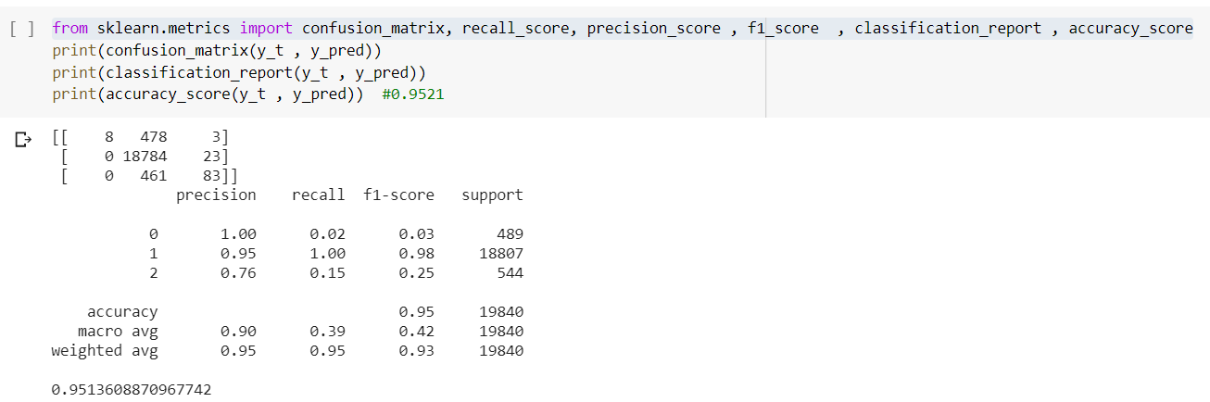
XGBOOST
build model on train_x, train_y and get 95.13% accuracy
precision , recall and f1-score better for 1
Finally selection of model carefully , because of our dataset is not balance we don’t trust only on accuracy , so we also looking for precision, recall , f1score behalf of that decide on Random Forest model

