Slide 1
PREDICTION OF
SCF USING DEEP LEARNING
K. VIJAY PRABHAS (200030028)
D.DHANUSH (200030018)

Slide 2
CONTENTS
PROBLEM STATEMENT
ANSYS MODEL
SOLUTION OF THE FIRST MODEL
AUTOMATED PARAMETRIC STRUCTURAL ANALYSIS
CHALLENGES FACED IN ANSYS
PREPROCESSING OF DATA
IMPLEMENTATION OF CODE
CHALLENGES FACED IN DEEP LEARNING MODEL
RESULTS
COMPARISON OF STRESS CONCENTRATION FACTOR
ERROR CALCULATION

Slide 3
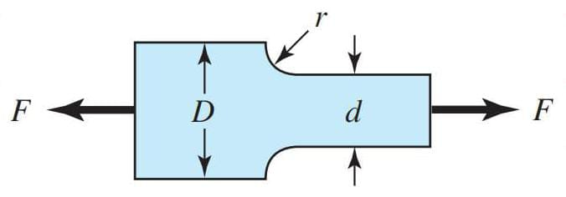
PROBLEM STATEMENT
Finding the stress concentration factor of a thick bar with a fillet is loaded axially with force using the deep learning concept.

Slide 4
ANSYS MODEL
SOLUTION OF THE FIRST SIMULATION

Slide 5
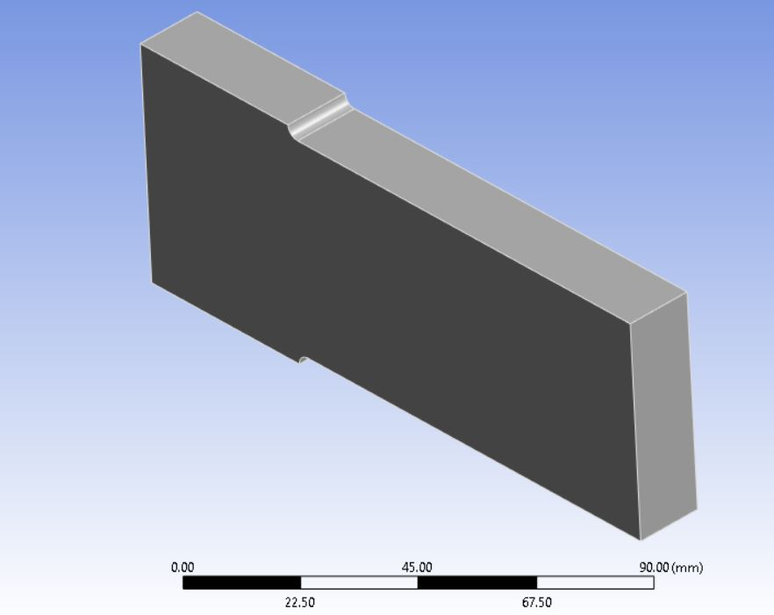
ANSYS MODEL
In Ansys, the specimen is designed in the design modeler,
STEPS FOLLOWED IN ANSYS:
In the Ansys workbench, static structural is selected in the toolbox, and the model is designed in the design modeler.
The material is structural steel.

Slide 6
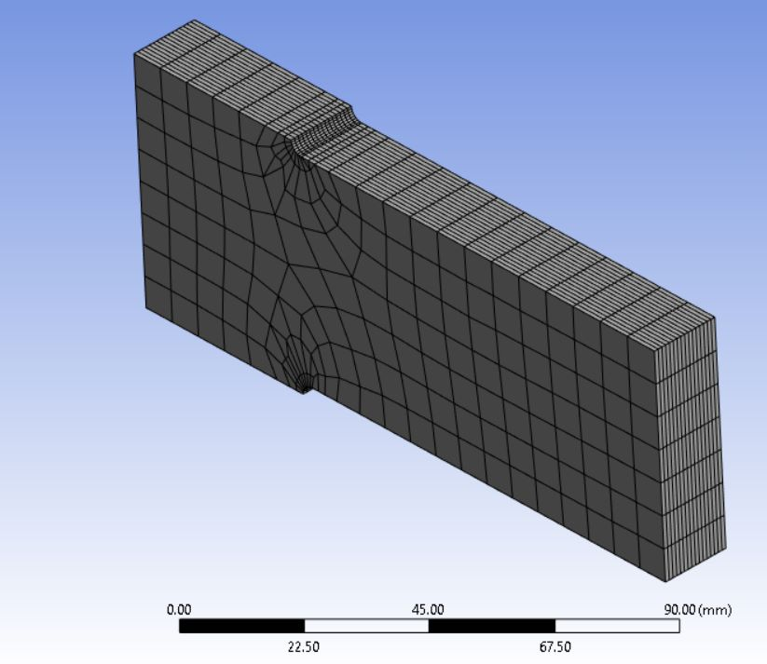
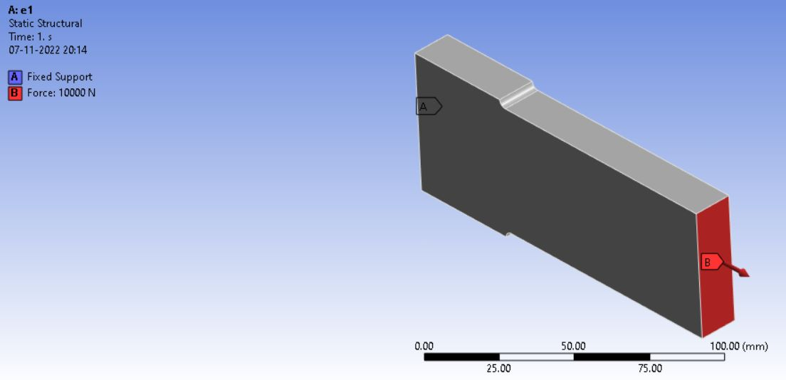
ANSYS MODEL
Going to Ansys mechanical in the project schematic. Initially, the mesh is generated to the specimen, which is the default. The sizing in the mesh is applied to increase the accuracy, particularly at the stress concentration region.
The boundary conditions were applied to the specimen; for this model, the fixed support was at the left and the force (e.g., 10KN) at the right end.

Slide 7
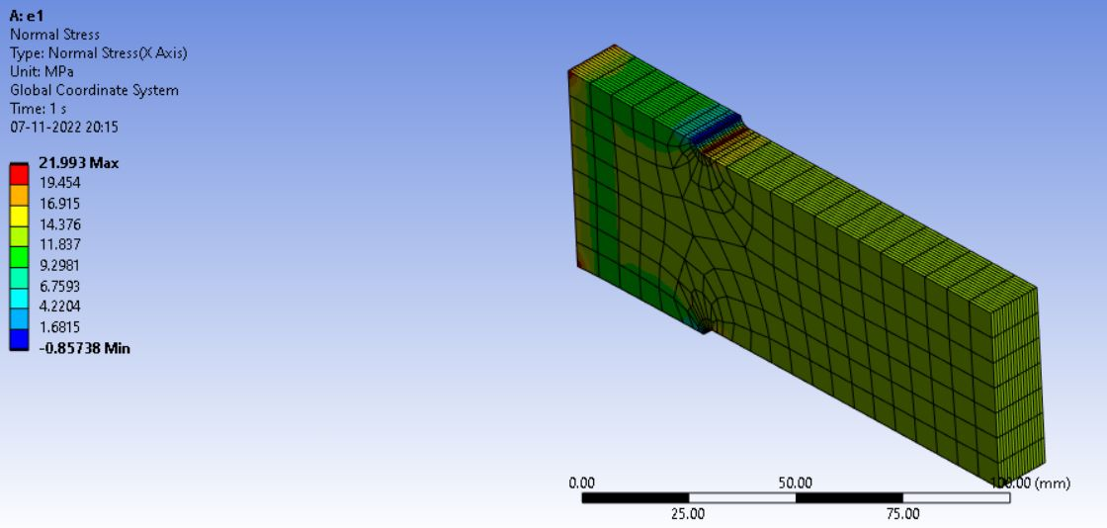
ANSYS MODEL
After that, the stress condition is applied we can look at here,

Slide 8
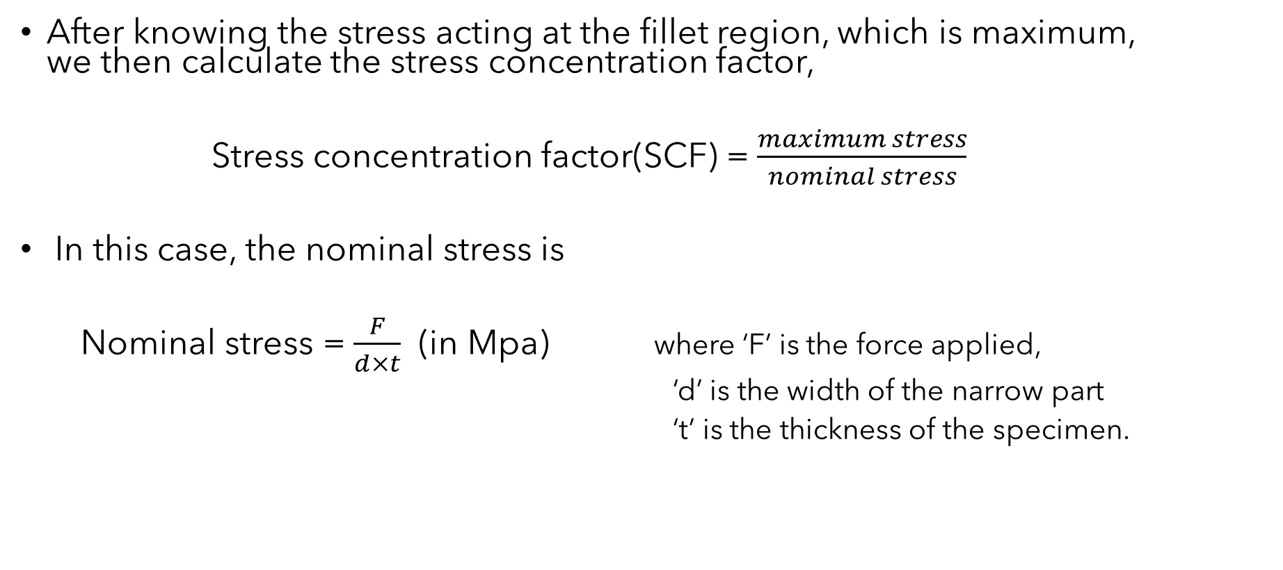
FINDING STRESS CONCENTRATION FACTOR

Slide 9
AUTOMATED PARAMETRIC STRUCTURAL ANALYSIS
Now, we enter the parametric analysis part, where we find the maximum stress for different specimens by varying geometric parameters.
For this case, the parameters are the radius of the fillet and the width of the broad part. ( ‘r’ and ‘D’).
We took over 500 design points in this analysis.
With the help of response surface in design exploration.

Slide 10
CHALLENGES FACED IN ANSYS
First, we tried to design the model in the Space Claim software, but there is no option to select parameters in the Space Claim.
For the parametric analysis part to generate the data for over 500 design points, it took more than 7 hrs.
We also faced problems determining the parameter range to generate huge design points.

Slide 11
PREPROCESSING OF DATA
The data collected from ANSYS have radius of the fillet(r), width of the big section(D) and maximum stress.
Feeding the deep learning model r/d, D/d and k(SCF) instead of r, D and stress directly increases the accuracy of the model(where d is width of the small section).
While the doing the simulations in the Ansys d, F and t are kept constant, so the nominal stress is constant(where F is the axial force applied and t is the thickness of the specimen).
Dividing the r column and D column by d we get r/d and D/d ratio and dividing maximum stress by nominal stress(10Mpa) we get SCF.

Slide 12
IMPLEMENTATION OF CODE

Slide 13
CHALLENGES FACED IN DEEP LEARNING
Accuracy of the model:
Increasing the number of hidden layers usually increases the accuracy of the model but after 3 hidden layers the accuracy decreased because of the overfitting.
We tried increasing the number of nodes or neurons in each layer to achieve higher accuracy keeping the number of layers constant but after a certain number of nodes the accuracy decreased.

Slide 14
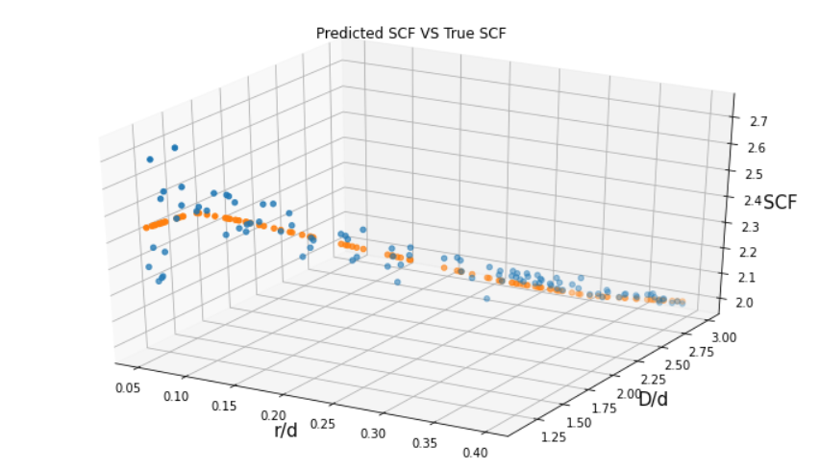
Results
3D plot showing predicted SCF and true SCF :

Slide 15
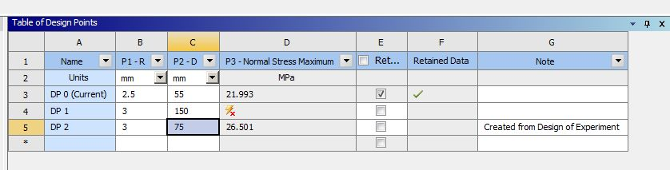
RESULTS
For r = 3mm, D = 75mm, d = 50mm, F = 10kN, t = 20mm,
the maximum stress obtained from the Ansys simulation was 26.501Mpa. So, SCF = 26.501/10 = 2.6501.

Slide 16
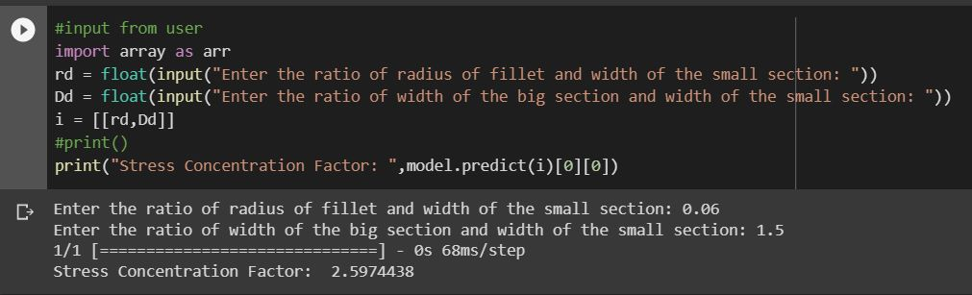
RESULTS
The SCF predicted by the deep learning model for the same is 2.5974438.

Slide 17
Results
Error Calculations:
relative error = (2.6501-2.5974438)/(2.6501)
= 0.01987
percent error = 1.987%
Hence the percent error between actual SCF and the SCF predicted by the deep learning model is 1.987%.

Slide 18
Thank you
K. VIJAY PRABHAS (200030028)
D.DHANUSH (200030018)

