Slide 1
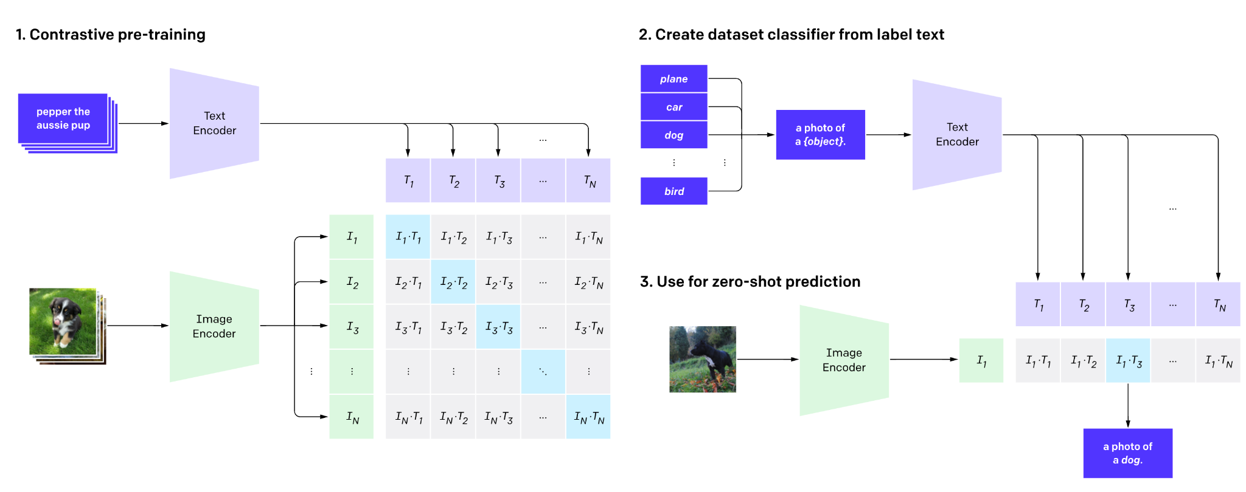
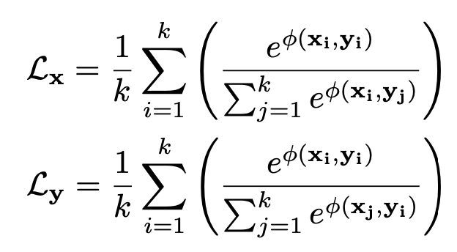


Open World Image Semantic Segmentation
Introduction to CLIP (Contrastive Language-Image Pre-training)
Aligns the CLS token of image and text encoder via InfoNCE
Zero-shot image classification

Slide 2
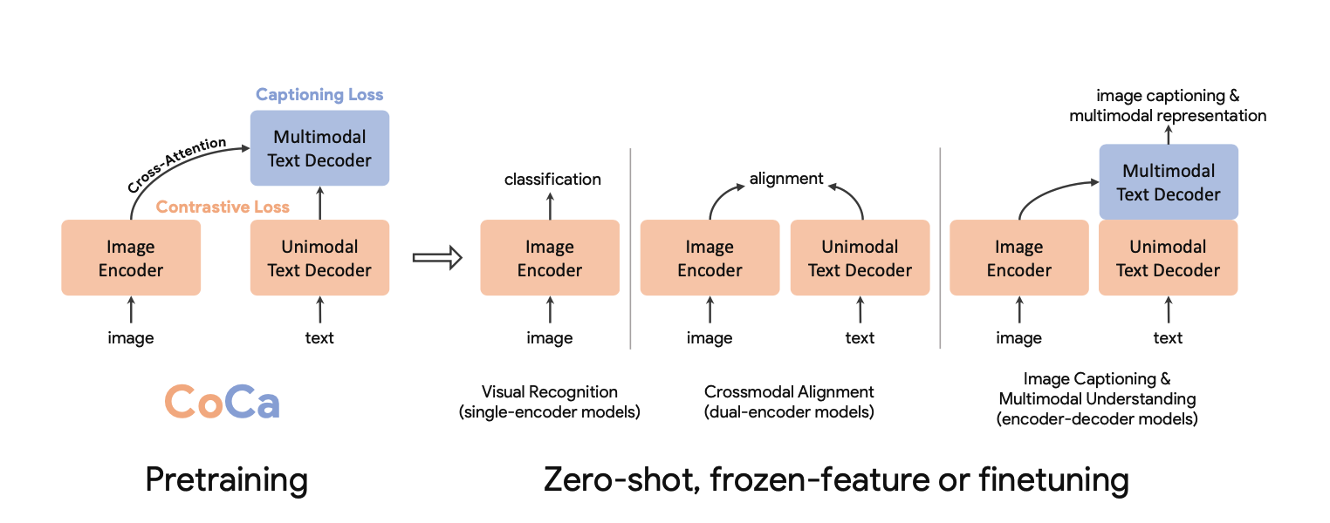
Contrastive Captioners (CoCa)
Idea:
One network to rule it all
Single encoders (e.g., ImageNet classifiers)
Double encoders (e.g., CLIP!!)
Encoder-Decoder (e.g., Image captioner)

Slide 3



The Three Musketeers
Image encoder
"Classical" image + ground truth labels training
Double encoder
CLIP
Image and text encoder for contrastive learning
Encoder-Decoder
Image input->encoder, text output like a T5

Slide 4
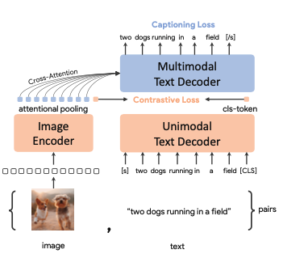
Tight Integration
Aspiration is to build a model that is generative (captioning) as well as contrastive
How to integrate them seamlessly
Discuss:
Early layers of the text decoder omit cross attention
Learning text representation
Later layers are cross attention between images and text
Half and half

Slide 5
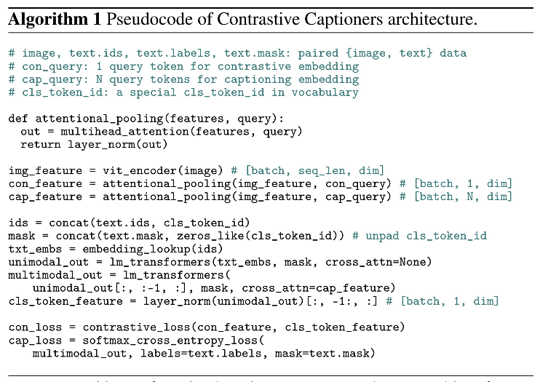

Together
Attentional Pooling
Learns how many tokens to use
Image classification – just one is fine (think CLS)
Captioning – more tokens are better

Slide 6
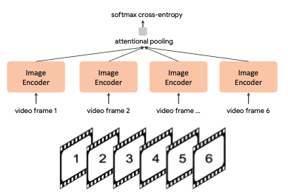
Downstream Tasks
Zero-shot transfers
Similar to CLIP
For video-trext as well (16 frames)
Frozen-feature evaluation
Use the trained image encoder e.g.
Attentional pooling
Video Action Recognition
Multiple frames of a video through the trained image encoder
Attentional pooling

Slide 7
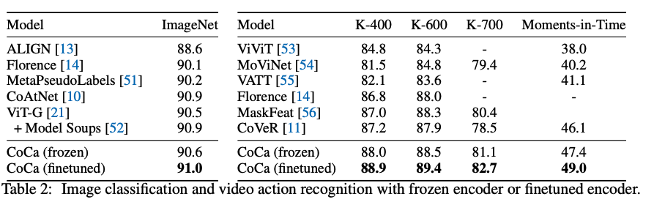
Datasets, Training
From scratch
JFT-3B (5 ep), ALIGN (10 ep)
Labels as text

Slide 8
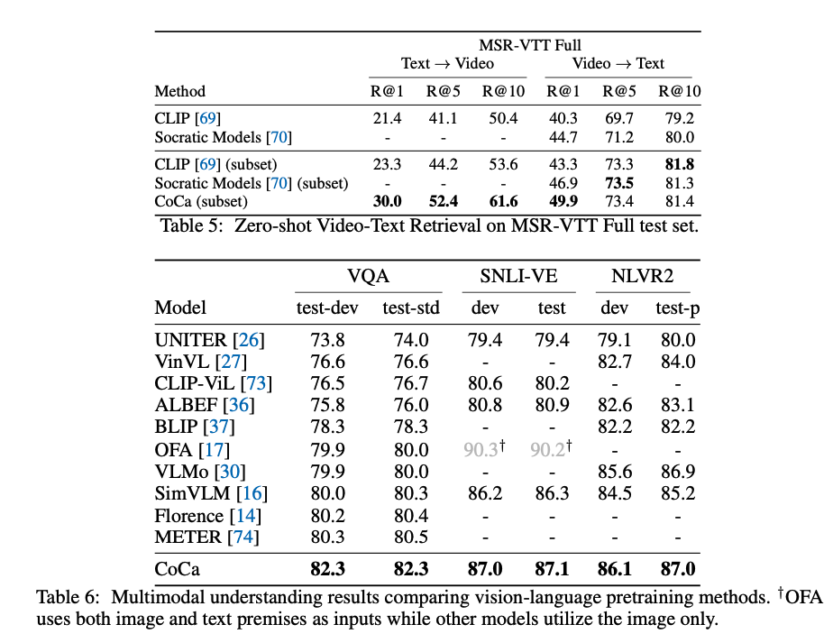
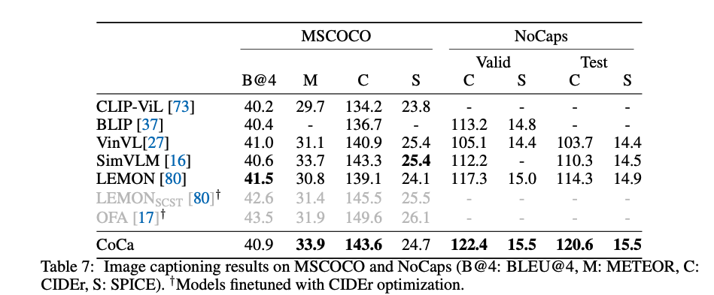
More Results

Slide 9
Interesting Findings
Encoder-decoder on par with single-encoder
Seems like generative pretraining subsumes classification pretraining
CoCa outperforms contrastive-only models

Slide 10
No Assignment
In lieu of CLIP assignment:
Implement PACL, which will require you to understand CLIP
Train PACL
Run semantic segmentation results
Compare to PACL paper
Next week:
10/3 -- DETR+GLIP assignment presentation
10/5 - Team project presentation

