Slide 1
Marlabs Assaignment
By VijayPrakash

Slide 2

Data Description :
No 77505 Yes 22495
No 77505 Yes 22495
There are 100000 rows and 23 columns are there in the data
In that Target column (RainTomorrow) has 77505 no’s and 22495 yes are there.
Here the data is very imbalanced.
20587 rows contains null values so there are removed from the data.

Slide 3
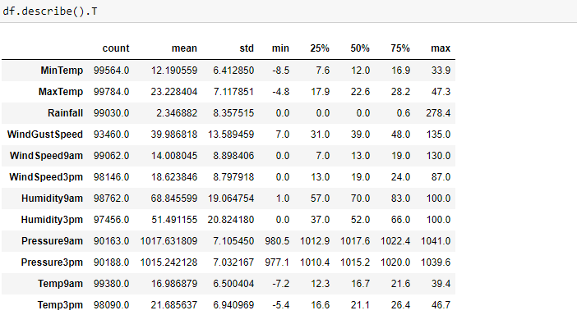
Observations :

Slide 4
Observations :
There is Temperature recorded min(-4.8) and max(47.3) centi grade.
To Rain Tomorrow the average Humidity3pm is more compared to not to rain Humidity3pm.
here,The MaxTemp is less for the RainTomorrow means if the recorded max temperature is leass then its also favouring to rain.

Slide 5

The data is divided into categorical and numerical data based upon the data types.
After loading the data,first step we do is to find out the missing values.Which are the columns which have missing values,what percentage of data is missing from the column.If more than 40% of the data is missing from the column,we can drop the column as it would affect the model accuracy.Here we have dropped six different columns from the data.These are : 'Sunshine','Evaporation','Cloud3pm','Cloud9am','Location','Date'.

Slide 6
We perform all these to get a more cleaner data so that it can be effectively used for the Data Modelling.I have used get_dummies, we can assign numeric values to the string data as per the label.Label Encoder are used to convert categorical data, or text data, into numbers, which our predictive models can better understand.We have used Test -Train Split. It split arrays or matrices into random train and test subsets.

Slide 7
Applied Models
I applied logit function to the data if the p-value for particular column less than 0.05 then I removed particular column from the data.
I applied Classification models Logistic regression ,Random Forest, Decision Tree Classifier and svm( for Classification I used SVC)
After performing these models I got more accuracy 83% with both Logistic and SVC.

