Slide 1
PCA
Sajan Kedia

Slide 2
Agenda
Standard Deviation
Covariance
Matrix transfomation
Eigen Value & Eigen vectors
PCA
Dimentionality Reduction
Use Cases
Demo
Labs

Slide 3
Standard Deviation
Statistics – analyzing data sets in terms of the relationships between the individual points
Standard Deviation is a measure of the spread of the data
Calculation: average distance from the mean of the data

Slide 4
Variance
Another measure of the spread of the data in a data set
Calculation:
  Var( X ) = E(( x – μ )^2)
Why have both variance and SD to calculate the spread of data?
Variance is claimed to be the original statistical measure of spread of data. However it’s unit would be expressed as a square e.g. cm^2, which is unrealistic to express heights or other measures. Hence SD as the square root of variance was born.

Slide 5
Covariance
Variance – measure of the deviation from the mean for points in one dimension e.g. heights
Covariance as a measure of how much each of the dimensions vary from the mean with respect to each other.
Covariance is measured between 2 dimensions to see if there is a relationship between the 2 dimensions e.g. number of hours studied & marks obtained
The covariance between one dimension and itself is the variance

Slide 6
Covariance Matrix
Representing Covariance between dimensions as a matrix e.g. for 3 dimensions:
cov(x,x) cov(x,y) cov(x,z)
C = cov(y,x) cov(y,y) cov(y,z)
cov(z,x) cov(z,y) cov(z,z)
Diagonal is the variances of x, y and z
cov(x,y) = cov(y,x) hence matrix is symmetrical about the diagonal
N-dimensional data will result in nxn covariance matrix

Slide 7
Covariance
Exact value is not as important as it’s sign.
A positive value of covariance indicates both dimensions increase or decrease together e.g. as the number of hours studied increases, the marks in that subject increase.
A negative value indicates while one increases the other decreases, or vice-versa e.g. active social life at RIT vs performance in CS dept.
If covariance is zero: the two dimensions are independent of each other e.g. heights of students vs the marks obtained in a subject

Slide 8
Transformation matrices
Consider:
2 3 3 12 3
2 1 2 8 2
Square transformation matrix transforms (3,2) from its original location. Now if we were to take a multiple of (3,2)
3 6
2 4
2 3 6 24 6
2 1 4 16 4
x
=
=
4
x
2
x
=
x
=
=
4
x

Slide 9
Transformation matrices
Scale vector (3,2) by a value 2 to get (6,4)
Multiply by the square transformation matrix
We see the result is still a multiple of 4.
WHY?
A vector consists of both length and direction. Scaling a vector only changes its length and not its direction. This is an important observation in the transformation of matrices leading to formation of eigenvectors and eigenvalues.
Irrespective of how much we scale (3,2) by, the solution is always a multiple of 4.

Slide 10
eigenvalue problem
The eigenvalue problem is any problem having the following form:
A . v = λ . v
  A: n x n matrix
  v: n x 1 non-zero vector
  λ: scalar
Any value of λ for which this equation has a solution is called the eigenvalue of A and vector v which corresponds to this value is called the eigenvector of A.

Slide 11
eigenvalue problem
2 3 3 12 3
2 1 2 8 2
A . v = λ . v
Therefore, (3,2) is an eigenvector of the square matrix A and 4 is an eigenvalue of A
Given matrix A, how can we calculate the eigenvector and eigenvalues for A?
x
=
=
4
x

Slide 12
Calculating eigenvectors & eigenvalues
Given A . v = λ . v
A . v - λ . I . v = 0
(A - λ . I ). v = 0
Finding the roots of |A - λ . I| will give the eigenvalues and for each of these eigenvalues there will be an eigenvector
Example …

Slide 13
Calculating eigenvectors & eigenvalues
If A = 0 1
-2 -3
Then |A - λ . I| = 0 1 λ 0 = 0
-2 -3 0 λ
-λ 1 = λ2 + 3λ + 2 = 0
-2 -3-λ
This gives us 2 eigenvalues:
λ1 = -1 and λ2 = -2

Slide 14
Properties of eigenvectors and eigenvalues
Note that Irrespective of how much we scale (3,2) by, the solution is always a multiple of 4.
Eigenvectors can only be found for square matrices and not every square matrix has eigenvectors.
Given an n x n matrix, we can find n eigenvectors

Slide 15
PCA
principal components analysis (PCA) is a technique that can be used to simplify a dataset
It is a linear transformation that chooses a new coordinate system for the data set such that
  greatest variance by any projection of the data set comes to lie on the first axis (then called the first principal component),
  the second greatest variance on the second axis, and so on.
PCA can be used for reducing dimensionality by eliminating the later principal components.

Slide 16
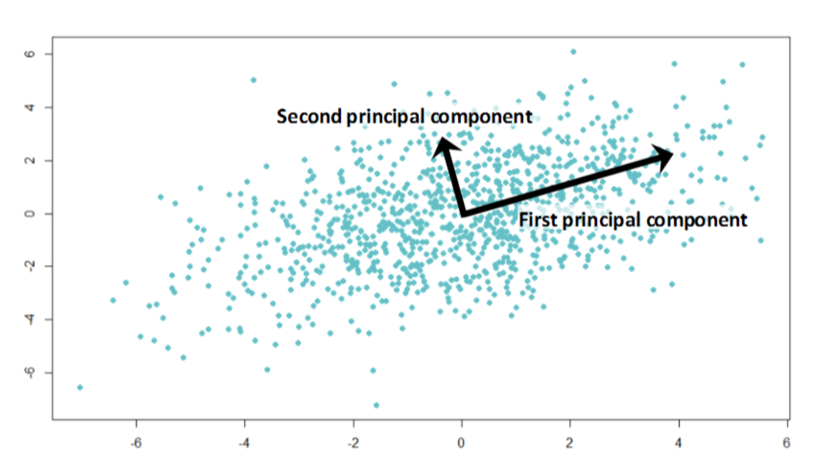

Slide 17
PCA
By finding the eigenvalues and eigenvectors of the covariance matrix, we find that the eigenvectors with the largest eigenvalues correspond to the dimensions that have the strongest correlation in the dataset.
This is the principal component.
PCA is a useful statistical technique that has found application in:
  fields such as face recognition and image compression
  finding patterns in data of high dimension

Slide 18
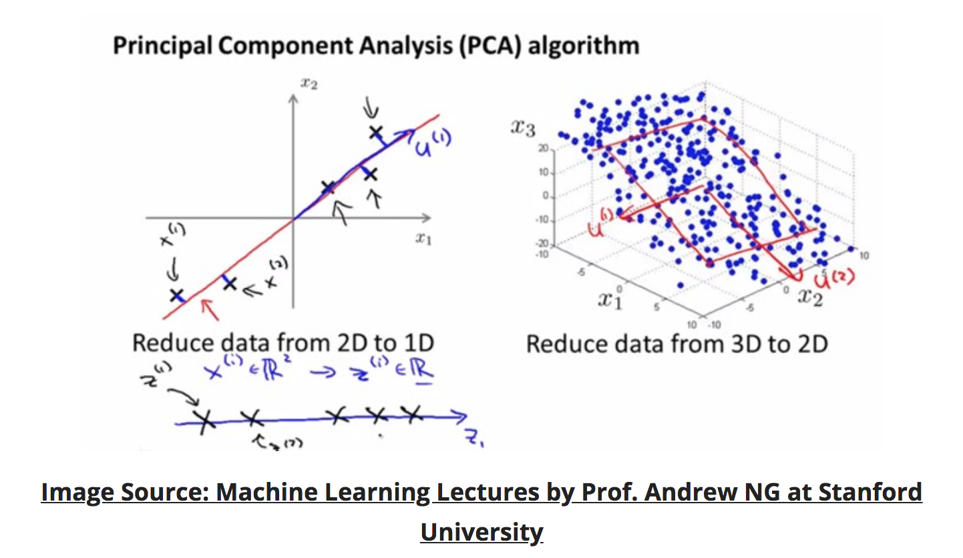

Slide 19
PCA process –STEP 1
Subtract the mean
from each of the data dimensions. All the x values have x subtracted and y values have y subtracted from them. This produces a data set whose mean is zero.
Subtracting the mean makes variance and covariance calculation easier by simplifying their equations. The variance and co-variance values are not affected by the mean value.

Slide 20
PCA process –STEP 1
DATA:
x y
2.5 2.4
0.5 0.7
2.2 2.9
1.9 2.2
3.1 3.0
2.3 2.7
2 1.6
1 1.1
1.5 1.6
1.1 0.9
ZERO MEAN DATA:
x y
.69 .49
-1.31 -1.21
.39 .99
.09 .29
1.29 1.09
.49 .79
.19 -.31
-.81 -.81
-.31 -.31
-.71 -1.01

Slide 21
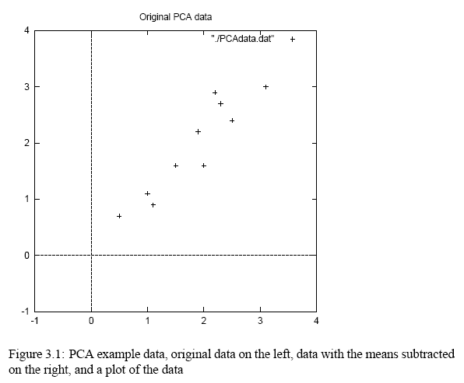
PCA process –STEP 1

Slide 22
PCA process –STEP 2
Calculate the covariance matrix
cov = .616555556 .615444444
.615444444 .716555556
since the non-diagonal elements in this covariance matrix are positive, we should expect that both the x and y variable increase together.

Slide 23
PCA process –STEP 3
Calculate the eigenvectors and eigenvalues of the covariance matrix
eigenvalues = .0490833989
1.28402771
eigenvectors = -.735178656 -.677873399
.677873399 -.735178656

Slide 24
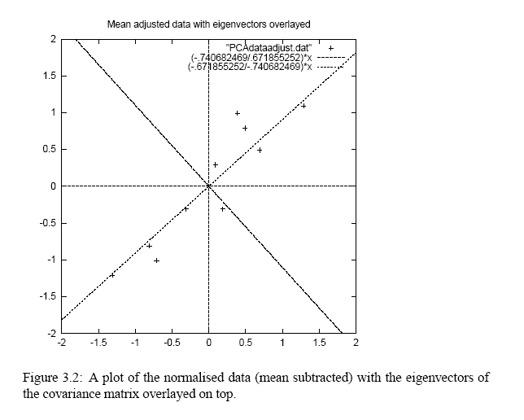
PCA process –STEP 3
eigenvectors are plotted as diagonal dotted lines on the plot.
Note they are perpendicular to each other.
Note one of the eigenvectors goes through the middle of the points, like drawing a line of best fit.
The second eigenvector gives us the other, less important, pattern in the data, that all the points follow the main line, but are off to the side of the main line by some amount.

Slide 25
PCA process –STEP 4
Reduce dimensionality and form feature vector the eigenvector with the highest eigenvalue is the principle component of the data set.
In our example, the eigenvector with the larges eigenvalue was the one that pointed down the middle of the data.
Once eigenvectors are found from the covariance matrix, the next step is to order them by eigenvalue, highest to lowest. This gives you the components in order of significance.

Slide 26
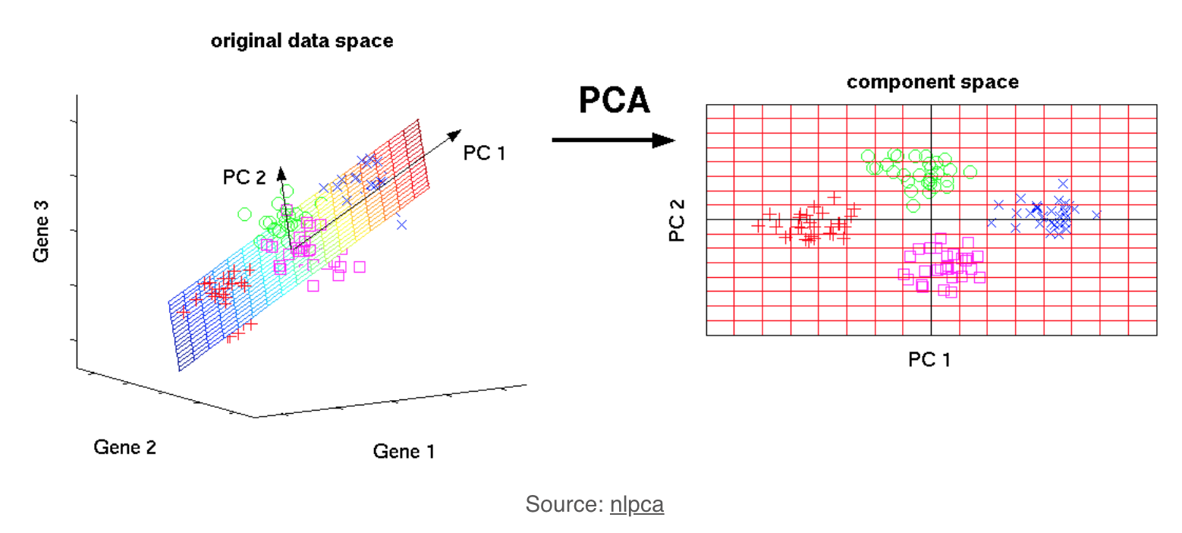

Slide 27
PCA process –STEP 4
Now, if you like, you can decide to ignore the components of lesser significance
You do lose some information, but if the eigenvalues are small, you don’t lose much
  n dimensions in your data
  calculate n eigenvectors and eigenvalues
  choose only the first p eigenvectors
  final data set has only p dimensions.

Slide 28
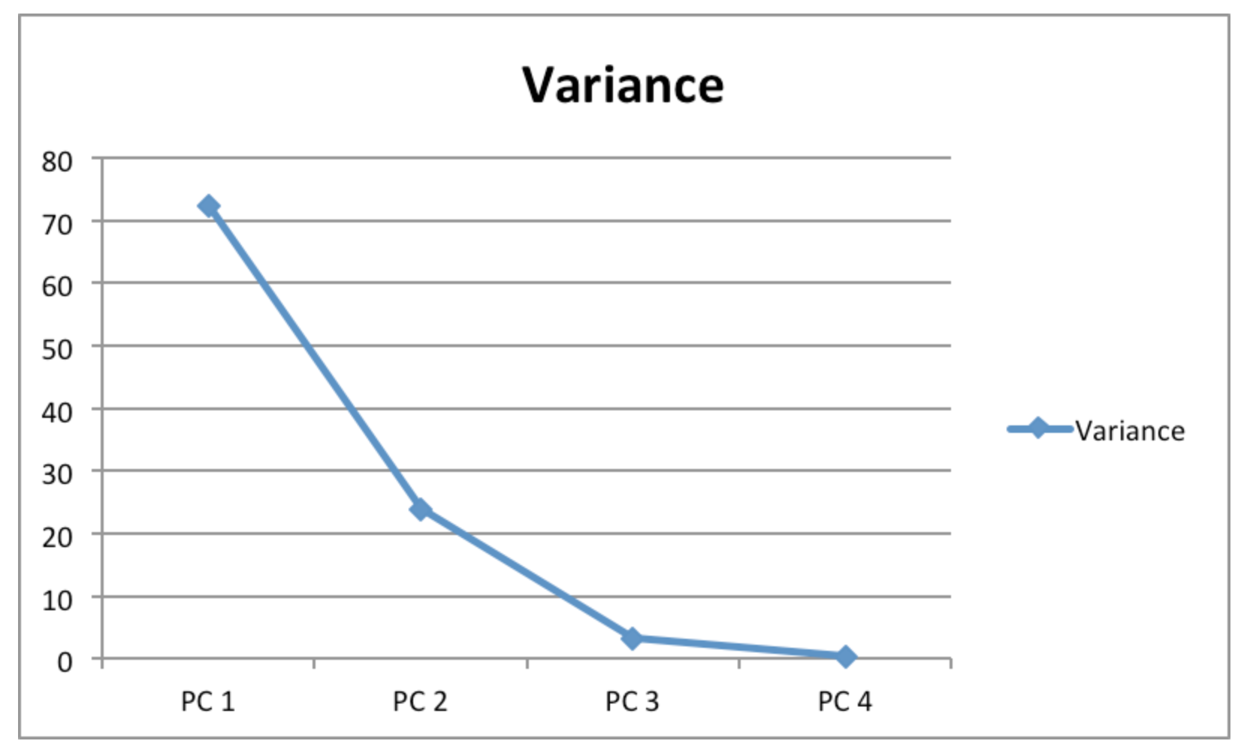

Slide 29
PCA process –STEP 4
Feature Vector
FeatureVector = (eig1 eig2 eig3 … eign)
We can either form a feature vector with both of the eigenvectors:
-.677873399 -.735178656
-.735178656 .677873399
or, we can choose to leave out the smaller, less significant component and only have a single column:
- .677873399
- .735178656

Slide 30
PCA process –STEP 5
Deriving the new data
FinalData = RowFeatureVector x RowZeroMeanData
RowFeatureVector is the matrix with the eigenvectors in the columns transposed so that the eigenvectors are now in the rows, with the most significant eigenvector at the top
RowZeroMeanData is the mean-adjusted data transposed, ie. the data items are in each column, with each row holding a separate dimension.

Slide 31
PCA process –STEP 5
R
=
U
S
V^{T}
variables
factors
factors
variables
sig.
significant
noise
noise
significant
noise
factors
factors
samples
samples

Slide 32
PCA process –STEP 5
FinalData is the final data set, with data items in columns, and dimensions along rows.
What will this give us?
  It will give us the original data solely in terms of the vectors we chose.
We have changed our data from being in terms of the axes x and y , and now they are in terms of our 2 eigenvectors.

Slide 33
PCA process –STEP 5
FinalData transpose: dimensions along columns
x y
-.827970186 -.175115307
1.77758033 .142857227
-.992197494 .384374989
-.274210416 .130417207
-1.67580142 -.209498461
-.912949103 .175282444
.0991094375 -.349824698
1.14457216 .0464172582
.438046137 .0177646297
1.22382056 -.162675287

Slide 34
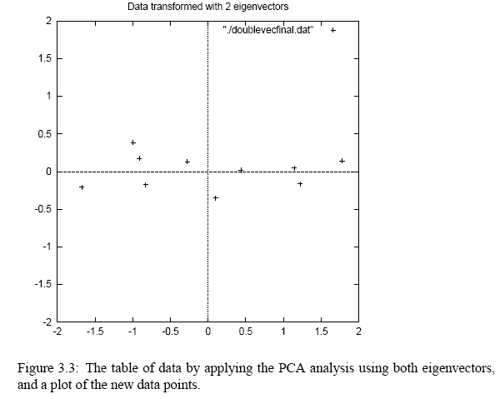
PCA process –STEP 5

Slide 35
Reconstruction of original Data
If we reduced the dimensionality, obviously, when reconstructing the data we would lose those dimensions we chose to discard. In our example let us assume that we considered only the x dimension…

Slide 36
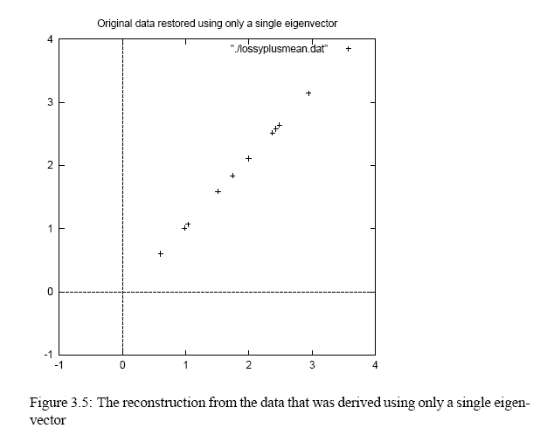
Reconstruction of original Data
x
-.827970186
1.77758033
-.992197494
-.274210416
-1.67580142
-.912949103
.0991094375
1.14457216
.438046137
1.22382056

Slide 37
Use Case
facial recognition
Dimensionality Reduction
computer vision & Image Processing
Image compression
finding patterns in data of high dimension in the field of finance, data mining, bioinformatics, psychology, etc.

Slide 38
Demo Code

Slide 39
Labs
http://archive.ics.uci.edu/ml/datasets/communities+and+crime

Slide 40
Thanks ☺

