Slide 1

9/12

Slide 2
DETR (Detection Transformer)
Recall:
Faster R-CNN tried to "merge" RPN as part of one network (sliding window based)
Each sliding window: k anchor boxes
DETR main principles:
One-shot detection – do away with surrogate predictions, postprocessing (NMS)
Transformer (attention, attention, attention)
Direct set prediction (set of bboxes)
Predict bbox regression and classification

Slide 3
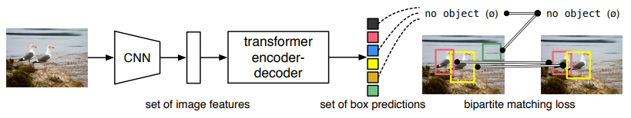

Key Ingredients
Set prediction loss that enforce unique matches
Recall in Faster R-CNN, there often are multiple overlapping bboxes
An architecture that predicts (in a single pass) a set of objects and models their relation.

Slide 4


Details
N is a large number such that an image will not contain more than N objects
Step 1 – Hungarian Matching:

Slide 5


Details
Step 2 – Hungarian Loss:

Slide 6
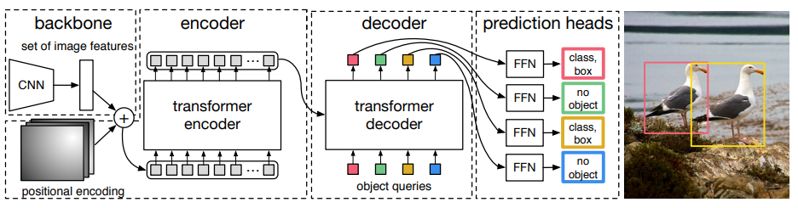




DETR Architecture

Slide 7

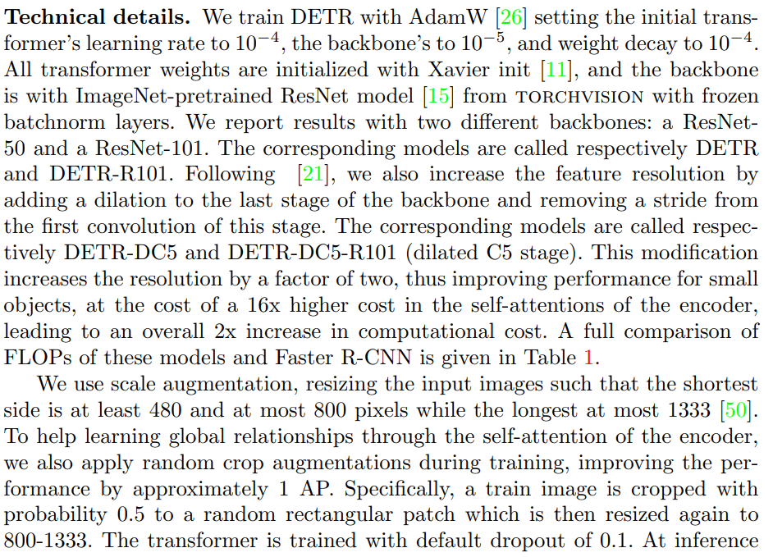
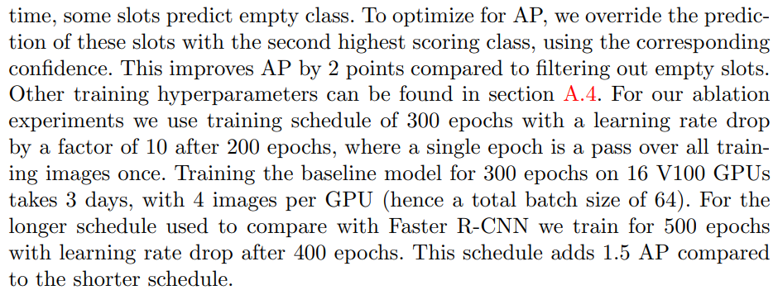
Training Details

Slide 8
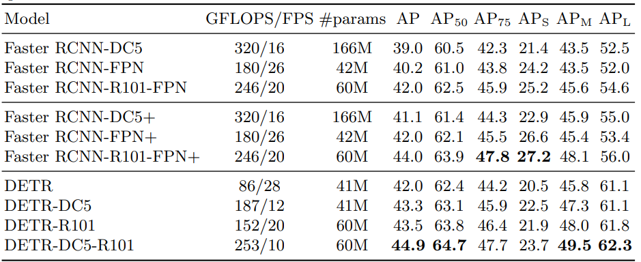
Assignment Due 9/19

