Slide 1
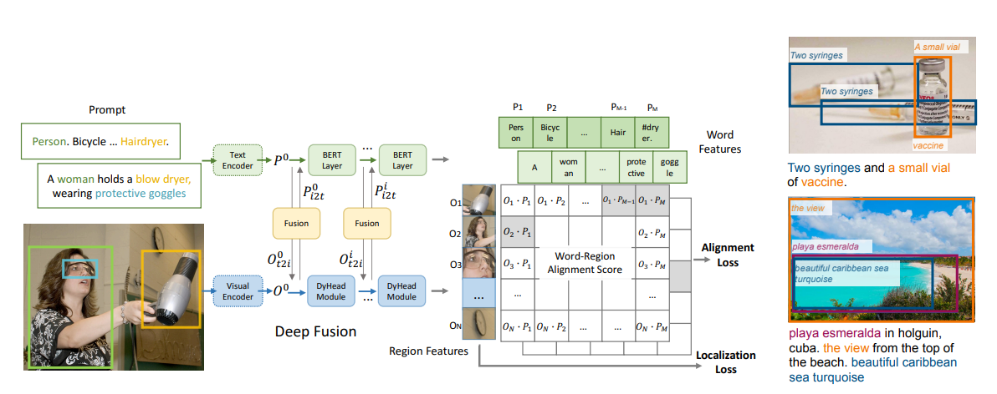
GLIP (Ground Language-Image Pretraining)
TBH: this is an example how NOT to write a paper

Slide 2
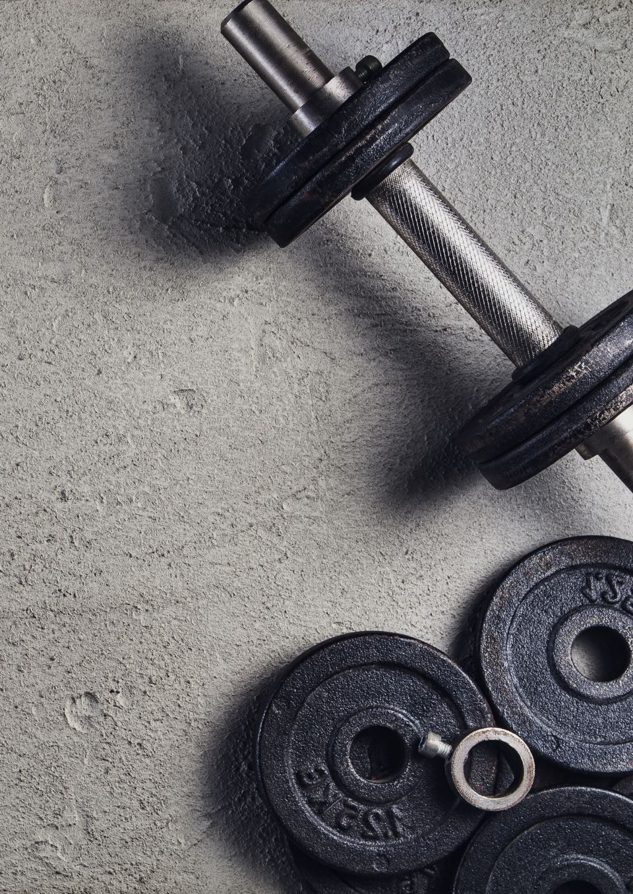






Training GLIP

Slide 3


Language-aware Deep Fusion

Slide 4


Training Data
3M human-annotated, 24M web-crawled

Slide 5
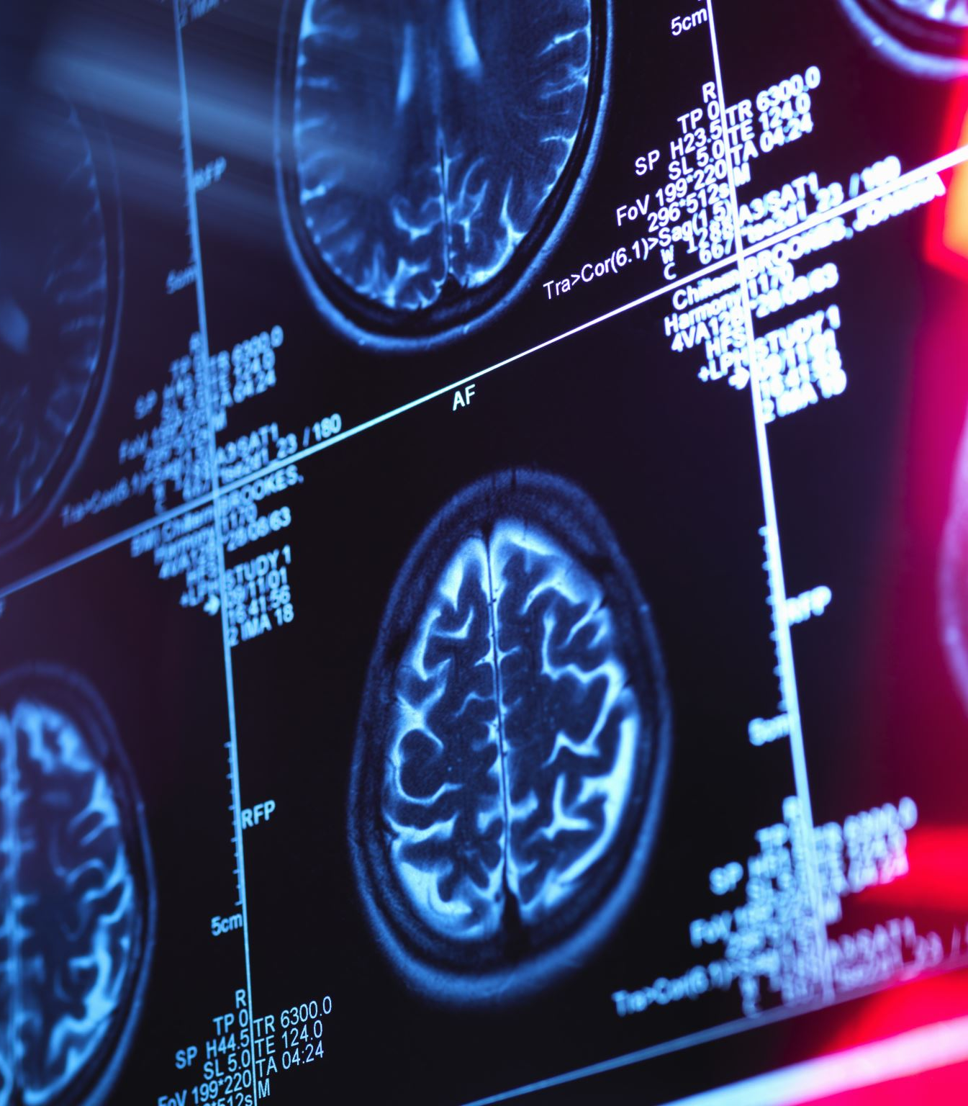

GLIP Variants

Slide 6
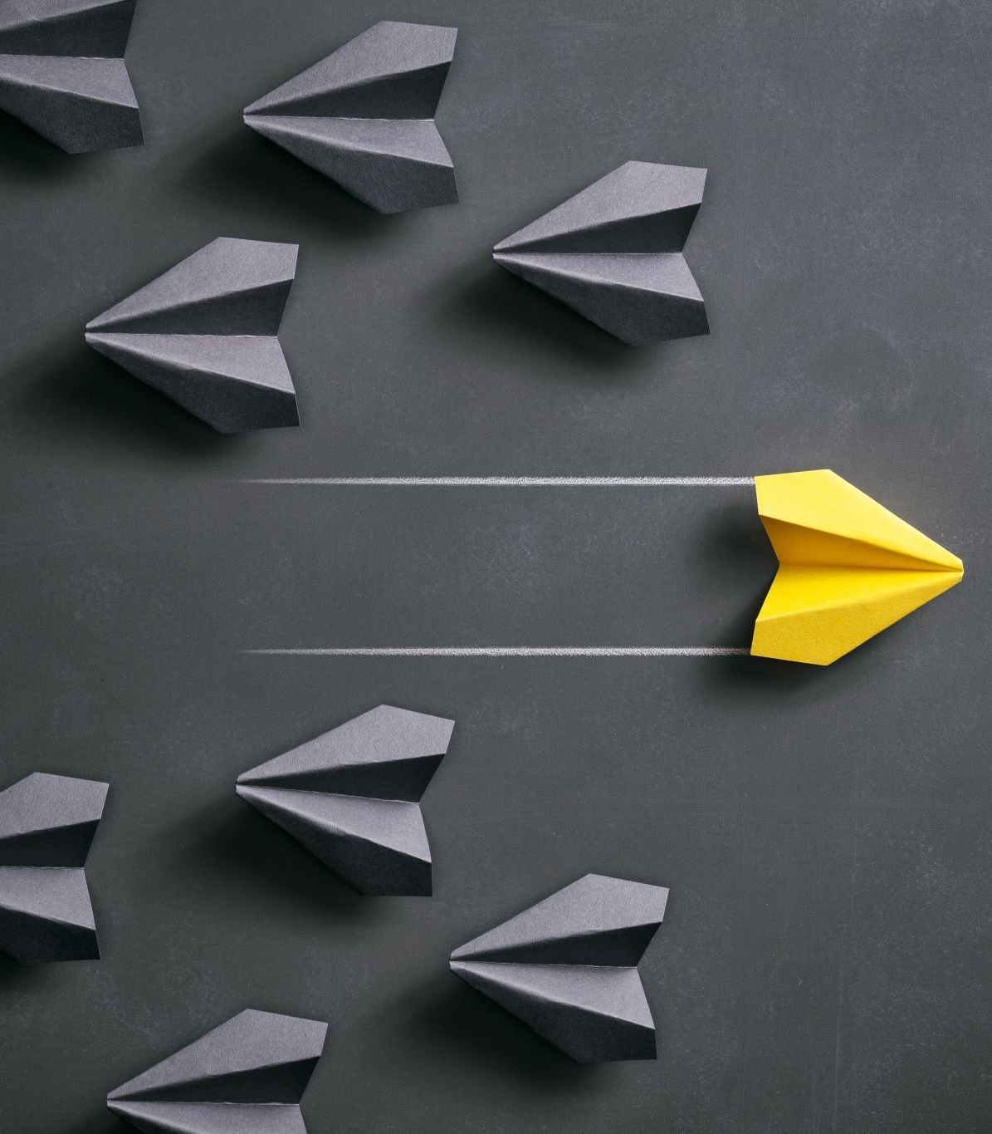
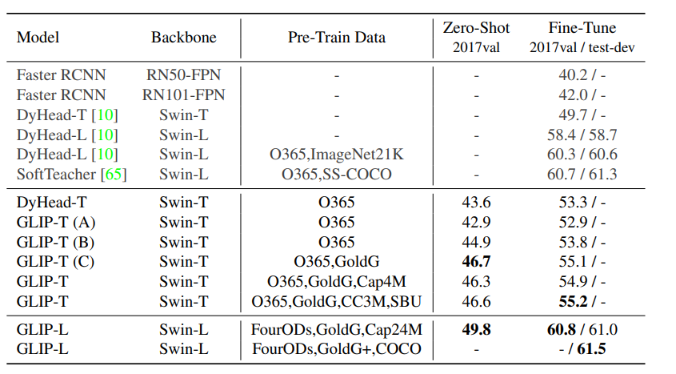
Assignment Due 9/19 (COCO)

Slide 7
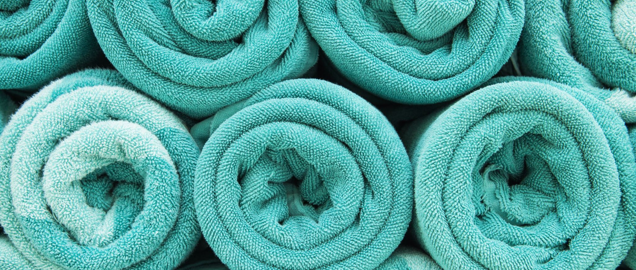
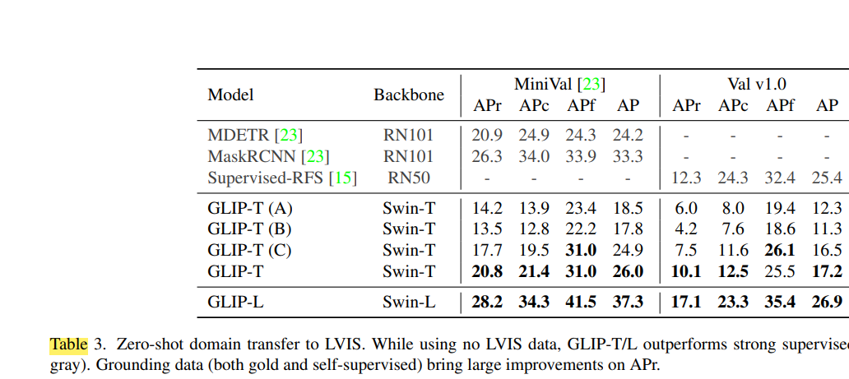
GLIP Transferability

