Slide 1
Crime Rate Prediction Using ML

Slide 2
ABSTRACT
Challenge of Crime Rate Prediction: The growing urban populations and increasing complexity of crime make it difficult for law enforcement to accurately predict future crime trends and allocate resources effectively.
Machine Learning (ML) in Crime Prediction: Machine Learning techniques, such as decision trees, random forests, and neural networks, are utilized to analyze large datasets, including historical crime records and geographic data, to predict crime patterns.
Predicting High-Risk Areas: By training ML models on past crime data, high-risk areas for future criminal activity can be identified, enabling more focused and precise crime prevention efforts.
Improved Policing and Safety: The use of ML for crime prediction, along with crime hotspot identification and spatial analysis, enhances policing strategies and resource allocation, leading to safer communities and more effective crime reduction.

Slide 3
INTRODUCTION
Crime is an act that is prohibited by law and is punishable by a fine, imprisonment, or other legal action.
Crime prediction is significant to determine increase or decrease in crime rate from preceding years.
Sophisticated ML algorithms and data-driven methods can be used to identify patterns in data to detect and predict criminal activities.
It can also be used to create predictive models that identify the likelihood of a certain crime occurring in a particular area or time frame.
Using machine learning, law enforcement professionals can gain insight into criminal behavior, enabling them to better detect and prevent crime

Slide 4
LITERATURE SURVEY
SL.NO | Author | YOP | NAME | SUMMARY | LIMITATION | PREDICTION
1 | Muhammad Alkaff, Nurul Fatanah Mustamin, Gusti Aditya Aromatica Firdaus | 2022 | Prediction of Crime Rate in Banjarmasin City Using RNN-GRU Model | This study proposes a model to predict the crime rate in Banjarmasin City, Indonesia, by using the Recurrent Neural Network (RNN) with the Gated Recurrent Unit (GRU) architecture. The model takes into consideration the inflation rate and discretionary income. Results show that the GRU-RNN model has an R-Squared value of 0.84 and an RMSE value of 2.21.GRU is a modified RNN algorithm that is simpler than the Long-Short Term Memory (LSTM) Neural Network and is more effective in adapting to different timescales and dealing with Vanishing Gradient problems. It consists of two gates, the Update gate (zt) and the Reset gate (rt), and is compatible with data that is not as much as LSTM, achieving optimal results even with less data. | The predicted value is not too close to the original value compared. Due to lower examples in the dataset, the training of the model becomes difficult. | This study applied a RNN-GRU model to predict data. After collecting and normalizing the data, the model produced the best results with the lowest MAE and RMSE values of 1.7368 and 2.21, respectively, and an R-Squared value of 0.84, indicating good model performance.

Slide 5
SL.NO | Author | YOP | NAME | SUMMARY | LIMITATION | PREDICTION
2 | Qifen Dong, Ruihui Ye, Guojun Li | 2022 | Crime amount prediction based on 2D convolution and long short-term memory neural network | This paper presents a crime prediction model, 2DCONV-LSTM, that combines 2D convolution and LSTM networks to capture spatiotemporal correlations. Experiments show it outperforms SVR and LSTM in prediction accuracy, with performance varying across regions with different crime rates. The model offers potential for improving crime forecasting and resource allocation. | The full variant of the proposed model, 2DCONV-LSTM-f, did not achieve the best performance, demonstrating that excessive auxiliary data reduces the performance of the prediction model. Founded that too much auxiliary data may contain redundant information, which negatively impacts the performance of the proposed prediction model. | The 2DCONV-LSTM model, evaluated with various auxiliary data combinations, showed improved prediction performance, with the 2DCONV-LSTM-d variant achieving the best RMSE of 9.981. While it performed better in areas with medium-high crime rates, its accuracy decreased in regions with lower crime rates, showing a slight improvement over Just-LSTM.

Slide 6
PROBLEM STATEMENT
Rising Crime and International Security Threats: Crime is a growing issue globally, posing a significant threat to international security as crime rates continue to rise.
Population Growth and Crime Rates: Increasing urban populations contribute to rising crime rates, making it more challenging to manage public safety effectively.
Data Analysis for Crime Prediction and Prevention: Authorities utilize large datasets, including crime location and nature, to predict future crime trends and develop strategies for crime reduction.
Crime Prediction Techniques: Various methods are used to identify regions with a high likelihood of future criminal activity, improving the effectiveness of crime prevention strategies.
Prediction Model for High-Risk Areas: Using historical crime data, prediction models are developed to pinpoint high-risk areas for future criminal activity, optimizing police efforts and resources.
Techniques for Improved Precision: Predictive analytics, crime hotspot identification, and historical data analysis are employed to enhance the precision and effectiveness of crime prevention and law enforcement strategies.

Slide 7
EXISTING SYSTEM
Traditional Crime Prediction Models:
Early systems used statistical methods like linear regression to predict crime rates based on historical data, but they struggled with accuracy and complexity.
Early crime prediction systems used statistical techniques like linear regression and time-series analysis to forecast crime rates.
These models typically focused on historical crime data, considering factors such as crime type, location, and time. However, traditional systems often struggled with accuracy, especially when handling large and complex datasets or accounting for various social, economic, and environmental factors.

Slide 8
PROPOSED SYSTEM
Data Preprocessing: The data is prepared in the correct format for analysis. Some columns are removed or transformed, and label encoding is used to convert the categorical data into numeric for better prediction.
Random Sampling: After feature selection, the data has been splitted into two parts: training data (70%) and testing data (30%).
Model Creation: The model algorithms are imported from sklearn. The dataset has been analyzed using five different models: support vector machine, nearest neighbor, decision tree, random forest, and neural network.
Model Selection: Based on the defined goals and model performance, random forest model has been selected.
Model Deployment: The model has been deployed for prediction using flask web technology.

Slide 9
THE DATASET
The dataset is prepared manually based on the publication available on the National Crime Rate Bureau (NCRB) official website.
The data provides statistics on the number of crimes committed in 19 Indian metropolitan cities during the year 2014 to 2021.
It includes statistics on 10 different categories of crime, including murder, kidnapping, crime against women, crime against children, crime committed by juveniles, crime against senior citizens, crime against SC, crime against ST, economic offences and cyber crimes.

Slide 10
ALGORITHM – RANDOM FOREST
Random Forest is an ensemble learning technique that combines multiple decision trees to generate a more accurate prediction.
It is a versatile and powerful algorithm used in a wide variety of applications.
The algorithm can be illustrated as follows:
Begin with a dataset of observations and their associated labels.
Randomly select ‘k’ features from the dataset.
For each of the ‘k’ features, choose the best split point.
Create a tree using the chosen split points.
Repeat steps 2-4 for each of the ‘k’ features.
Combine the trees to form a forest.
Use the forest to make predictions on new data.
Calculate the accuracy of the predictions.

Slide 11
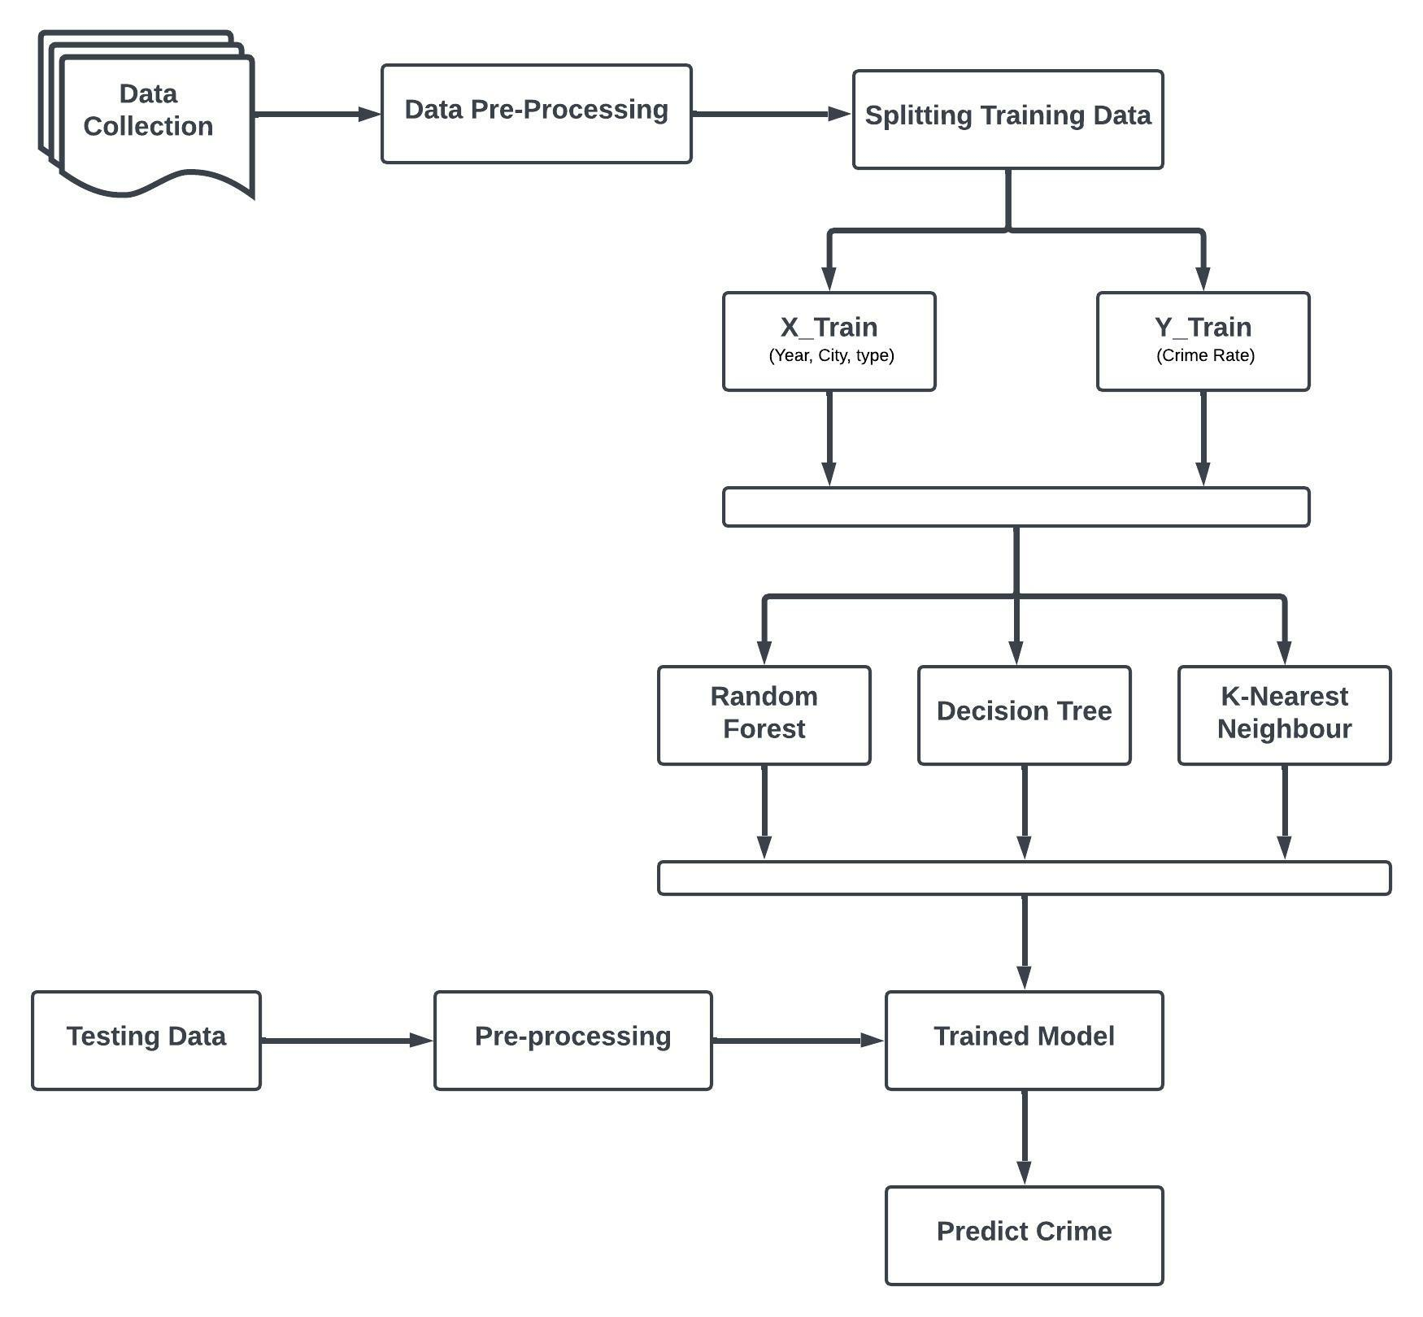
SYSTEM ARCHITECTURE

Slide 12
RESULTS & DISCUSSION
The Random Forest Regression model demonstrates the best accuracy in predicting test data among the five selected models.
The model predicts the crime rate with an accuracy of 93.20% on the testing data.
The accuracy results obtained after testing are listed below:
Algorithm | Mean Absolute Error | Mean Squared Error | R2 Score
Support Vector Machine | 10.3204 | 371.7907 | 0.17886
K-Nearest Neighbor | 6.58181 | 140.8179 | 0.55349
Neural Networks MLPRegressor | 12.4248 | 307.5506 | 0.24823
Decision Tree Regressor | 2.89024 | 34.95932 | 0.88915
Random Forest Regressor | 2.49143 | 21.43956 | 0.93201

Slide 13
CONCLUSION
Crime rate prediction has become an important tool for law enforcement agencies to help them focus their resources in high-crime areas.
By focusing their resources in the right areas, police officers can help reduce the overall crime rate in a community.
As a result of machine learning technology, finding relationships and patterns between various data has become easier.
The model prediction of crime rate and data visualization helps in analysis of data set and prediction of crimes.
The model helped in understanding different crime datasets that can be used in implementing the factors that can help in keeping society safe.

Slide 14
FUTURE WORK
Data Quality and Integration: Focus on improving the accuracy and diversity of crime-related datasets, integrating sociol-economic, environmental, and real-time data.
Bias and Fairness: Address biases in models, enhance transparency, and ensure ethical use of predictive policing to avoid reinforcing systemic inequalities.
Advanced Models and Techniques: Use advanced machine learning techniques like deep learning and spatiotemporal modeling for more accurate and real-time crime predictions.
Community Collaboration and Long-term Impact: Involve local communities in model development, design interventions, and predict long-term crime trends influenced by social changes.

