Slide 1
Investigation of the E-Retail factors Affecting Customers Retention and Consumers purchasing Decision in Indian E-Commerce
Submitted by: Vijay

Slide 2
Problem Statement
In such competitive market retaining customers and winning trust is very big challenge for every e-retailers.
Understanding various factors that influence buying decision
Understanding customer’s perception regarding selected online retailers.

Slide 3
Data Visualization and analysis
In this step we will analyze and visualize our data
We will use tools available in python for data analysis and visualization.
We will use NumPy for Numerical analysis
Pandas for performing operation on data frame
Matplotlib Provide visualization capability.
We will use Seaborn for more enhanced visualization and analysis

Slide 4
EDA Steps
During EDA we have first changed our data columns name
After changing name we will see shape of the data and check the null values present in the data .
Data is not having any null values and all the data is object type.
As the data is object type we will mostly perform count plot.

Slide 5
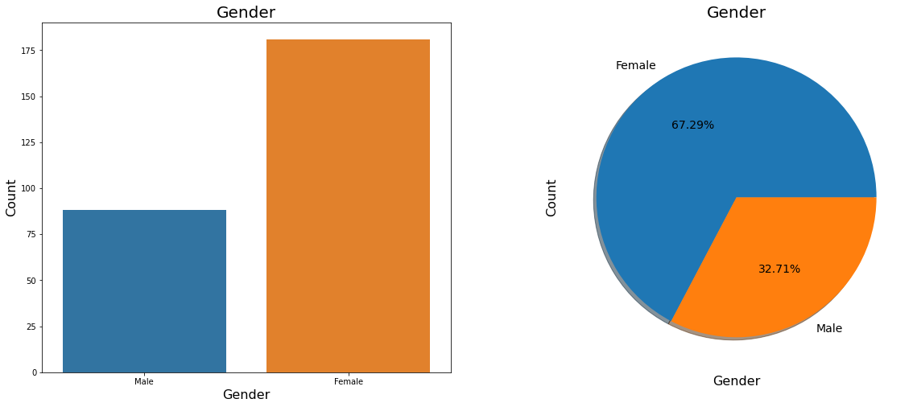
Majority of the Shoppers are Female

Slide 6
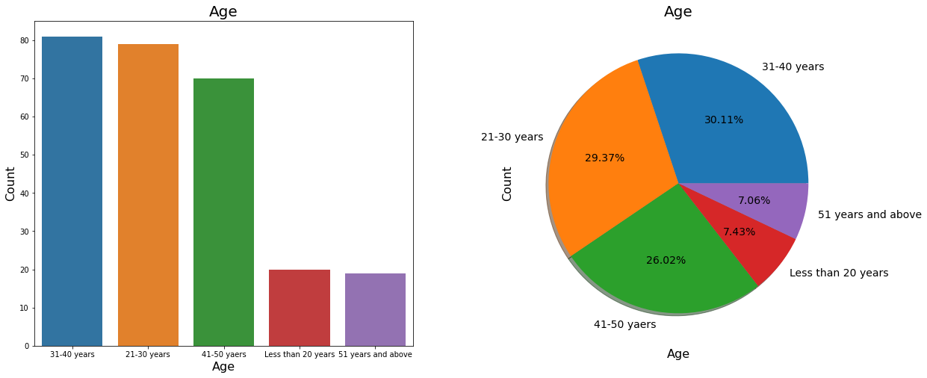
Majority of the shoppers are between 21-50 Years old.

Slide 7
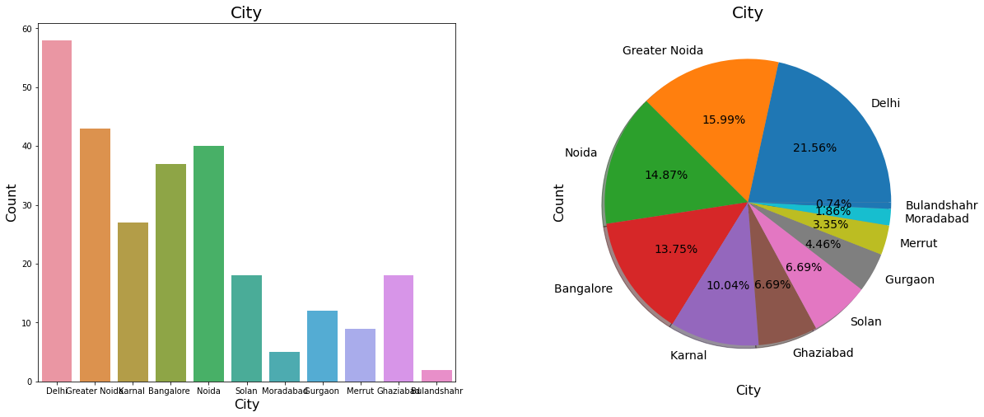
Majority of the shoppers are from Delhi, Noida, Bangalore.

Slide 8
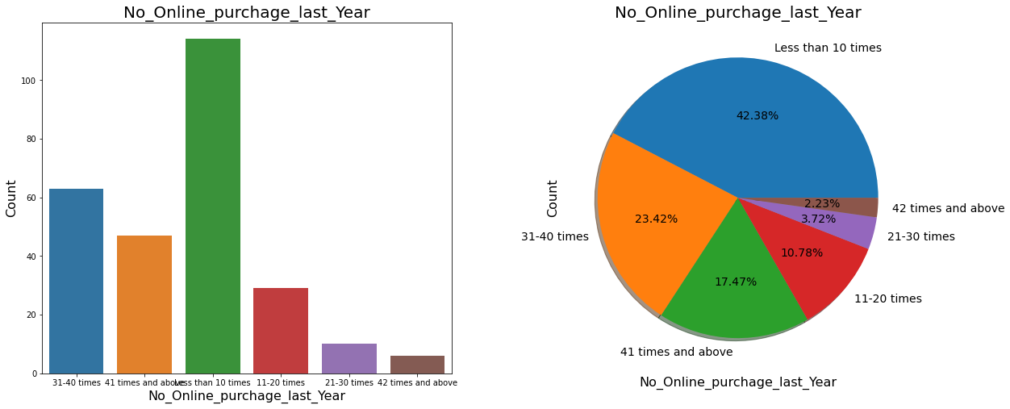
Majority of shoppers purchased less than 10 times last year.

Slide 9
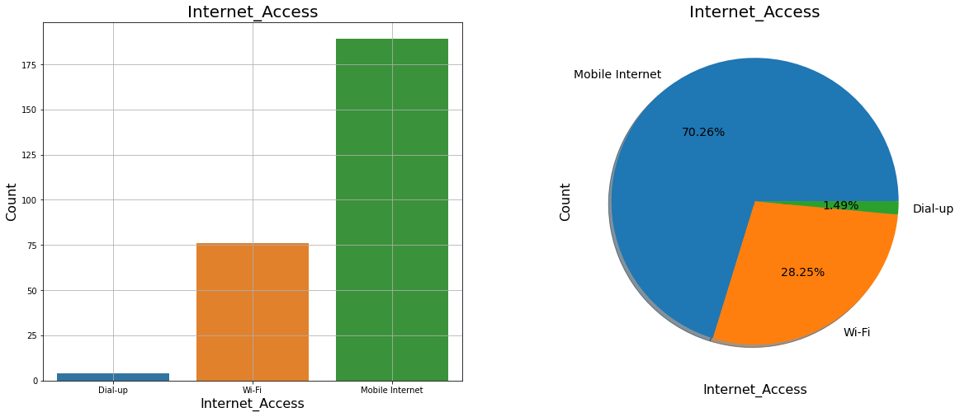
Majority of the online shopper’s Use Mobile Internet for online purchase

Slide 10
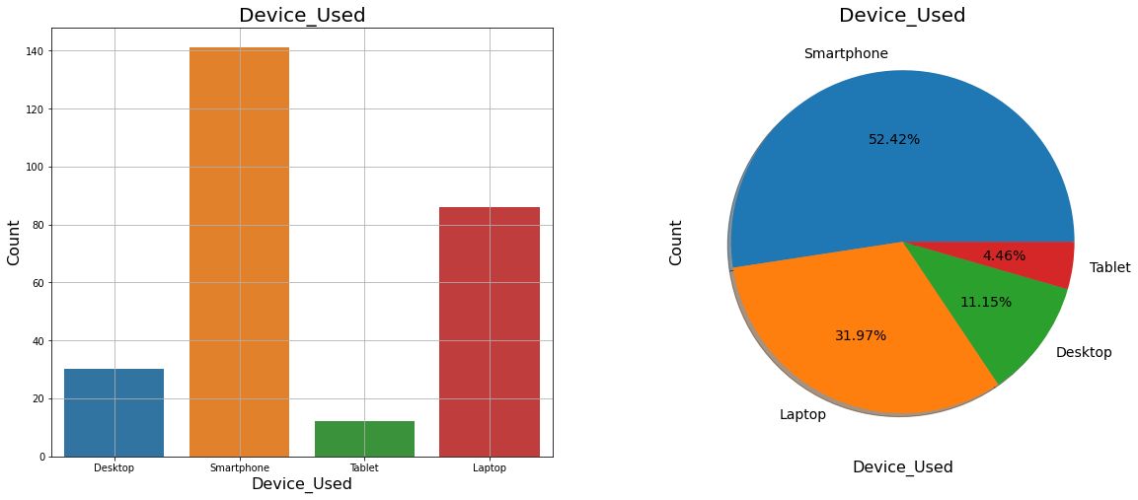
Majority of the online shopper’s Use Smartphone for online purchase

Slide 11
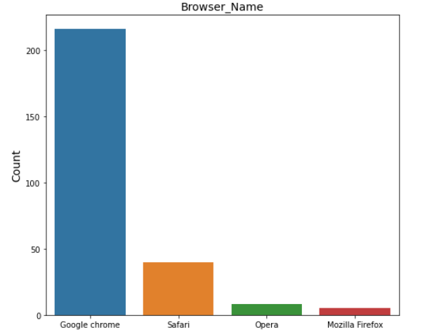
Majority of the online shopper’s Use Google Chrome for Exploring products

Slide 12
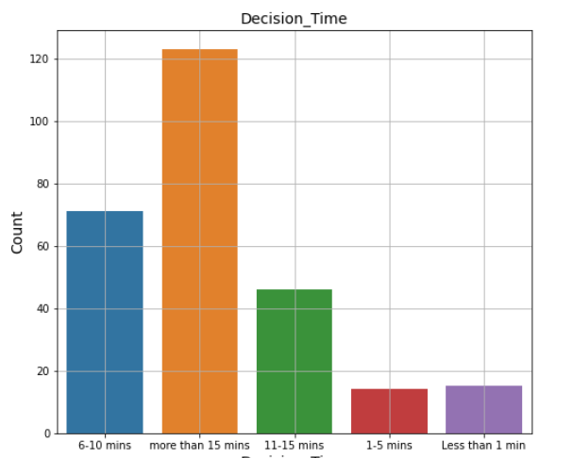
Majority of the online shopper’s take more than 15 min to make purchase

Slide 13
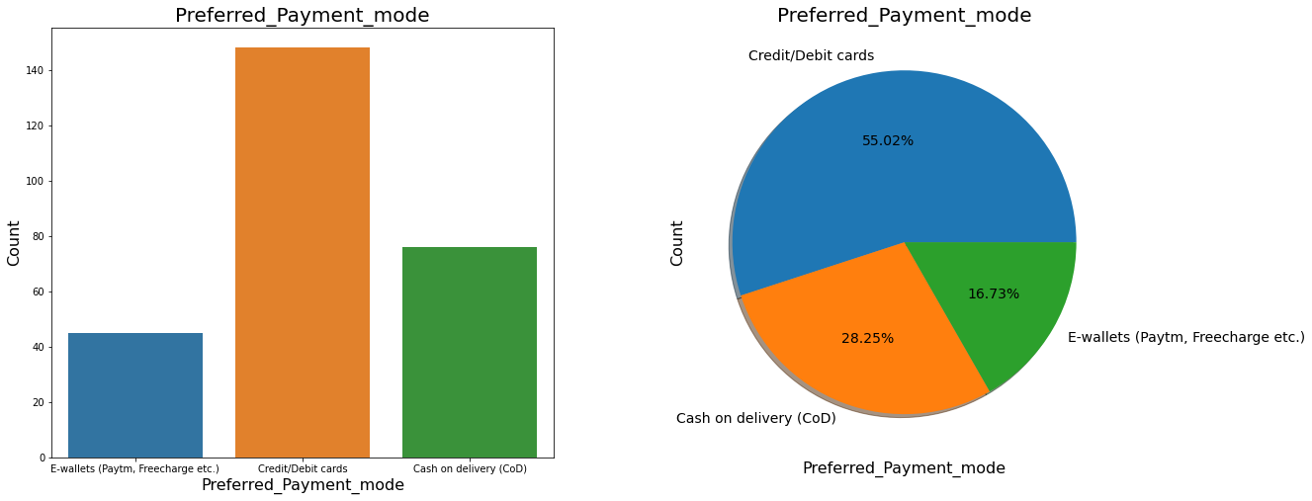
Majority of the online shopper’s Use Credit/Debit card for online purchase

Slide 14
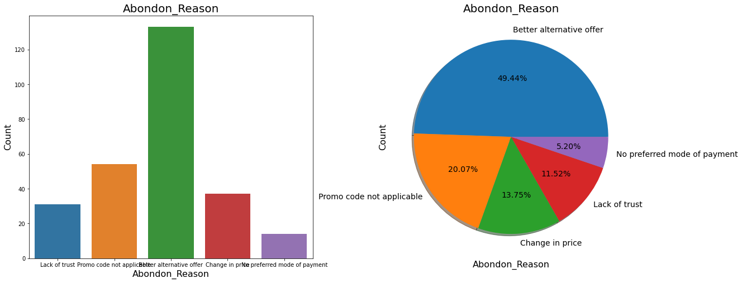
Majority of the shopper’s abandon because they find better option

Slide 15
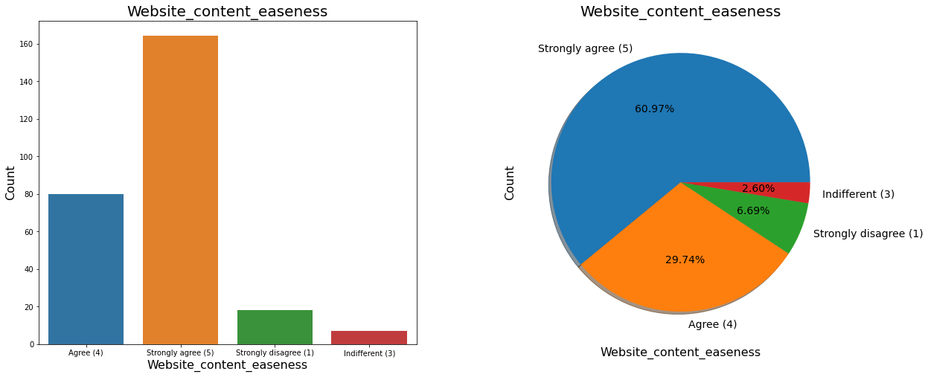
Majority of the online shopper’s strongly agree website content should be easy.

Slide 16
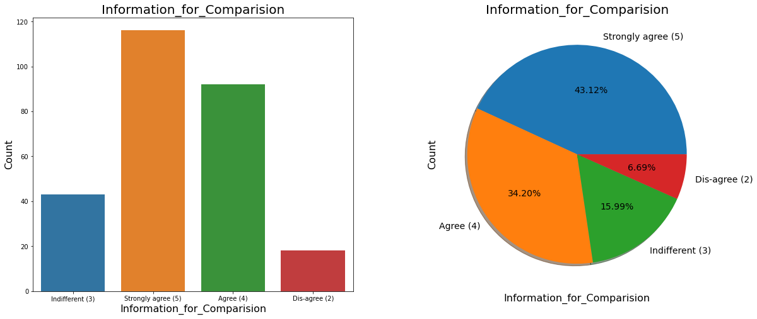
Majority of the online shopper’s agree that Highlighted information is easy to compare.

Slide 17
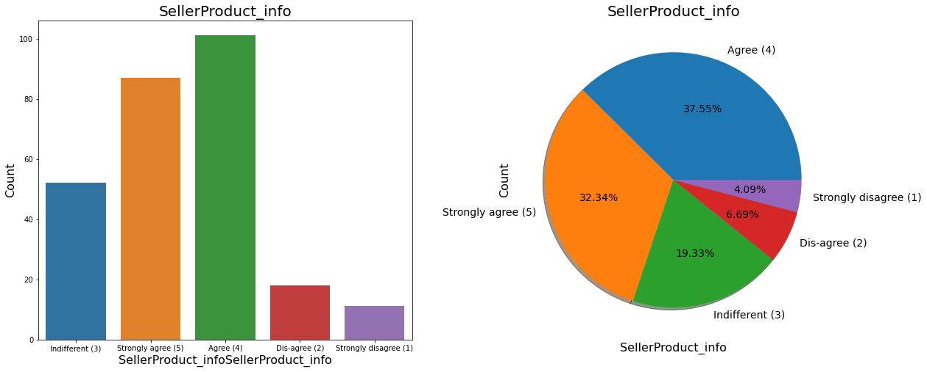
Majority of the online shopper’s agree there should be sellers and product information.

Slide 18
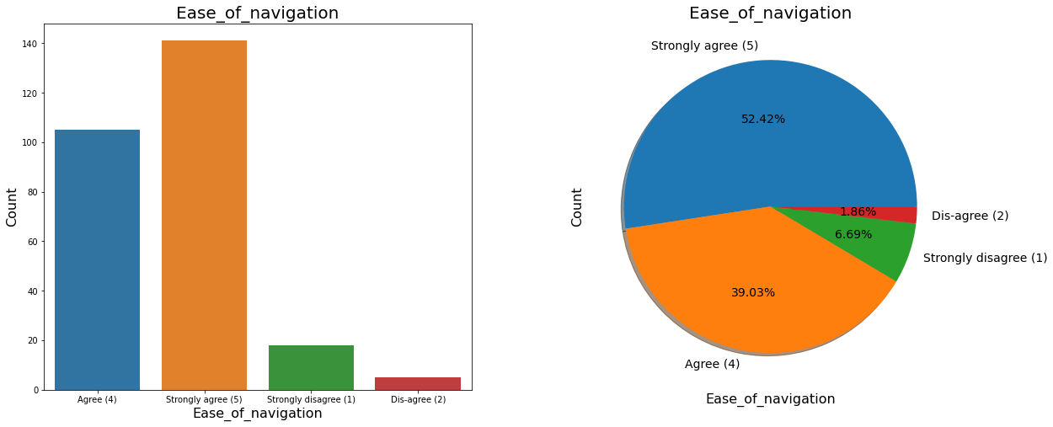
Majority of the online shopper’s Strongly agree, website should be easy to navigate.

Slide 19
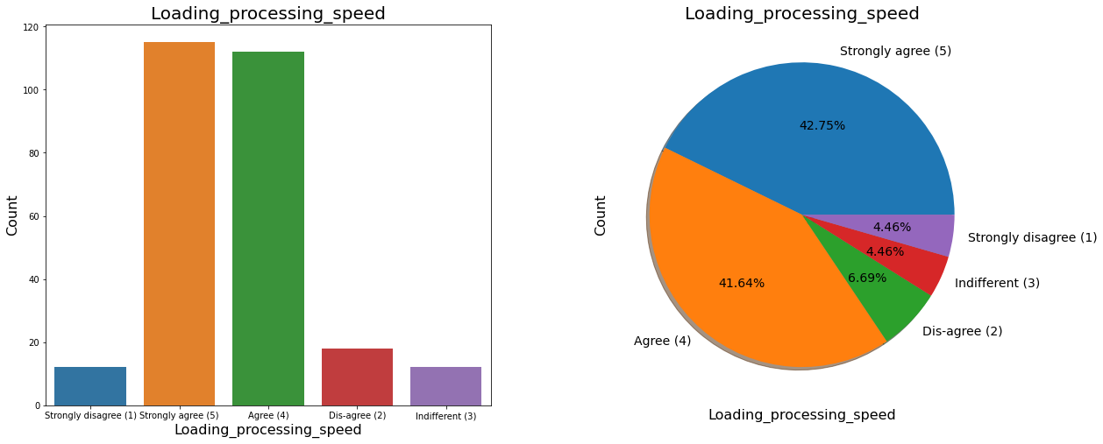
Majority of the online shopper’s Use Mobile Internet for online purchase

Slide 20
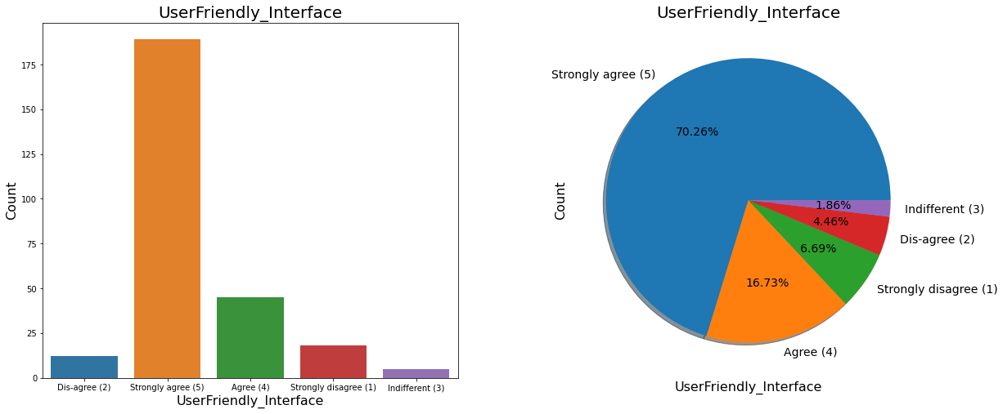
Majority of the online shopper’s Strongly agree, Website should be user friendly.

Slide 21
Majority of the online shopper’s Strongly agree to have convenient pay mode.

Slide 22
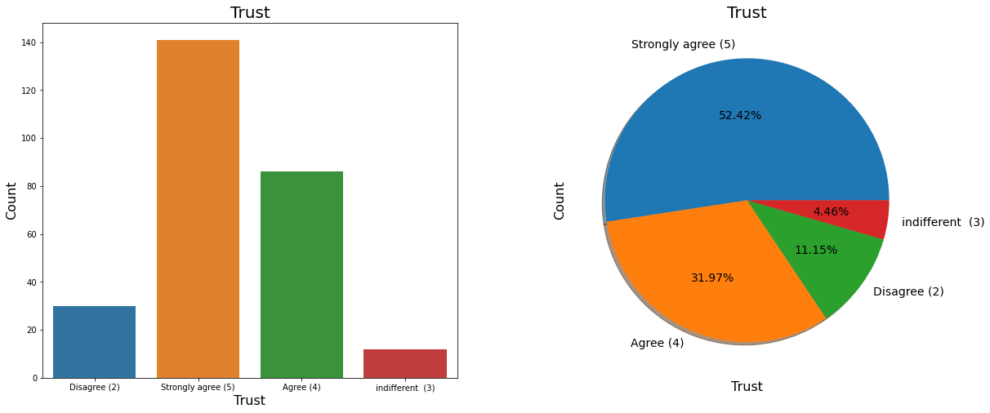
Majority of the shoppers are strongly agree to have trust for transaction, for making buying decision.

Slide 23
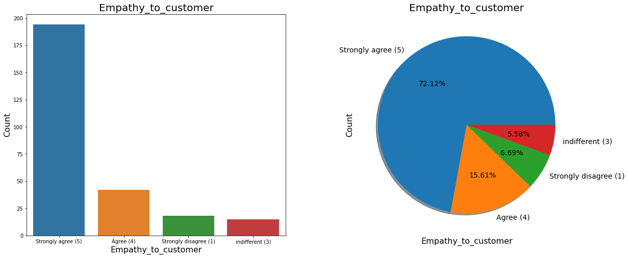
Majority of the shoppers are agree that having empathy to customers, affect the chance of buying

Slide 24
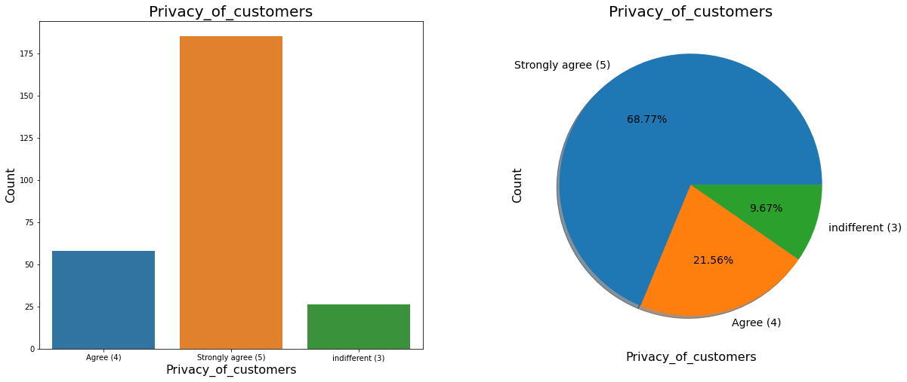
Graphs showing privacy play important role in making buying decisions, majority of the shoppers are strongly agree.

Slide 25
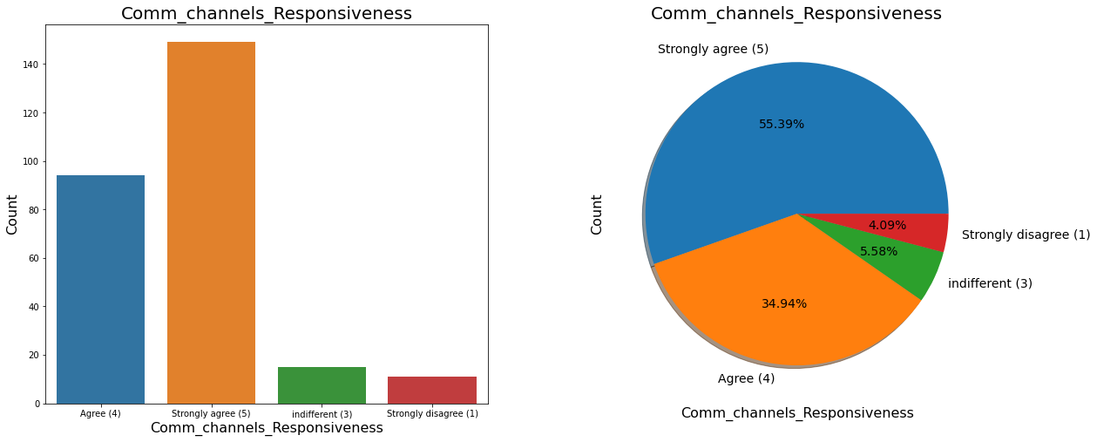
Majority of the shoppers are agree that having Responsiveness Communication channels, affect the chance of buying.

Slide 26
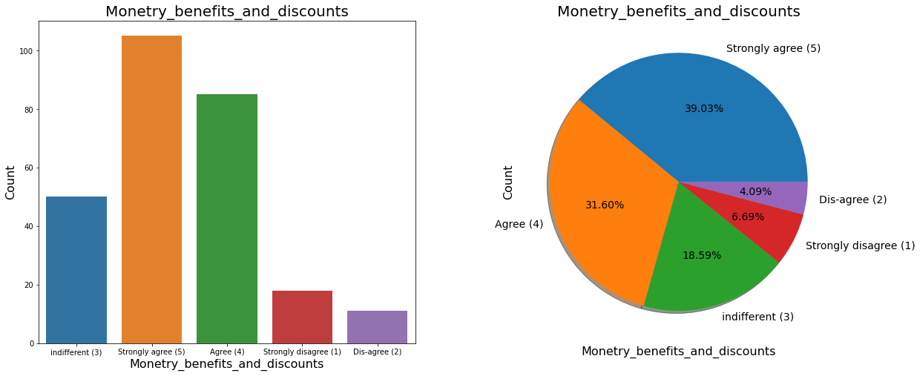
Majority of the shoppers are agree that online shopping gives Monetary Benefits and discounts.

Slide 27
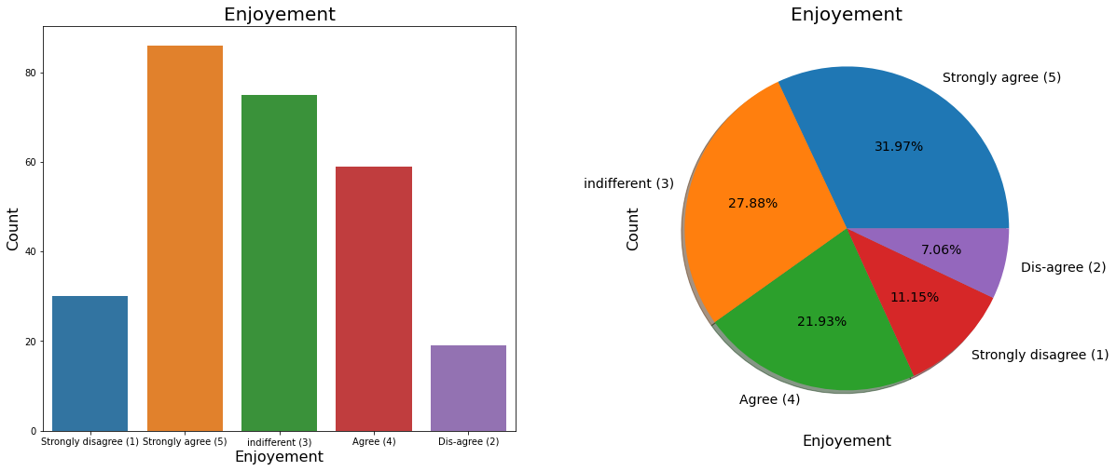
Majority of the shoppers are strongly agree to have enjoyment from online shoping online

Slide 28
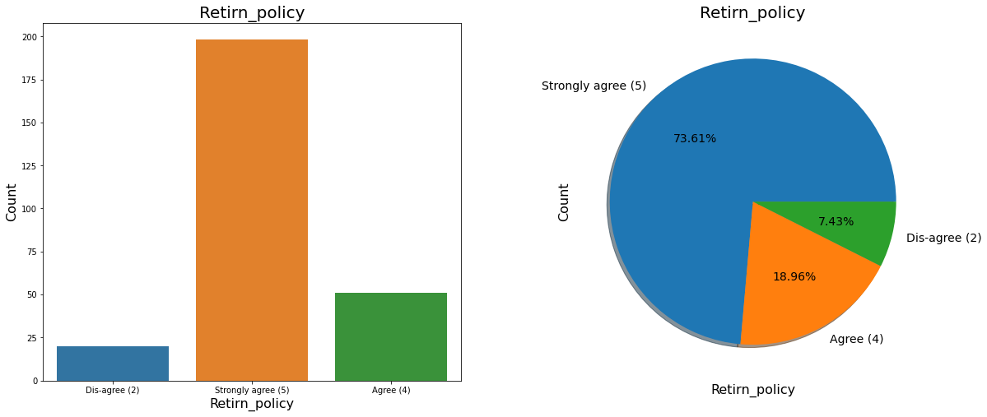
Majority of the shoppers are strongly agree that Return policy affect the buying decision.

Slide 29
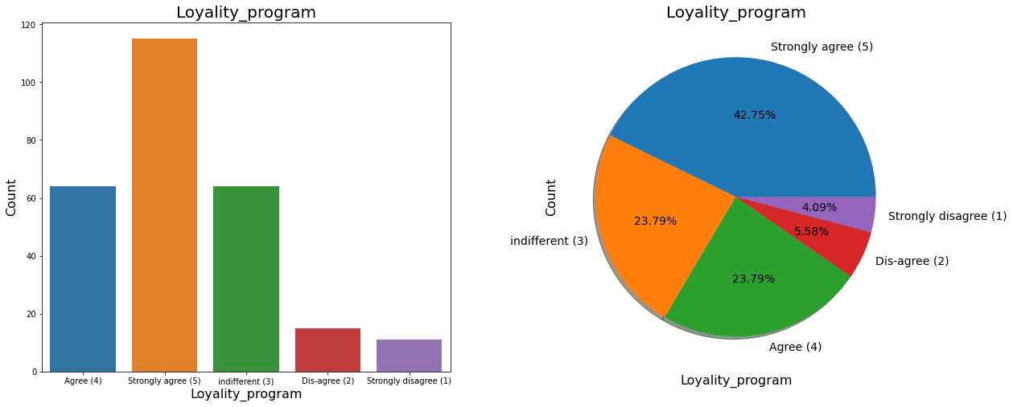
Majority of the shoppers are strongly agree that Gaining access to loyalty programs is a benefit of shopping online

Slide 30
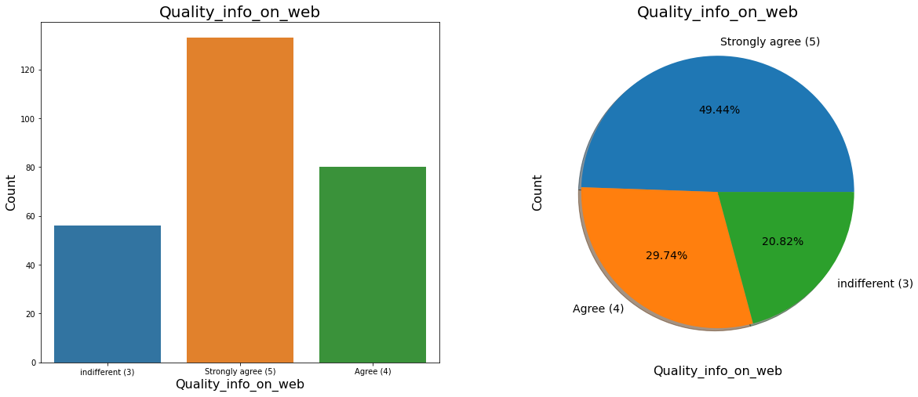
Majority of shoppers are strongly agree Displaying quality Information on the website improves satisfaction of customers

Slide 31
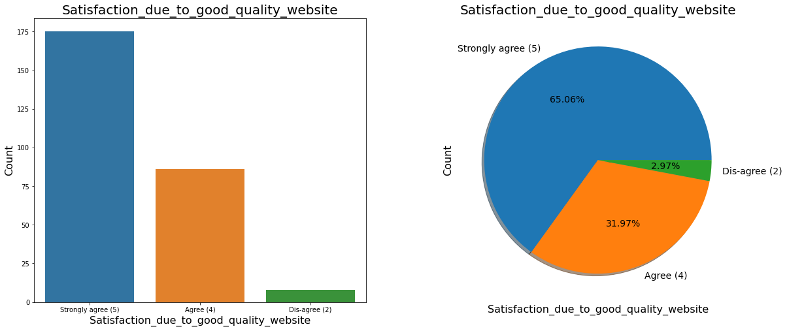
Majority of the shoppers are strongly agree User derive satisfaction while shopping on a good quality website or application

Slide 32
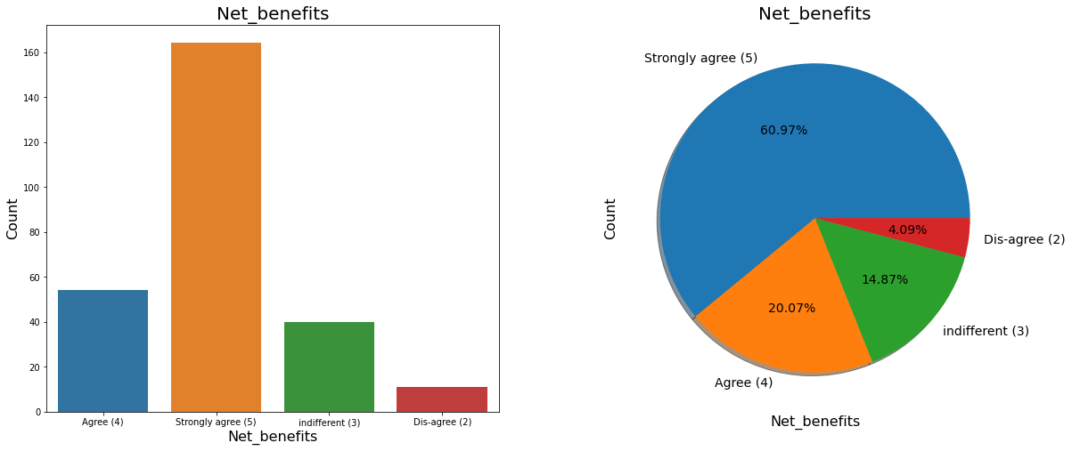
Majority of the shoppers are strongly agree that Net Benefit derived from shopping online can lead to users satisfaction

Slide 33
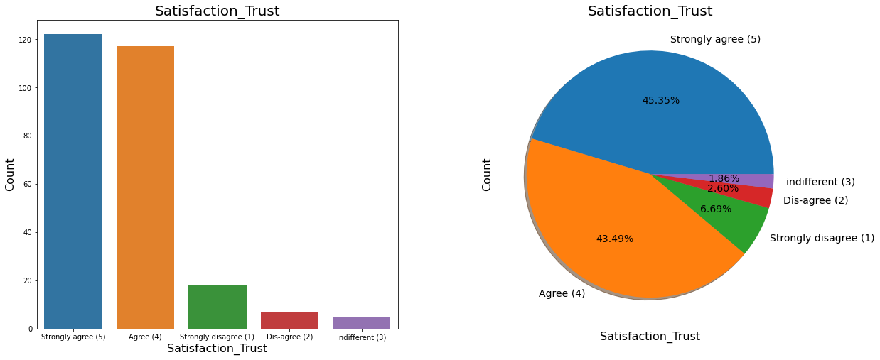
Majority of the shoppers strogly agree that User satisfaction cannot exist without trust

Slide 34
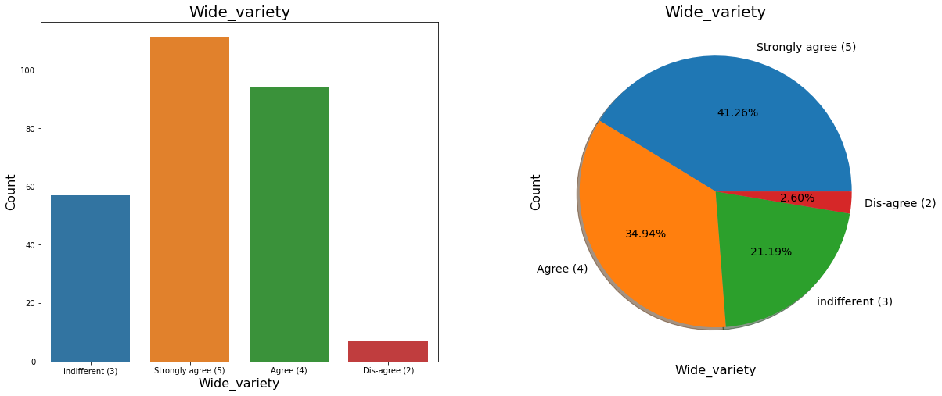
Majority of the shoppers are agree that online shoping Offering a wide variety of listed product in several category

Slide 35
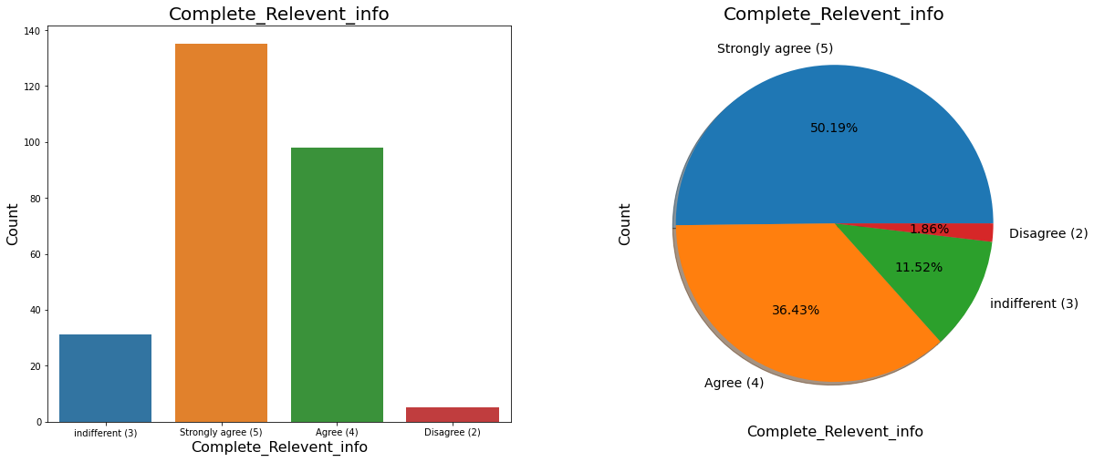
Majority of the shoppers are strongly agree that having complete and relevant product information increase chance of buying .

Slide 36
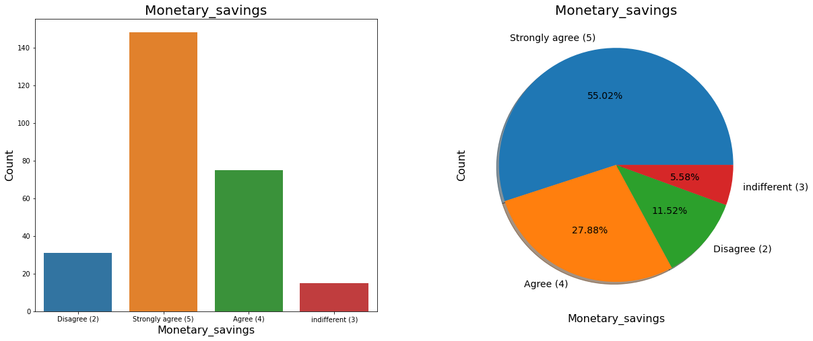
Majority of the shoppers strongly agree that online shoping provide monetary savings

Slide 37
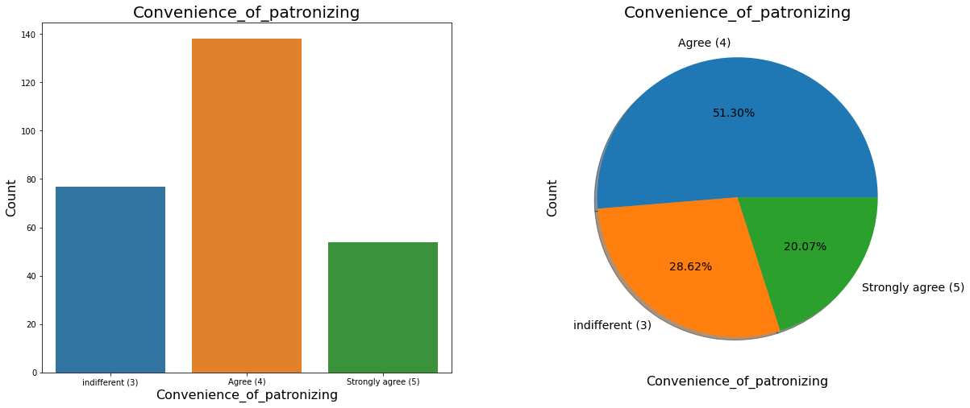
Majority of the shoppers are agree,There is Convenience of patronizing the online retailer

Slide 38
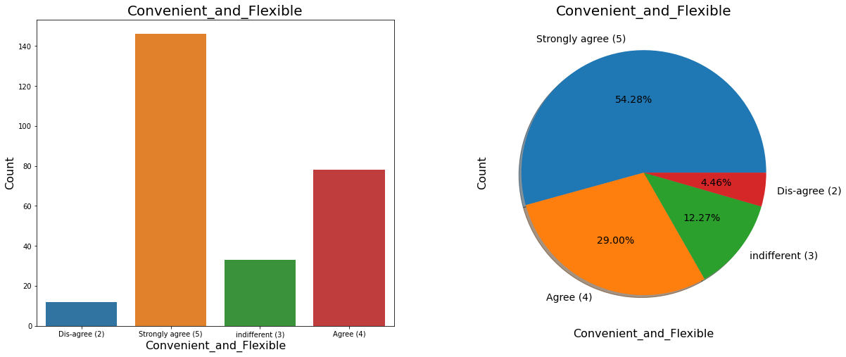
Majority of the shoppers are agree that Shopping online is convenient and Flexible.

Slide 39
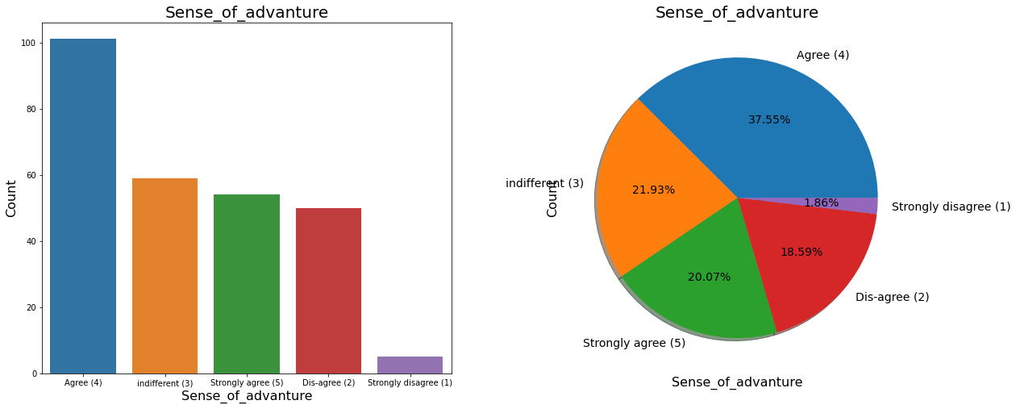
Majority of the shoppers are agree that Shopping on the website gives you the sense of adventure

Slide 40
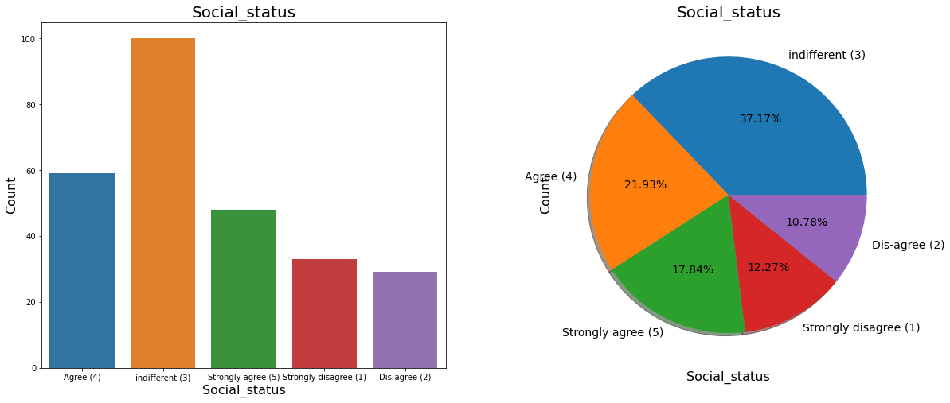
Majority of the online shoppers are having Indifferent views for Shopping on your preferred e-tailer enhances your social status

Slide 41
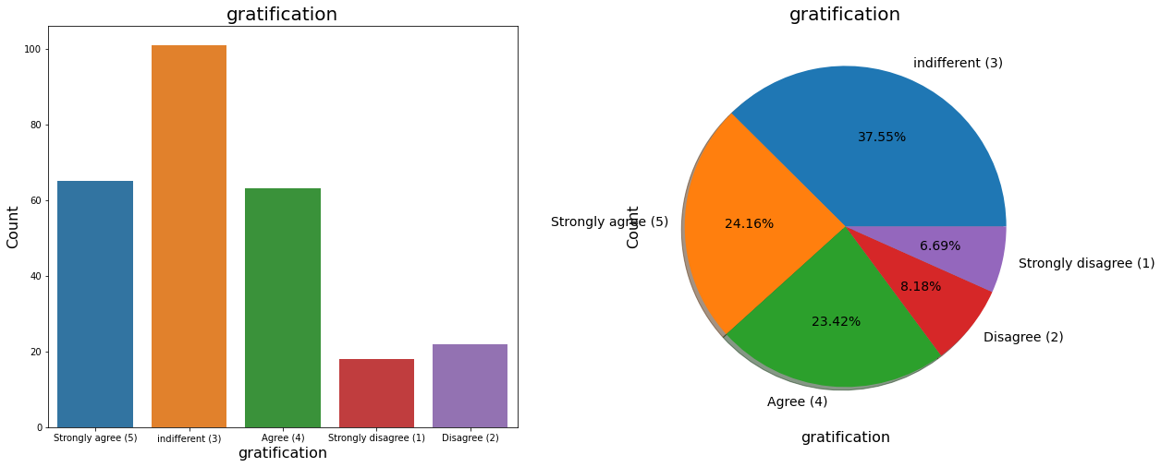
Shoppers having Indifferent view for feel gratification shopping on your favorite e-retailer

Slide 42
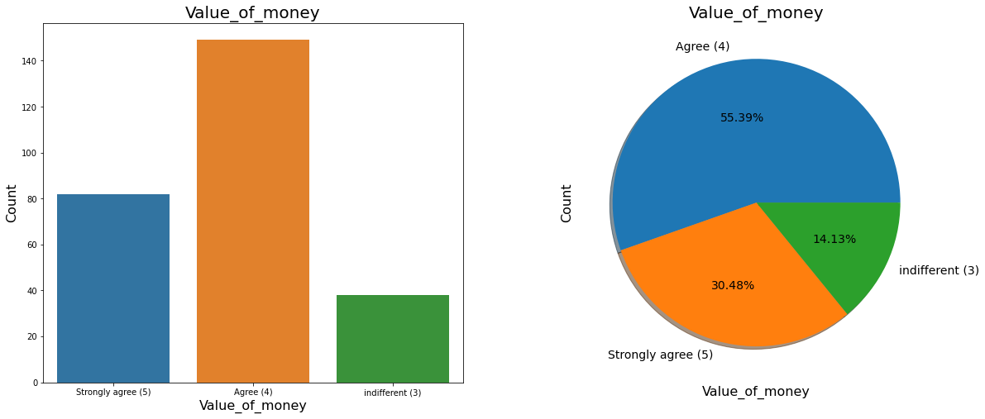
Majority of the shoppers are agree to have value of money.

Slide 43
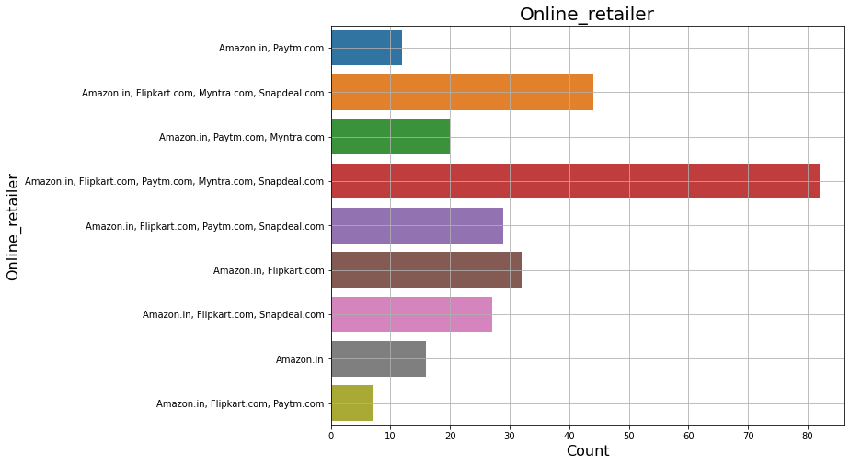
Majority of the shoppers are using multiple retailers for shoping online.

Slide 44
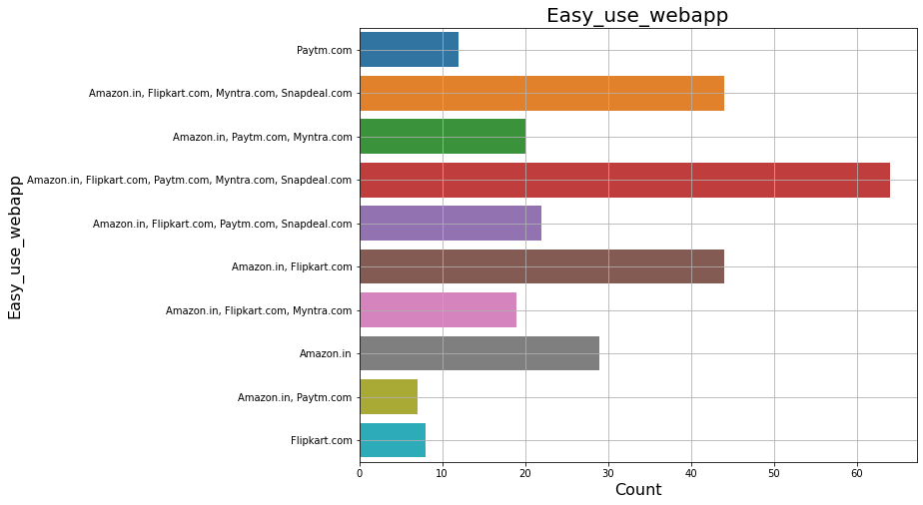
Majority of website and applications are easy to use.

Slide 45
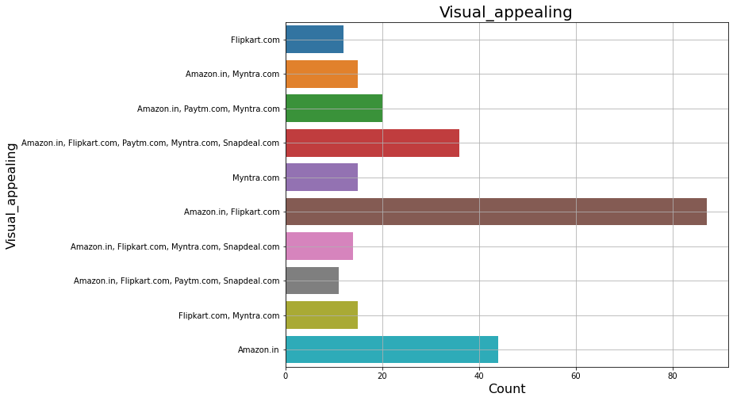
According Majority of shoppers Amazon and Flipkart having good visual appealing

Slide 46
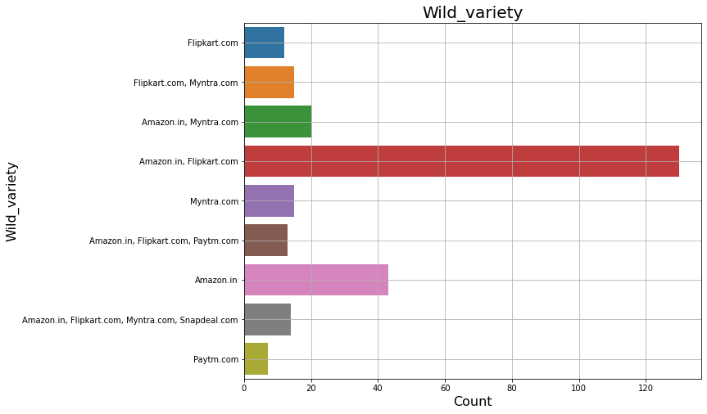
Amazon and flipcart are having wild variety of prodcts on offer.

Slide 47
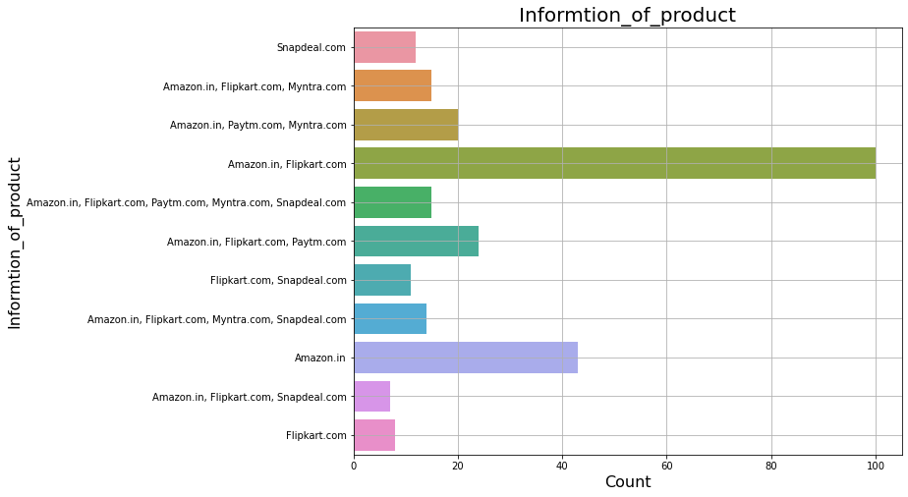
Amazon and Flipkart having Complete, relevant description information of products.

Slide 48
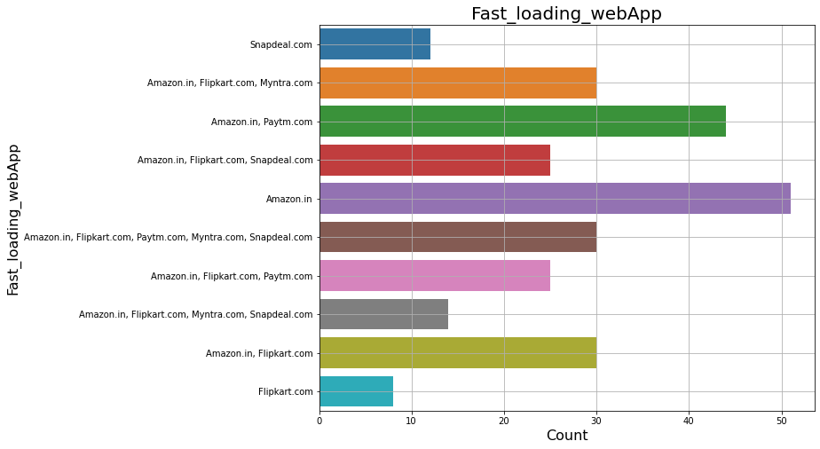
Amazon, flipcart and Paytm having fastest loading website and application

Slide 49
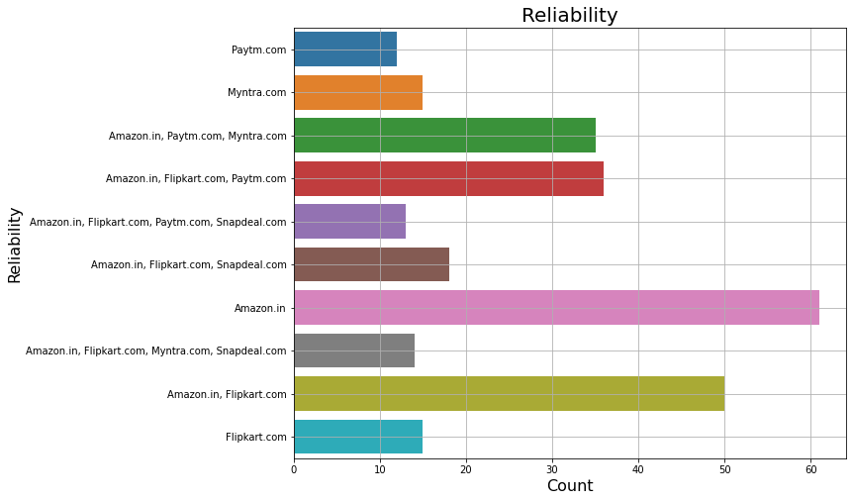
According to majority of the shoppers amazon is more Reliable website or application

Slide 50
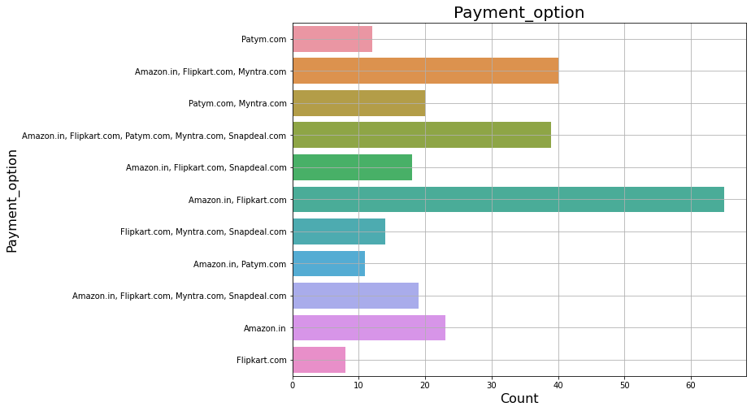
Amazon and Flipcart are having Availability of several payment options

Slide 51
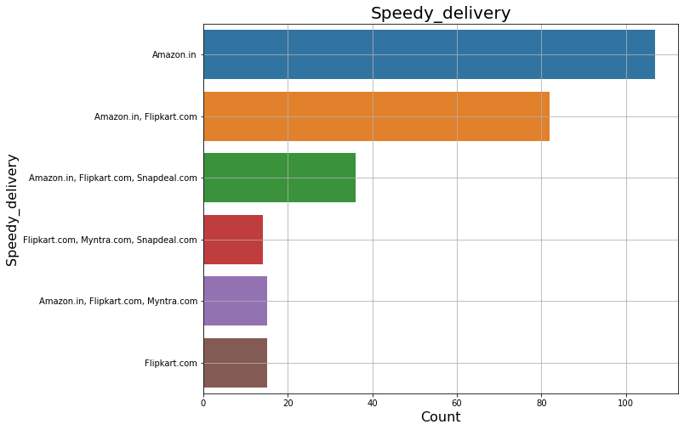
Amazon provide Speedy order delivery

Slide 52
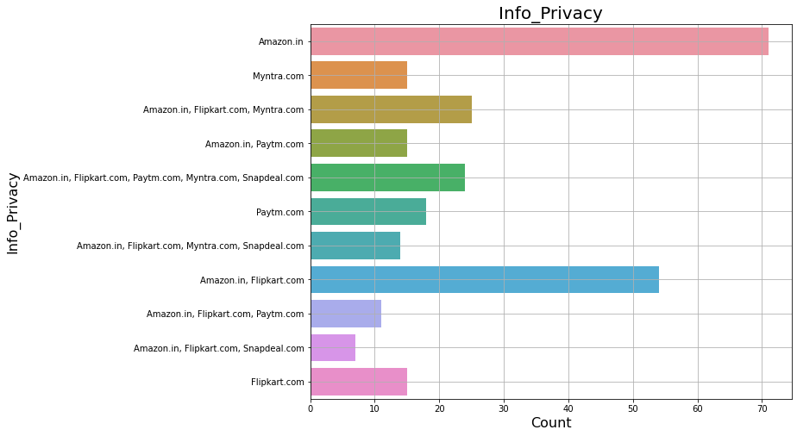
Majority of the shoppers recommend Amazon as best retails for providing Privacy of customers’ information

Slide 53
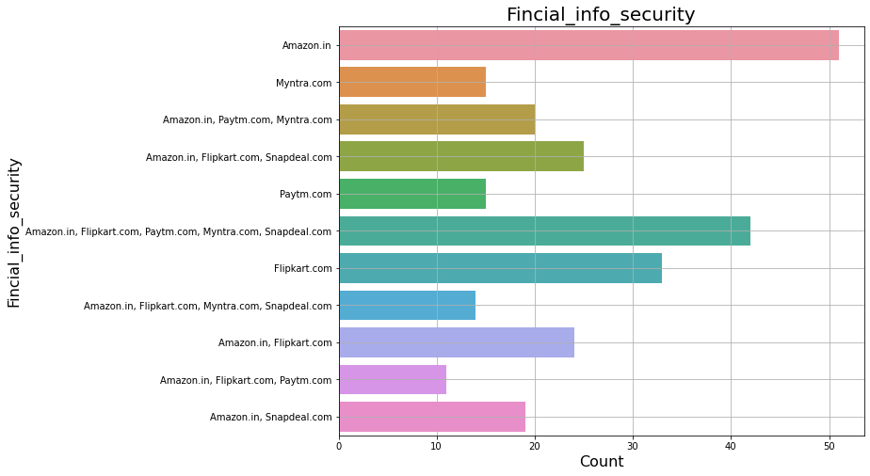
majority of retails provide Security of customer financial information, Amazon is on top.

Slide 54
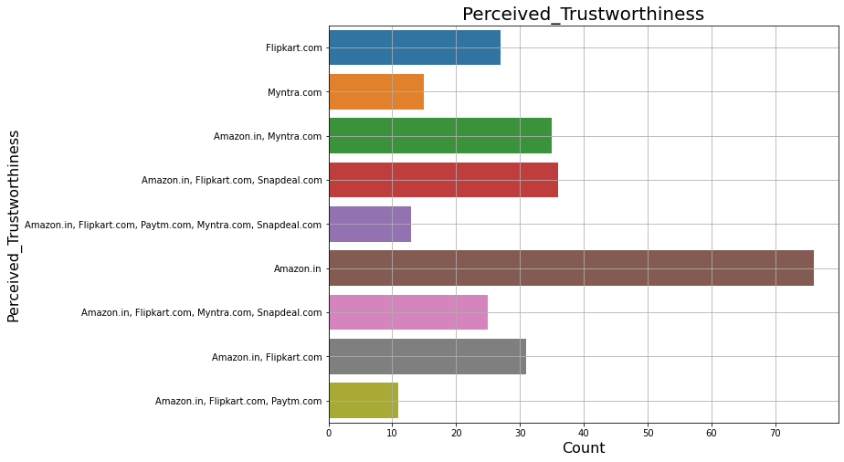
Amazon is more Perceived_Trustworthiness than other retailers

Slide 55
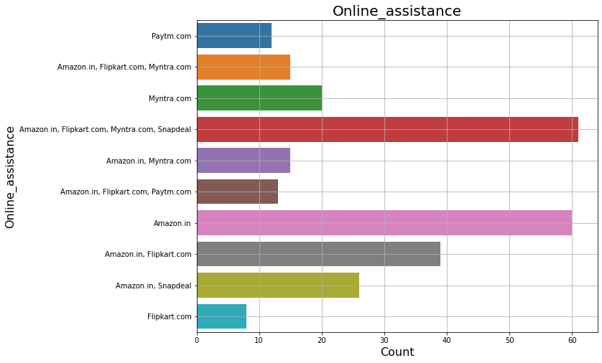
Majority of the retailers provide online assitance through multiple channels

Slide 56

According to Majoroty of the shoper Myntra having Late declaration of price (promotion, sales period)

Slide 57

According to Majoroty of the shoper Myntra having longer page loading time, paytm is at 2nd place

Slide 58

According to Majoroty of the shoper Snapdeal having Limited_payment_mode

Slide 59

According to Majoroty of the shoper Paytm having Long_delivary_period

Slide 60

Amazon make Change_in_website according to requirements of user.

Slide 61

According to majority of shoppers Amazon.in is Efficient website.

Slide 62

Amazon and Flipcart are most recomended retailers.

Slide 63

Age group 21- 50 years are actively purchasing online as compare to age less than 20 and 51 years above.

Slide 64

Here we can see in most of the cities Female buyers are more as compare to male.

Slide 65

We can see Girls taking more exploration time befor making buying decision,

Slide 66

Majority of females are recommending Amazon and Flipkart

Slide 67
Conclusion
With increase in the internet access and mobile shoppers are switching form offline mode of shopping to online mode of shopping.
Majority of the shoppers find it adventures, time saving and value of money.
The main factors which affect the customer’s retentions are Trust, return policy, privacy of the user payment details, Fast delivery and return policy.

