Slide 1
E-retail factors for customer activation and retention: A case study from Indian e-commerce customers
By,
Vijay Ashley Rodrigues K

Slide 2
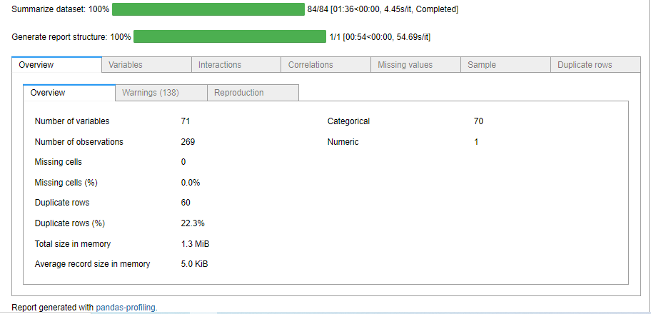
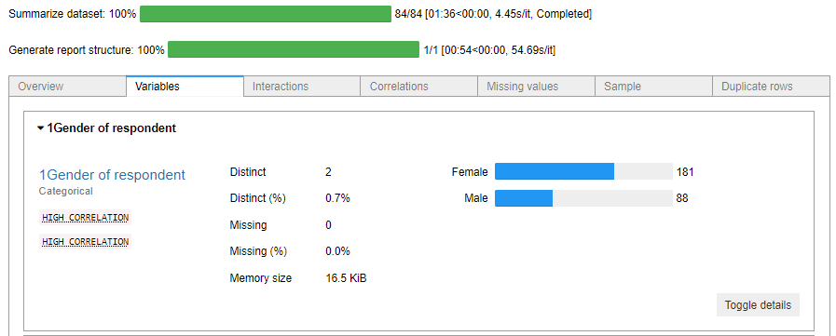
The following library helps in analysing the dataset to give us some understanding on individual features

Slide 3
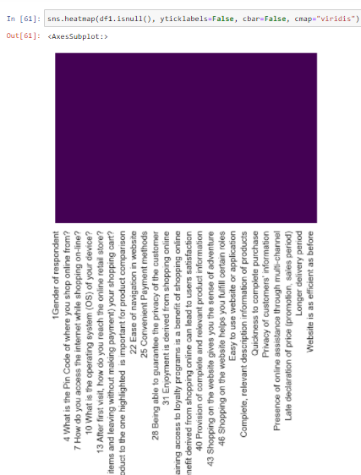
This heatmap shows us if there is any null values in the dataset. From this we can see that there are no null values

Slide 4
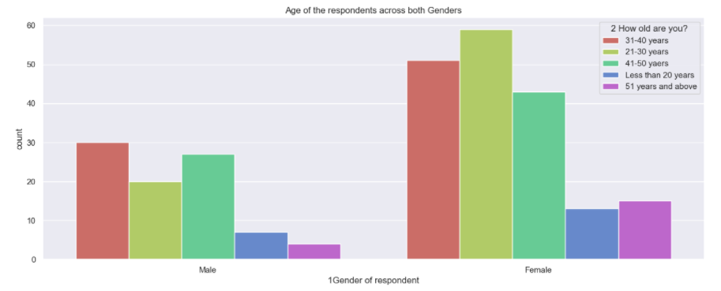
The following dataset appears to have approximately 67% of Female respondents and approximately 32 % of Male respondents. But can we simply assume that Female purchase more online than Male? No we cannot. This dataset has only 269 records and it's merely difficult to conclude the majority in general.
However we can assume that the data when this was recorded Female made more purchases than Male customers. Below is the percentage count followed with a plot to give us an idea of how it looks like in general.

Slide 5
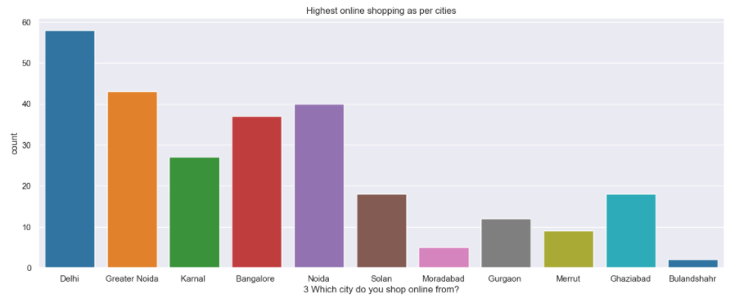
Let's observe if there is any relationship between online purchases and the city We can see that the respondents in this case appear to be majorly from "Delhi" as it has highest online purchases followed by "Greater Noida" , "Noida" and "Bangalore" seem to have high traffic in online purchases
We can observe that these are metropolitan or semi metropolitan cities at least, known for multiple companies and IT sector in general. A lot of outsiders come here and population is also very high. This could in a way may have created a pavement for more online purchases as opposed to going to Brick-and-Mortar stores

Slide 6
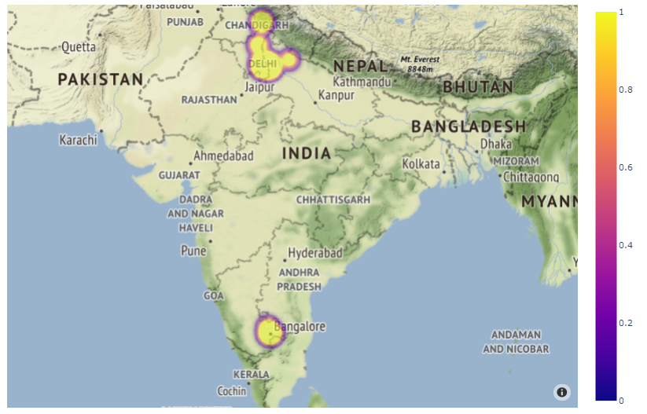
For ease of reference, I have plotted a map of the location I have extracted the "latitude" and "longitude" as many as possible using the "zipcodes" from the dataset
For this I have used Python's geopy library. Since all the zipcodes are in and around the limited cities, I have not extracted all the pincodes and only a handful of them.
I have used "Plotly" for displaying the map using "density_mapbox"
We can see the highlighted areas and majority of shopping have taken place in "North India" and in "South India" only Bangalore seems to be the city.

Slide 7
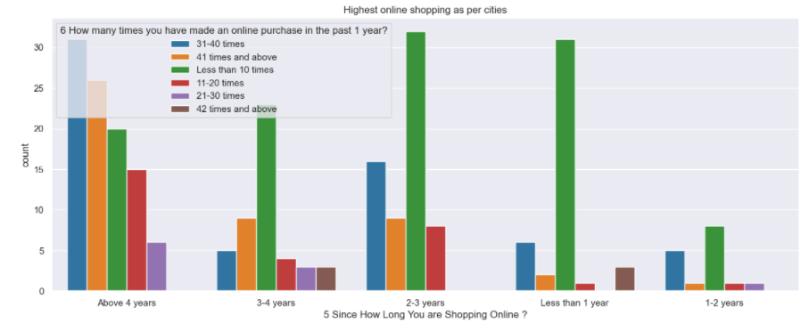
Let's see if we can find any relationship between number of purchases made from online sources We can see in every case, majority of people have bought products less than 10 times at least in 1 the last 1 year
As the customer gives more number of years to online purchase, the quantity of purchase also increases We can see that customer who have been purchasing online for more than 4 years and above have bought atleast 31- 40 times

Slide 8
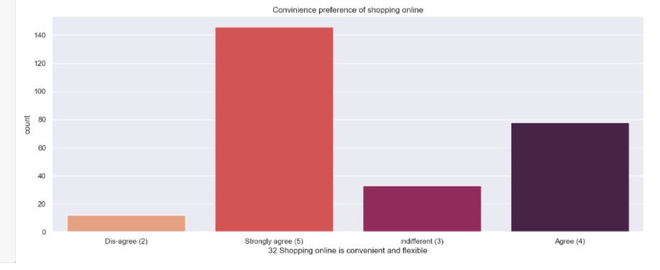
We can see from the below plot that majority of customers prefer and are of the opinion that shopping online is convenient and flexible. At present, given the work conditions a person may not prefer going out. Going out for shopping also means spending more time and spending money to commute etc.
It may not be a big deal, but imagine all you want is to buy a product that is relatively cheaper, or if products are manufacture or found in specific location, provinces etc. Travelling to that place for that product makes no sense.
Also, the amount of time we may spend to investigate or compare physically can be reduced considerably by browsing online

Slide 9
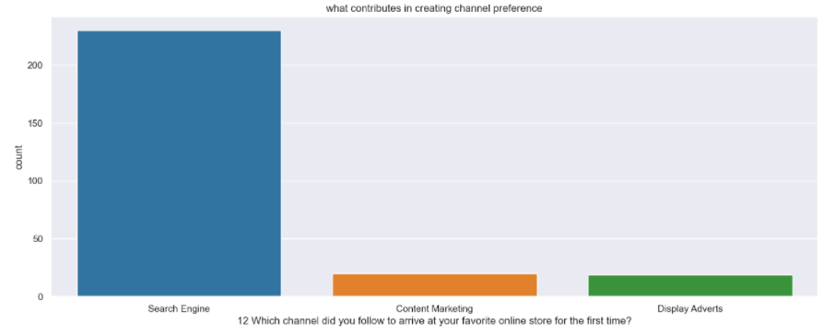
The system understands our needs and in a way acts as a recommendation systems by targetting specific portions of that product by indirectly placing it in the search feeds. If we consider the other categories "Content Marketing" and "Display Adverts", we can see the count if very less and these categories could also be influencing customers through online medium
Let's see if there is any relationship between channel and online store.
We can see majority of people got to know about a specific store through search engines. These days it's quite common to search for an item online before buying products and the moment we do search, we get tons of ads.

Slide 10
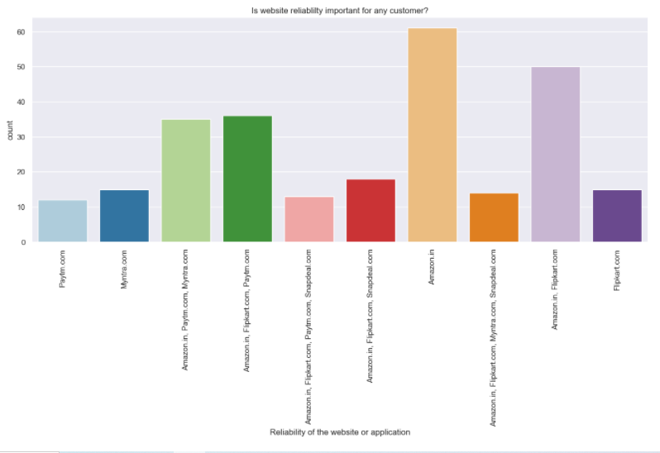
People seem to prefer websites that are highly reliable. This could include how fast it loads, how soon a graphic or certain feature is loaded, how flexible is the website that can be toggled on both Laptops and Smartphones.
This also explains the past user experience and no matter how good it was, if there is a very bad experience, the customer is lost for good and may not prefer that channel next time.
In this case we can see Amazon has good customer base followed by Flipkart and are have more reliable and stable platform / website compared to others. In short, these are trusted openly compared to other E-Commerce brands.

Slide 11
Run and Evaluate selected models
I have used a total of 4 ML algorithms to find the best and suited model.
I have used all 4 metrics i.e Accuracy, Precision, Recall and F1 score for all the algorithms. If you observe carefully, all show an 100% output.
In a typical dataset, it’s practically not possible to get such percentage but since this is a very small and a perfect / clean dataset this output may have occurred.
I have used 1 ensemble algorithm and remaining are the regular classification algorithms.
But we cannot simply rely on these scores as we cannot have any scope for assumption. Hence post this I have also performed Cross Validation for all these algorithms to find the estimated performance metric when it’s actually used in production.

Slide 12
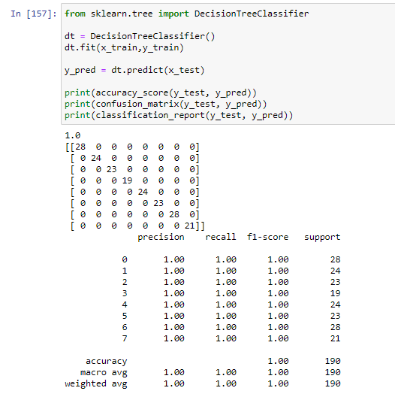
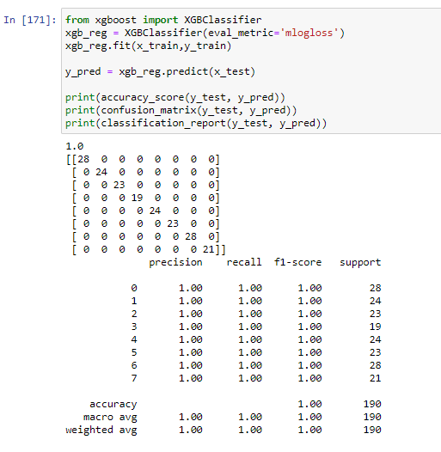
DecisionTreeClassifier
XGBClassifier

Slide 13
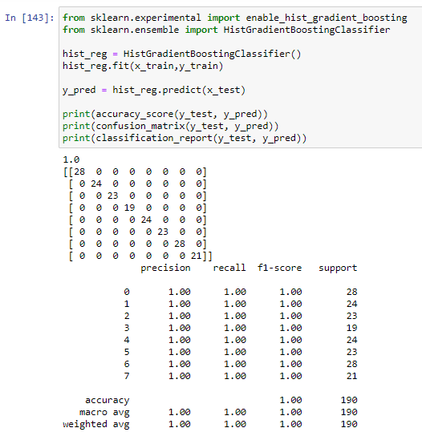
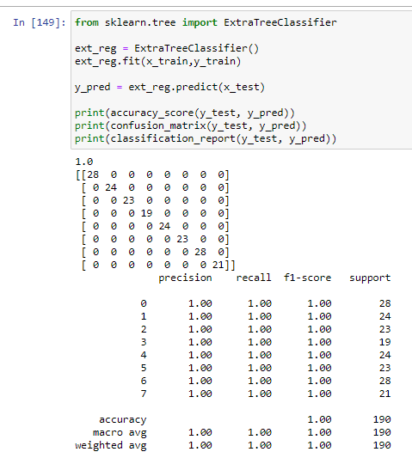
HistGradientBoostingClassifier
ExtraTreeClassifier

Slide 14
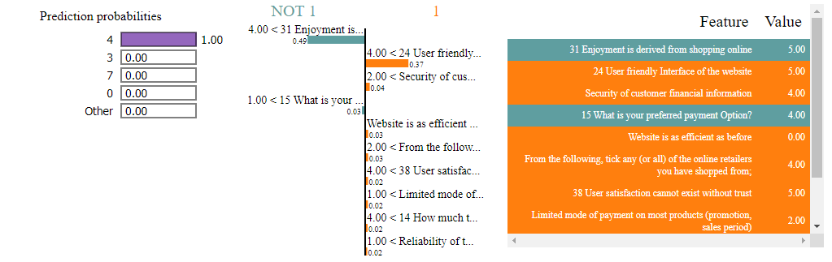
Intepreting the pkl file ( final model ) for better understanding I have used Lime library for the same and we need to pass the attributes and mode of model as shown below A handful of data is selected from train dataset using Lime libray In the following figure, we can see what features are falling under 0 or 1 and gives us the prediction probabilities.

Slide 15
Thank You…

