Slide 1

AI-Powered Solution for Assisting Visually Impaired Individuals Leveraging Generative AI for Accessibility

Slide 2
About me
Student Name: Vijay Rawasaheb Shinde
Internship ID: IN9240777
Email ID: shindevijay595@gmail.com
Github: https://github.com/VijayShinde1996/AI_Powered_Assistant_Visually_Impaired_Individuals
Linkedin Profile: www.linkedin.com/in/vijay-shinde-098202133
Project: Project Submission - Building AI Powered Solution for Assisting Visually Impaired Individuals
Under the guidance of: Kanav Bansal (Innomatics Research Labs)
Project Submit Date: 30th November 2024

Slide 3
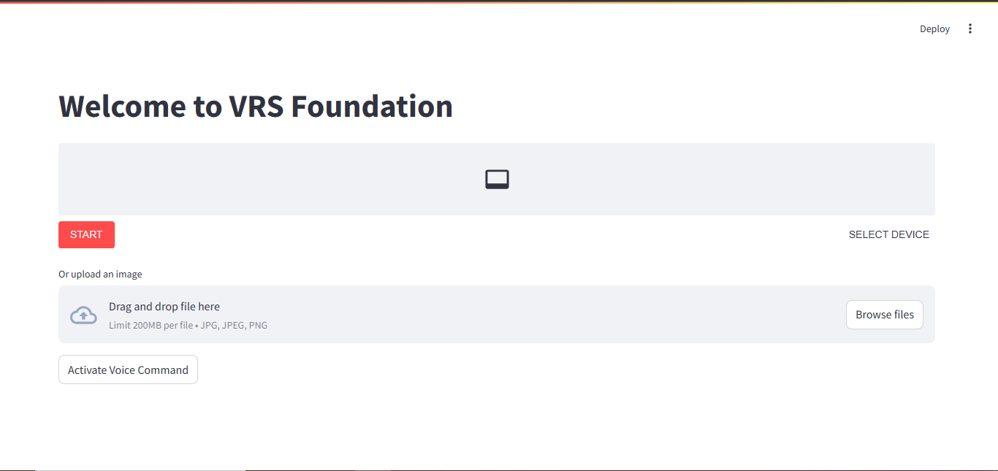
Project Demo: Home UI

Slide 4
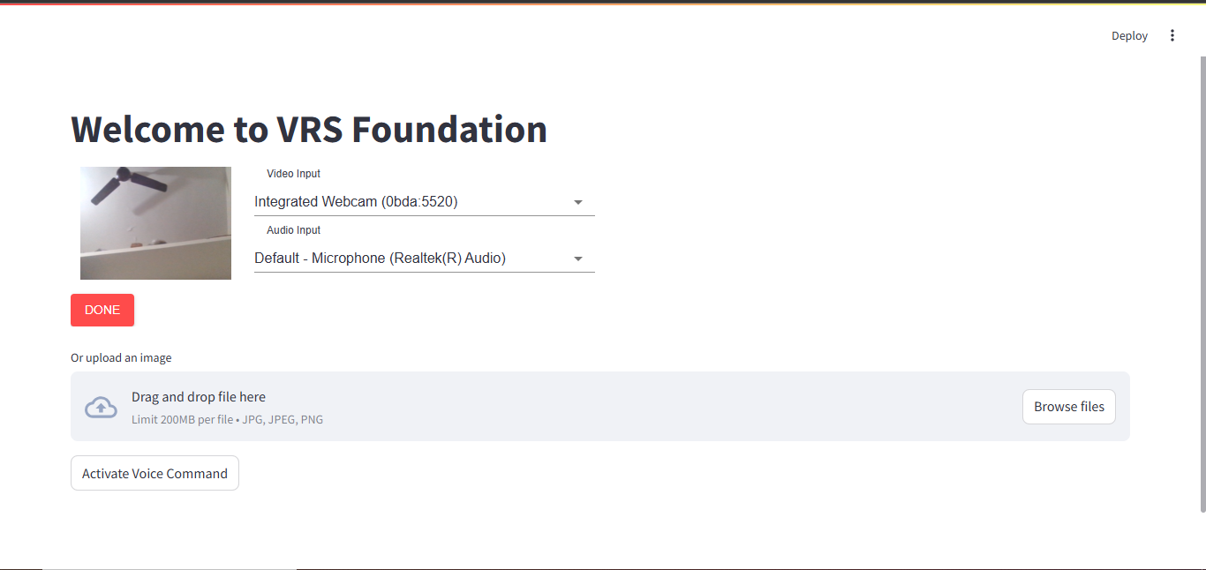
Project Demo: Camera & Audio Device Selection

Slide 5
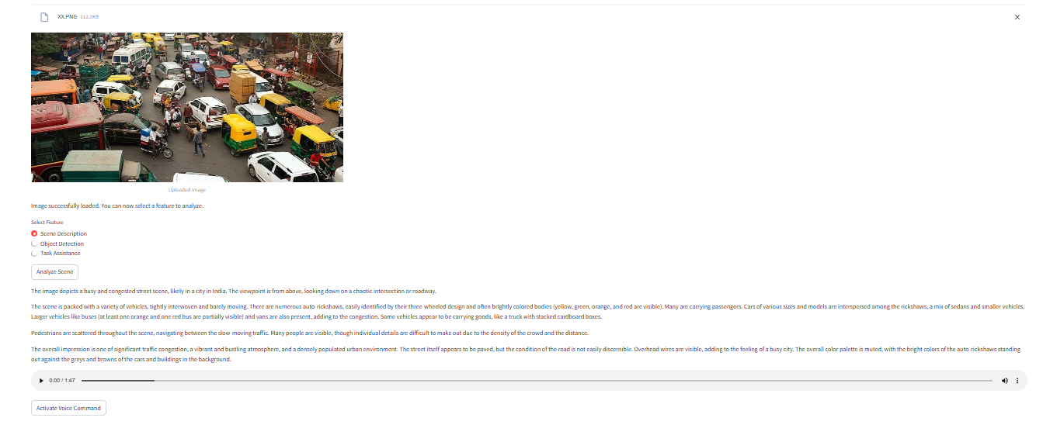
Project Demo: Analyse the Image Data

Slide 6
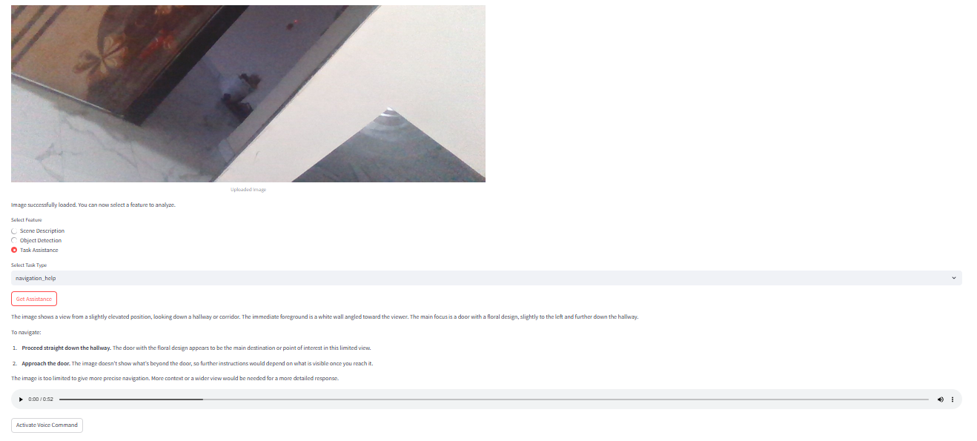
Project Demo: Navigate based on Camera Image

Slide 7
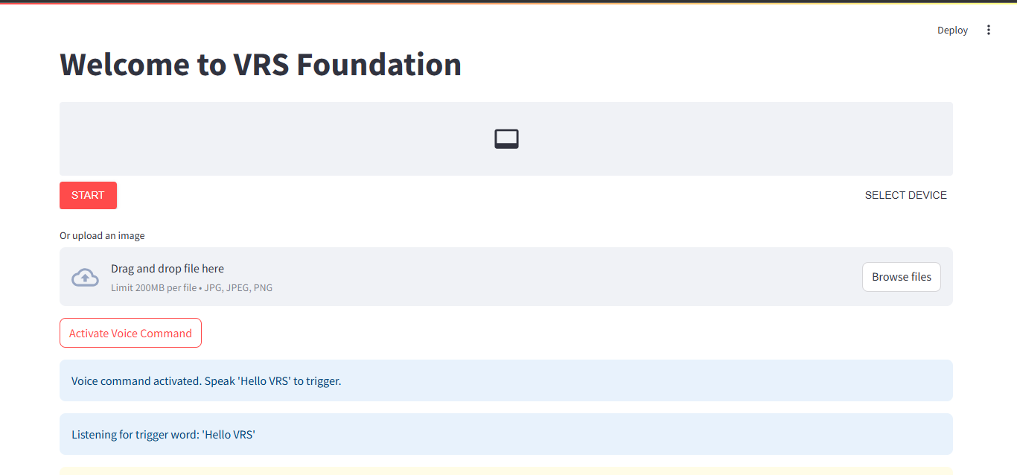
Project Demo: Voice Assistance

Slide 8
Problem Statement
Visually impaired individuals face significant challenges in perceiving and interacting with their environment. Everyday tasks that rely on sight, such as recognizing objects, reading text, and understanding surroundings, become barriers. Therefore, there is an urgent need for an intelligent, adaptable, and user-friendly solution that can offer:
Real-time scene understanding: Interpretation of surroundings and scene context for better awareness.
Text-to-speech conversion: Reading visual content to enhance accessibility.
Object and obstacle detection: Helping individuals safely navigate by identifying obstacles and objects.
Personalized task assistance: Providing support for daily activities, such as identifying items and reading labels.
This project seeks to build an AI-powered application that offers these functionalities through a seamless interface, enabling visually impaired users to interact with the world more effectively.

Slide 9
Process Flow
Opening the App: The user is greeted with a welcome message, "Welcome to VRS Foundation.“
Capturing Image: The camera opens automatically, and the user is prompted to take a photo.
Selecting Action: After capturing the image, the user is asked what they would like to do with the image. Available options include:Scene Description
Object Detection
Task Assistance
Providing Results: The app processes the image based on the selected action and provides either an audio description or guidance.Voice Command Activation: The app can also be triggered by saying "Hello VRS," allowing the user to perform the same tasks without touching the interface.
Voice Command Activation: The app can also be triggered by saying "Hello VRS," allowing the user to perform the same tasks without touching the interface.

Slide 10
Tasks & Features
The app is designed to offer the following core functionalities using AI and Streamlit:
Real-Time Scene Understanding: The app generates a textual description of the scene in the uploaded or captured image, helping users understand their surroundings.
Text-to-Speech Conversion for Visual Content: Extracts text from images using OCR techniques and converts it into audible speech, allowing users to hear any visual text or labels present.
Object and Obstacle Detection: Identifies objects and obstacles within the image, helping visually impaired users navigate safely.
Personalized Assistance for Daily Tasks: Provides task-specific guidance based on the image, such as recognizing objects, reading labels, or giving directions for daily tasks.

Slide 11
Code Walkthrough
Import Libraries:
The necessary libraries are imported, including Streamlit for the web interface, Pillow for image processing, gTTS for text-to-speech conversion, Google Vision for image analysis, and Langchain for using generative AI models.
API Initialization:
API keys are set for accessing Google’s Generative AI and Vision models.
Langchain’s ChatGoogleGenerativeAI is initialized to process image analysis requests.
Error Handling:
A function is defined to handle and log any errors that occur during the execution.
Image Analysis:
The function converts the uploaded image into a byte stream and sends it to the Google Generative AI model to process and return content like scene descriptions, object detection, or task-specific information.
Text-to-Speech Conversion:
The extracted text (like scene descriptions or object details) is converted into speech using the gTTS library and returned as an audio file.
Webcam Capture:
A class is defined to use Streamlit WebRTC for capturing an image from the webcam. The first captured frame is saved for analysis.
Voice Command Listener:
The app listens for the voice command "Hello VRS" using SpeechRecognition, which triggers the app’s main functionality.
Main App Logic:
The app greets the user and displays options to either capture an image using the webcam or upload one manually.
After selecting an image, the user can choose from features such as Scene Description, Object Detection, or Task Assistance.
The app then analyzes the image based on the selected feature and provides both text and audio output.
Voice commands are continuously monitored to allow hands-free interaction.

Slide 12
Conclusion
This AI-powered assistive application, developed using Streamlit, Google Generative AI, Langchain, and Text-to-Speech, provides valuable functionalities to visually impaired users. By offering scene descriptions, object detection, text reading, and task assistance, this app empowers users to interact more effectively with their environment and navigate safely. Voice activation further enhances user interaction, creating a seamless experience.
With potential future improvements like personalized assistance and multi-language support, this app could become a powerful tool for improving the independence and quality of life for visually impaired individuals.

Slide 13
Future Scope
The current app offers a robust solution, but there are several areas for improvement and new features that could be added to enhance the experience for visually impaired users:
Personalization:
Introduce user profiles to save preferences, such as preferred speech speed or tone.
Customizable settings for object detection to focus on specific items like food or common household objects.
Real-time Navigation:
Implement real-time navigation assistance using a mobile phone camera to detect obstacles and guide the user through their environment.
Integrate with a GPS system for location-based assistance (e.g., guiding through a building or outdoor spaces).
Multi-language Support:
Add multi-language capabilities, allowing users to interact in their native language.
Enhanced Object Detection:
Improve object detection by training custom models for specific use cases, like identifying medical equipment, currency notes, or reading labels in different fonts.
**Integration with Smart Devices

Slide 14

THANK YOU

