Slide 1

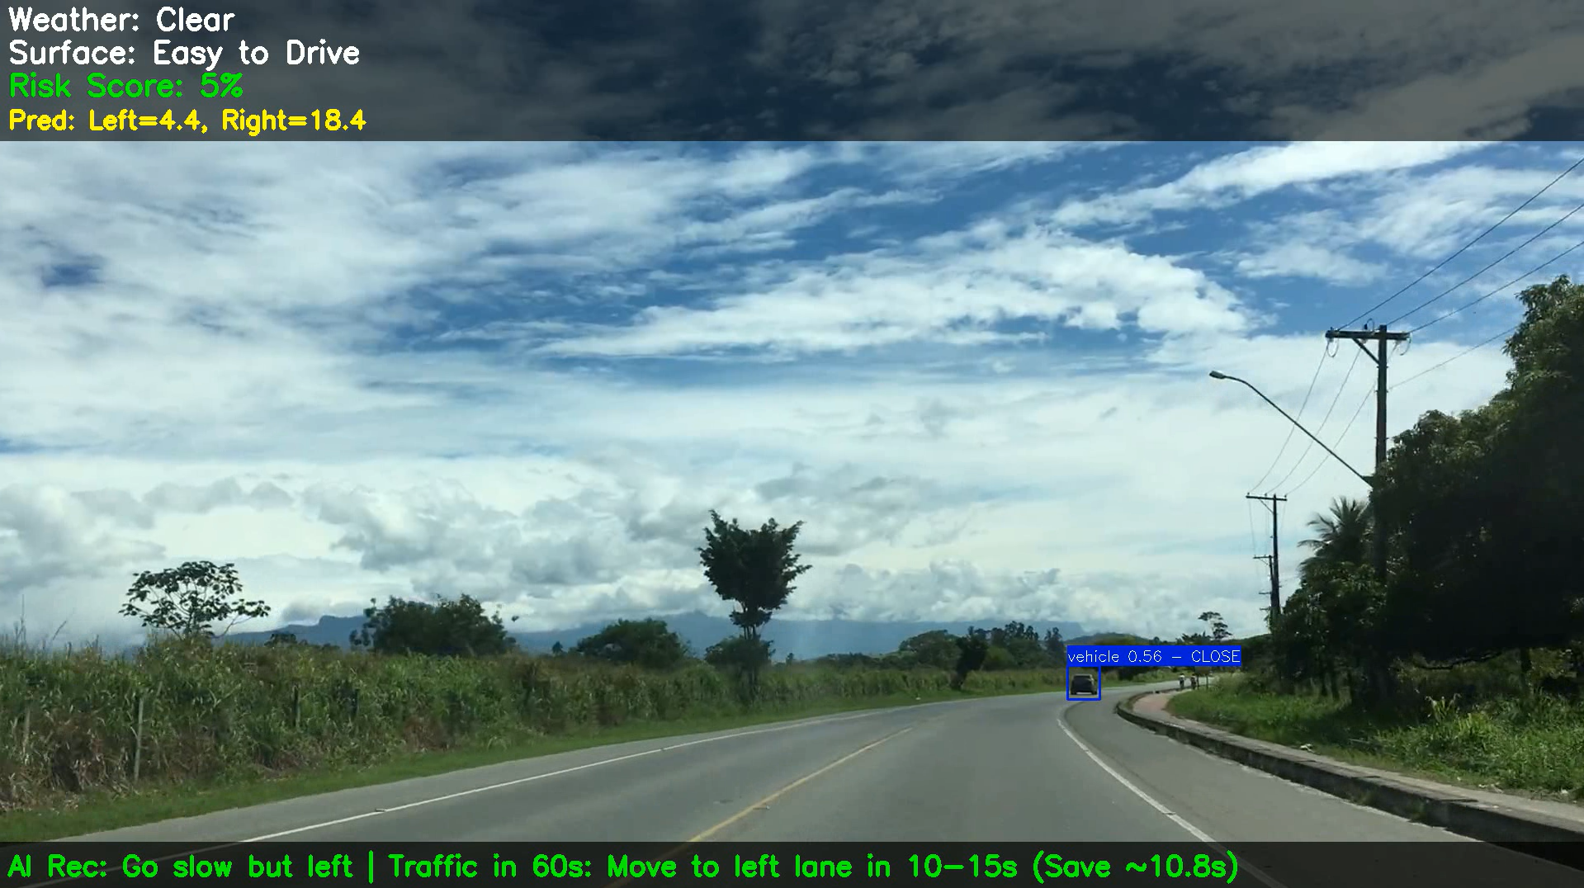
AI-Powered Advanced Driver Assistance System For Ambulances
Vijay Shankar Singh(2201229)
Abstract:
This project develops an AI-based ADAS for ambulances that uses video input to detect road conditions, obstacles, and traffic. By applying YOLO, CNN and segmentation models, it provides driving recommendations like “slow down/up,” “move left/right,” or “change lane.” CCTV footage is used to predict upcoming traffic at that location, enabling safer decisions without changing the route.
Objective:
To build an AI-driven ADAS that detects road and traffic conditions and gives driving decisions. These decisions would be based on both live video analysis and predictive insights from CCTV footage to give timely decisions on the same route
Approach:
1.A Fine tuned YOLOv8 model was used to detect objects like vehicles, people, potholes, and speed breakers in real-time video.
- Dataset:4000 self-labeled images were used for object detection.
2.A Fine tuned YOLOv8n-seg was used for segmenting the road area and identifying the safest path.
- Dataset: Road segmentation was trained using the data from Roboflow.
3. Weather condition detection, Road Surface type classification were performed using fine-tuned CNN models.
- Dataset: 12,000 images were used for weather model training; RSCD dataset was used for Surface Detection Model.
4. CCTV video(60 seconds ahead) was used which gives the number of vehicles on both lanes as input to ensemble-based(3 LSTM models)Traffic prediction model ,trained on Synthetic Data .
5. Dashcam video was given as input to object detection, road segmentation, weather, surface,
6. Using the outputs the system suggested actions like “Slow Down/Up”, “Move Left/Right” or “Change Lane” on the Dashcam.
Results:
1) Yolov8 model reached a high map@0.5 of 92.5%
2) Yolov8n-seg model reached a map@0.5 of 82.1%
3) Weather detection model had train accuracy of 98.1% and a validation accuracy of 97.6%
4) Surface detection model had train accuracy of 95% and a validation accuracy of 85%
5) Below are the results of traffic prediction model
6)Successfully integrated all models and they worked well in providing accurate and timely driving recommendations.
7) This is one screenshot
from the output dashcam
video
Existing ADAS research focuses
on isolated perception modules,
but lacks integrated, foresight-driven systems tailored for real-time emergency vehicle navigation
Significance:
The project offers a reliable AI-based decision support system for ambulances ,it enhances real-time awareness using CCTV foresight and multi-model integration and this can reduce delays and improve safety in emergency response driving.
Model | Cases with Red Light | RMSE (Red Light) | Cases without Red Light | RMSE (No Red Light) | Final Validation RMSE
Model 1 | 1860 | 0.2423 | 1910 | 0.2498 | 0.2464
Model 2 | 1860 | 0.2423 | 1910 | 0.2498 | 0.2465
Model 3 | 1860 | 0.2423 | 1910 | 0.2497 | 0.2461

