Slide 1
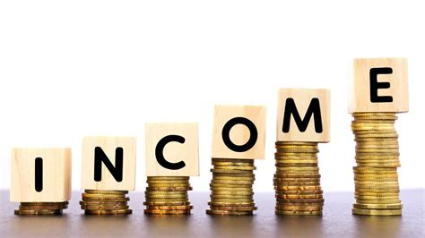
INCOME OF PEOPLE ANALYSIS
From
VIJAY TKMOGE

Slide 2
INCOME OF PEOPLES ANALYSIS
Analysis of peoples whose income greater than 50,000 and less than or equals to 50,000
The reason can be:
Job Type of peoples
Education Type of peoples
Occupation of peoples
Gender
Age

Slide 3
Model on Income of peoples
Prediction models are used to identify peoples who has income more than 50,000 and less than or equals to 50,000
Which variable play main roll in high income ?

Slide 4
Behaviour variables
Behaviour variables look at the previous behaviour of peoples
How often he or she is working to earn money
Education of person

Slide 5
Methods used to build a model
Logistic Regression
Decision Tree classifier
Random Forest Classification
Support Vector Machine
K- Nearest Neighbor

Slide 6
Logistic Regression
Logistic Regression is a fundamental statistical method used for binary classification tasks. Unlike linear regression, it predicts the probability of an observation belonging to a particular class by applying the logistic function. This model is well-suited for problems where the dependent variable is categorical and has two possible outcomes. It's computationally efficient and provides interpretable results, making it a popular choice for various predictive modeling tasks.

Slide 7
Decision Tree
Decision Tree is a versatile supervised learning algorithm used for both classification and regression tasks. It partitions the feature space into segments based on the features' values, forming a tree-like structure to make predictions. Each node in the tree represents a feature and a decision point, optimizing to minimize impurity or maximize information gain at each step. Decision Trees are easy to interpret and visualize, making them valuable in understanding feature importance.

Slide 8
Random Forest classifier
Random Forest is an ensemble learning method that operates by constructing multiple decision trees during training. Each tree in the forest independently predicts the target variable, and the final prediction is determined by averaging the predictions (regression) or taking a majority vote (classification) from all the trees. It's known for its robustness against overfitting, handles high-dimensional data well, and generally provides high predictive accuracy.

Slide 9
Support Vector Machine
Support Vector Machine is a powerful supervised learning algorithm used for classification and regression tasks. It aims to find the optimal hyperplane that best separates different classes in the feature space. SVM works by maximizing the margin between classes while minimizing classification errors. It's effective in handling high-dimensional data and works well in scenarios with clear class boundaries.

Slide 10
K-Nearest Neighbor
The K-Nearest Neighbors (KNN) algorithm is a popular machine-learning technique used for classification and regression tasks. It relies on the idea that similar data points tend to have similar labels or values. During the training phase, the KNN algorithm stores the entire training dataset as a reference. When making predictions, it calculates the distance between the input data point and all the training examples, using a chosen distance metric such as Euclidean distance

Slide 11
Conclusion
People those who works in private job has income grater than 50,000 and as well as peoples has high education has high income ,older the person higher the income

Slide 12
Thank You!

