Slide 1
Smart Helpdesk Ticketing Solution for IT Services
CSE7302- University Project
Review-4
Batch Number:
Under the Supervision of,
Ms. Ashishika Singh
Dr./Mr./Ms./Prof.
Professor / Associate Professor / Assistant Professor
School of Computer Science and Engineering
Presidency University
Roll Number | Student Name
20221CIT0089 | Sappidi Hemanth
20221CIT0090 | Vasikeri Praneeth Sai
20221CIT0063 | Talari Vijay Kumar
Name of the Program: B.TECH
Name of the HoD: Dr. Anandaraj S.P
Name of the Program Project Coordinator: Dr. Sharmasth Vali
Name of the School Project Coordinators: Dr. Sampath A K , Dr. Geetha A

Slide 2
Problem Statement Number: 190
Organization: Ministry of Power
Category (Hardware / Software / Both) :Software
Problem Description:
Large organizations like POWERGRID receive a large number of IT service requests daily, which are currently handled through multiple independent platforms such as GLPI, SAP Solution Manager (Solman), and email. This fragmented approach requires employees to navigate different systems to raise tickets, resulting in confusion, manual ticket classification, delayed routing, and increased workload for IT support teams. Additionally, the lack of centralized visibility and self-service mechanisms leads to slower resolution of common issues and reduced user satisfaction. Hence, there is a need for a centralized, AI-based helpdesk system that can consolidate tickets from multiple sources, automatically classify and route them, and efficiently resolve common IT issues.

Slide 3
Content
Objectives
Background and Related work for title Selection
Analysis of Problem Statement
Innovation or Novel Contributions
Git-hub Link
Timeline of the Project
References

Slide 4
Objectives
To design and develop a centralized AI-based helpdesk system for managing IT service requests.
To enable employees to raise tickets through multiple channels such as chatbot, email, and existing ticketing tools.
To consolidate all tickets into a single platform for better visibility and management.
To implement NLP-based automated ticket classification based on user queries.
To provide intelligent routing of tickets to the appropriate IT support teams.
To enable AI chatbot-based self-service resolution for common IT issues.
To reduce manual effort and response time in IT service management.
To improve overall user satisfaction and IT service efficiency.

Slide 5
Background and Related work
Large enterprise organizations such as POWERGRID handle a high volume of IT service requests daily.
IT tickets are currently raised using multiple platforms such as GLPI, SAP Solution Manager (Solman), and email.
Most traditional systems rely on manual ticket classification and predefined routing rules.
Limited use of AI and Natural Language Processing (NLP) in existing solutions.
Lack of chatbot-based self-service mechanisms for resolving common IT issues.
These limitations create the need for a centralized, intelligent helpdesk solution with automated classification, routing, and self-service support.

Slide 6
Analysis of Problem Statement
Technology Stack Components:
1. Frontend:
HTML, CSS, JavaScript
Used for building user interfaces such as login, ticket creation, chatbot, and dashboards
2. Backend:
Python (Flask Framework)
Handles business logic, ticket processing, AI integration, and API management
3. Database
SQLite / MySQL
Stores user details, tickets, categories, status, and routing information

Slide 7
Analysis of Problem Statement (contd...)
4. Artificial Intelligence & NLP
Python-based NLP techniques
Used for automated ticket classification and priority detection.
5. Chatbot Module
Rule-based AI chatbot
Provides instant self-service support for common IT issues
6. Payment Integration
Email and SMS (simulated)
Used for ticket updates, alerts, and escalations
6. Development Tools
VS Code
Git for version control

Slide 8
Analysis of Problem Statement (contd...)
Current Challenges:
IT service requests are handled through multiple independent platforms such as GLPI, Solman, and email.
Employees face difficulty in deciding which platform to use for raising a particular issue.
Lack of a centralized view of all IT tickets across the organization.
Manual ticket classification and routing lead to delays and errors.
Repetitive IT issues require human intervention, increasing workload
Needs & Expectations
A centralized platform to manage all IT service requests.
Ability to ingest tickets from multiple sources into one system.
AI/NLP-based automatic classification of tickets.
Intelligent routing of tickets to the appropriate IT teams.
Chatbot-based self-service for resolving common IT issues.

Slide 9
Github Link
The Github link provided should have public access permission.
GitHub Link

Slide 10
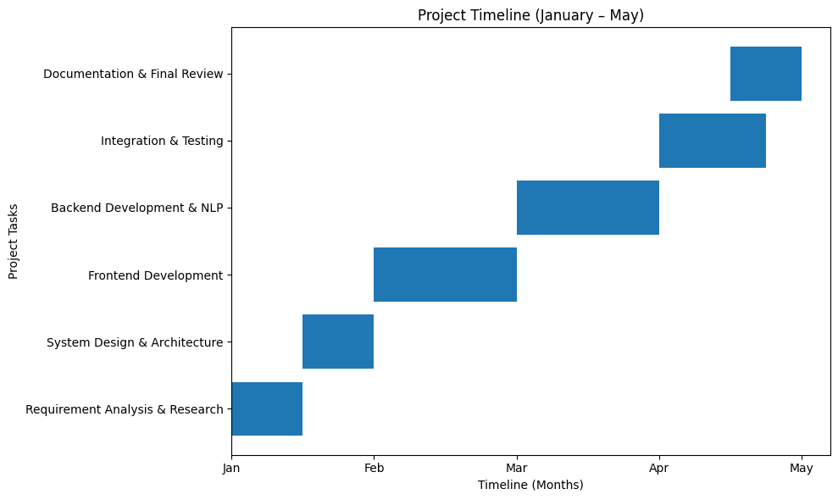
Timeline of the Project (Gantt Chart)

Slide 11
References (IEEE Paper format)
[1] A. Kumari, R. Verma, and S. Patel, “An intelligent IT service management system using artificial intelligence,” IEEE Access, vol. 9, pp. 112345–112356, May 2021.
[2] M. Gupta and P. K. Singh, “Automated ticket classification and routing using natural language processing,” IEEE Transactions on Services Computing, vol. 14, no. 3, pp. 890–901, Jun. 2021.
[3] R. Zhang, Y. Liu, and H. Chen, “Chatbot-based customer support system using NLP and machine learning,” International Journal of Computer Applications, vol. 176, no. 25, pp. 15–20, Oct. 2020.
[4] SAP SE, “SAP Solution Manager – IT Service Management,” [Online]. Available: https://www.sap.com/products/solution-manager.html. [Accessed: Jan. 10, 2026].

Slide 12


