Slide 1
Employee Performance Evaluation System (EPES)
A Java-Hibernate based system to evaluate employee performance using KPIs and generate reports.
Vijaya K
Senior Faculty
Deep Tech

Slide 2
Project Scope
Evaluate employee performance using measurable KPIs.
Allow managers to record scores for each KPI twice a year.
Automatically calculate weighted scores.
Generate half-yearly performance reports with comments.
Maintain department, employee, KPI, and review data in a structured database.

Slide 3
Technology Stack
Frontend: Console-based Java UI
Backend: Core Java
ORM: Hibernate (JPA)
Database: MySQL
Tools: Eclipse, Maven
Others: ANSI Colors for console output formatting

Slide 4
Key Features / Modules
Department Management
Employee Management (Add, Update, Delete and view all employees)
KPI Management (Add, List)
Performance Review Entry (H1 & H2)
Report Generation per Employee and per Year
Console UI with ANSI coloring for clarity

Slide 5
ER Diagram
Refer to uploaded diagram image.
Entities: Employee, Department, KPI, PerformanceReview, Report
Relationships:
Employee → Department (Many-to-One)
PerformanceReview → Employee, KPI (Many-to-One)
Report → Employee (Many-to-One)

Slide 6
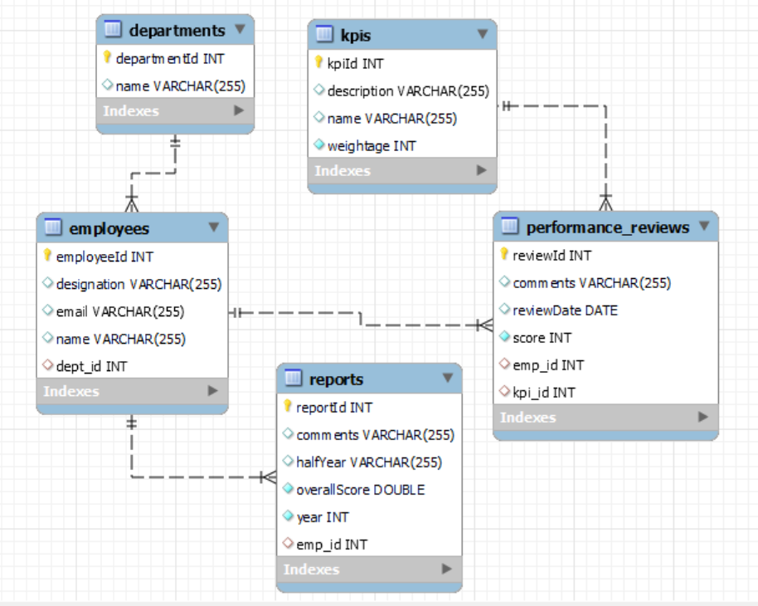
ER Diagram

Slide 7
Project Architecture
**Layered Architecture:**
Presentation Layer: Main class (EPESApp.java)
Service Layer: Business logic (PerformanceService, ReportService, etc.)
DAO Layer: Hibernate-based DB interaction (DAO classes)
Entity Layer: JPA Entities (Employee, Department, KPI, etc.)

Slide 8
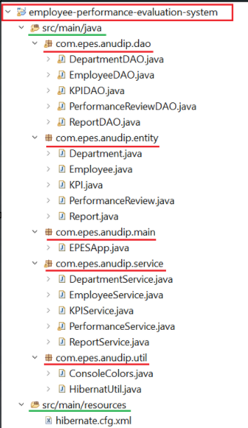
Project Architecture

Slide 9
Sample Workflow
1. Manager adds Department and Employees.
2. Defines KPIs.
3. Reviews employee KPIs every half year.
4. System generates scores and performance reports.
5. Manager views reports per employee or entire year.

Slide 10
Future Enhancements
Web-based frontend using Spring Boot + React
Manager login and authentication
Export reports to PDF
Graphical dashboards
Notification/email integration

Slide 11
Conclusion
The EPES system helps track and evaluate employee productivity using structured KPIs.
Built with clean modular architecture using Java and Hibernate.
Can be scaled and extended to enterprise-level web-based HR tools.

Slide 12
Thank You
Q&A / Discussion

