Slide 1
Student Result Management System
Built with HTML, CSS, JS, PHP, MySQL
Vijaya K | 21-May-25

Slide 2
Technologies Used
Frontend: HTML, CSS, JavaScript
Backend: PHP
Database: MySQL
Tools: XAMPP, phpMyAdmin, VS Code

Slide 3
Project Modules
Module | Description
Admin Login | Secure login for admin users
Admin Dashboard | Central panel to manage the system
Add Student | Add student records including class & email
Add Marks | Input subject-wise marks for each student
View/Edit/Delete Student | Admin can view a list of all students, update their details, or delete their record permanently
View Results | View and search results by roll number
Student Registration | Allow new students to register
Student Login | Students login using roll number/password
Student View Result | Students view their own results
Logout | log out from the system

Slide 4
Visual Flow Diagram
Admin: Login → Dashboard → Add Student/Marks →View/Edit/Delete Student → View Results → Logout
Student: Register → Login → View Result → Logout

Slide 5
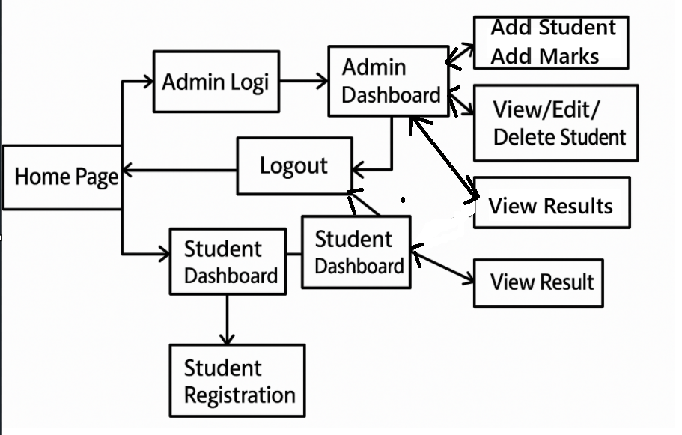
Visual Flow Diagram

Slide 6
Database Design
Tables: admin, students, marks
admin: id, username, password
students: id, roll_no, name, email, password, class
marks: id, roll_no, language1, language2, maths, science, social, total, grade
marks.roll_no is a foreign key referencing students.roll_no

Slide 7
Screenshots / Key Pages
Home Page
Admin Login Page
Admin Dashboard
Add Student Form
Add Marks Form
Student Login Page
Student Result View Page

Slide 8
Key Features
Secure login with hashed passwords
Search results by roll number
Modular layout using header/footer includes
Responsive design using Bootstrap
JavaScript form validation

Slide 9
Future Enhancements
Export results as PDF
Email result to student
Graphical result analysis
Student profile pictures
Admin analytics dashboard

Slide 10
Conclusion
The Student Result Management System provides a reliable and user-friendly way for schools and institutions to manage academic records.
✅ Secure admin and student login
✅ Easy marks entry and result viewing
✅ Reduces manual effort and improves accuracy
This system promotes transparency and efficiency in academic workflows.

