Slide 1
Product Management System
Spring Boot Project Overview
Prepared by Vijaya K

Slide 2
Project Overview
This is a Spring Boot based Product Management System.
It follows layered architecture using Controller, Service, Repository.

Slide 3
Problem Statement
Manual product management is inefficient and error-prone.
There is a need for a centralized system to manage products digitally
with CRUD operations and simple UI.

Slide 4
Features
• Add new products
• View product list
• Update product details
• Delete products
• REST API based backend
• Simple HTML + JS frontend

Slide 5
Technology Stack
Java 21
Spring Boot
Spring Data JPA
MySQL
HTML, CSS, JavaScript
Maven

Slide 6
Project Structure
controller - handles HTTP requests
service - business logic
repository - database access
model - entity classes
dto - data transfer objects

Slide 7
Frontend Resources
static folder
index.html
styles.css
app.js

Slide 8
Configuration
application.properties
Database and server configuration

Slide 9
API Flow Diagram
Browser UI
↓
Controller (ProductController)
↓
Service (ProductService)
↓
Repository (ProductRepository)
↓
MySQL Database

Slide 10
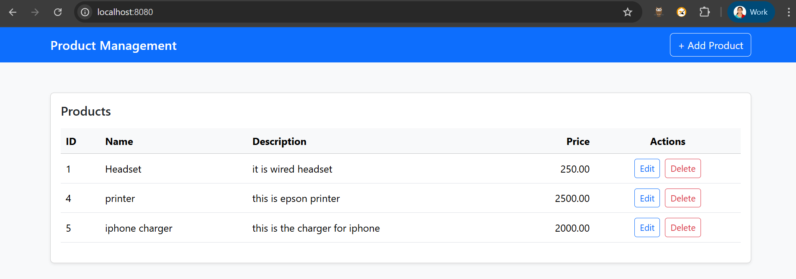
Browser UI – Product Management Dashboard

Slide 11
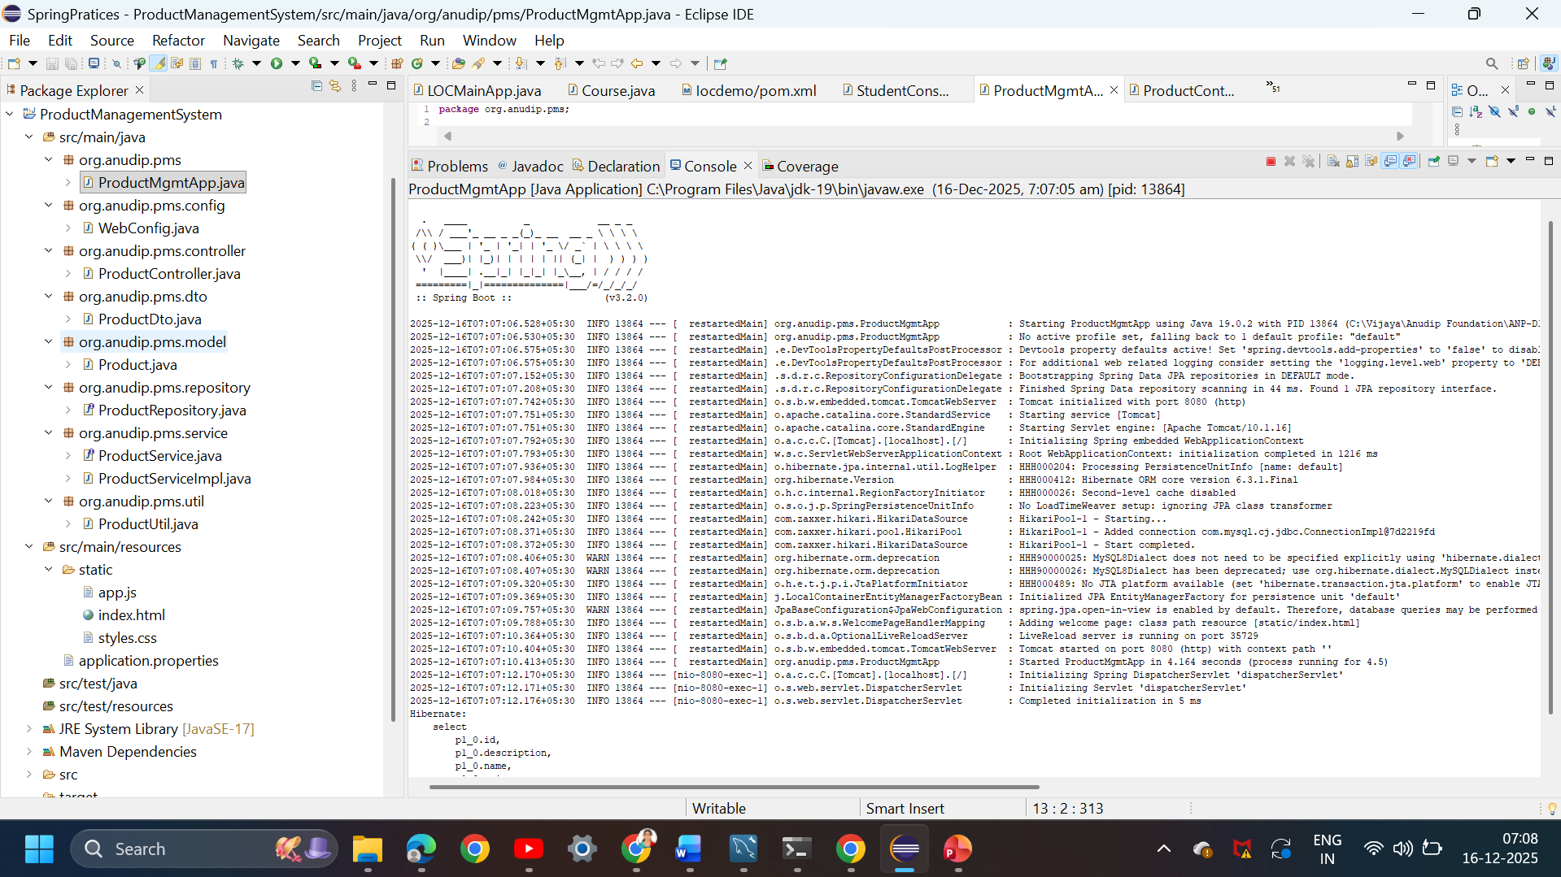
Spring Boot Application Running (Eclipse & Console Logs)

Slide 12
Future Enhancements
• User Authentication & Role Management
• Pagination & Search for Products
• REST API Security using JWT
• Cloud Deployment (AWS / Azure)
• CI/CD Integration using Jenkins
• Dockerization of Application
• Improved UI using React / Angular

Slide 13
Conclusion
Spring Boot simplifies backend development.
Layered architecture improves maintainability.
Project demonstrates real-time CRUD application.
Easy to maintain and scalable

