Slide 1
AUDIO CLASSIFICATION DEEPLEARNING
USING
NAME : VIJAYADHARSHINI S
NM-id : au711721243124
KGISL INSTITUTE OF TECHNOLOGY
3/21/2024 Annual Review

Slide 2
PROJECT TITLE
Audio classification using deeplearning
3/21/2024 Annual Review

Slide 3


AGENDA
This project aims to build a deep learning model for audio classification using the UrbanSound8K dataset. It involves extracting key features from audio files and training a model to classify them into predefined categories.
3/21/2024 Annual Review

Slide 4

PROBLEM STATEMENT
Automatically classifying urban sounds is crucial for urban planning, noise monitoring, and public safety. Yet, manual classification is time-consuming and subjective. Hence, an automated system is needed for accurate and efficient classification.
3/21/2024 Annual Review

Slide 5

PROJECT OVERVIEW
The project aims to create a deep learning model for classifying urban sounds like "car horn," "dog bark," "siren," etc. It includes preprocessing audio, feature extraction, neural network construction, training, and performance evaluation.
3/21/2024 Annual Review

Slide 6
WHO ARE THE END USERS?
The project's end users extend to urban planners, who utilize the classification of urban sounds to comprehend noise distribution across various regions, aiding in effective urban planning and zoning decisions. Environmental agencies rely on the model to monitor noise pollution levels, enabling them to implement targeted interventions to mitigate environmental impact.
3/21/2024 Annual Review

Slide 7

YOUR SOLUTION AND ITS VALUE PROPOSITION
Our solution entails crafting a precise deep learning model capable of categorizing urban sounds effectively by analyzing their audio features. This automated approach significantly reduces the time and effort required compared to manual classification methods. Furthermore, it offers real-time assessment of urban soundscapes, facilitating prompt responses to emergencies or unusual noise occurrences.
3/21/2024 Annual Review

Slide 8

THE WOW IN YOUR SOLUTION
The standout feature of our solution is its remarkable accuracy in classifying a diverse array of urban sounds with exceptional precision and recall. Its capacity to generalize effectively to new data and process information in real-time renders it a potent asset for urban sound analysis.
3/21/2024 Annual Review
8

Slide 9
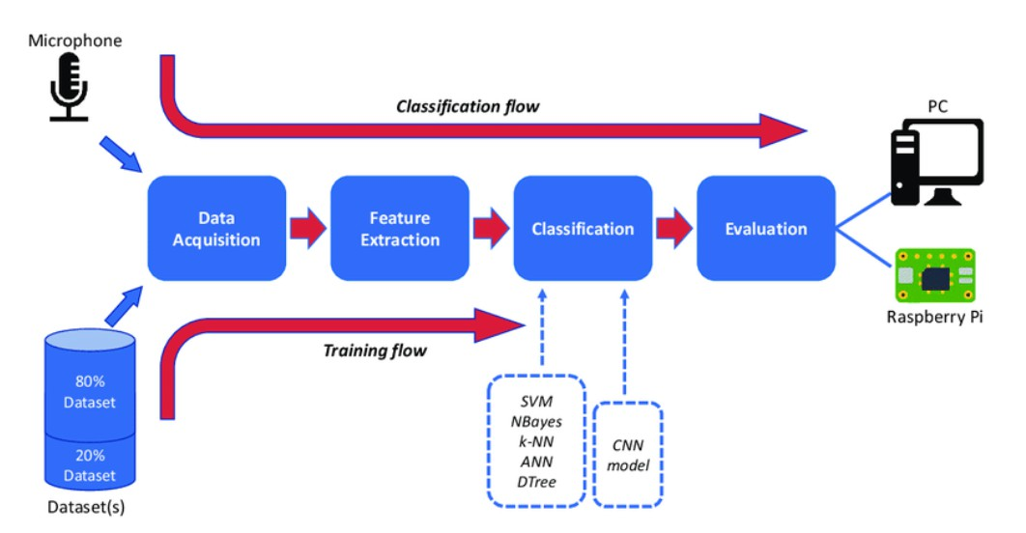
MODELLING
Description of the deep learning model architecture.
Explanation of model training and evaluation processes.
3/21/2024 A nual Review
9
n

Slide 10
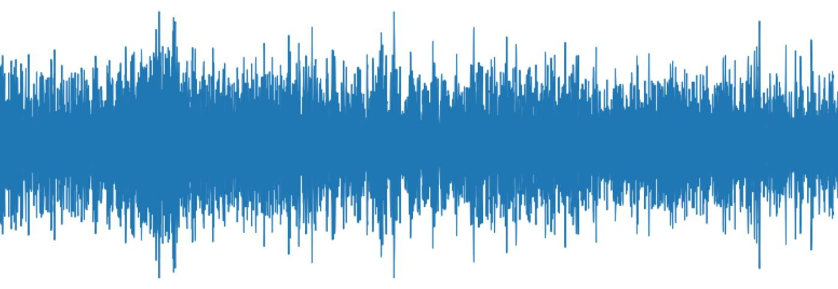
RESULTS
This project proposal outlines the objectives, target users, and key features of our audio classification solution for urban sounds. By addressing the problem of manual classification and providing an automated, efficient solution, our project aims to make a positive impact in urban planning, environmental monitoring, and public safety.
https://drive.google.com/file/d/1wUd-GBjsn0jGQIzZ4Yz82D0LpxLwagxM/view?usp=sharing
10

