Slide 1

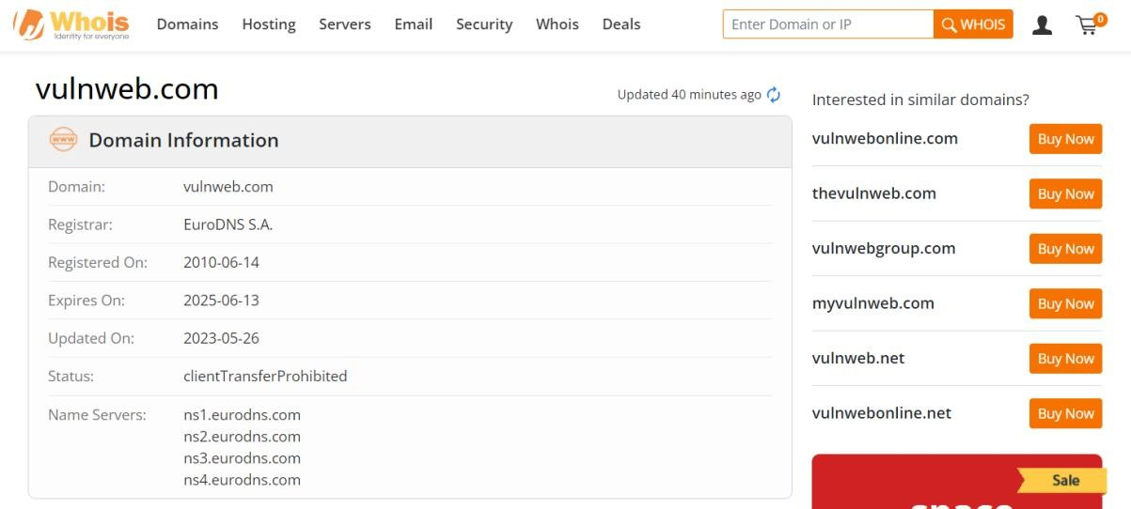
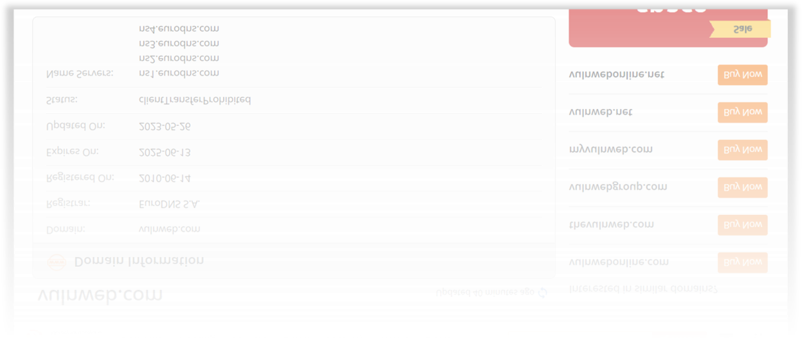
Information gathering in WHOIS
Domain Information
Registrant Contact

Slide 2
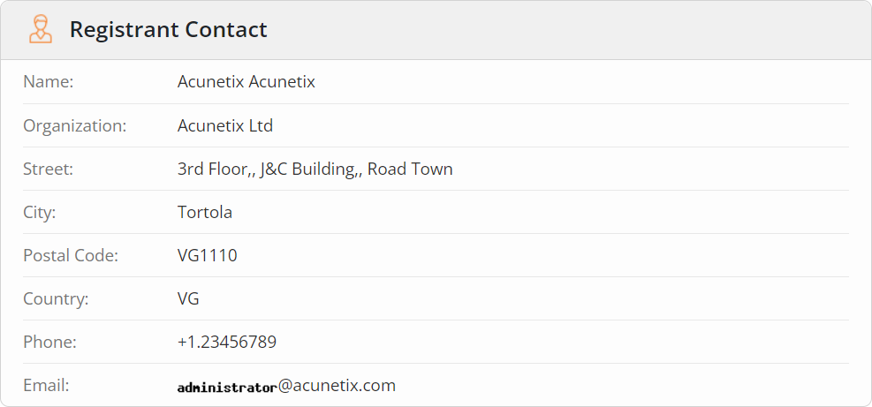
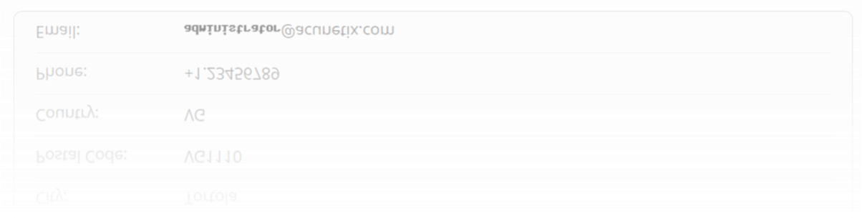
Administrative Contact

Slide 3
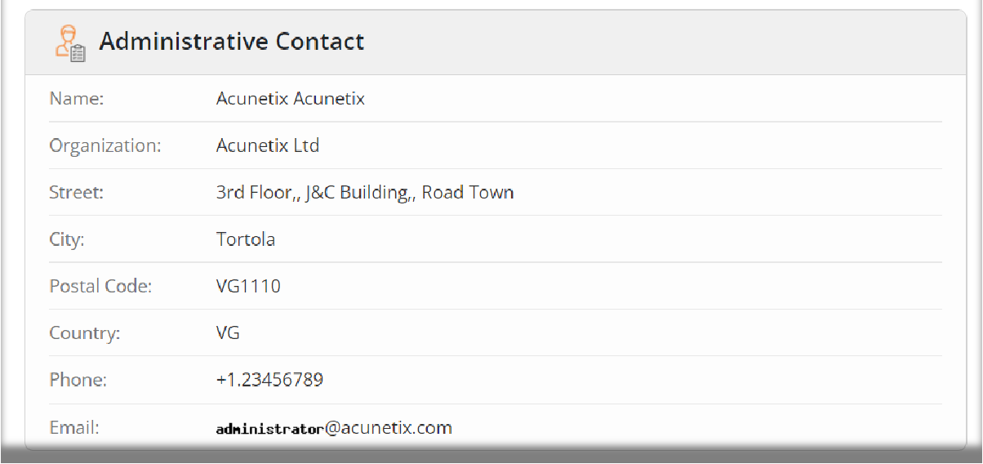
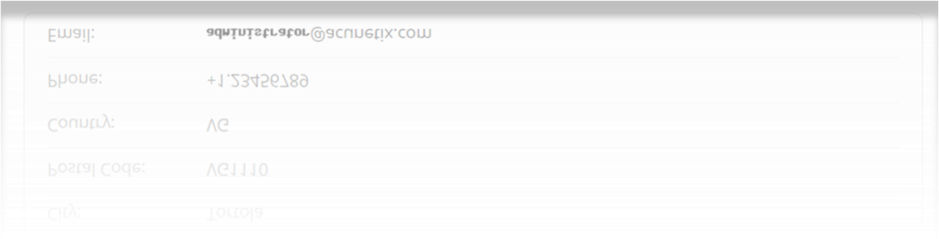
Technical Contact

Slide 4
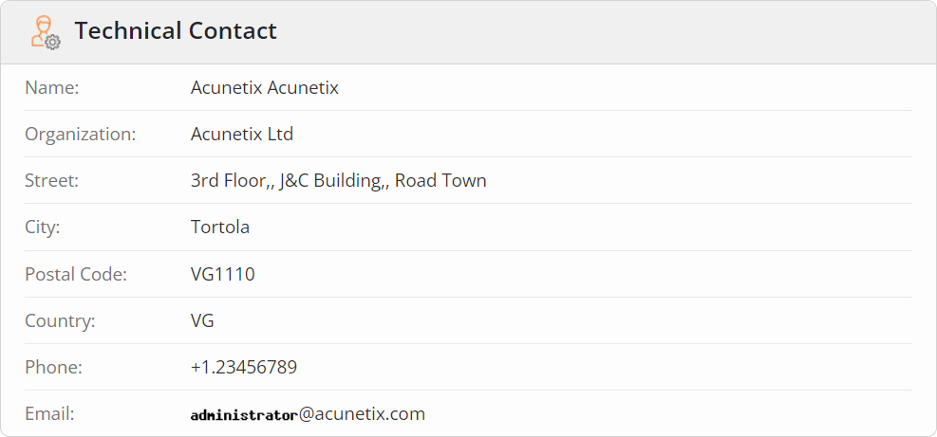
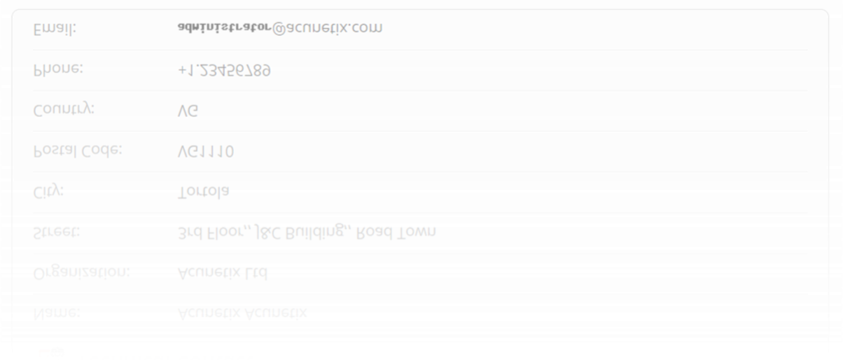
Raw Whois Data
Domain Name: vulnweb.com
Registry Domain ID: D16000066-COM
Registrar WHOIS Server: whois.eurodns.com Registrar URL: http://www.eurodns.com Updated Date: 2023-05-26T10:04:20Z
Creation Date: 2010-06-14T00:00:00Z
Registrar Registration Expiration Date: 2025-06- 13T00:00:00Z

Slide 5
Registrar: Eurodns S.A.
Registrar IANA ID: 1052
Registrar Abuse Contact Email: @eurodns.com
Registrar Abuse Contact Phone: +352.27220150
Domain Status: clientTransferProhibited http://www.icann.org/epp#clientTransferProhibit ed
Registry Registrant ID:
Registrant Name: Acunetix Acunetix Registrant Organization: Acunetix Ltd
Registrant Street: 3rd Floor,, J&C Building,, Road Town
Registrant City: Tortola
Registrant State/Province: Registrant Postal Code: VG1110 Registrant Country: VG Registrant Phone: +1.23456789 Registrant Fax:
Registrant Email:
@acunetix.com
Registry Admin ID:
Admin Name: Acunetix Acunetix

Slide 6
Admin Organization: Acunetix Ltd
Admin Street: 3rd Floor,, J&C Building,, Road Town
Admin City: Tortola Admin State/Province:
Admin Postal Code: VG1110
Admin Country: VG
Admin Phone: +1.23456789
Admin Fax:
Admin Email:
@acunetix.com
Registry Tech ID:
Tech Name: Acunetix Acunetix Tech Organization: Acunetix Ltd
Tech Street: 3rd Floor,, J&C Building,, Road Town
Tech City: Tortola Tech State/Province:
Tech Postal Code: VG1110 Tech Country: VG
Tech Phone: +1.23456789 Tech Fax:
Tech Email: @acunetix.com
Name Server: ns1.eurodns.com

Slide 7

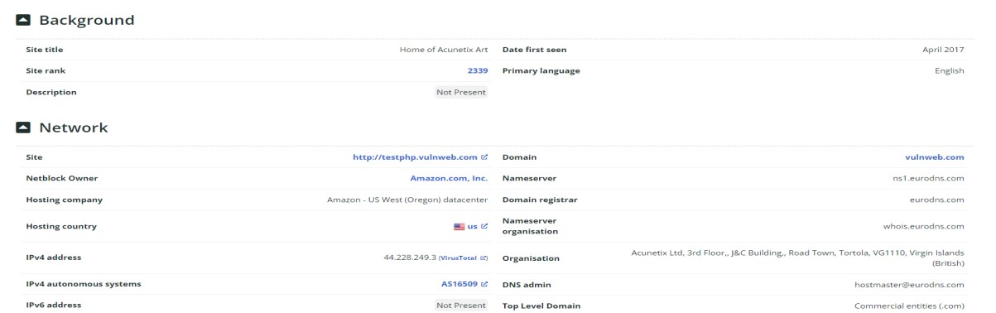
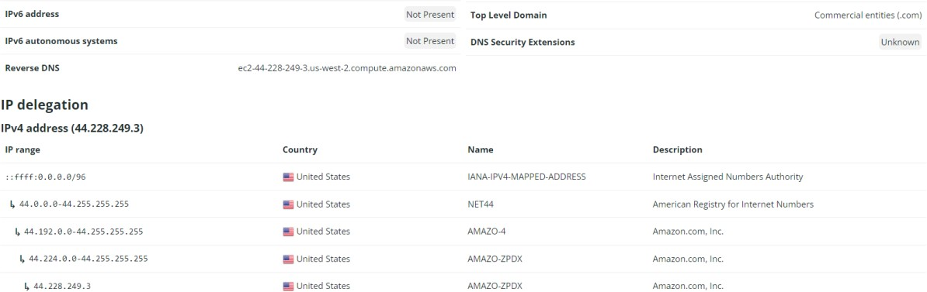
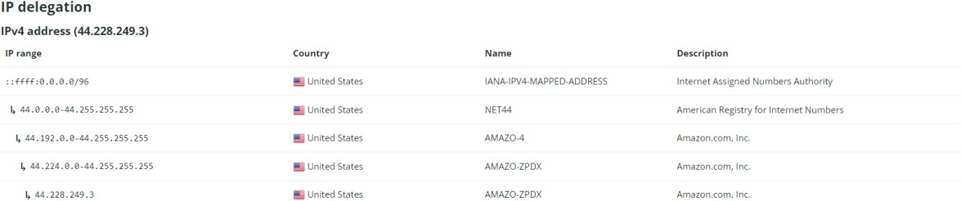
Name | Server: | ns2.eurodns.com
Name | Server: | ns3.eurodns.com
Name | Server: | ns4.eurodns.com
DNSSEC: unsigned

Slide 8
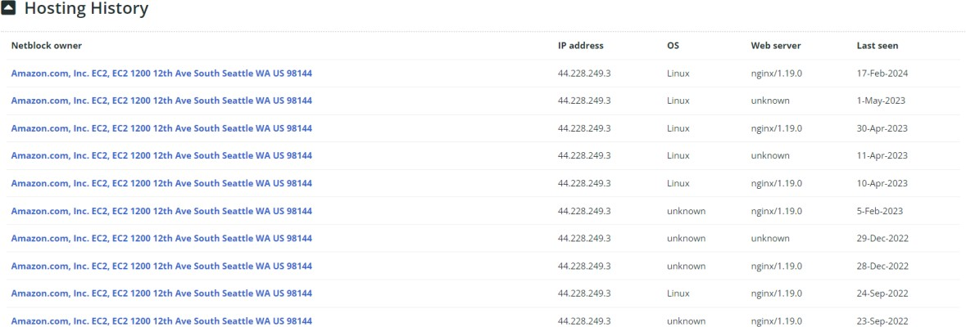
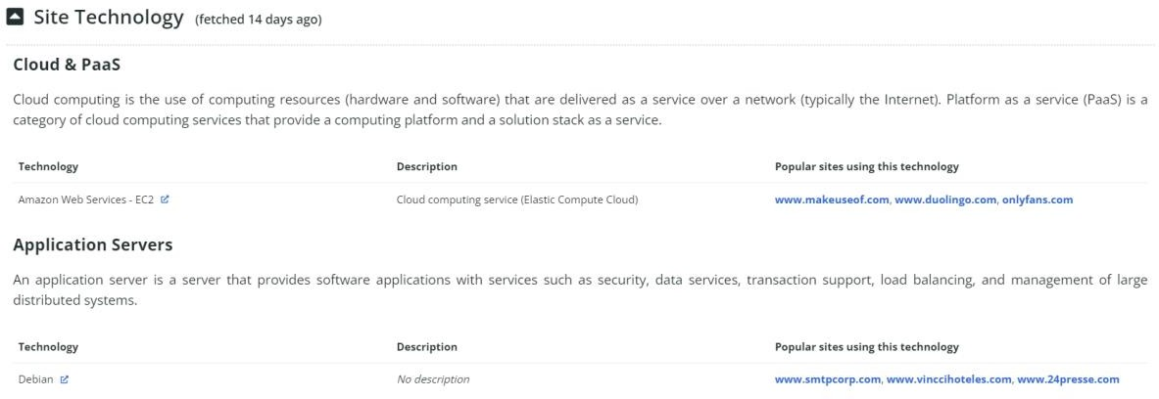
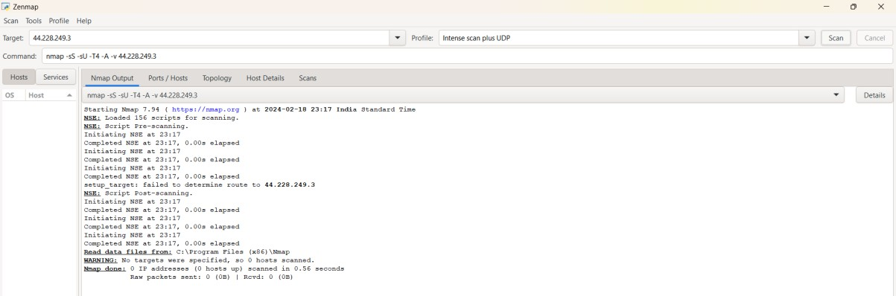
Using Nmap Tool
Intense Scan

Slide 9
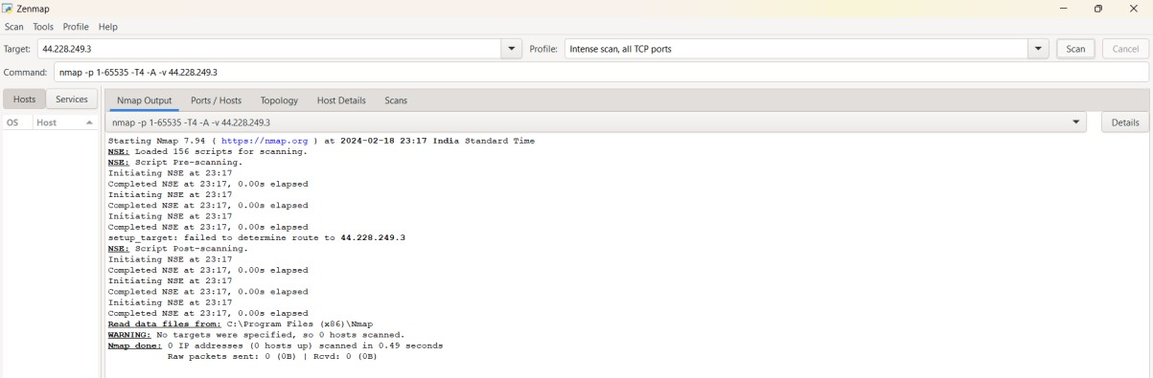
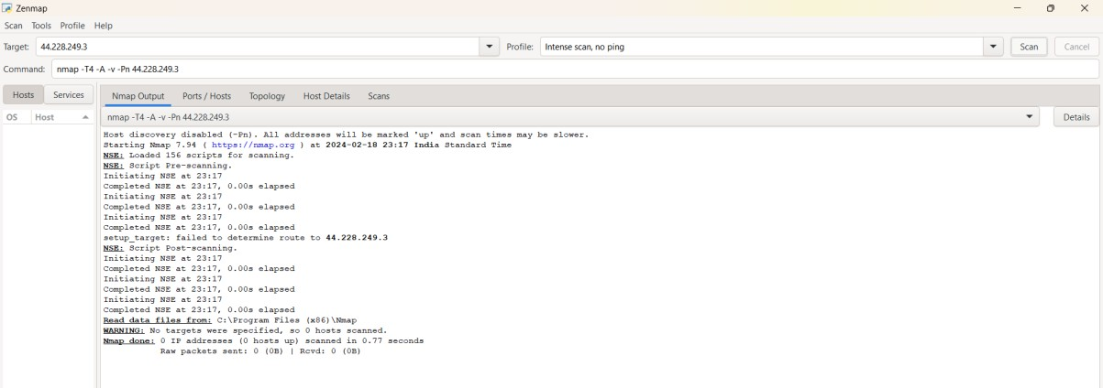
In Kali linux Nmap

Slide 10
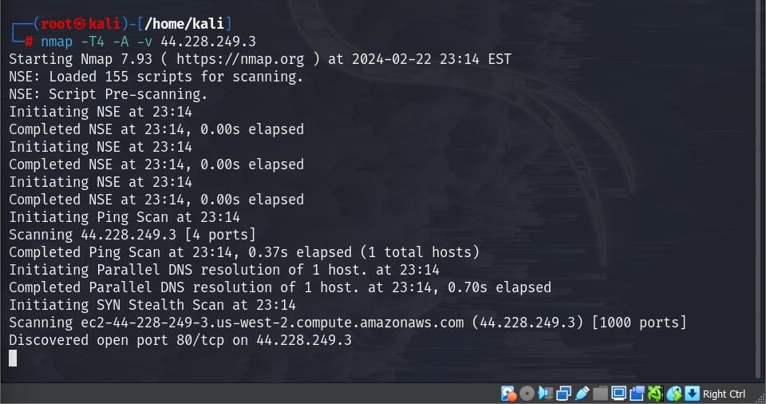
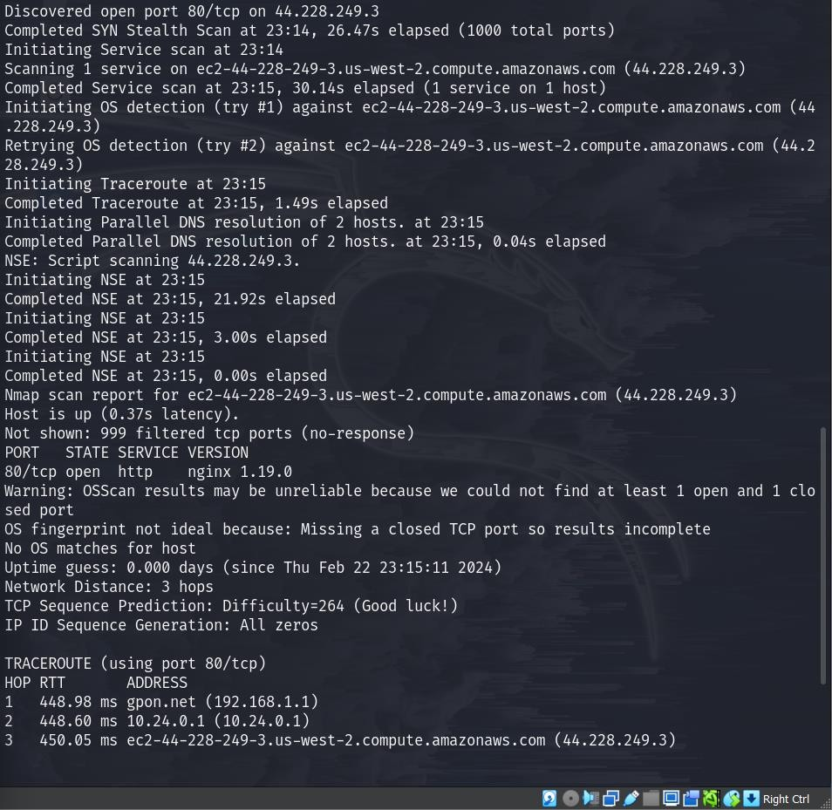

Slide 11
