Slide 1
VIJAYA MEGHANA TETALI
FINAL PROJECT

Slide 2
PROJECT TITLE:-
KEY LOGGER AND SECURITY

Slide 3

AGENDA
Introduction
Problem Statement
Project Overview
End Users
Solution & Value its Proposition
WOW in the solutions
Modelling
Results
Conclusion

Slide 4
INTRODUCTION
A Keylogger, also known as a keystroke logger , is like a silent observer in the digital world .
Imagine it as a tiny spy sitting inside your keyboard, meticulously recording every key
you press.
Whether you’re typing a heartfelt email, entering a password, or crafting a code snippet,
the keylogger diligently notes it all.

Slide 5


PROBLEM STATEMENT
A keylogger is a software or hardware tool that secretly records every keystroke made on a computer or mobile device.
Its primary purpose is to monitor and capture the keys pressed on a keyboard, including letters, including letters, numbers, symbols, and special characters .
Keyloggers can be used for legitimate purposes

Slide 6
PROJECT OVERVIEW
Develop a comprehensive understanding of keyloggers, their type , how to work , and effective security measures to prevent keylogging attacks.
Scope:
Development Phase:
Design and implement a basic keylogger using programming languages and libraries.
Testing Phase:
Test the keylogger in a controlled environment to evaluate its functionality.
Analysis Phase:
Analyze the captured data to understand the keylogger’s effectiveness.

Slide 7
END USERS
End Users are the individuals within an organization who regularly engage with digital platforms, applications, and devices . They play a crucial role as the first line of defense against cyber threats.
Organizations : Companies and institutions that need to ensure compliance with usage policies, enhance security, and monitor employee productivity.
System Administrators: IT professionals responsible for managing and securing computing environments within an organization.

Slide 8

SOLUTION AND ITS VALUE PROPOSITION
Creation for Educational and Defensive Purposes:
Purpose: An ethical keylogger is designed to be used as a tool for educational and defensive cybersecurity purposes.
Educational Use:
Demonstrates how keyloggers operate, providing insights into their mechanisms and behaviors.
Defensive Use:
Assists in developing robust security measures by understanding potential vulnerabilities exploited by malicious keyloggers.
Defensive Strategies:
Building Resilience:
Helps in creating more resilient security systems by knowing the tactics and techniques used by attackers.
Enhanced Detection:
Contributes to the development of advanced detection tools and methods to identify and neutralize keyloggers.

Slide 9
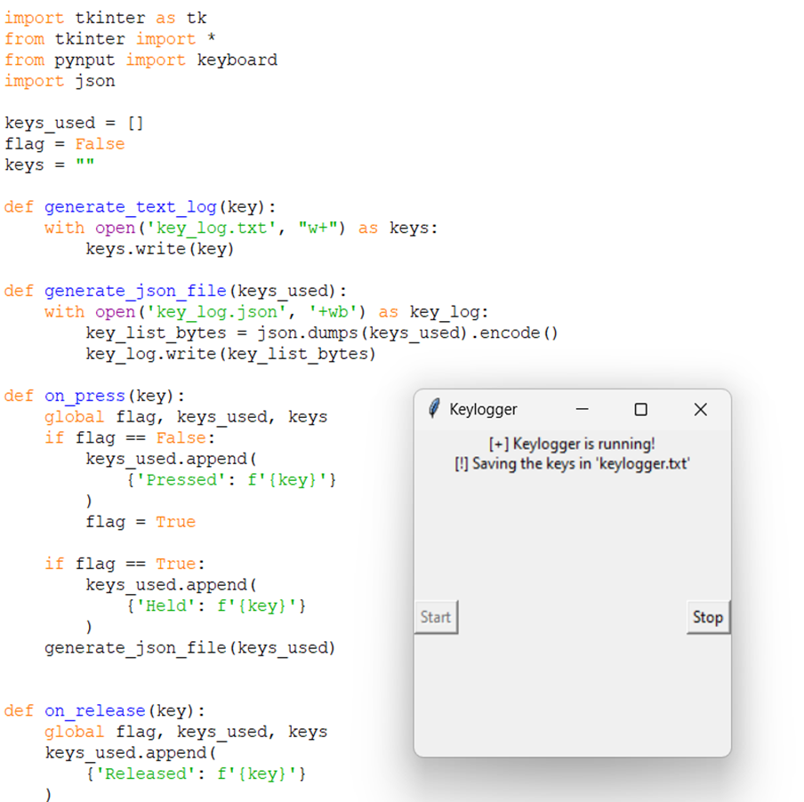
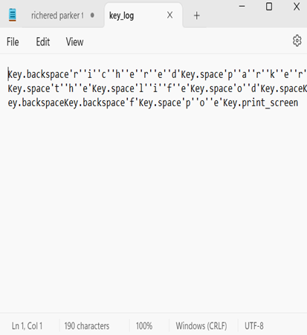
THE WOW IN OUR SOLUTION
STEPS:
1.User input Device (keyboard)
2.Keylogger (software/Hardware)
3.Data capture Module
4. Data Storage Module
5.Data Transmission module (for remote keyloggers)
6.Attacher’s Server

Slide 10
RESULT
The keyloggers captures and logs keystrokes in real – time ,successfully
Displaying them in the user interface.
Performance metrics show minimal system impact and secure data transmission to the server.
Keyloggers can be used for legitimate purposes , such as employee monitoring , but they are often associated with malicious activities like identify theft, financial fraud

Slide 11
THANKYOU
GITHUB LINK:-
https://github.com/VijayaMeghanaT/finalproject.git

