Slide 1


Slide 2
LangChain

Slide 3


LangChain
Welcome the course!
Please make sure you’ve read the very first lecture in the course, which is an article with links to the .zip file of notebooks as a resource and has links to the Google Slides for the course.
In this lecture we’ll give you a brief overview of the course and how it relates to LangChain, then we’ll dive right into coding components with LangChain!

Slide 4
LangChain
Why LangChain?
LangChain is a framework for developing applications that are powered by Large Language Models, such as OpenAI’s GPT models or Google’s PaLM-2 or Gemini LLMs.
The framework does this through the use of Modules (also sometimes referred to as Components).

Slide 5
LangChain
Why LangChain?
The best way to understand the benefits of LangChain is to understand these Components and how the work together to make it easier to build robust LLM based Applications.
Let’s explore the main ideas of the modules in relation to the course.

Slide 6
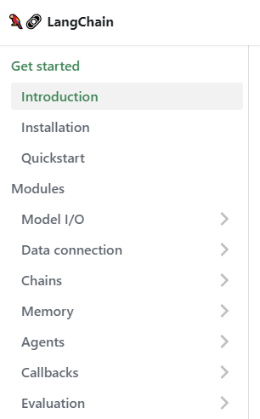
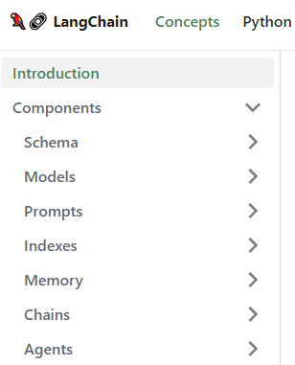
LangChain
LangChain - Modules or Components?
?

Slide 7
LangChain
LangChain - Modules or Components?
Python Documentation:
https://python.langchain.com/
General Documentation:
https://docs.langchain.com/docs/
JS/TS Documentation:
https://js.langchain.com/docs/get_started/introduction/
Don’t be surprised if some links between General Docs and Python Docs are a 404!

Slide 8
LangChain
Course Structure
This course is designed to slowly build up to understanding LangChain Agents, which are extremely powerful LLM based applications that allow you to perform complex tasks and allow an LLM to perform actions (Wikipedia Search, use a Calculator, etc…).
Agents themselves only require a few lines of code, but jumping straight to Agents can result in confusion about LangChain!

Slide 9
LangChain
Course Structure
Advanced users may then try to learn LangChain on their own, starting at Model IO, and then be confused on what benefits LangChain provides versus the default APIs.
This course trys to frame the modules in a way where their individual utility is clear, along with their “synergies” once you understand multiple modules!

Slide 10
LangChain
LangChain Course Sections
MODEL IO
DATA
CONNECTION
CHAINS
MEMORY
AGENTS

Slide 11
LangChain
LangChain Course Sections
Model IO focuses on basic LLM inputs and outputs. This replicates a lot of the functionality already present in default APIs, such as the OpenAI API.
LangChain Advantage:
Model IO is standardized, allowing you to easily switch between LLMs in the future and supports both Text Completion APIs and Chat Interface APIs.
MODEL IO

Slide 12
LangChain
LangChain Course Sections
Data Connection focuses on connecting an LLM Model to a data source, such as your own documents or a vector store.
LangChain Advantage:
Easily swap vector stores (ChromaDB).
Integrate with many different data sources to create standardized document objects from a variety of sources (CSVs, PDFs, AWS, Google Cloud, etc…).
DATA
CONNECTION

Slide 13
LangChain
LangChain Course Sections
Chains allows you to link the output of one model to be the input of another model call.
LangChain Advantage:
Easily chain together different LLM calls to separate out work between models, allowing you to swap LLMs in the middle of a chain easily.
CHAINS

Slide 14
LangChain
LangChain Course Sections
Memory allows your models to retain historical context of previous interactions.
LangChain Advantage:
Easily save historical conversations or results from LLMs or Chat Models and reload them for future use.
MEMORY

Slide 15
LangChain
LangChain Course Sections
Agents are the most powerful part of LangChain. Utilizing Models, Data Connections, Chains, and Memory, Agents can use tools to reason through requests and perform actions based on observational outputs.
LangChain Advantage:
Create agents and custom tools with just a few lines of code!
AGENTS

Slide 16
LangChain
Thoughts to keep in mind about LangChain:
Users new to LangChain may find themselves confused or frustrated because they only interact with one module and sometimes miss the larger picture of how they interact.
This course is meant to guide you step-by-step to see how all the modules work together, meaning you’ll want to take the course in order (don’t just jump straight to Agents, even though they are very cool!).

Slide 17
Let’s get started!

