Slide 1


Slide 2
Data Connections

Slide 3


LangChain
It’s time to learn how to connect our Models to data sources.
In this section we’ll explore how to load documents, transform them to vector embeddings, and then store and query those vector embeddings.

Slide 4
LangChain
Section Overview:
Document Loading and Integrations
Document Transformers
Text Embedding
Vector Stores
Queries and Retrievers

Slide 5
Let’s get started!

Slide 6
Document Loaders

Slide 7
LangChain
Langchain comes with built-in loader tools to quickly load in files to its own Document object.
Note that many of these loaders require other libraries, for example PDF loading requires the pypdf library and HTML loading requires the Beautiful Soup library. Make sure to pip install the required libraries before using the loader (the loaders will inform you if they can’t find the installed libraries)

Slide 8
Document
Integrations

Slide 9
LangChain
Document Loaders labeled as “integrations” can essentially be thought of as the same as normal document loaders, but they are integrated with some specific 3rd party, such as Google Cloud or even a specific website, like Wikipedia.
Let’s explore an integration to grab a document and then use that document with a model.

Slide 10
Let’s get started!

Slide 11
Document Loading
Exercise

Slide 12
Document Loading
Exercise Solution

Slide 13
Document
Transfomers

Slide 14
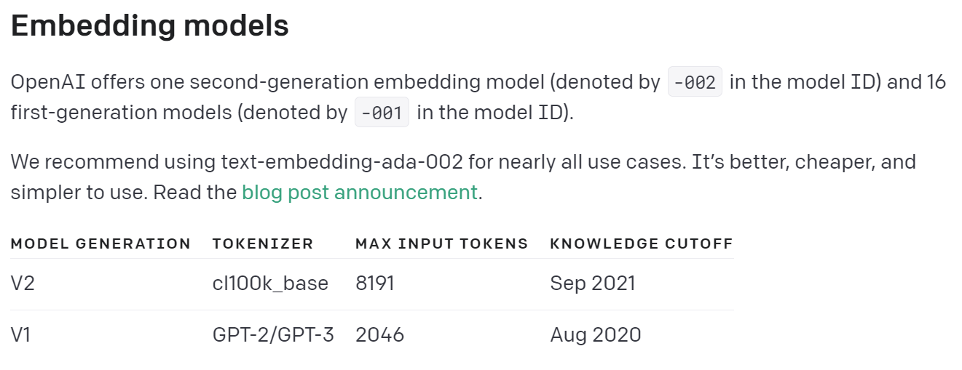
LangChain
Notice that after you load a Document object from a source, you end up with strings by grabbing them from page_content.
In certain situations, the length of the strings may be too large to feed into a model, both embedding and chat models.

Slide 15
LangChain
Langchain provides Document Transformers that allow you to easily split strings from Document page_content into chunks.
These chunks will then later serve as useful components for embeddings, which we can then look up using a distance similarity later on.
Let’s explore the two most common splitters:
Splitting on a Specific Character
Splitting based on Token Counts

Slide 16
Text Embeddings
with Langchain

Slide 17
LangChain
Langchain supports many text embeddings, that can directly convert string text to an embedded vectorized representation.
Later on we can store these embedding vectors and then perform similarity searches between new vectorized documents or strings against or vector store.

Slide 18
LangChain
Documentation for different integrations can be found here:
python.langchain.com/docs/modules/data_connection/text_embedding/integrations/openai
We will use the OpenAI Embeddings since that is one of the most popular.

Slide 19
LangChain
Important Note:
Choose your initial embedding model carefully!
Different embedding models can not interact with each other, meaning you would need to re-embed an entire set of documents if you were to switch embedding models in the future!

Slide 20
Vector Store

Slide 21
LangChain
We just learned how to take documents and strings and embed them into vectors.
In the previous lecture however, we just had these embeddings in memory as a Python list, how can we make sure these embeddings persist to some more permanent storage solution?
For this, we use a vector store, otherwise known as a vector database.

Slide 22
LangChain
Vector Store Key Attributes:
Can store large N-dimensional vectors.
Can directly index an embedded vector to its associated string text document.
Can be “queried”, allowing for a cosine similarity search between a new vector not in the database and the stored vectors.
Can easily add, update, or delete new vectors.

Slide 23
LangChain
Vector Store Integrations:
Just like with LLMs and Chat Models, Langchain offers many different options for vector stores!
We will use an open-source and free vector store called Chroma, which has great integrations with Langchain.
Feel free to use an alternative you find in the documentation under Vector Store Integrations.

Slide 24
Vector Store Retriever

Slide 25
LangChain
As we begin to link Langchain objects, there are times when we need to pass in Vector Stores as retriever objects, which can be easily done via a as_retriever() method call.
Let’s quickly see what this looks like from the Chroma DB connection in the previous lecture.

Slide 26
MultiQuery Retriever

Slide 27
LangChain
Sometimes the documents in your vector store may contain phrasing that you are not aware of, due to their size. This can cause issues in trying to think of the correct query string for similarity comparisons.
We can use an LLM to generate multiple variations of our query using MultiQueryRetriever, allowing us to focus on key ideas rather than exact phrasing.

Slide 28
Context Compression

Slide 29
LangChain
We just saw how to leverage LLMs to expand our queries, now let’s explore how to use LLMs to “compress” our outputs (similar documents being returned).
Previously we returned the entirety of the vectorized document. Ideally we would pass this document as context to an LLM to get a more relevant (compressed) answer.

Slide 30
LangChain
Note:
We are not performing compression in the traditional sense, instead we are using an LLM to grab a larger document text output and “distill” it to a smaller and more relevant output.
Let’s explore an example of this!

Slide 31
Data Connections
Exercise

Slide 32
Data Connections
Exercise Solution

