Slide 1


Slide 2
Memory

Slide 3


LangChain
In this section we’ll briefly show you the memory options LangChain provides.
When LangChain refers to the term “memory”, they are usually referring to keeping track of message interaction history.

Slide 4
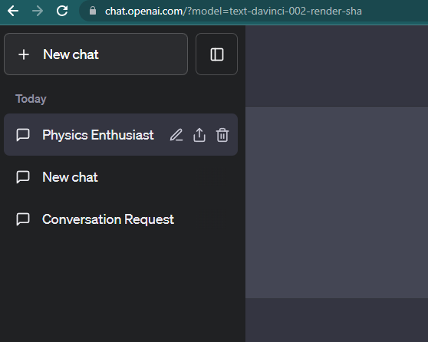
LangChain
You can think of this as analogous to ChatGPT being able to store a “memory” of your prior conversations by tracking Human Inputs and AI Outputs:

Slide 5
LangChain
LangChain provides a few different options for storing a conversation memory:
Storing all messages
Storing a limited number of interactions
Storing a limited number of tokens

Slide 6
LangChain
LangChain provides a few different options for storing a conversation memory:
Storing all messages
Storing a limited number of interactions
Storing a limited number of tokens
It also comes with specialized chains that store a memory with other transformations, such as a vector store or auto-summarizing conversations.

Slide 7
LangChain
Memory Section:
ChatMessageHistory
ConversationBufferMemory
ConversationBufferWindowMemory
ConversationSummaryMemory

Slide 8
ChatMessageHistory

Slide 9
ConversationBufferMemory

Slide 10
ConversationBuffer
WindowMemory

Slide 11
ConversationSummary
Memory

