Slide 1
GLOBAL ELECTRONICS DATA ANALYTICS TEAM

Slide 2
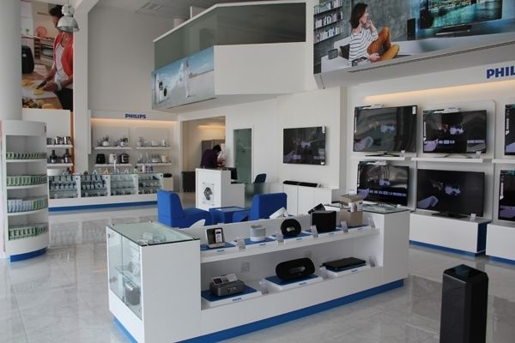
Global Electronics Data Analysis and Recommendations
Global Electronics, a leading retailer of consumer electronics, has provided us with several datasets containing information about their customers, products, sales, stores, and currency exchange rates. The company seeks to leverage this data to better understand their business and identify areas for improvement.
The aim is to conducting a comprehensive Exploratory Data Analysis (EDA) to uncover valuable insights from the company’s data.The goal is to provide actionable recommendations that can enhance customer satisfaction, optimize operations, and drive overall business growth.

Slide 3
Customer Analysis
Demographic Distribution :-
Most people are from United States followed by United Kingdom, Germany etc...
Least people are from France followed by Netherlands, Italy, Australia, Canada etc..
Majority of people are from North America and Europe continents.
According to Age and Gender people distributed uniformly across all states and countries.
Purchase Patterns :-
Average Order Value across States,Countries and Continets are almost Same.
Frequency of Purchases are more in last Quarter and less in Second Quarter.
Movie DVD, Desktops and Bluetooth Headphones are most prefered products and Air Conditioners, Lamps and Washers and Dryers are least preferred.

Slide 4
Sales Analysis
Different versions of WWI Desktop PC and Adventure Works Desktop PC products are sold most.
Lamps, Fans, Chandiliers, Car Video, Washers & Dryers and AirConditioners are least sold.
Different versions of WWI Desktop PC and Adventure Works Desktop PC products are generating more Revenue.
Data Cables, Charge Cables, Batteries, Case fans,Tablet Pens are generating least Revenue.
Most sales happened from California Store followed by Texas, Ontorio, NewYork, Freistaat Bayern etc...
Brighton and Hove, Tameside, Prato, Wyre, Lanarkshire state stores had least sales.
Most sales happened from United States Stores# France, Netherlands,Italy etc.. countries stores had least sales.

Slide 5
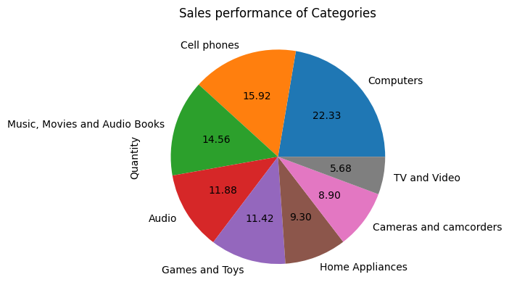
Product Analysis
Adventure Works Desktop PC2.33 XD233 Black, WWI Desktop PC2.33 X2330 Black, Adventure Works Desktop PC2.33 XD233 Silver, Adventure Works Desktop PC2.33 XD233 Brown, WWI Desktop PC2.33 X2330 Brown are producing more profits
SV USB Data Cable E600 Black, SV USB Data Cable E600 Pink, SV USB Sync Charge Cable E700 Silver, SV USB Data Cable E600 Grey, SV USB Data Cable E600 Silver are producing least profits
Movie DVD, Desktops and Bluetooth Headphones are most sold products and Air Conditioners, Lamps and Washers and Dryers are least sold products.
Computers Category is most performed according to sales followed by Cell phones, Music, Movies and Audio Books etc...
TV and Video is least performed according to sales followed by Cameras and camcorders and Home Appliances etc...

Slide 6
Store Analysis
Wyoming, Hawai, Alaska, New Hampshire etc... had high performance based on Sales and area of stores and Northern Territory, Caltanissetta, Tasmania etc.. had least performance based on Sales and area of stores.
Iowa, Hawai, Nunavut, Nebraska etc... had high performance based on Sales and years of establishment of stores and Northern Territory, Franche-ComtÃ© ,Martinique etc.. had least performance based on Sales and years of establishment of stores.
Iowa, Alaska, Nebraska etc... had high performance based on Total Profit and years of establishment of stores and Northern Territory, Franche-ComtÃ© ,Martinique etc.. had least performance based on Total Profit and years of establishment of stores.
Wyoming, Alaska, Hawai etc... had high performance based on Total Profit and Area of stores, Northern Territory, Caltanissetta ,Fermanagh etc.. had least performance based on Total Profit and Area of stores

Slide 7
Exchange Rate Analysis
By neglecting other factors Sales decreased when the USD gets stronger(Dollor Rate increased) and Decreased when USD gets weaker.
USD is not affecting the Sales.So, we focus more on other currencies to analyze the Sales.

Slide 8
Recommendations To Improve Business
Offers to be given on the Brand Products with less Sales to increase their Sales and reduce their storage.
Majority of the Sales happened in Home Appliances and Computers. So the Products of these categories with new technology to be increased.
Average Order value is uniform across all states and countries.So, may business can expand to other states and countries also.
Frequency of Purchases are more in last Quarter and less in Second Quarter. So, campaigns to be increased last quarter of the year and Offers have to be given in Second Quarter.
We have to do better inventory management on most frequent purchased Products and Least purchased products.
Different versions of WWI Desktop PC and Adventure Works Desktop PC products are generating more Revenue. So, the margin Percentage may increase to increase profits.
Data Cables, Charge Cables, Batteries, Case fans, Tablet Pens are generating least Revenue. So, the margin Percentage may decrease to sell fastly.

Slide 9
Recommendations To Improve Business
The States generating more revenue, we should expand business like opening more stores and outlets.
-- We have to do cost cutting in less performing states.
-- Stores performing more Sales with less area are to be expanded and performing less Sales with more area, the part of them are to be used for some other purposes to generate some revenue.
-- The old stores with more sales are to be rennovated for customer satisfaction.
-- Margin rate will be increased if the USD value decreased and offers have to be given when USD value increases.

