Slide 1



M.TECH CSE (AI & ML) PROJECT PRESENTATION
SpamShield AI
Machine Learning-Based SMS Spam Detection and Evaluation
Group Members
ADITYA BANERJEE(MT/AI/10006/26)
SUMIT SHARMA(MT/AI/10031/26)

Slide 2
Problem Definition
Challenges in SMS Spam Detection
Key Challenges
Unwanted Messages: Promotional SMS and misleading offers clutter users' inboxes.
Potential Security Risks: Phishing attempts and suspicious links may deceive users.
Manual Screening: Checking messages individually is time-consuming.
Ambiguous Text: Short messages can be difficult to classify from their wording alone.
  Different Message Patterns: Spam and legitimate messages may use similar words.
  Classification Errors: Spam may be missed, or genuine messages may be flagged.
  Imbalanced Data: Legitimate messages greatly outnumber spam messages in our dataset.
  Reliable Evaluation: Accuracy alone may not reveal how effectively spam is detected.

Slide 3
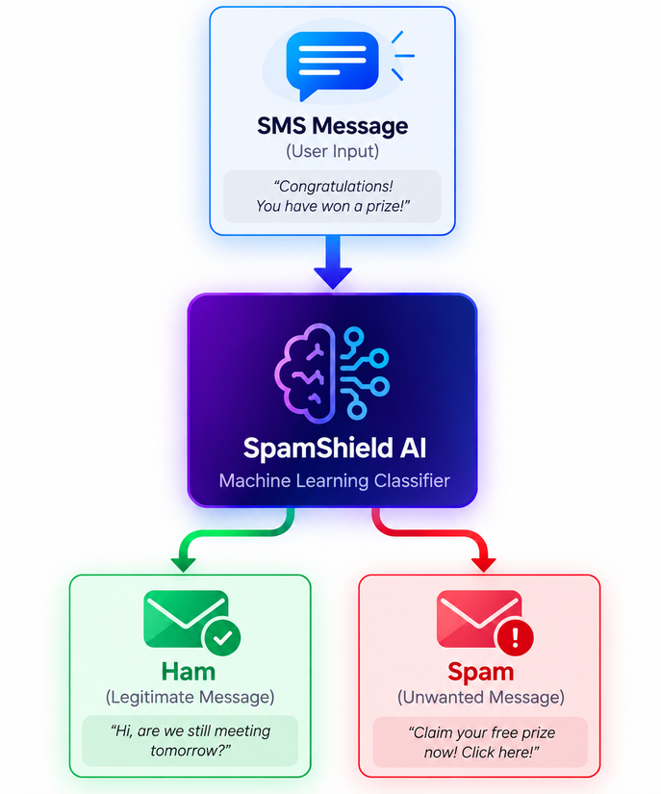
Proposed Solution
1. Automated SMS Classification
Classify incoming SMS messages as Ham (legitimate) or Spam.
2. Machine Learning-Based Detection
Train and compare three classifiers: Naive Bayes, Logistic Regression, and Linear SVM using TF-IDF features.
3. Multi-Metric Performance Evaluation
Compare the classifiers using Accuracy, Spam Recall, Macro-F1, Balanced Accuracy, and Matthews Correlation Coefficient (MCC).
4. Explainable Predictions & Model Comparison
Display spam probability estimates, compare predictions across models, and highlight agreement or disagreement between classifiers.
5. Error Analysis
Inspect false positives and false negatives to understand misclassifications and identify potential weaknesses.
6. Interactive Prototype
Provide a Streamlit interface for live SMS detection, model evaluation, dataset exploration, and prediction analysis.
Objective: Identify the best-performing classifier and investigate whether evaluation metrics change the model ranking.

Slide 4

Research Question & Hypothesis
RESEARCH QUESTION
Does the choice of evaluation metric change which machine learning model appears best for SMS spam detection?
Alternate Hypothesis
Null Hypothesis
Different evaluation metrics may rank classifiers differently, particularly on an imbalanced datasett.
The choice of evaluation metric does not change the ranking of the classifiers.
Evaluation Metrics
Accuracy
Spam Recall
Macro F1
Balanced Accuracy
MCC

Slide 5
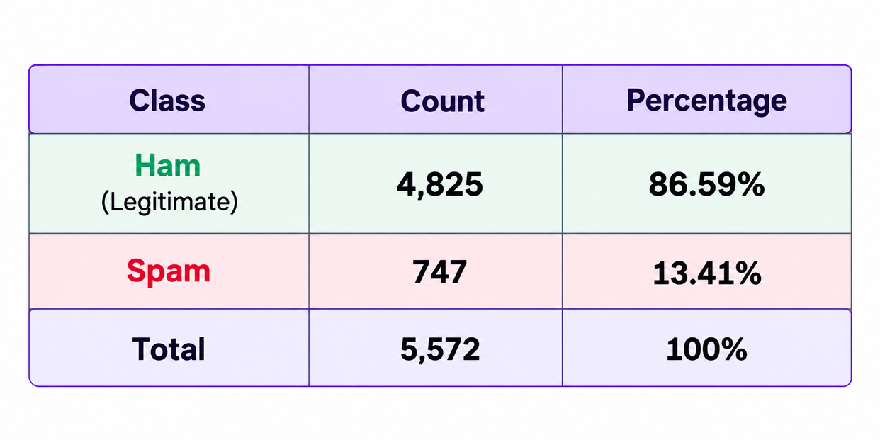

Dataset & Class Distribution
SMS Spam Collection
Source: UCI Machine Learning Repository
Task: Binary text classification — Ham vs. Spam
Records: 5,572 SMS messages
Dataset Class Distribution
Dataset Source: UCI Machine Learning Repository
Link
Key Observation
The dataset is imbalanced: legitimate messages substantially outnumber spam messages, making minority-class evaluation important.

Slide 6
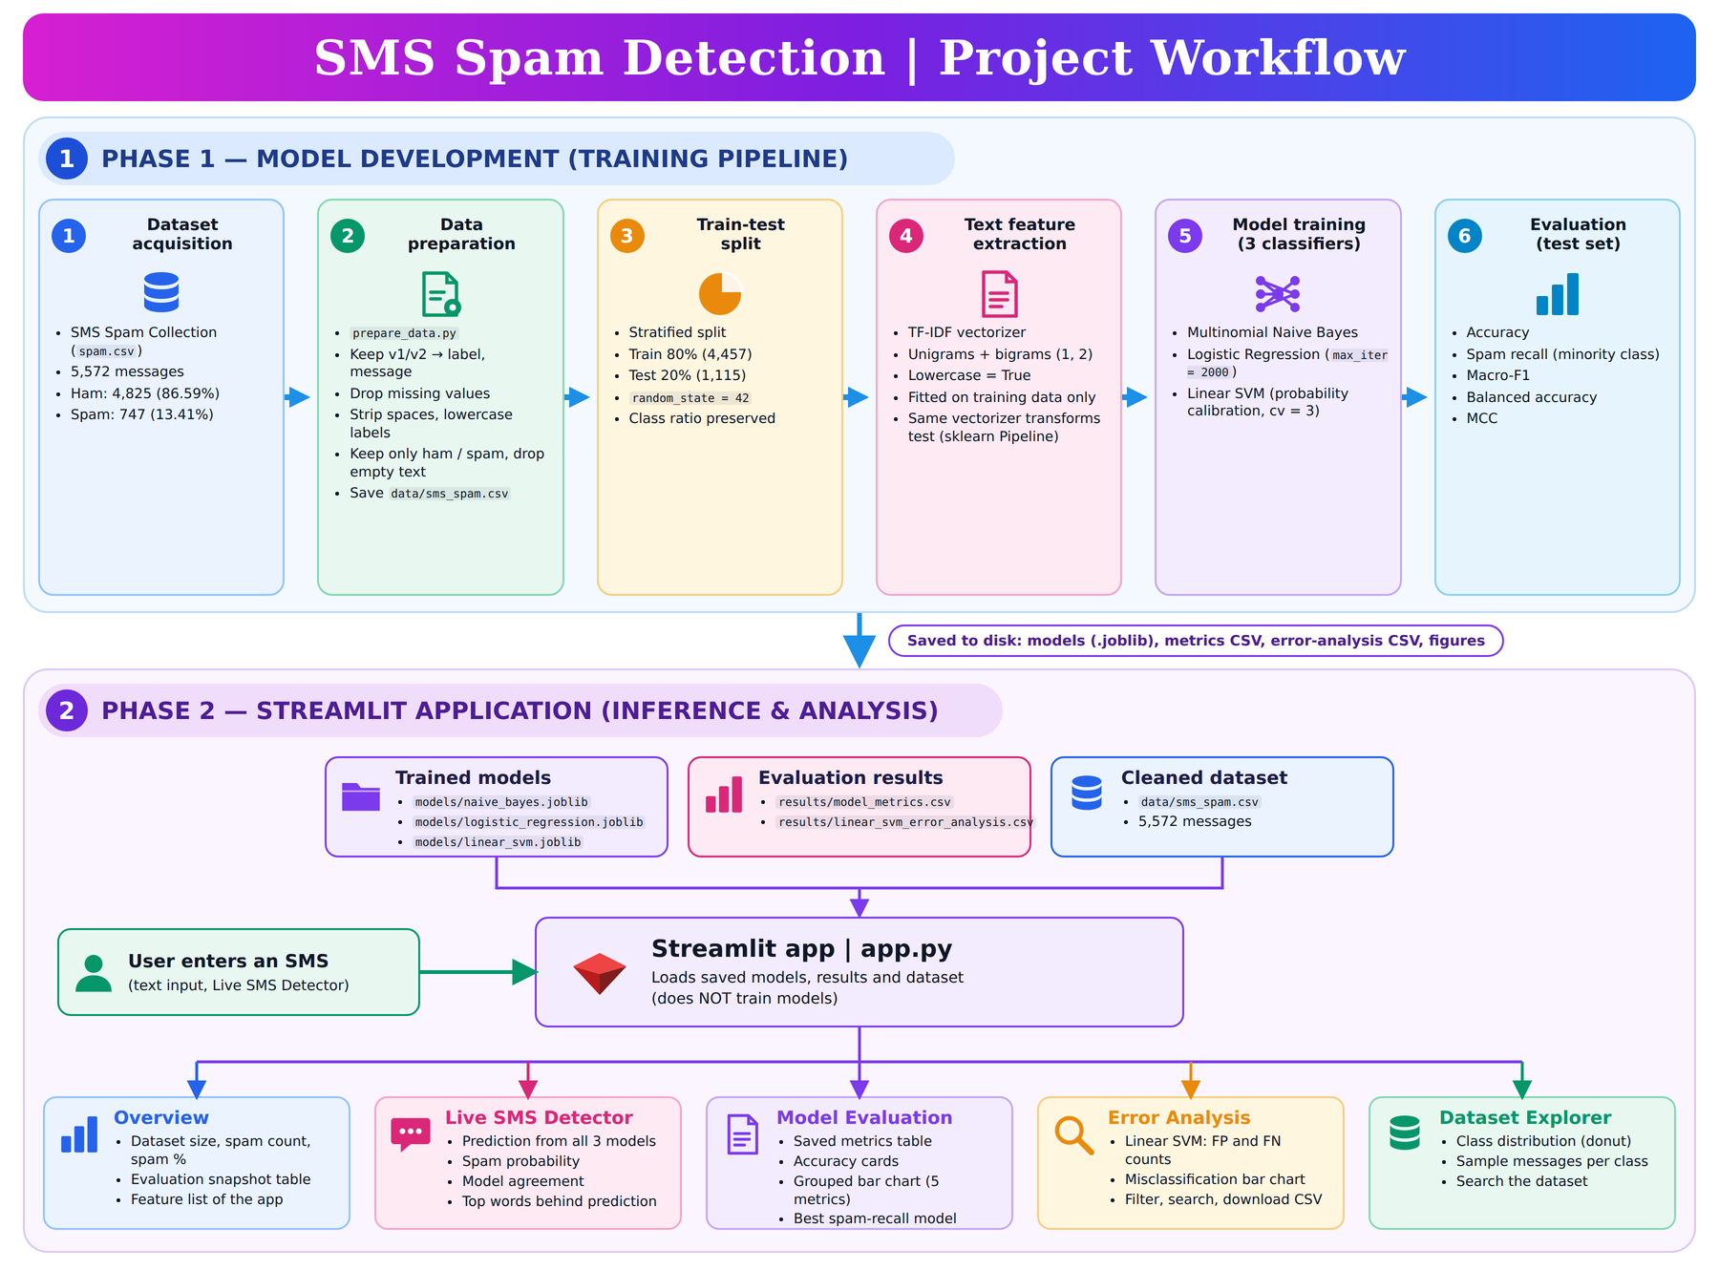
Methodology and WorkFlow

Slide 7
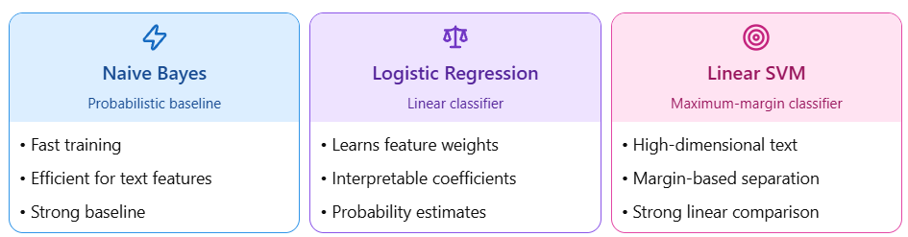
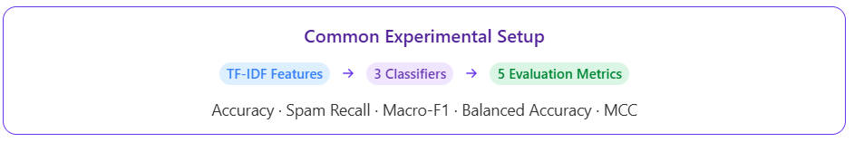
Why These Three Models

Slide 8
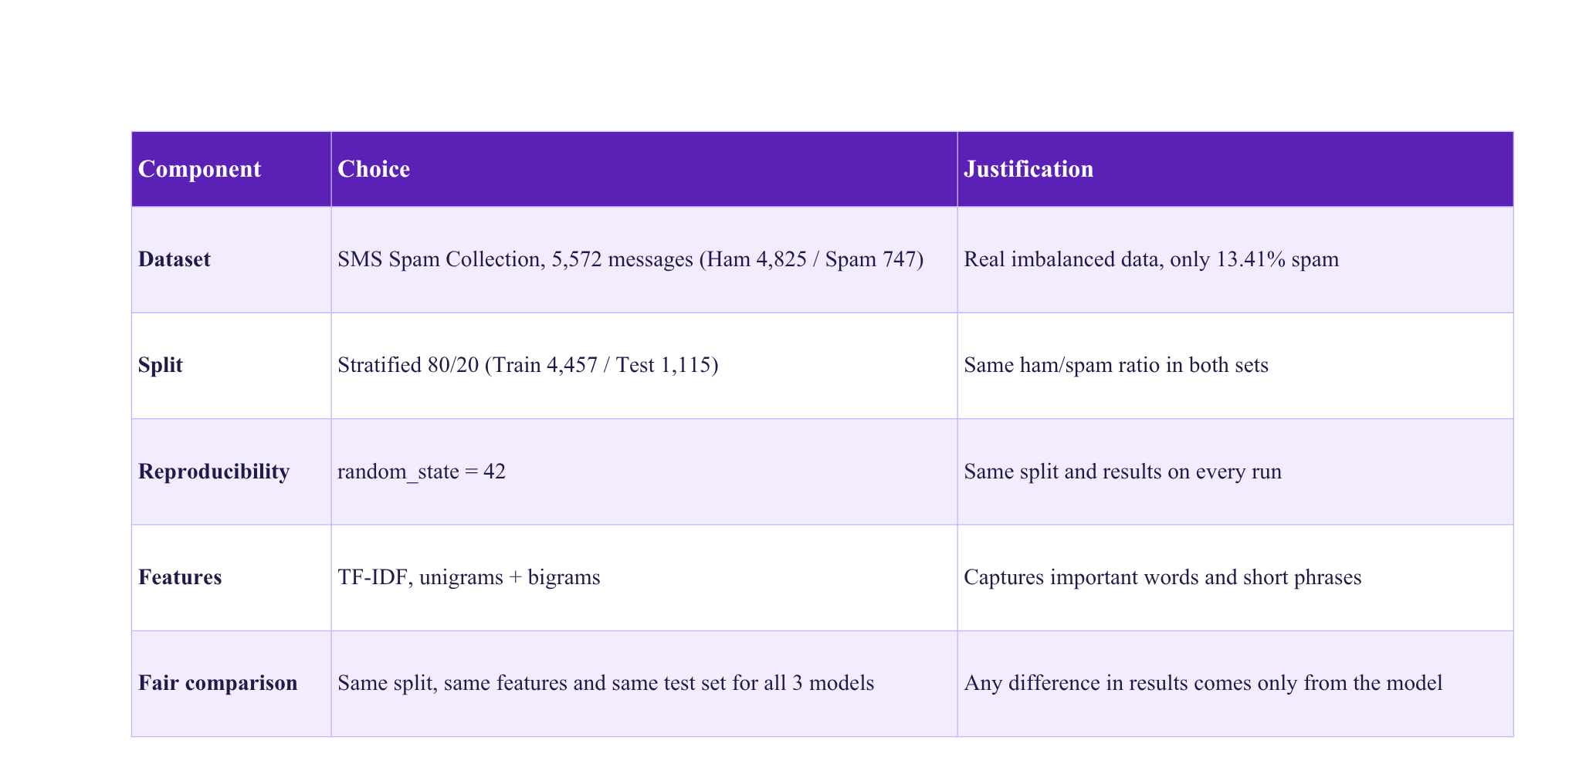
Experimental Setup

Slide 9
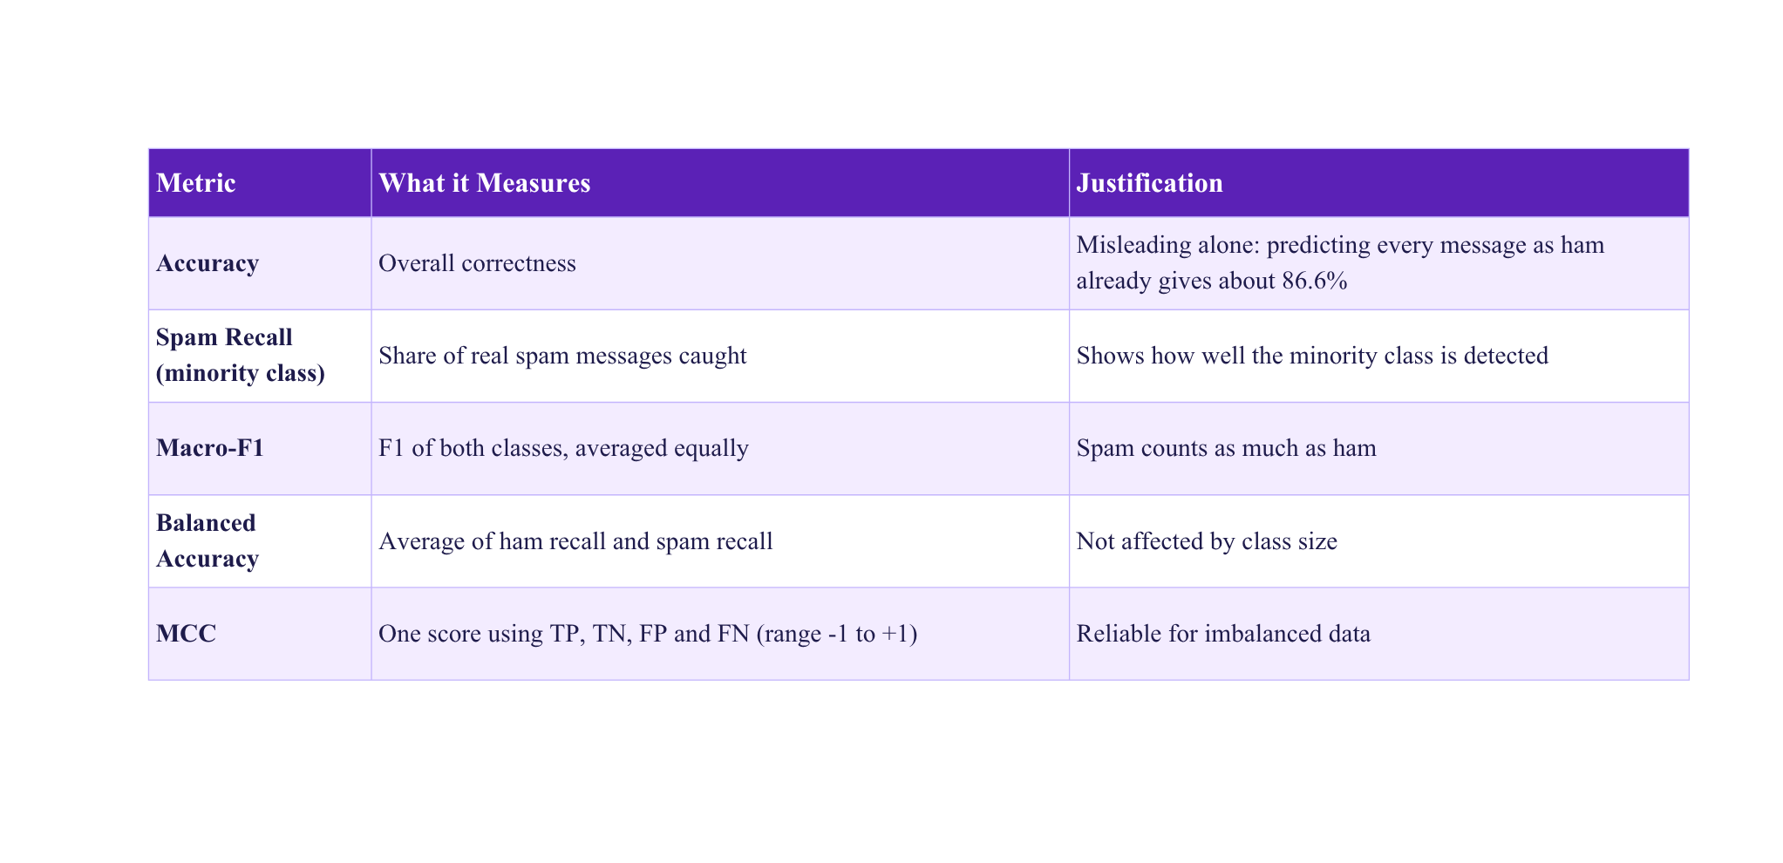
Evaluation Metrics
Key Takeaway
On imbalanced data, accuracy alone can hide poor spam detection. Five complementary metrics give a fair comparison of the three models.

Slide 10
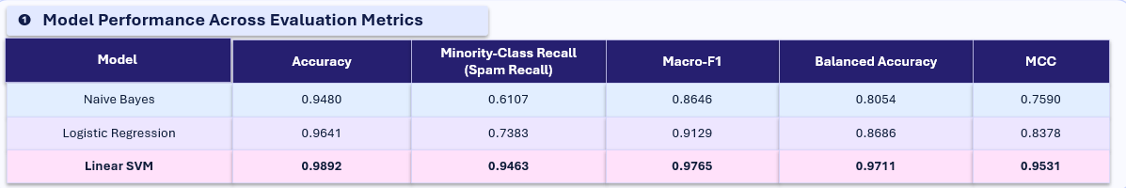
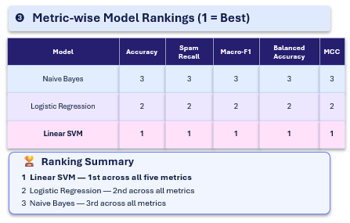
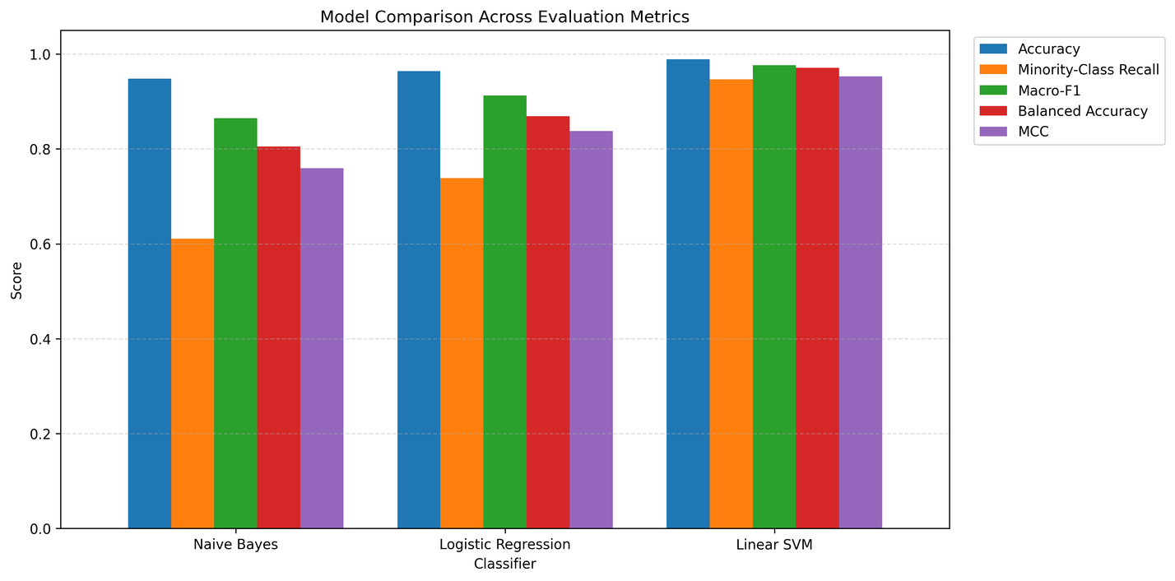
Results & Model Comparison
❷Model Comparison Across Evaluation Metrics
✓ Key Finding
Linear SVM achieved the highest score across all five evaluation metrics.

Slide 11
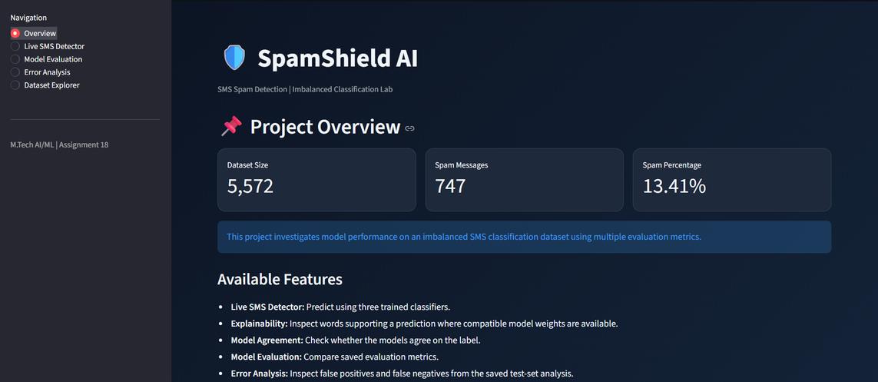
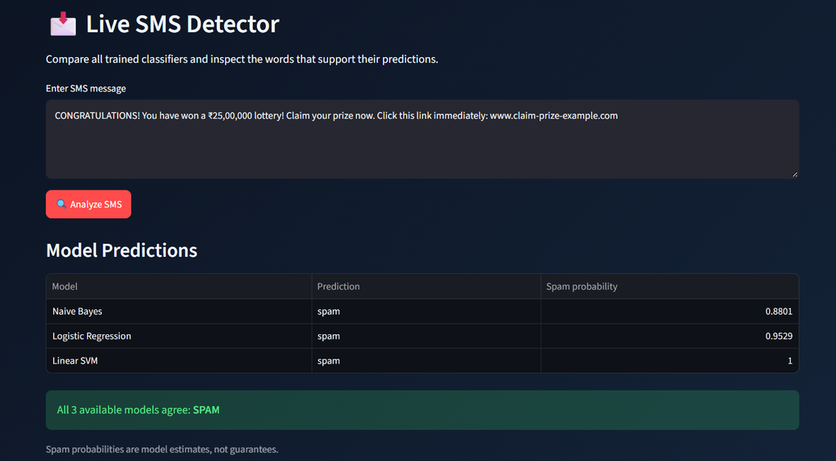
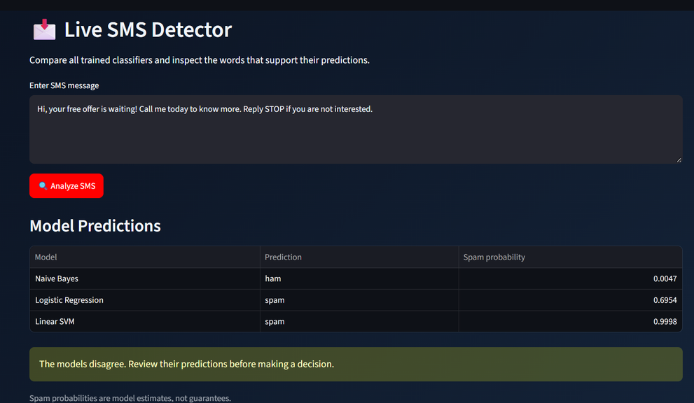
Live Demo
Observation
“The prototype compares three classifiers, displays their predictions, and highlights disagreements on ambiguous messages.”

Slide 12
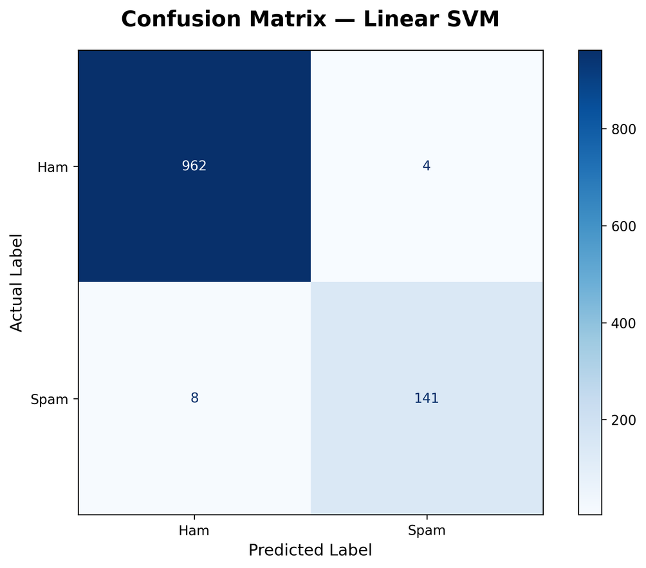
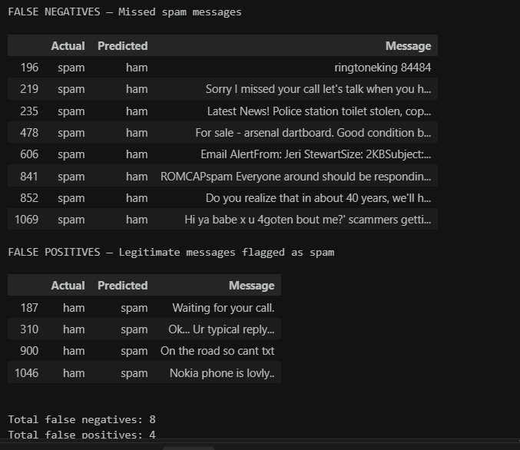
Error Analysis & Critical Findings
✓ Key Finding
Linear SVM achieved 98.92% accuracy, with 8 false negatives and 4 false positives, highlighting the need to evaluate both missed spam and legitimate messages incorrectly flagged as spam.

Slide 13
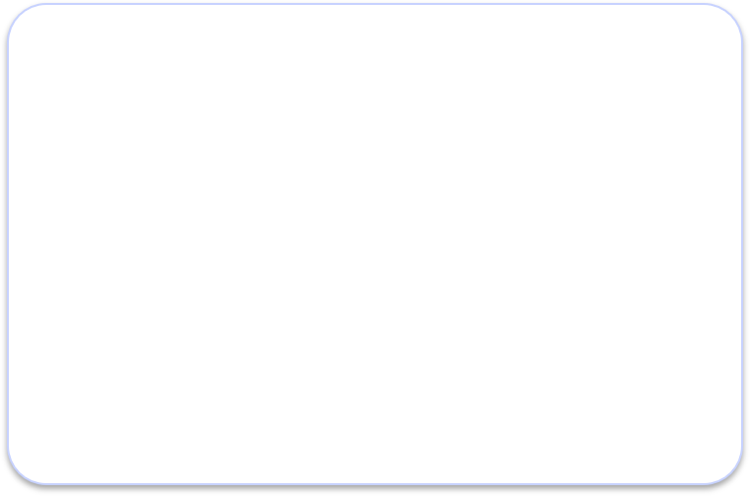
Conclusion & Future Scope
Key Conclusion
Linear SVM achieved the best performance across all five evaluation metrics.
Hypothesis Verdict
Not supported: the top-ranked model did not change across the five metrics in our results.
Limitations & Future Scope
• Evaluate on additional and real-world SMS datasets.
• Explore threshold tuning to balance spam detection and false alarms.
• Extend explainability and multilingual SMS detection.

Slide 14

Thank you
Questions & Answers

