Slide 1
MACHINE LEARNING SUPERVISED & UNSUPERVISED
PROJECT DETAILS
PRESENTED BY: P.VIJAYAKUMAR

Slide 2
INTRODUCTION:
Machine learning is a subset of artificial intelligence that enables systems to learn and improve from experience without being explicitly programmed, using algorithms to analyze data, identify patterns, and make predictions or decisions.
In this project I am using supervised and unsupervised learning for Indian car brand sales data.

Slide 3
Objective:
Data Preprocessing
Supervised Learning
Unsupervised Learning

Slide 4
1.DATA PREPROCESSING
Data preprocessing in machine learning involves transforming raw data into a suitable format for analysis and model training, encompassing tasks like cleaning, transforming, and preparing data for machine learning algorithms.

Slide 5
How I Preprocessed the Data Using Python :
1.1 Import the required libraries and load the
dataset.
1.2 The file car_dataset_india.csv is read using
pandas.
1.3 First 5 row displayed using df.head() function.
1.4 General dataset information are retrieved
using df.info() function.
1.5 Missing values count are checked using
df.isnull().sum().

Slide 6
1.6 Filled null values using .ffill() function.
1.7 Basic statistical information is displayed using
df.describe().
Feature transformation and scaling:
1.8 Categorical variables are converted to numerical
values using Label_Encoder.
1.9 Standardized the dataset using standard_scaler

Slide 7
2.Supervised Learning:(Linear_Regression)
2.1 select the input X value (Independent
value) and Y value (dependent Value or
target Value).
2.2 Data is split into train and test sets.
Model Selection:
2.3 select the supervised learning model from
sci- kit learn library.(Linear_Regression)
2.4 Train the models using model.fit()
2.5 Next predict the model

Slide 8
2.6 Find the accuracy score using r2 score formula
via prediction model
Best accuracy score is above the 0.7 -0.9
But this model is come only -> -.0018...
2.7 so we using hyper_parameter tuning to improve
the model accuracy
- This program we used GridsearchCV method
for tuning
2.8 Then visualize the predicted model using
matplotlib.pyplot

Slide 9
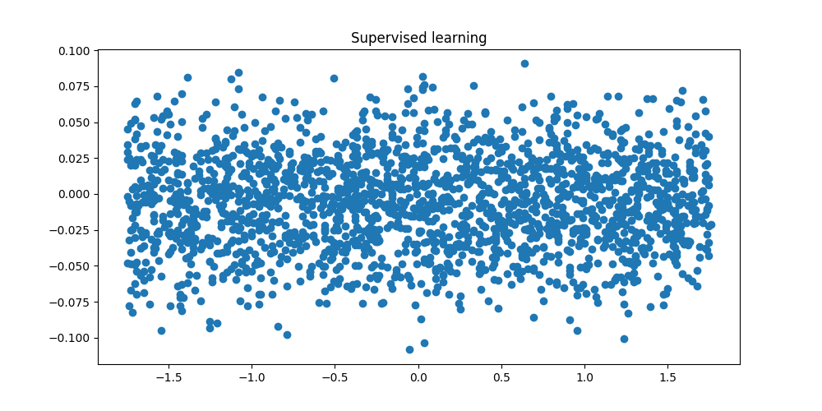
SUPERVISED LEARNING VISUALIZE

Slide 10
Advantages of Linear Regression
Linear Regression is perform well when the data is linearly separable . We can use it to find the relation between the variables.
Linear Regression is easily to implement, Interpret and very efficient to train.

Slide 11
Disadvantages of Linear Regression
Difficulty with Non-Linear Relationships
Multi-collinearity occurs when two or more independent variables are highly correlated with each other.
Linear regression can be prone to over fitting, where the model learns the training data too well.

Slide 12
3. Unsupervised Learning(Clustering)
3.1 For unsupervised learning used K-Mean
clustering.
3.2 load and read the dataset using pandas.
3.3 First we visualize the dataset using seaborn
scatterplot.
3.4 Select the X value. This case we don't select
the Y value because we play using X data
only. In unsupervised learning we don't
know the target.
3.5 Normalize the X value using preprocessing

Slide 13
3.6 The optimal value of K in the K-Means
algorithm can be found using the Elbow
method.
3.7 We use K-Means algorithm from Sci-kit-learn
and provide it the K value. After that we will
fit it on our training dataset and get cluster
labels.
3.8 finally we visualize datasets.
3.9 Unsupervised learning are mainly used for
preparing the data for analyzing not for
prediction and accuracy.

Slide 14
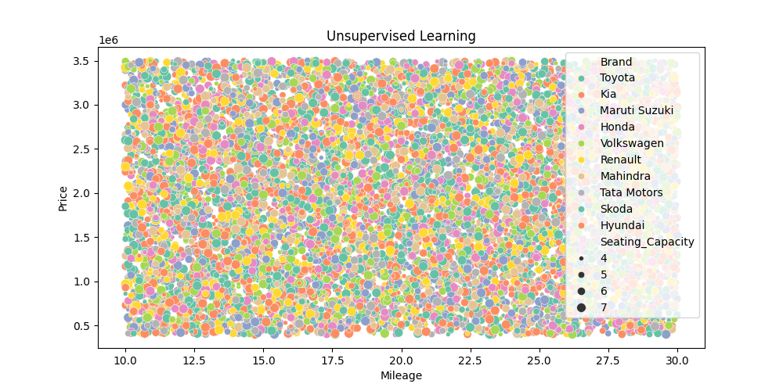
UNSUPERVISED LEARNING VISUALIZE

Slide 15
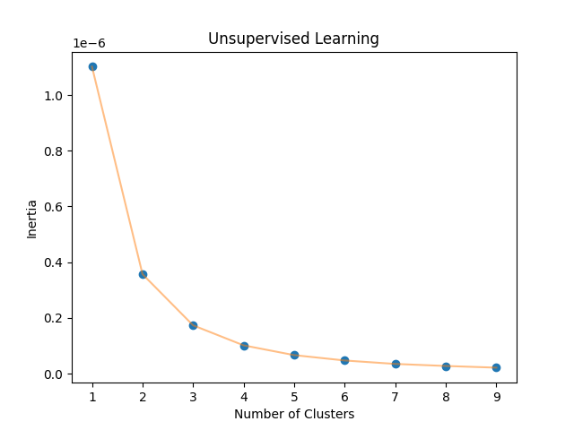
UNSUPERVISED LEARNING VISUALIZE

Slide 16
Advantages of Clustering
simplifying complex data
uncovering hidden patterns
enabling data summarization
facilitating anomaly detection
and enabling customer segmentation

Slide 17
Disadvantages of Clustering
Difficulty in Determining the Optimal Number of Clusters.
Difficulty in Interpreting Results and Ambiguous Clusters.

Slide 18
THANK YOU…..

