Slide 1

Book Hub App Specification
Presented by,
Jude Vergara
Vijayalakshmi C

Slide 2
What will the app do?
The book recommendation app recommends books that meets users’ criteria/filters. Some filters (tentative) are fiction/non-fiction, genre, subject, target audience (age, gender), language, price, date released, and rating. When users have submitted finalized their filters, the app will recommend books that match and/or similar (not full match). Books that meet the criteria will have a small display showing summary, book cover, and details. At the end, the app could also link websites, stores, libraries to borrow/buy/rent/read the books from.

Slide 3

Why there is a need for it?
In the present day, there exists more books than any time in history and that collection only keeps on growing. Along with that, it’s the easiest it has ever been to access books. An app that would offer users a way to filter a database of books to match their liking would reduce the burden and increase the quality of users’ reading experience.

Slide 4
Color Choice
Color Choice
Based on the meanings of colors, color palettes that include both yellow and purple/violet will fit well. This is because books are often associated with intellect (yellow) and wisdom (purple). Many people like to read books as a form of entertainment so, yellow also fits that purpose.
Colorhunt
https://colorhunt.co/palette/e5df88e8e8e8a37eba4c4c4c
#CCB4DB
#F0EDCC
#383838 - text

Slide 5


Font Choice
Typeface - Serif
Bodoni 72 Small Caps – Headers
- https://en.m.fontke.com/font/10593760/
Bodoni Book Regular – Body
- https://en.m.fontke.com/font/20901787/

Slide 6
Font Size
ELEMENT | SIZING
Titles (pages or modals) | 17pt
Secondary text | 15pt
Tertiary text, Captions, Segmented buttons | 13pt
Buttons, Text inputs | 16pt
Tab bar, Action bar | 10pt

Slide 7
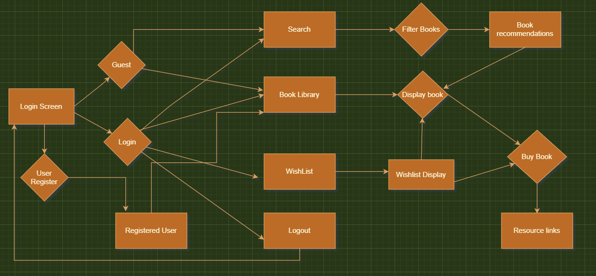
User Flow

Slide 8
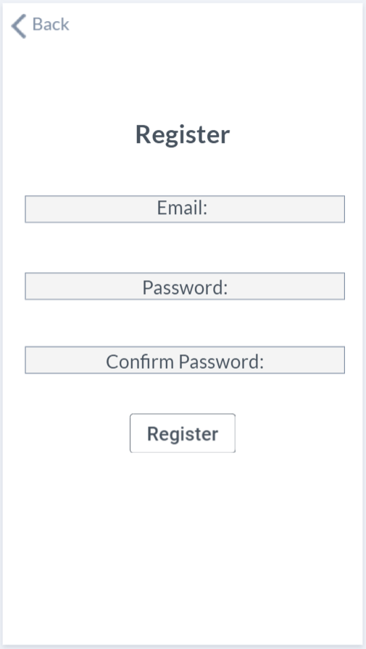
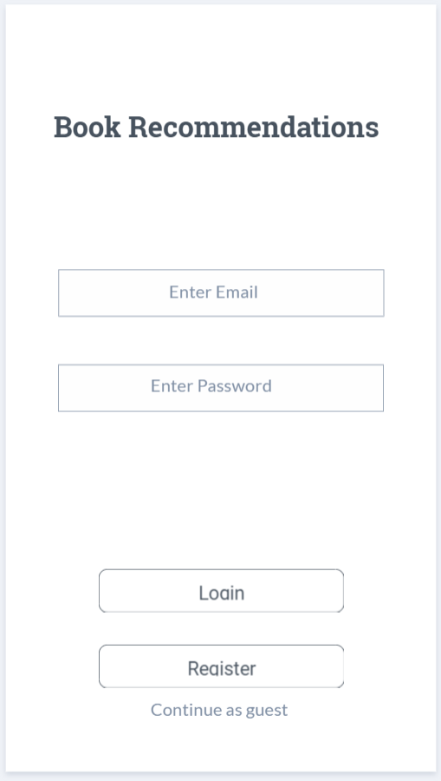
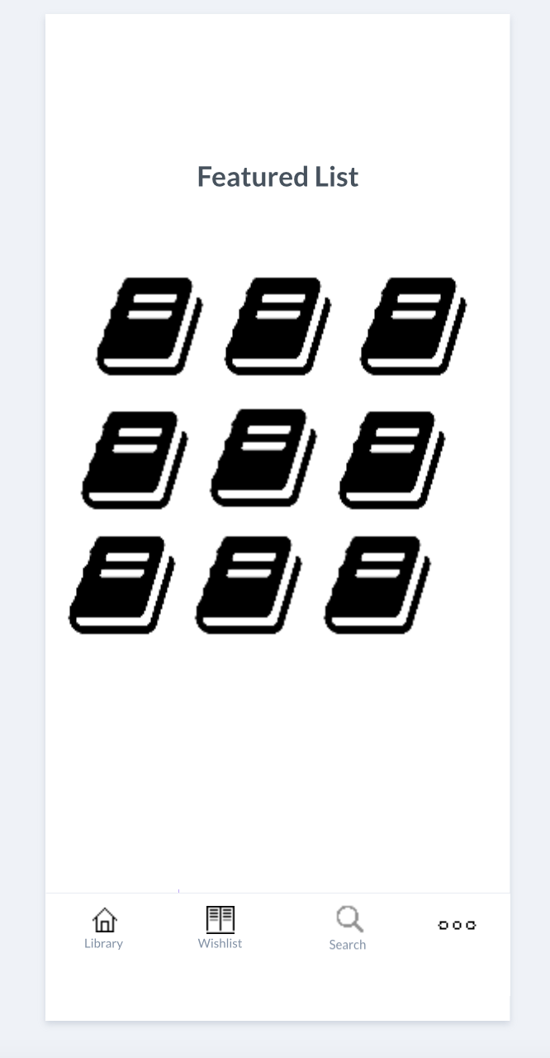
Wireframes

Slide 9
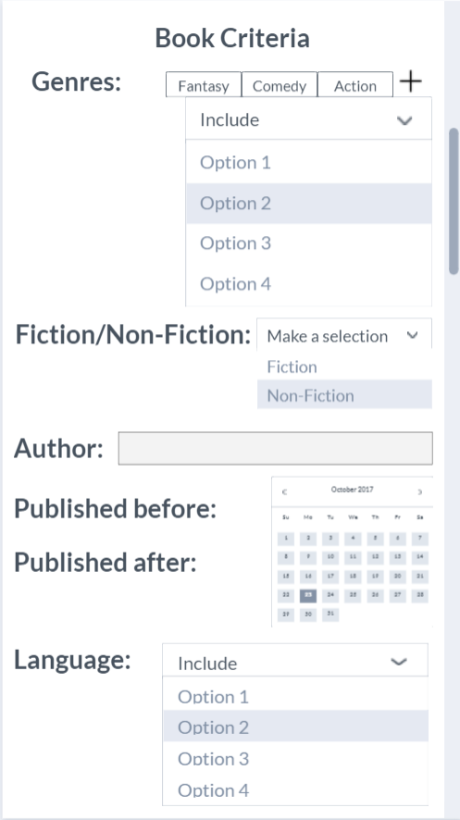
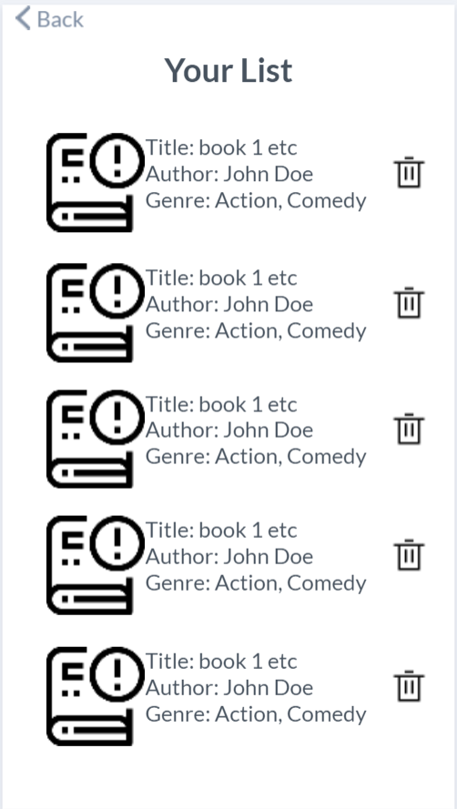
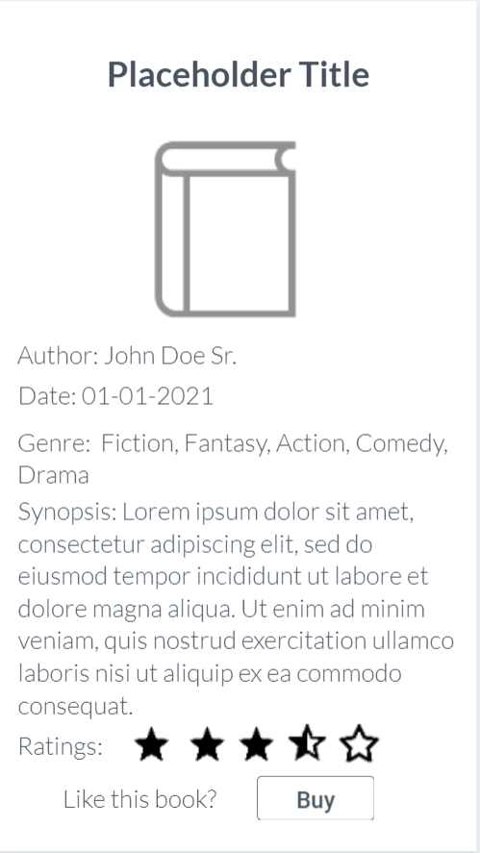
Wireframes

Slide 10
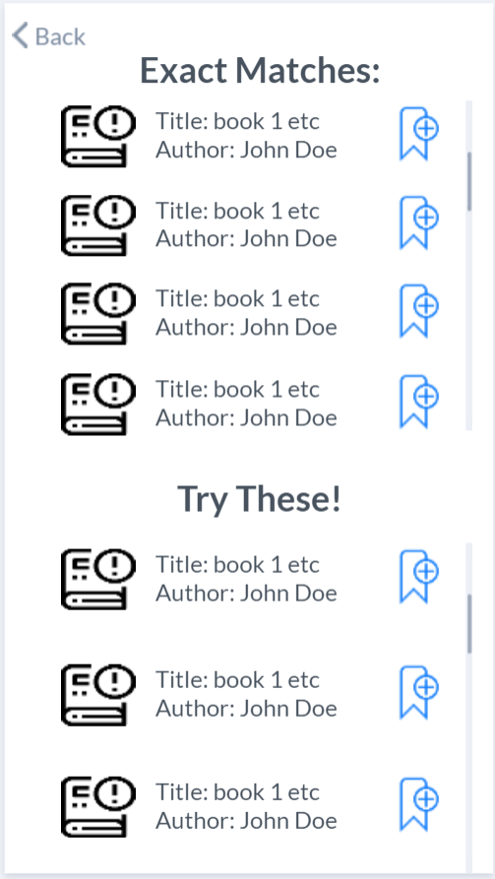
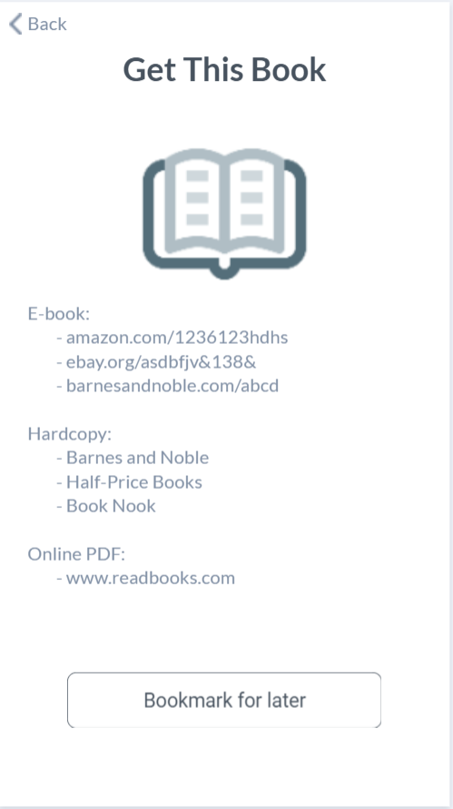
Wireframes

Slide 11
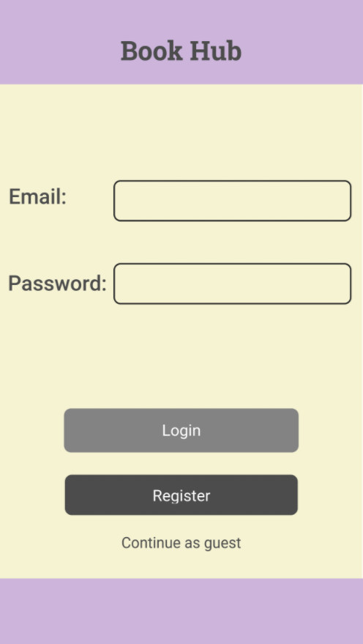
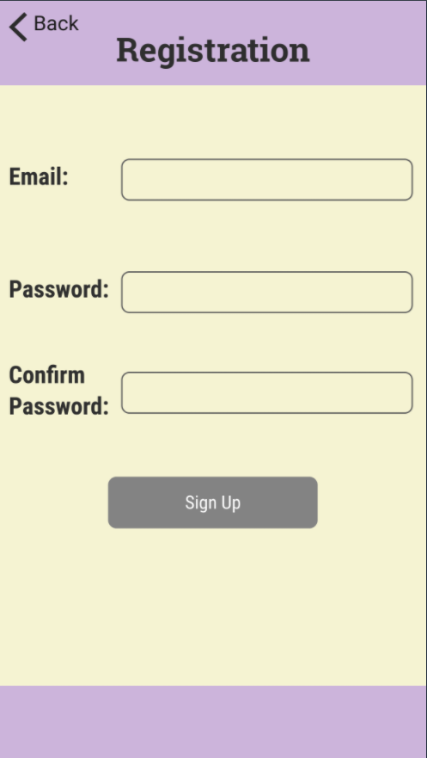
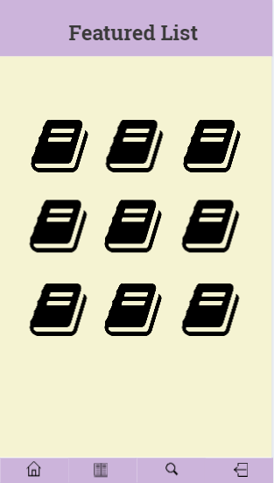
Mockups

Slide 12
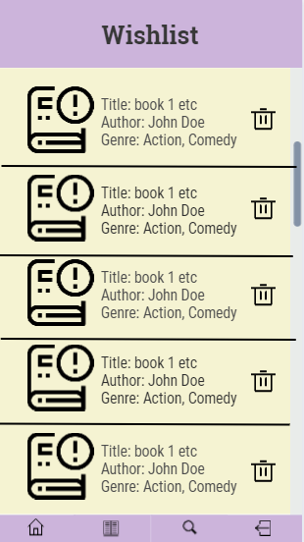
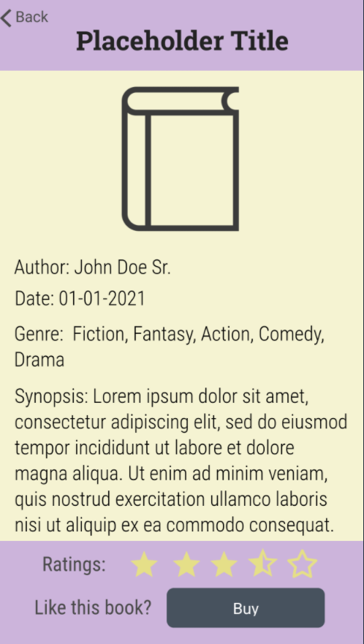
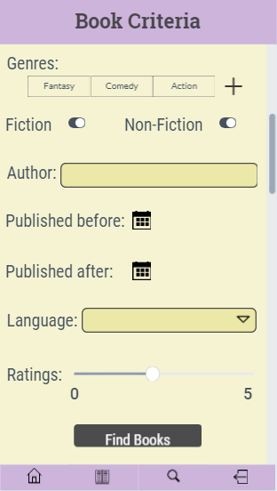
Mockups

Slide 13
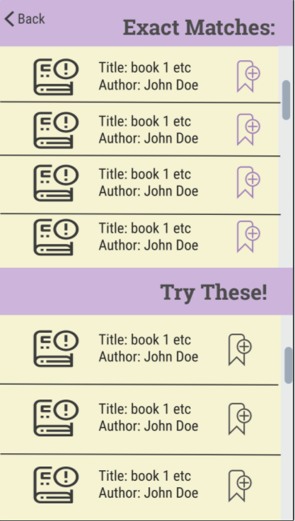

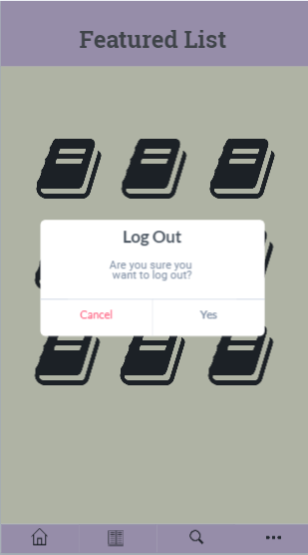
Mockups

Slide 14
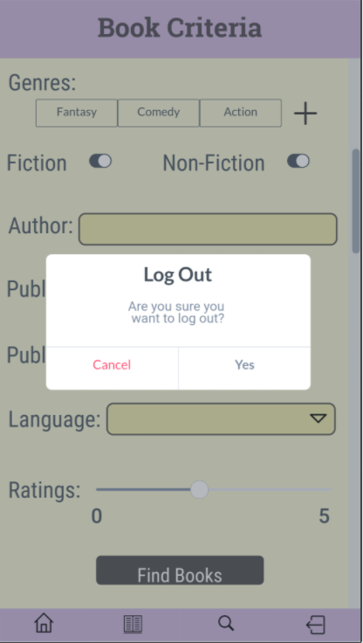
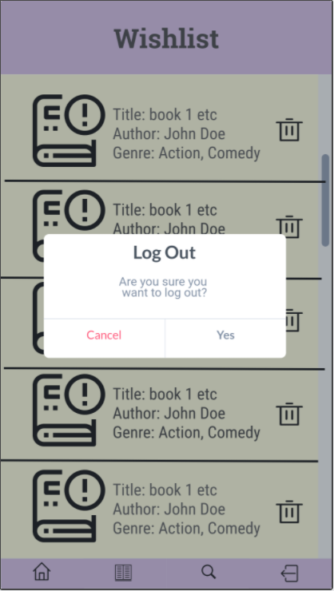
Mockups

Slide 15
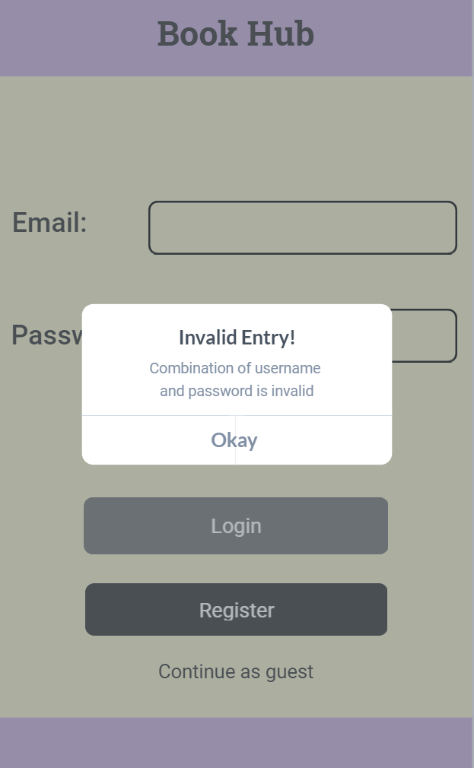
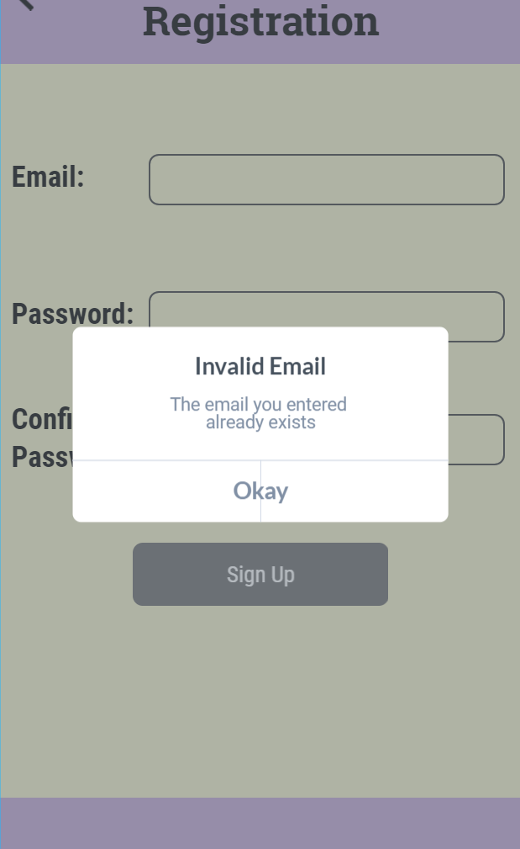
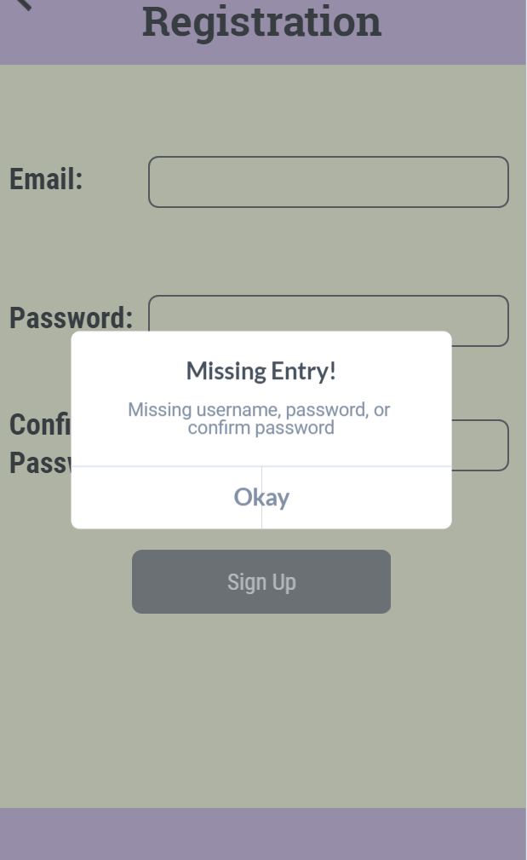
Mockups

Slide 16
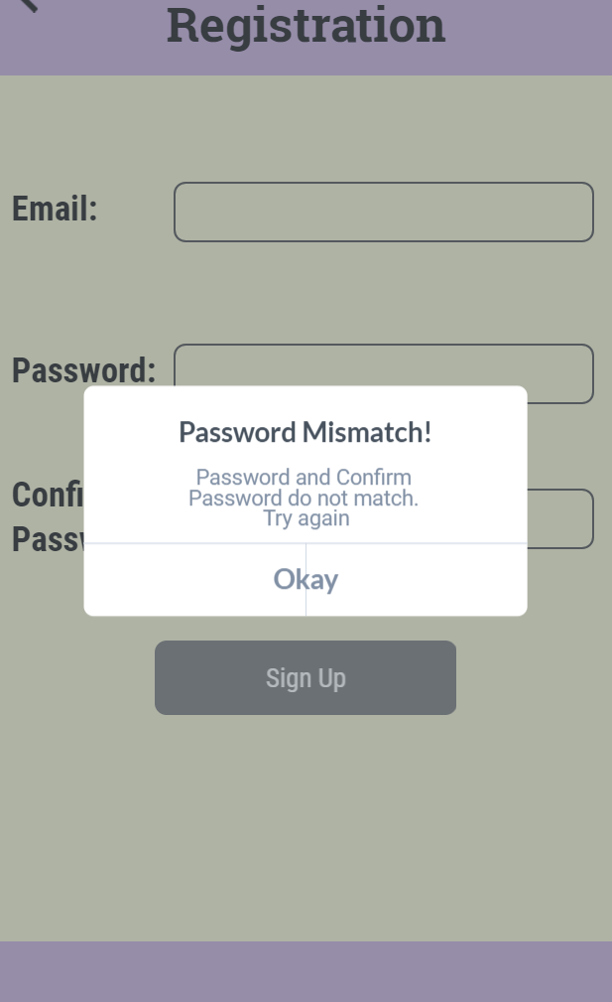
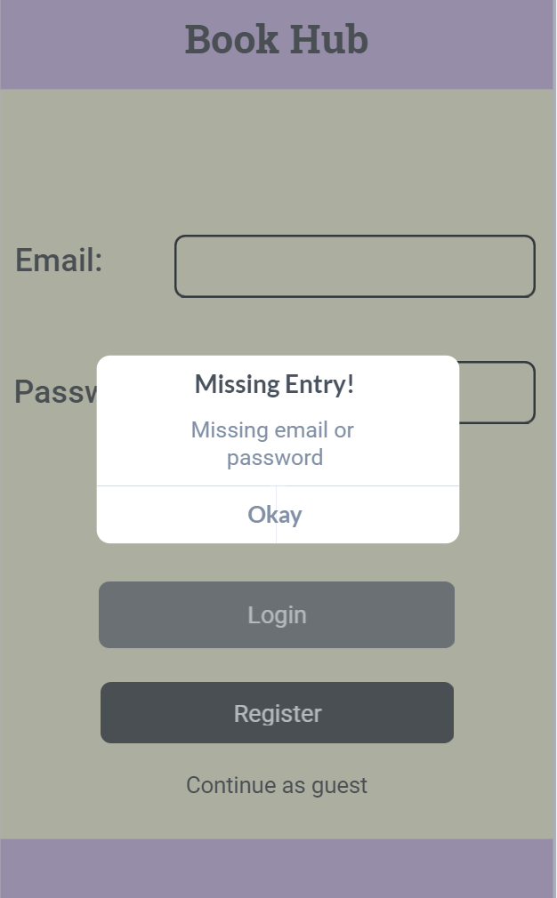
Mockups

Slide 17
Beta Version Changes

Slide 18
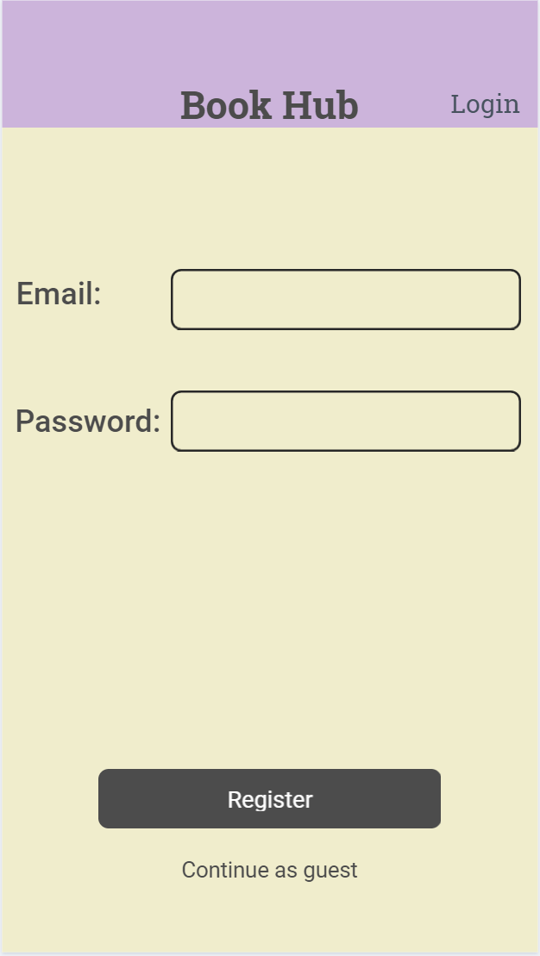
Changes
Login button moved to the navigation bar.
Removed footer
Lowered header title slightly

Slide 19
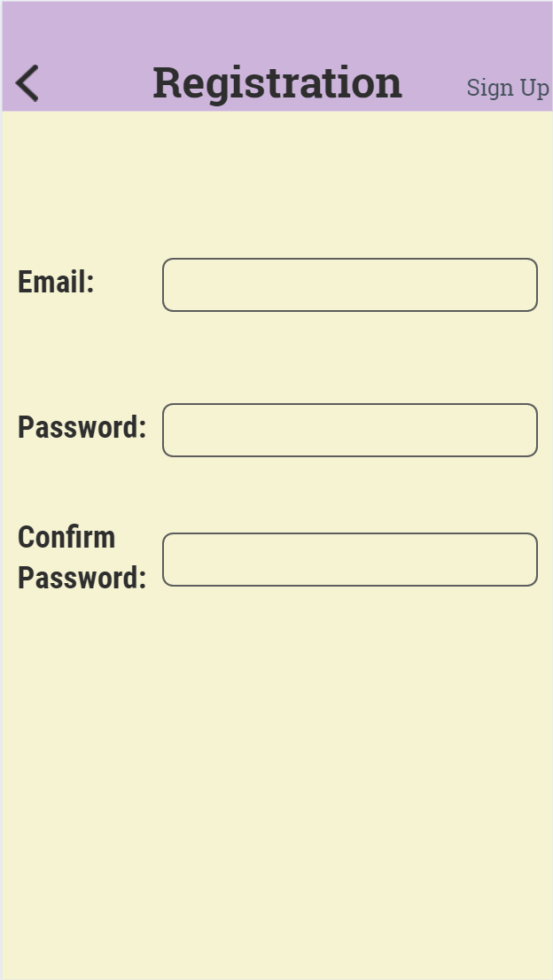
Changes
Sign Up button moved to the navigation bar.
Removed footer
Lowered header title slightly
Removed “Back” text

Slide 20
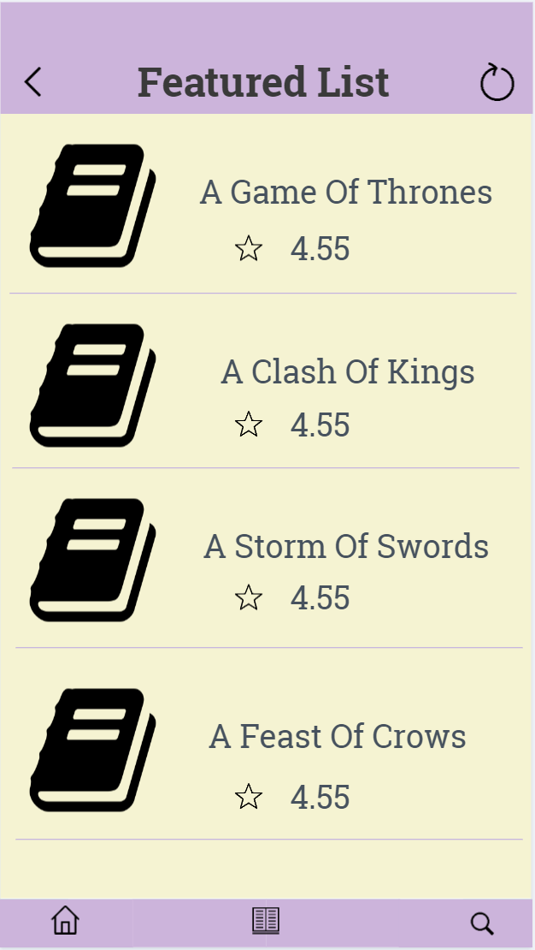
Changes
Changed to table view
Logout button on top right corner
Tab bar buttons reduced to 3
Cells show title and rating

Slide 21
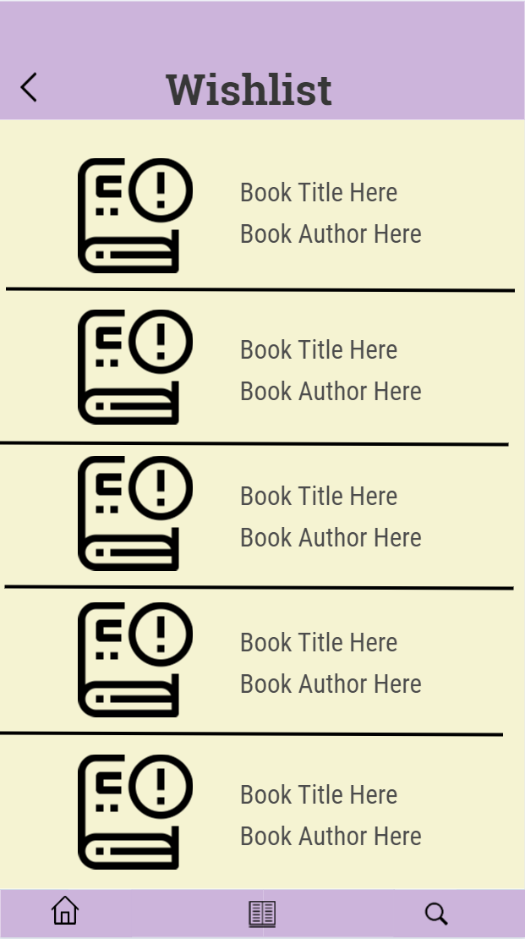
Changes
Removed genre from Wishlist
Removed ‘trash’ icon for unbookmarking books. Use swipe to remove from Wishlist instead.
Tab bar buttons reduced to 3
Lowered header title

Slide 22
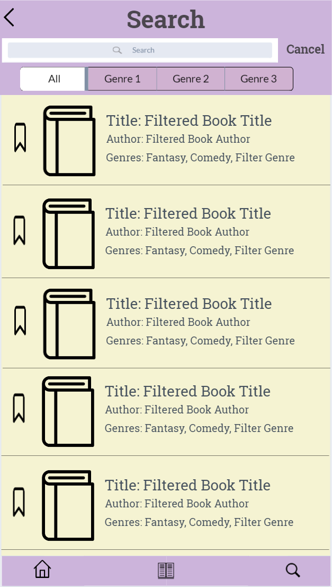
Changes
Changed search criteria's
Added Search Bar (Title, Author, Genre)
Genre filter
Results now show in the same view as search
Table view
Tab bar buttons reduced to 3
Bookmark button to the side

Slide 23
Changes
Results view removed completely as the page was redundant in the beta version.
Instead, search results show up in the table view below the search/genre filter.

Slide 24
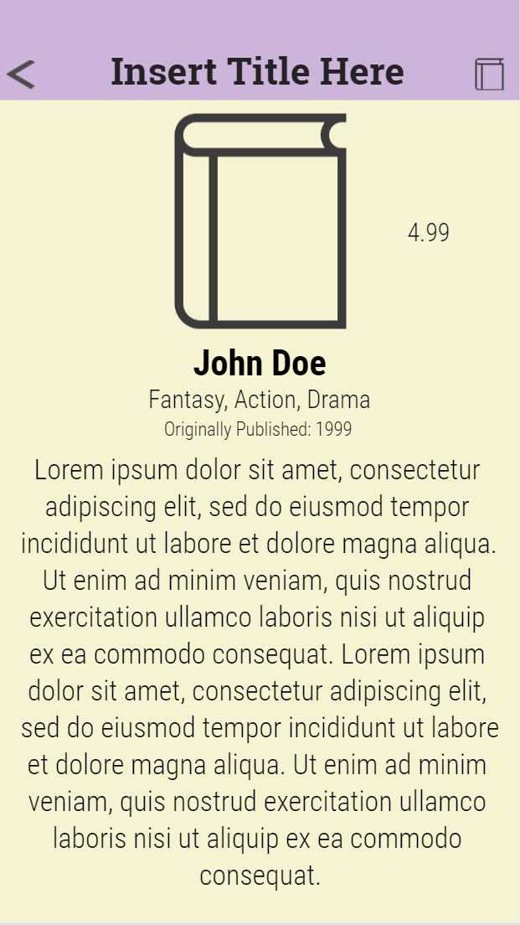
Changes
Centered Text
Rating as number instead
Removed footer
Buy button moved to navigation bar (right side)
Removed “Back” text beside back button

Slide 25

Changes
Removed footer
Removed “Back” text beside back button
Added title below book cover
Moved bookmark button to navigation bar
Changed book links from labels to icons for a cleaner look.
Added ISBN #
Links are now: amazon, eBay, ebooks, goodreads, and ISBN#

Slide 26
Production Release Notes
Login and registration of user details stored using User Defaults
Added bookmark option in Book Details view
Implementation of bookmark (stored locally in the machine)
Implementation of swipe to delete in the Wishlist
Bug fixes on UI (different colors for the table view background and table view cells)
Fixed too dark font color for book titles
Added Launch Screen and AppIcon
Added auto layout/constraints for iphone 8
Fixed ebay button image PNG background from showing

Slide 27
Full Feature List
Register Account
Login Account (enables wishlist/bookmark functionality)
Guest Mode (can search books but can’t bookmark)
Featured List tab landing page
Only books with rating of greater than 4.5 will show
Wishlist Tab
Shows books you have bookmarked
Swipe to delete OR
Swipe slightly then press to delete
Search Tab
Shows all available books
Can select Genre from the segmented control to filter
Can further search manually genres, author, title, etc
No results found will be displayed if no books found from search

Slide 28
Full Feature List
In any of the 3 tabs, user can select a book to show more details.
Includes the book cover, book title, author, language, Fiction/Non-fiction, Genres (3 genres each), publication date, rating, and the number of pages (estimate as each medium will have different number of pages) and finally, a short summary.
There is a bookmark button on the top left corner where the book cover is.
Bookmark feature
User can bookmark books to save them in their wishlist and they can delete them by navigating to the wishlist tab and swiping to delete
No duplicates allowed
Only for registered user
Resources/Link button in book details view
Resources page
Amazon, ebay, ebooks, goodreads, and ISBN # links
Bookmark feature is here too just in case
When links are pressed, user is redirected to in-app browser
There is a button to return back to the app
Works best with iphone 8 Plus ☺

Slide 29
Prototype
https://marvelapp.com/prototype/69432ai

