Slide 1
GENETIC ALGORITHMS
A PROJECT BY : -
VIJAYLAKSHMI SIDAPPA
ABHINAV YOGESH TIWARI

Slide 2
PROBLEM STATEMENT
If we are given a linear equation in the form of ax ± by … ± c = 0, where a, b, c, etc. are constants.
The objective of our Genetic Algorithm is to find a solution for the given equation from a set of randomly generated integers.

Slide 3
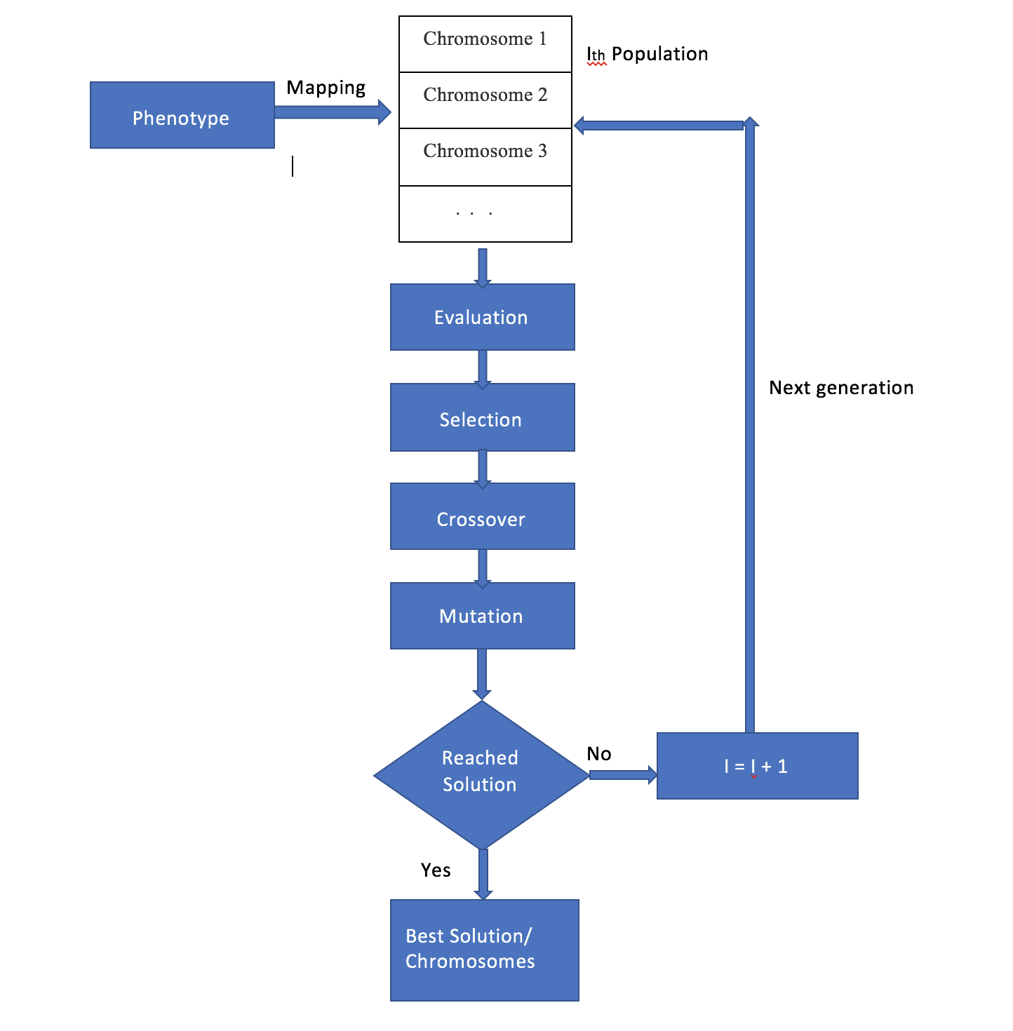
APPROACH

Slide 4
TEST CASES
We carried out two sets of test cases for the following methods :
calcFitness() – which evaluates the Individual Probability of each member
performSelection() – which carries out selection of members with higher probabilities
performCross() – which performs Crossover between two parents to form a child
One of the sets of test cases has been done on a simple equation with both co-efficients set to 1.
The other set consists of equations that have both co-efficients > 1.

Slide 5
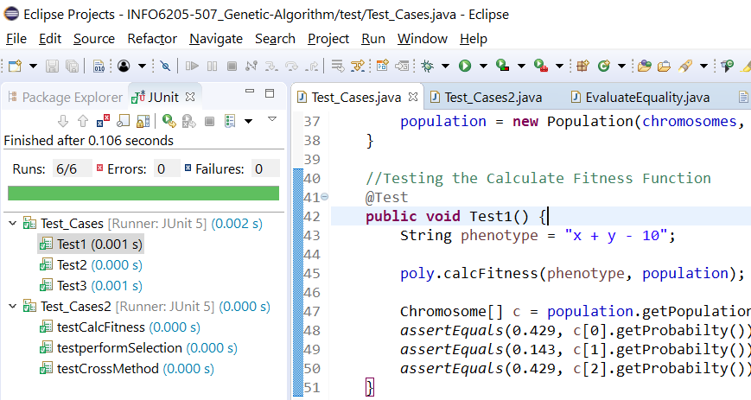
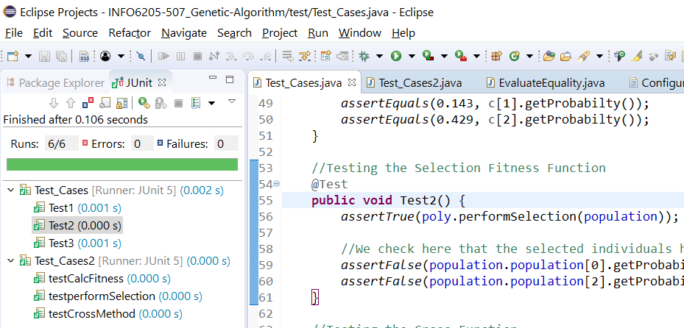
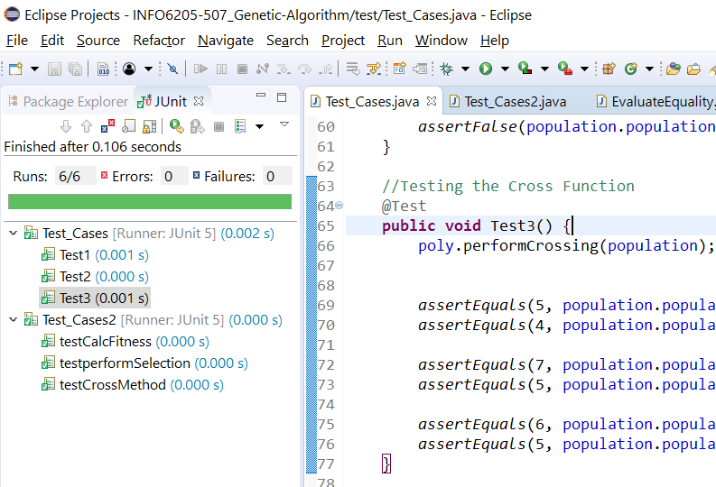
TEST CASES SET 1 (x+y-10)

Slide 6
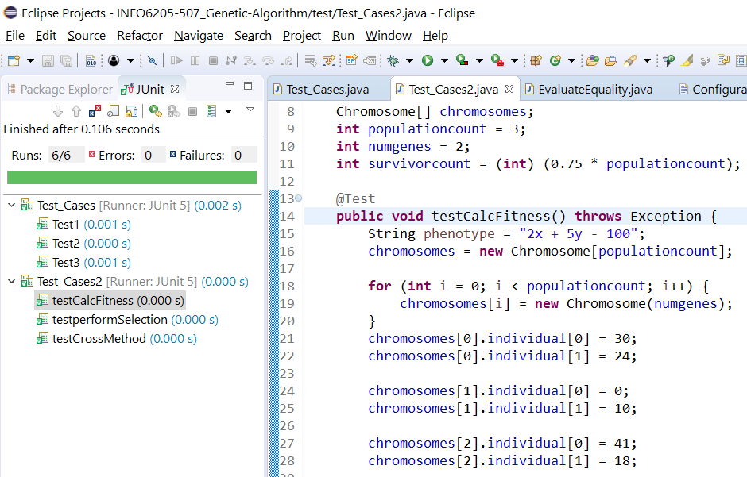
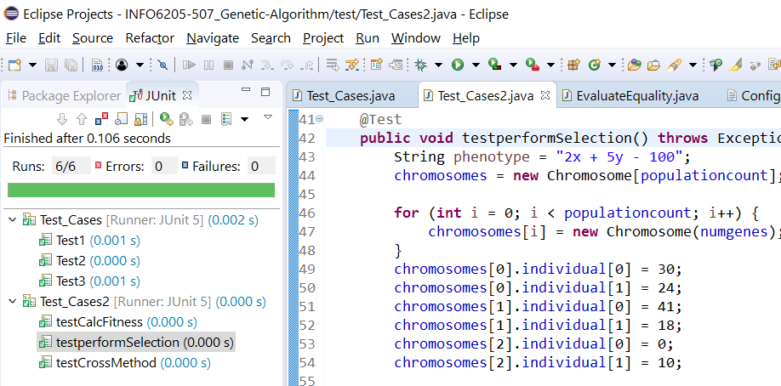
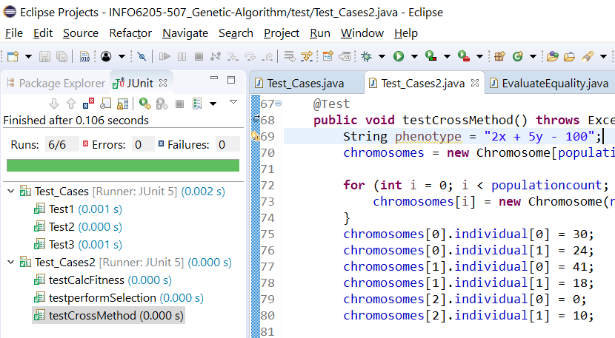
TEST CASES SET 2 (2x + 5y - 100)

Slide 7
SCREENSHOTS FROM RUNS
We ran the program against three different equations
  x + y – 13
  4x + 5y -200
  10x + 21y – 2400
It was observed that in most cases our solution space contained a solution for the equations,
In cases where we couldn’t find an exact solution, we found the best solutions from the given solution space.

Slide 8
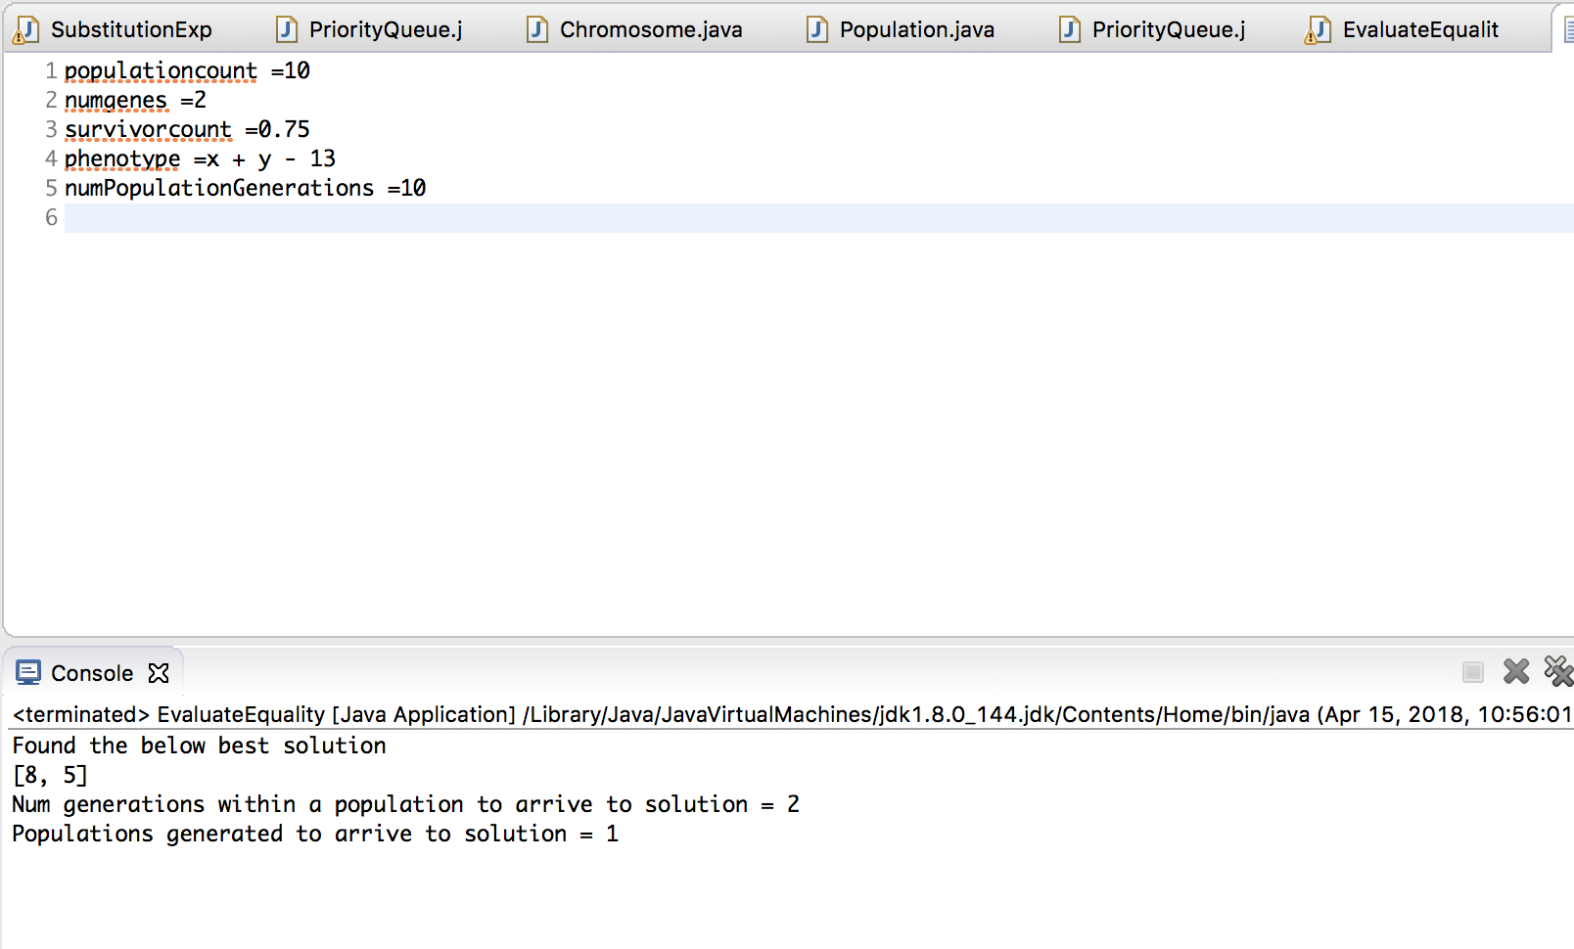
Equation : X + y – 13 solution : [8,5] generation taken : 2 populations generated : 1

Slide 9
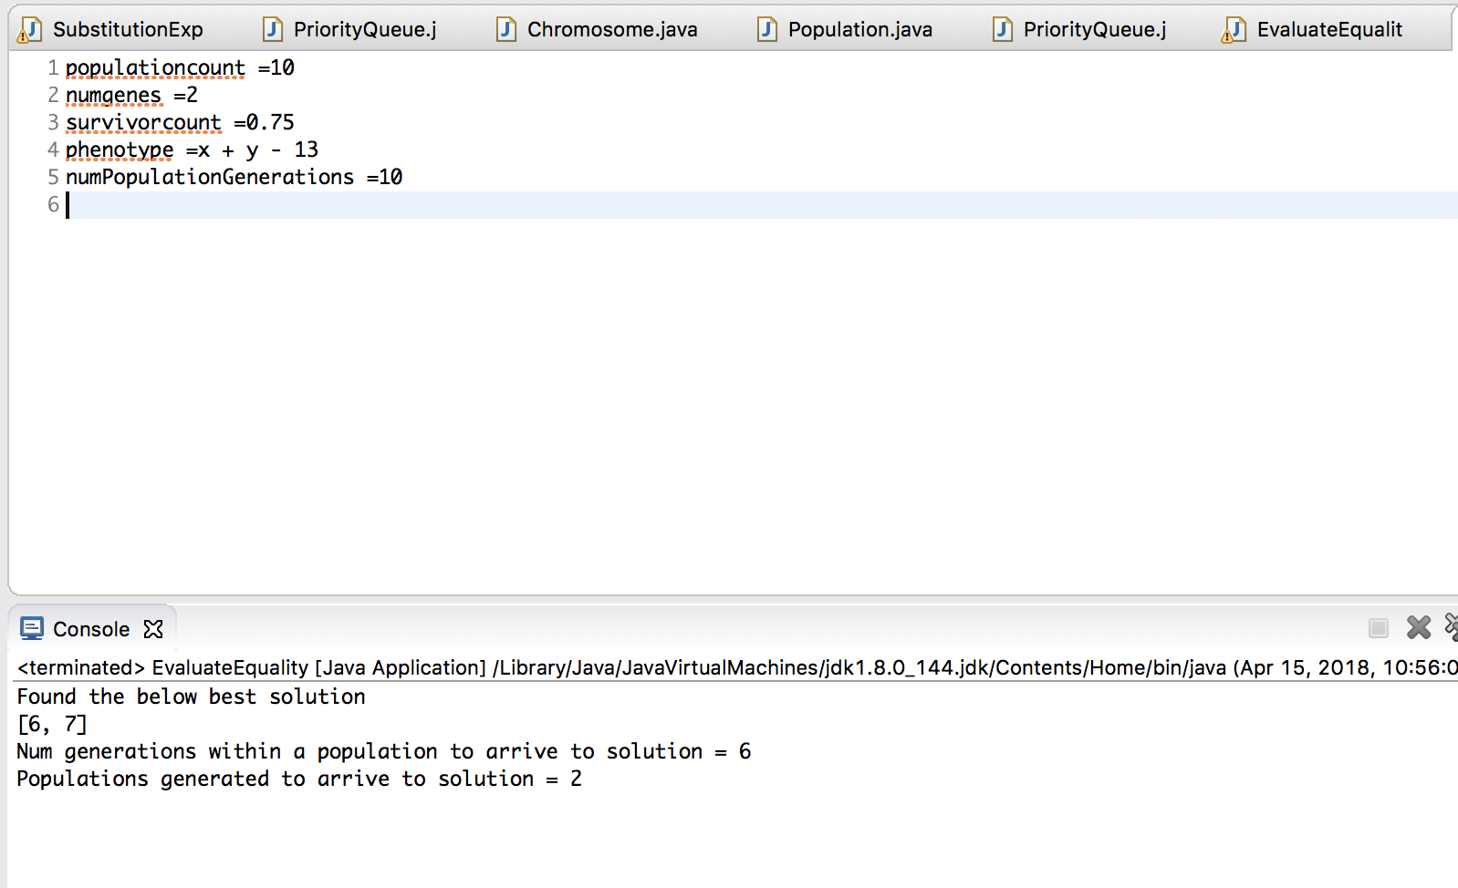
Equation : X + y – 13 solution : [6,7] generation taken : 6 populations generated : 2

Slide 10
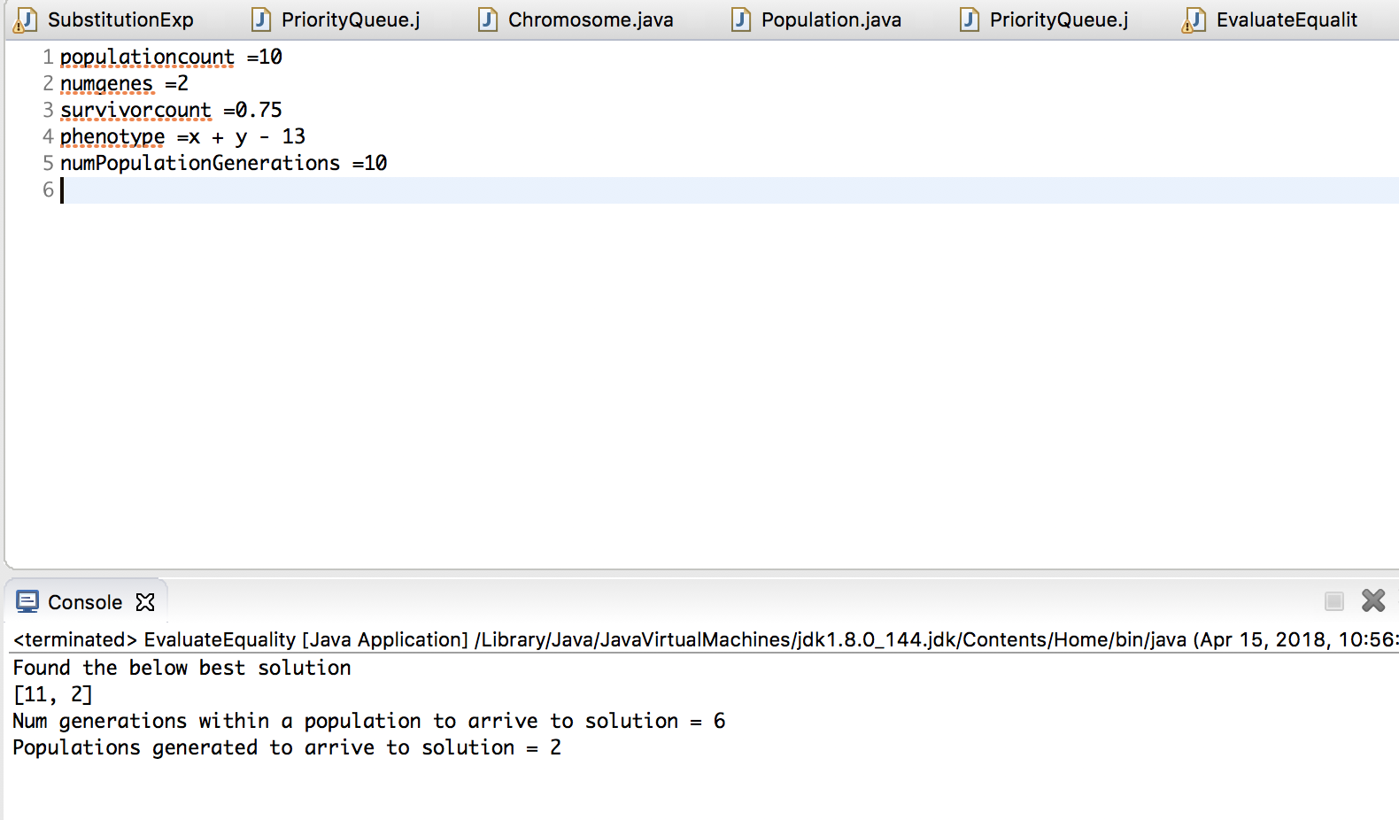
Equation : X + y – 13 solution : [11,2] generation taken : 6 populations generated : 2

Slide 11
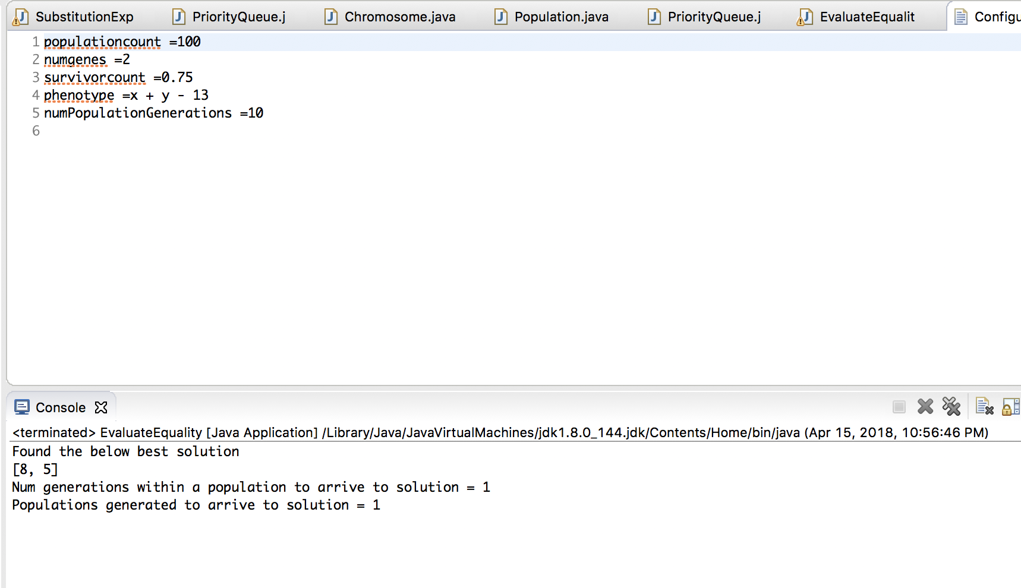
Equation : X + y – 13 solution : [8,5] generation taken : 1 populations generated : 1
Notes:
Here since the population was set to 100, hence the number of generations taken to arrive at the solution is just 1.

Slide 12
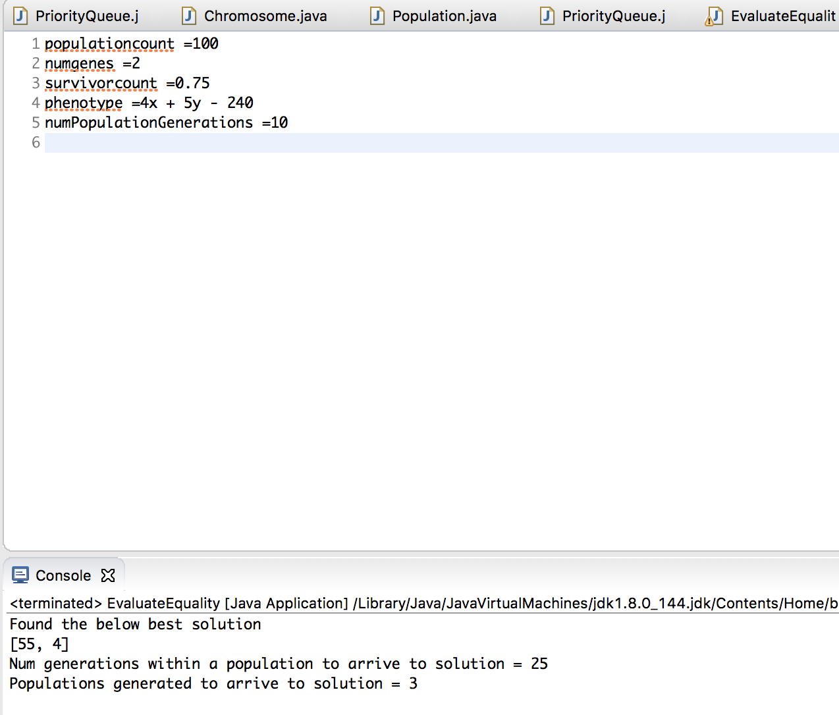
Equation : 4X + 5y–200 solution : [55,4] generation taken : 25 populations generated : 3

Slide 13
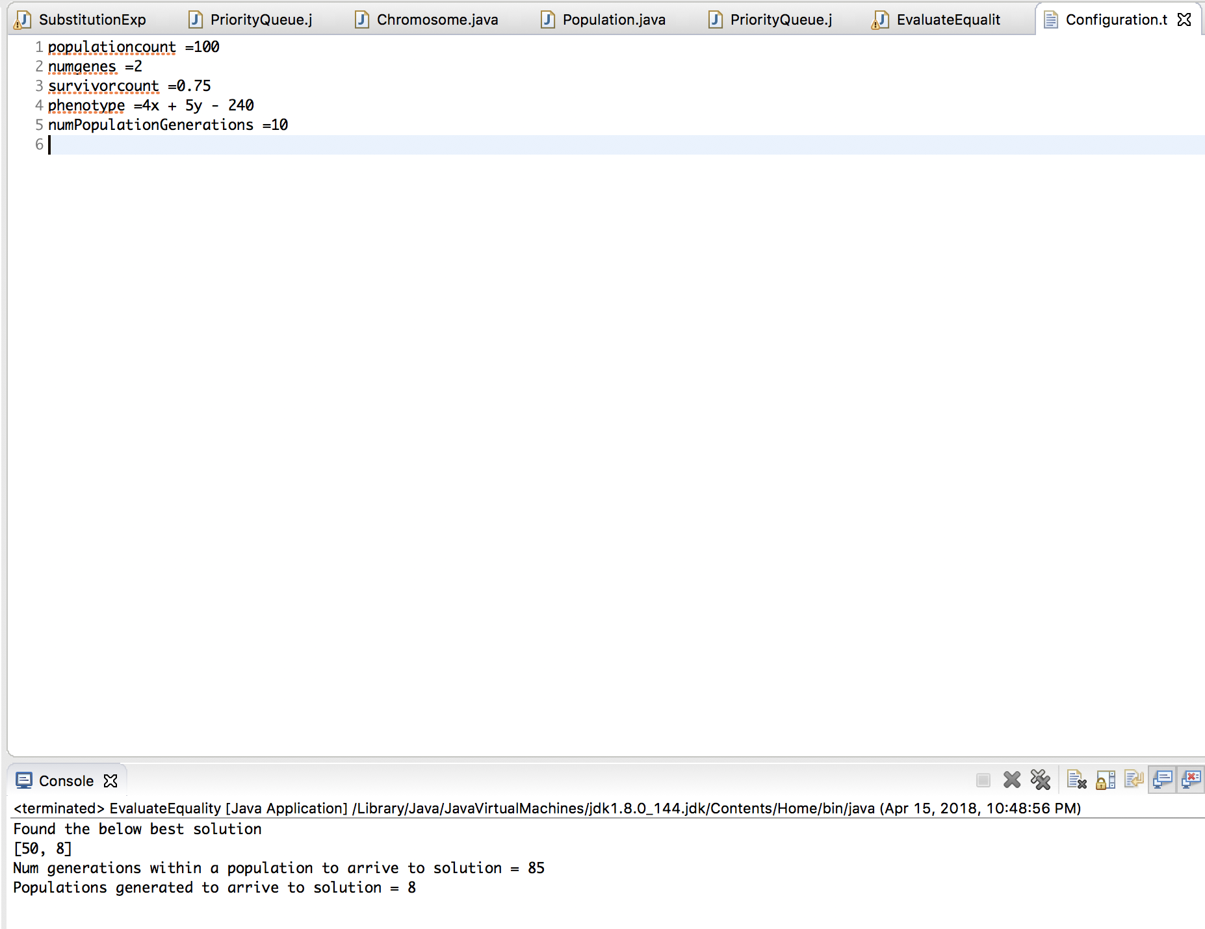
Equation : 4X + 5y–200 solution : [50,8] generation taken : 85 populations generated : 8

Slide 14
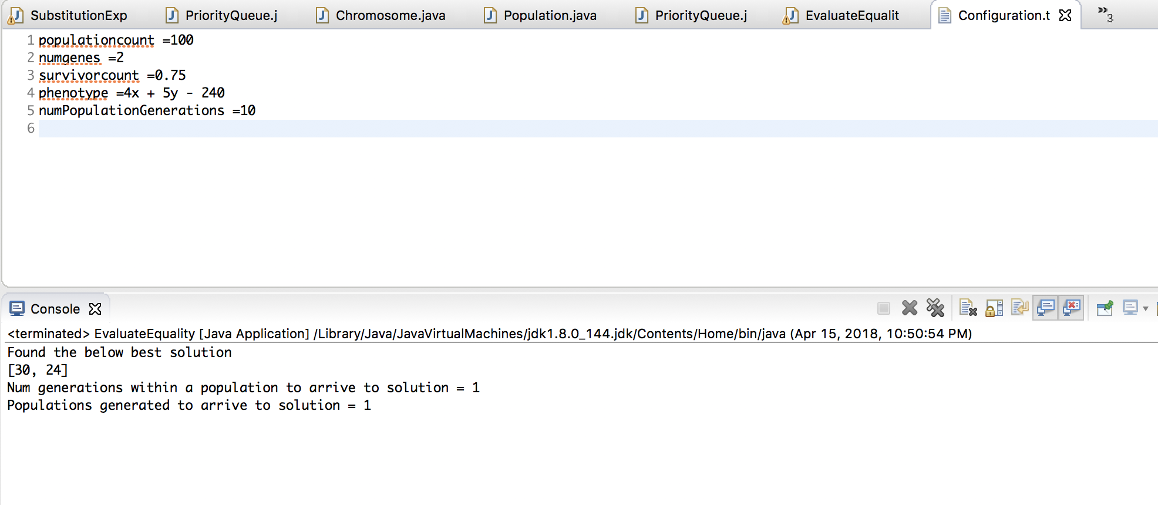
Equation : 4X + 5y–200 solution : [30,24] generation taken : 1 populations generated : 1

Slide 15
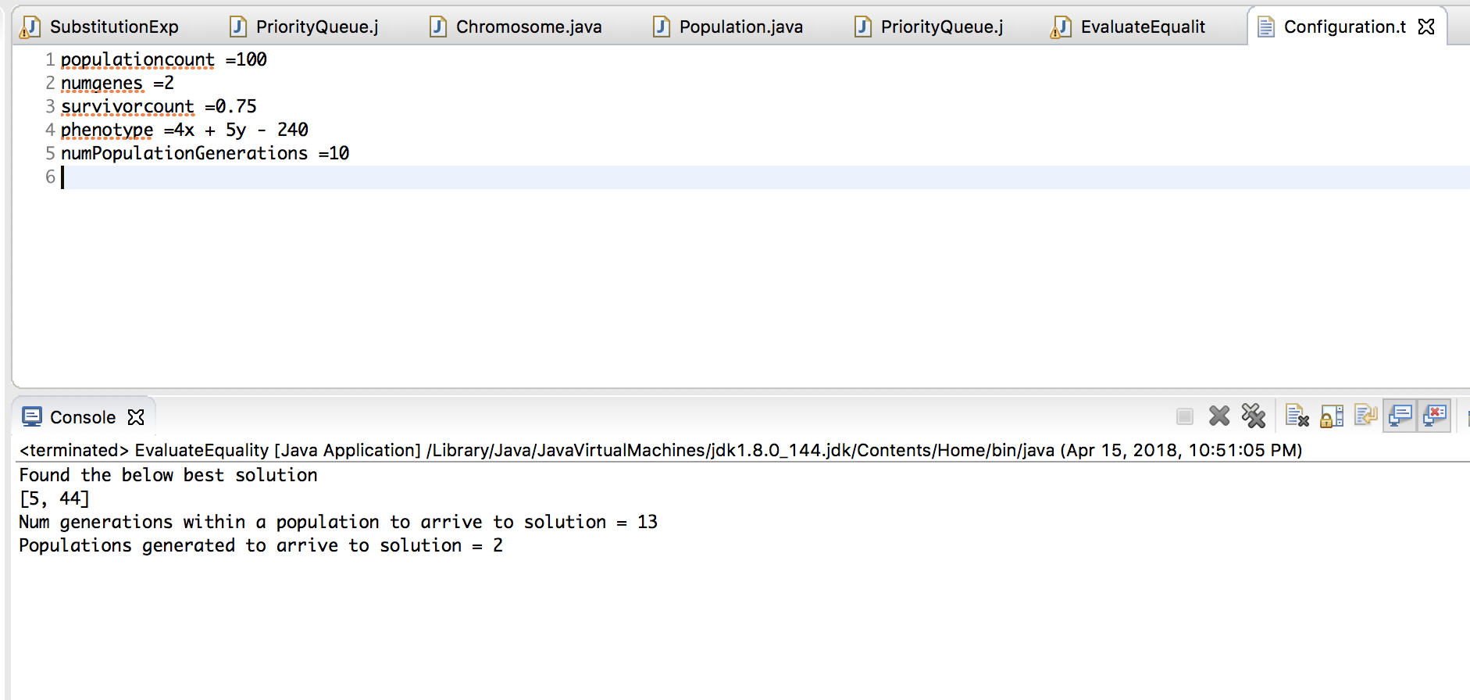
Equation : 4X + 5y–200 solution : [5,44] generation taken : 13 populations generated : 2

Slide 16
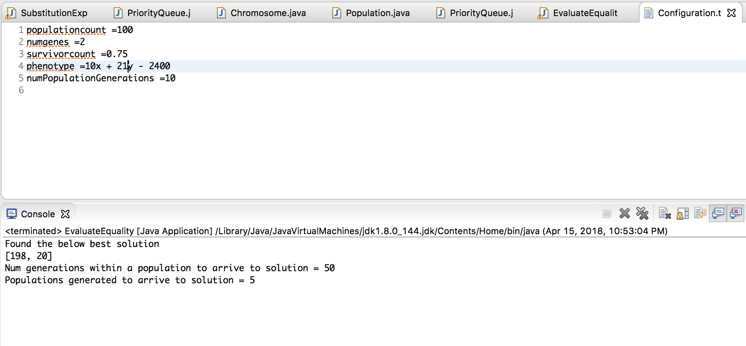
Equation :
10X + 21y–2400 solution : [198,20] generation taken : 50 populations generated : 5

Slide 17
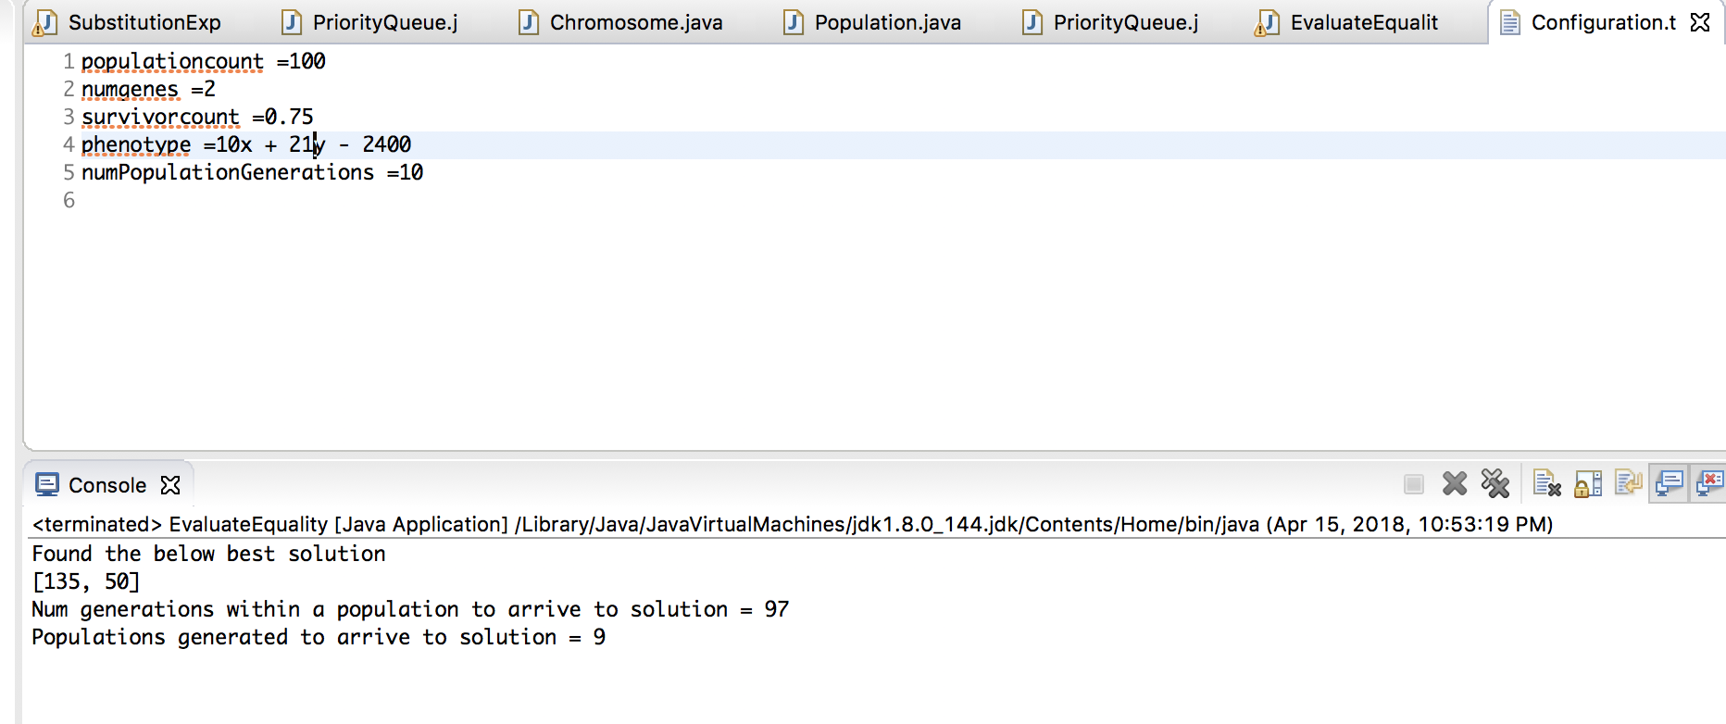
Equation :
10X + 21y–2400 solution : [135,50] generation taken : 97 populations generated : 9

Slide 18
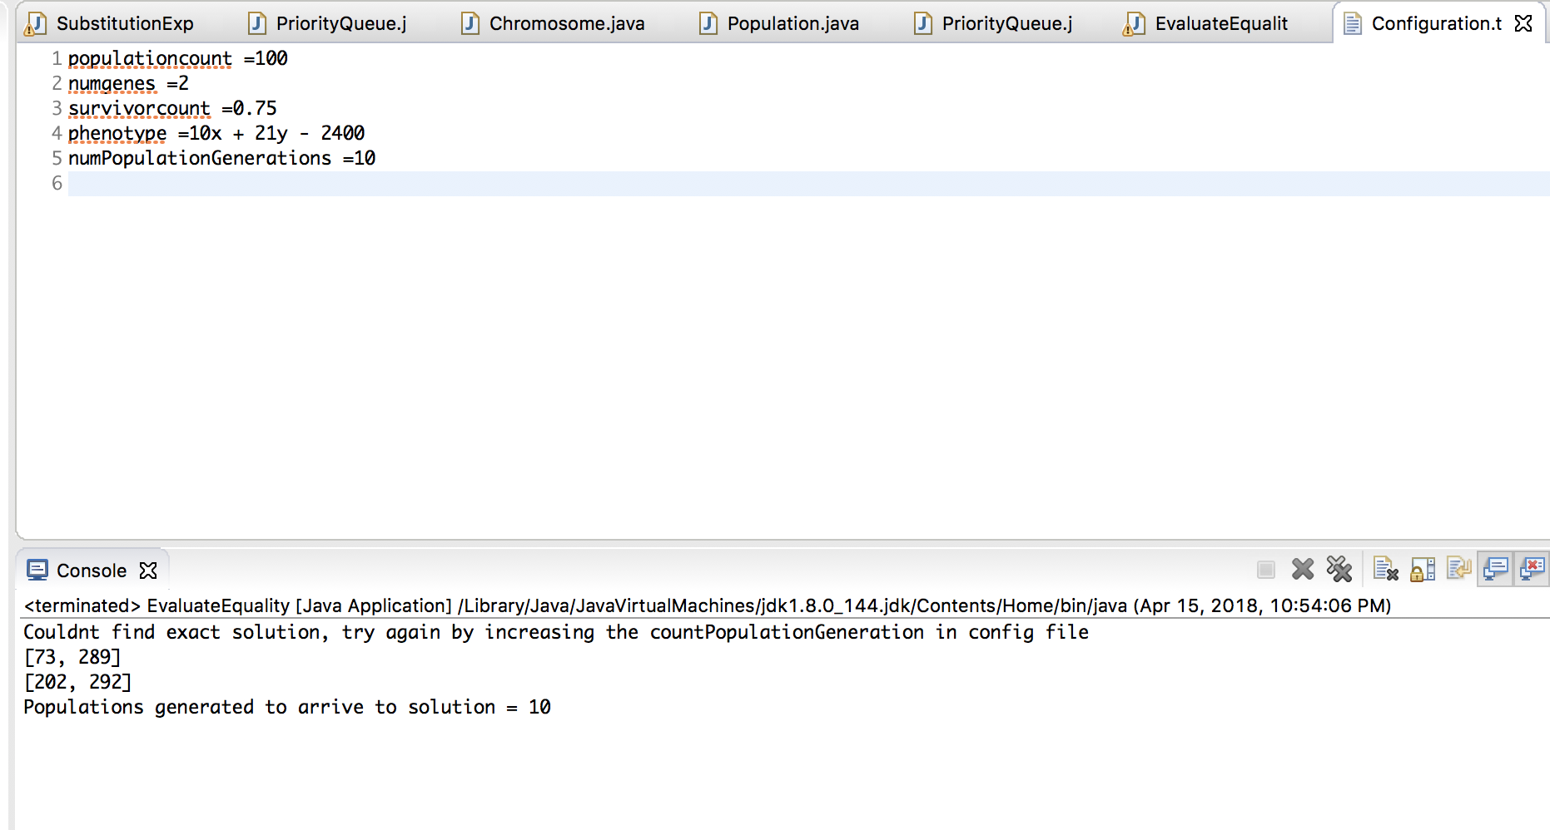
Equation :
10X + 21y–2400
BEST solutionS :
[73,289]
[202,292] populations generated : 10
Notes:
Here, it can be seen that we couldn’t find the exact solution and therefore we found 2 of our best solutions from the random integer set.

Slide 19
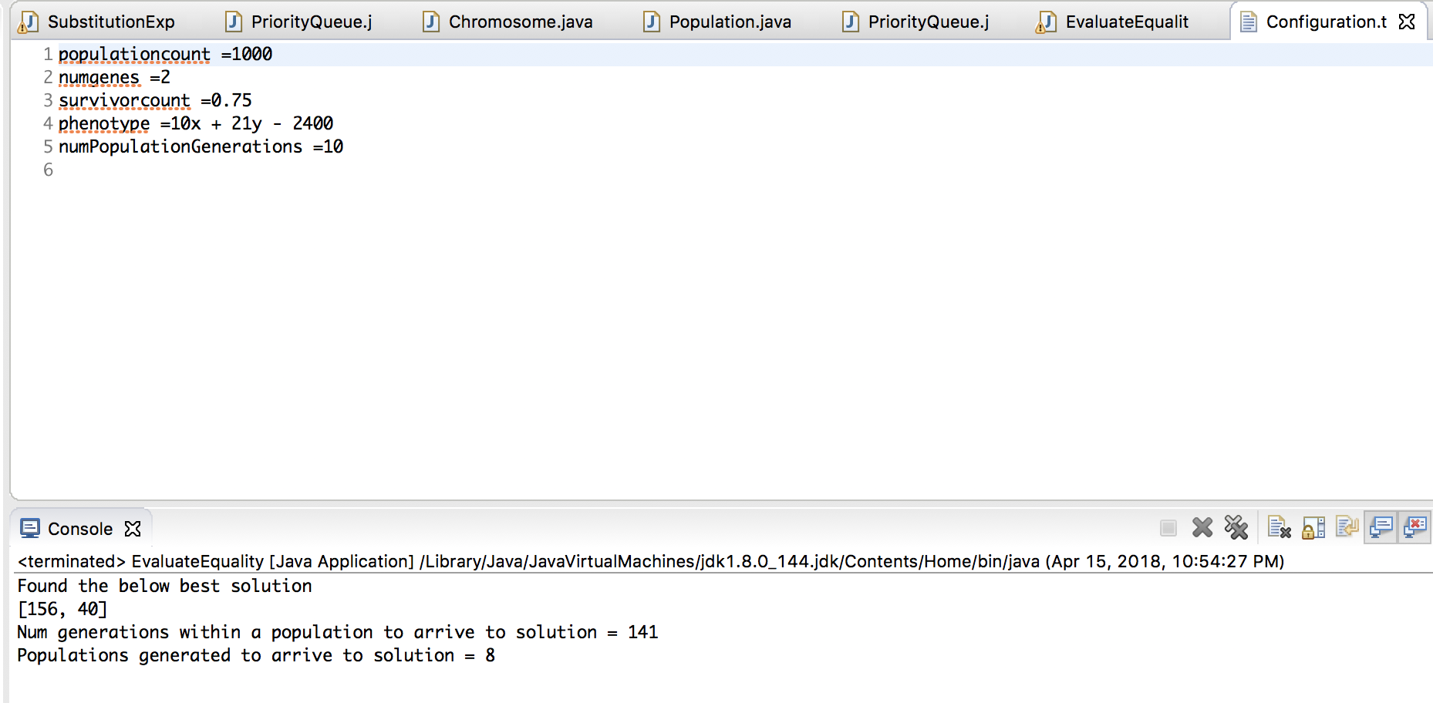
Equation :
10X + 21y–2400 solution : [156,40] generation taken : 141 populations generated : 8

