Slide 1
Employee Data Analysis using Excel
STUDENT NAME:VIJAYALAKSHMI S
REGISTER NO:C9A9DE18B478FBC83DD4FDFEF74385DC
DEPARTMENT:B.COM(GENERAL)
COLLEGE: MEENAKSHI COLLEGE FOR WOMEN

Slide 2
PROJECT TITLE
Employee Performance Analysis Based On Work Location And Gender using Excel

Slide 3


AGENDA
Problem Statement
Project Overview
End Users
Our Solution and Proposition
Dataset Description
Modelling Approach
Results and Discussion
Conclusion
3/21/2024 Annual Review

Slide 4

PROBLEM STATEMENT
The purpose this statement is to calculate the Full – Time Equivalent (FTE) based on the Employee Work Location and Gender regardless of how many Male and Female employees are working in the specific location.
Notes:
O

Slide 5

PROJECT OVERVIEW
Employee analysis involves examining various aspects of the workforce to gain insight that can help in decision – making, improving efficiency , and enhancing employee satisfaction

Slide 6

WHO ARE THE END USERS?
HUMAN RESOURCE DEPARTMENT
MANAGEMENT AND LEADERSHIP
TEAM LEADERS AND SUPERVISORS
EMPLOYEES
EXECUTIVE LEADERSHIP
BUSINESS ANALYSTS
RECRUITERS

Slide 7

OUR SOLUTION AND ITS VALUE PROPOSITION
FILTERING – REMOVE VALUES
PIVOT TABLE – SUMMARY OF EMPLOYEES PERFOMANCE
BAR DIAGRAM – FINAL REPORT

Slide 8
Dataset Description
.EMPLOYEE DATA SET – NAN MUDHALAVAN PORTAL
. 9 FEATURES IN EXCEL:
EMPLOYEE ID – ALPHANUMERICAL (TEXT)
NAME – ALPHABETICAL(TEXT)
GENDER – ALPHABETICAL (TEXT)
DEPARTMENT – ALPHABETICAL (TEXT)
SALARY – NUMERICAL
START DATE – ALPHANUMERICAL (TEXT)
FTE – NUMERICAL
EMPLOYEE TYPE – ALPHABETICAL (TEXT)
EMPLOYEE LOCATION – ALPHABETICAL (TEXT)
. 3 FEATURES USED:
EMPLOYEE LOCATION – ALPHABETICAL (TEXT)
FTE – NUMERICAL
GENDER – ALPHABETICAL (TEXT)

Slide 9

THE "WOW" IN OUR SOLUTION
Effective data visualization makes it easier to present complex data in an engaging and understandable way.
Well – presented data can have a significant impact on decision – makers , helping to drive change and innovation
3/21/2024 Annual Review
9

Slide 10
MODELLING
STEP -1
DOWNLOAD THE EMPLOYEE DATASET AND OPEN THE EMPLOYEE DATASET IN EXCEL.
STEP – 2
SELECT THE ENTIRE DATA AND CLICK ON DATA AND CLICK ON FILTER OPTION.
STEP -3
FILTER FTP FROM A TO Z ORDER
STEP – 4
SELECT THE ENTIRE DATA AND CLICK ON INSERT AND CLICK ON PIVOT TABLE TO CREATE PIVOT TABLE
10

Slide 11
STEP – 5
DRAG THE NEEDED DATA AND CREATE A PIVOT TABLE
STEP – 6
SELECT THE PIVOT TABLE AND CLICK ON INSERT
STEP – 7
NOW CLICK ON TH CHART THAT YOU WANT
STEP – 8
THE CHART IS CREATED

Slide 12
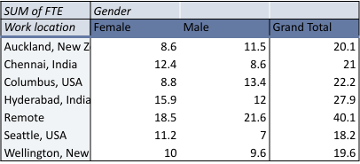
RESULTS
1.BAR GRAPH
12

Slide 13
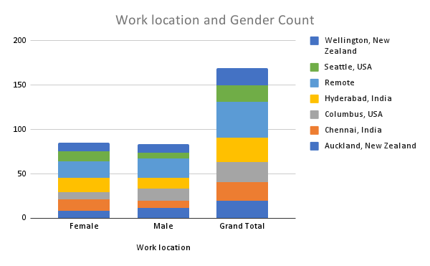
2.STACKED COLUMN CHART

Slide 14
Conclusion
The dataset reveals the overall composition of the workforce, including demographics such as gender salary, employee type
and work location. This information is crucial for understanding the diversity and experience level within the organization
The analysis aids in workforce planning by forecasting future staffing needs based on current trends and organizational growth projections.

