Slide 1
Analysis on BOX OFFICE mojo

Slide 2
Data Source
http://www.boxofficemojo.com/movies/( from 1982 to 2015 )
All Movies
Top 20 Movies

Slide 3
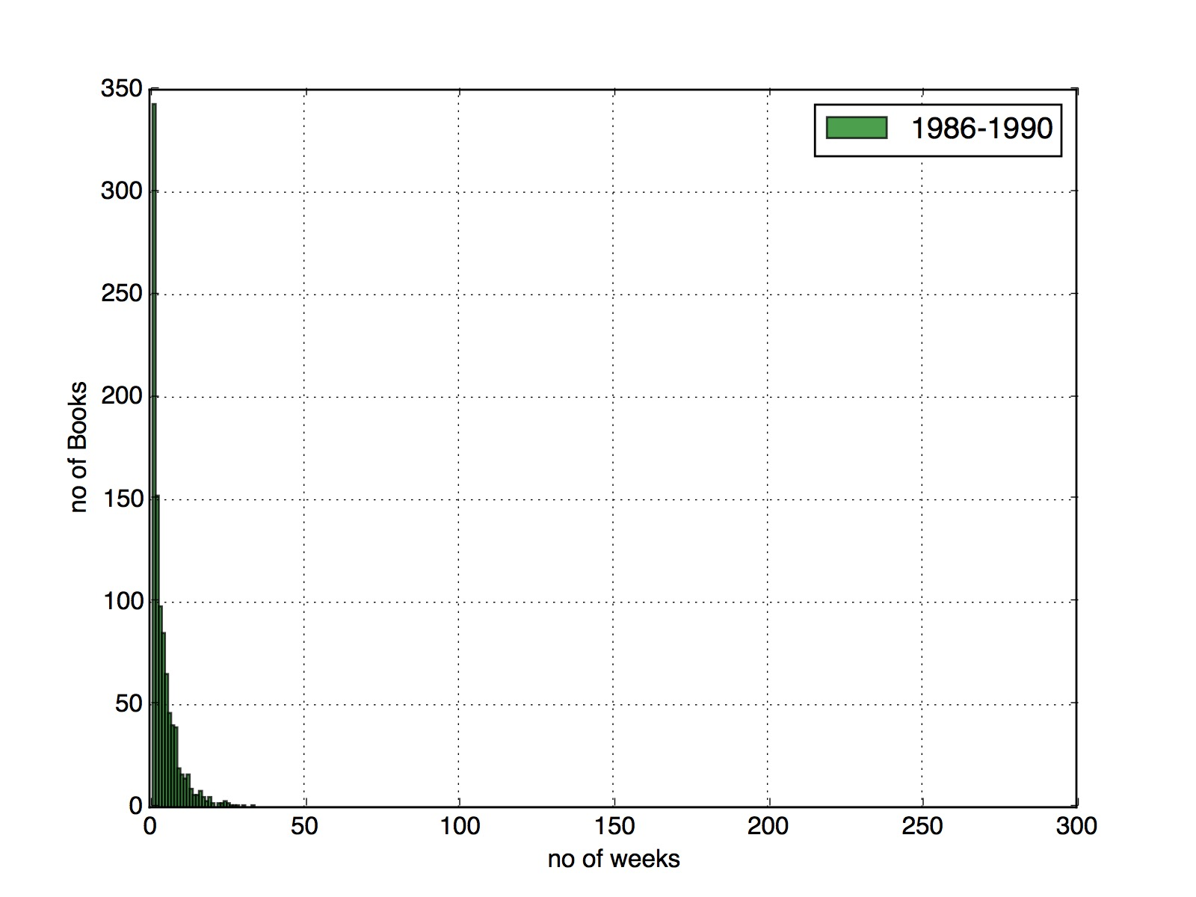
Histograms
Capture Movies spent on chart

Slide 4
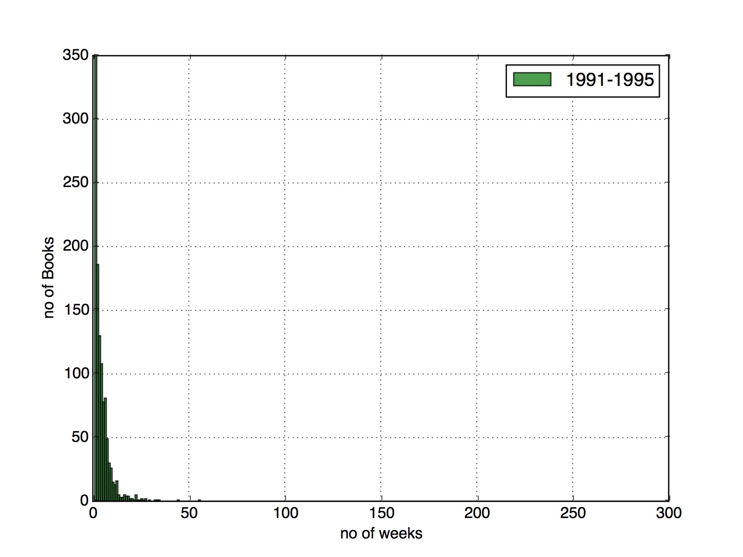
Histograms
Capture Movies spent on chart

Slide 5
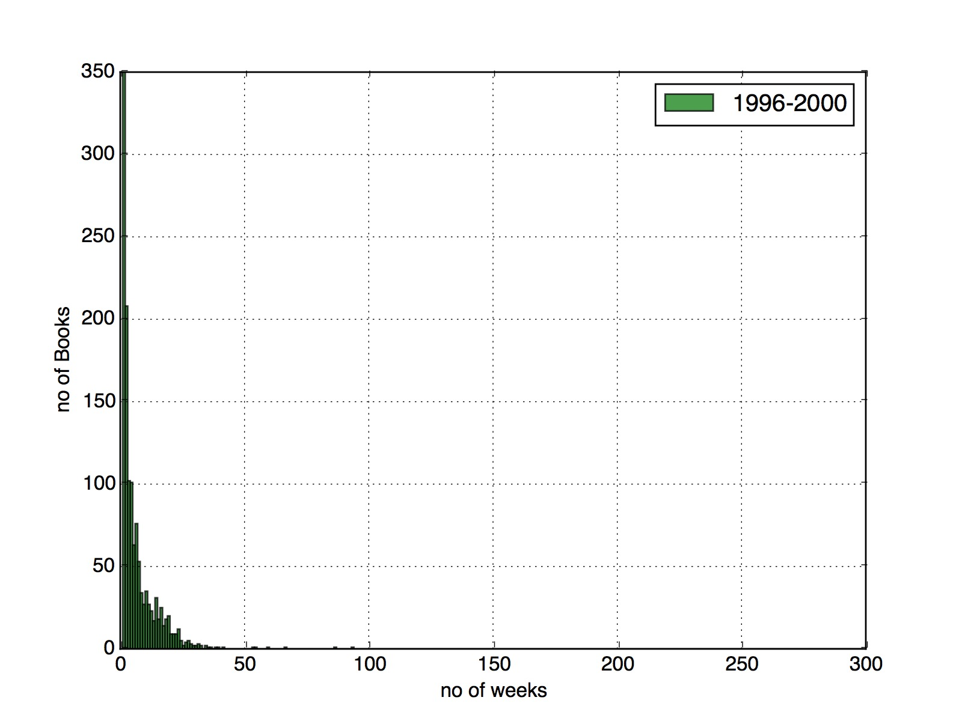
Histograms
Captured Movies spent on chart

Slide 6
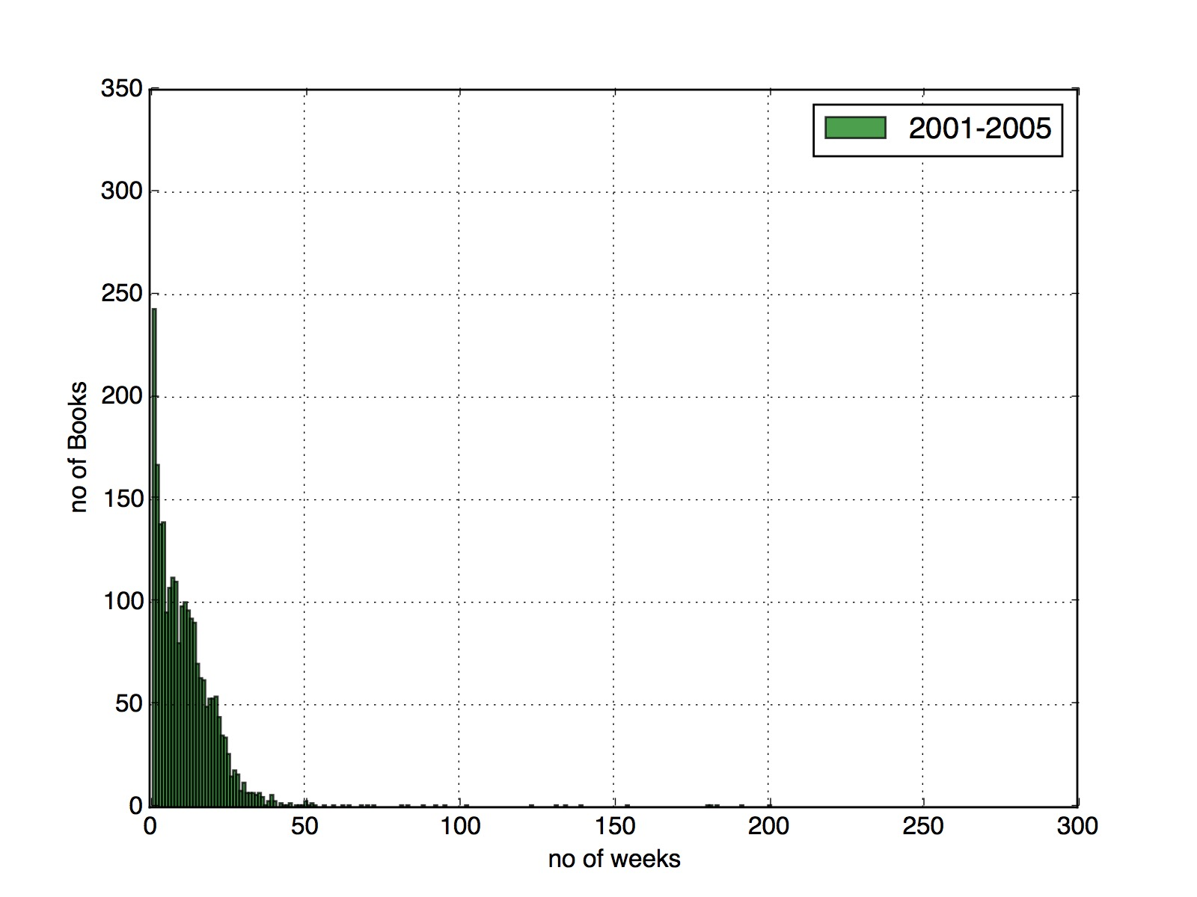
Histograms
Captured Songs spent on chart

Slide 7
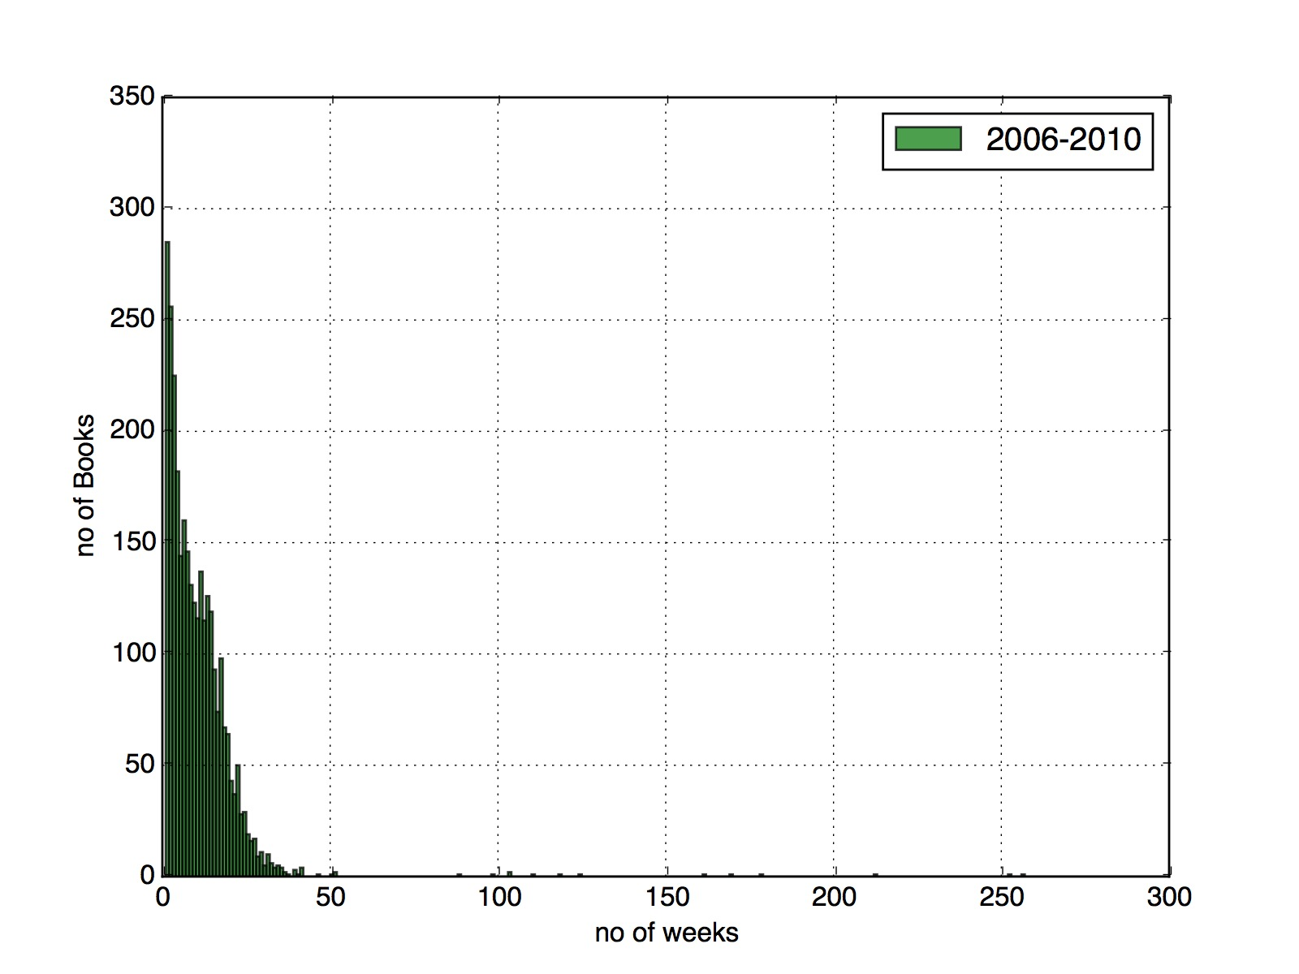
Histograms
Captured Movies spent on chart

Slide 8

Histograms
Captured Movies spent on chart

Slide 9
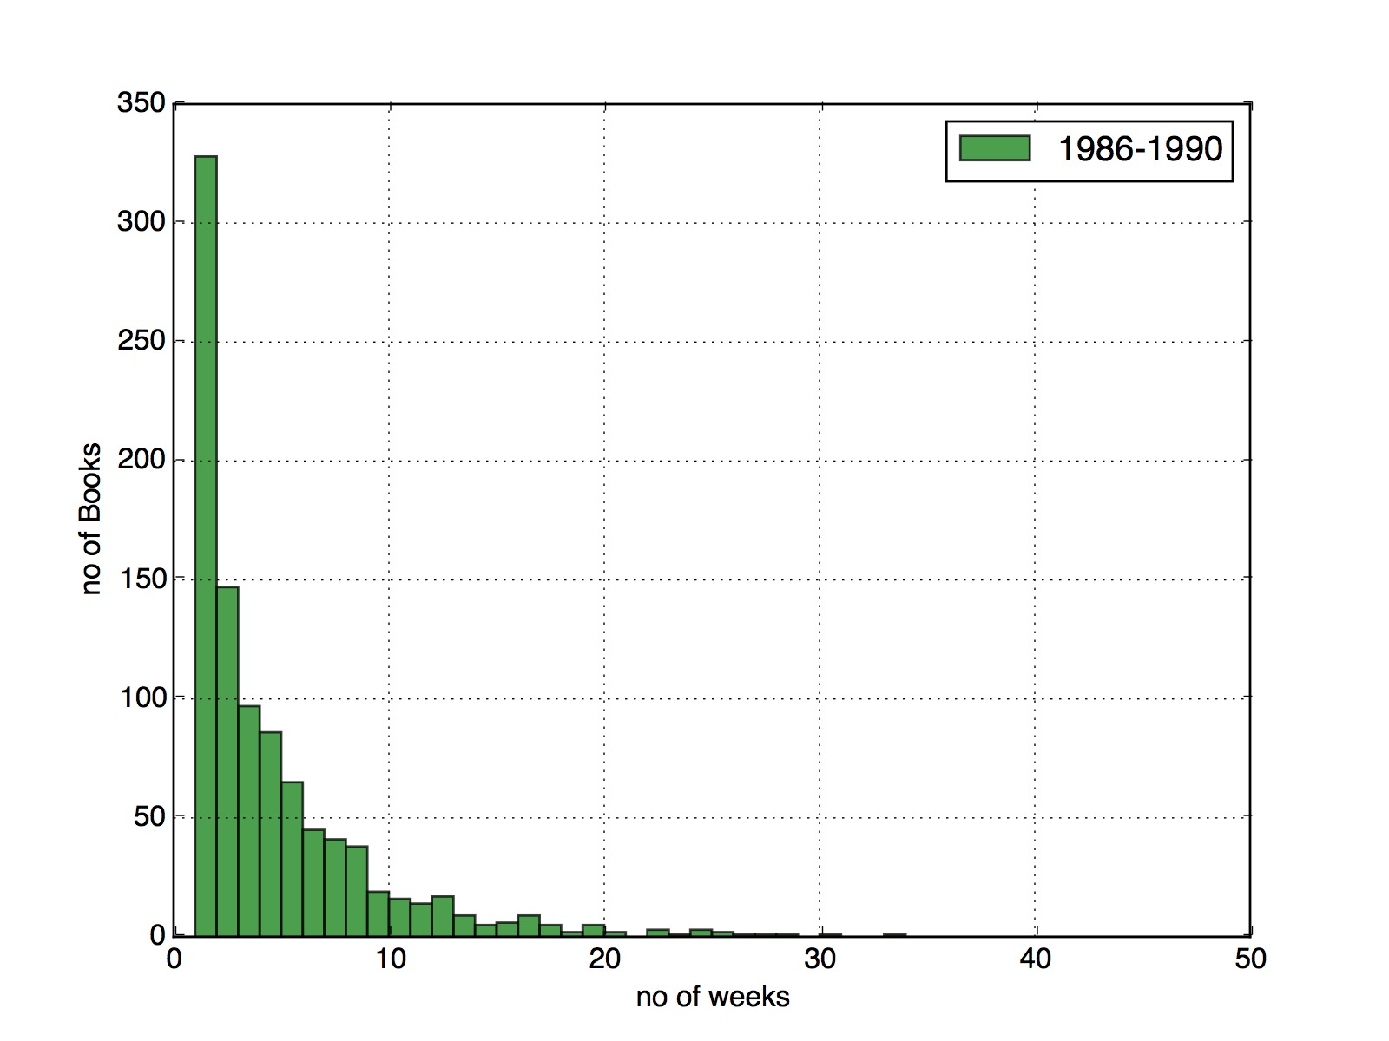
Histograms
Captured Movies spent on chart (Top 20)

Slide 10
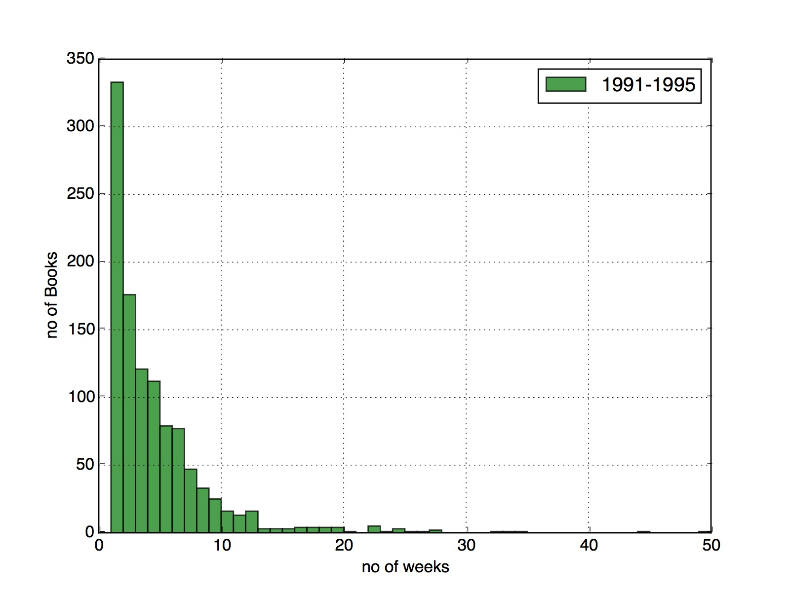
Histograms
Captured Movies spent on chart ( Top 20)

Slide 11

Histograms
Captured Movies spent on chart ( Top 20)

Slide 12
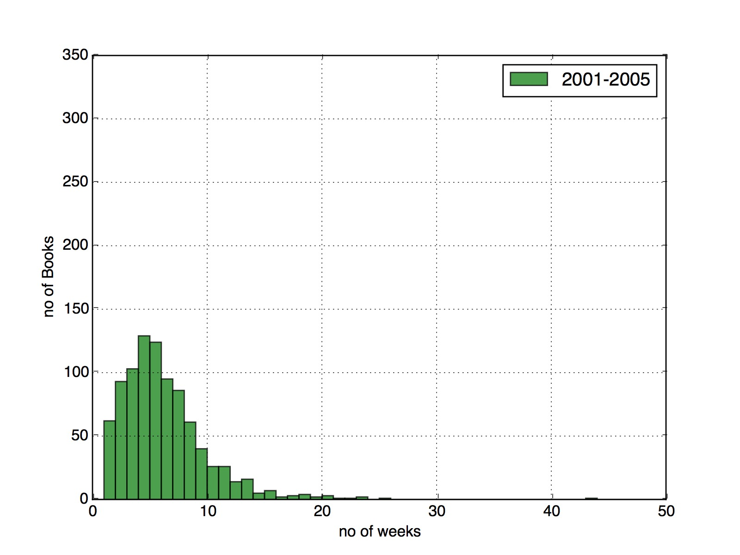
Histograms
Captured Movies spent on chart ( Top 20)

Slide 13
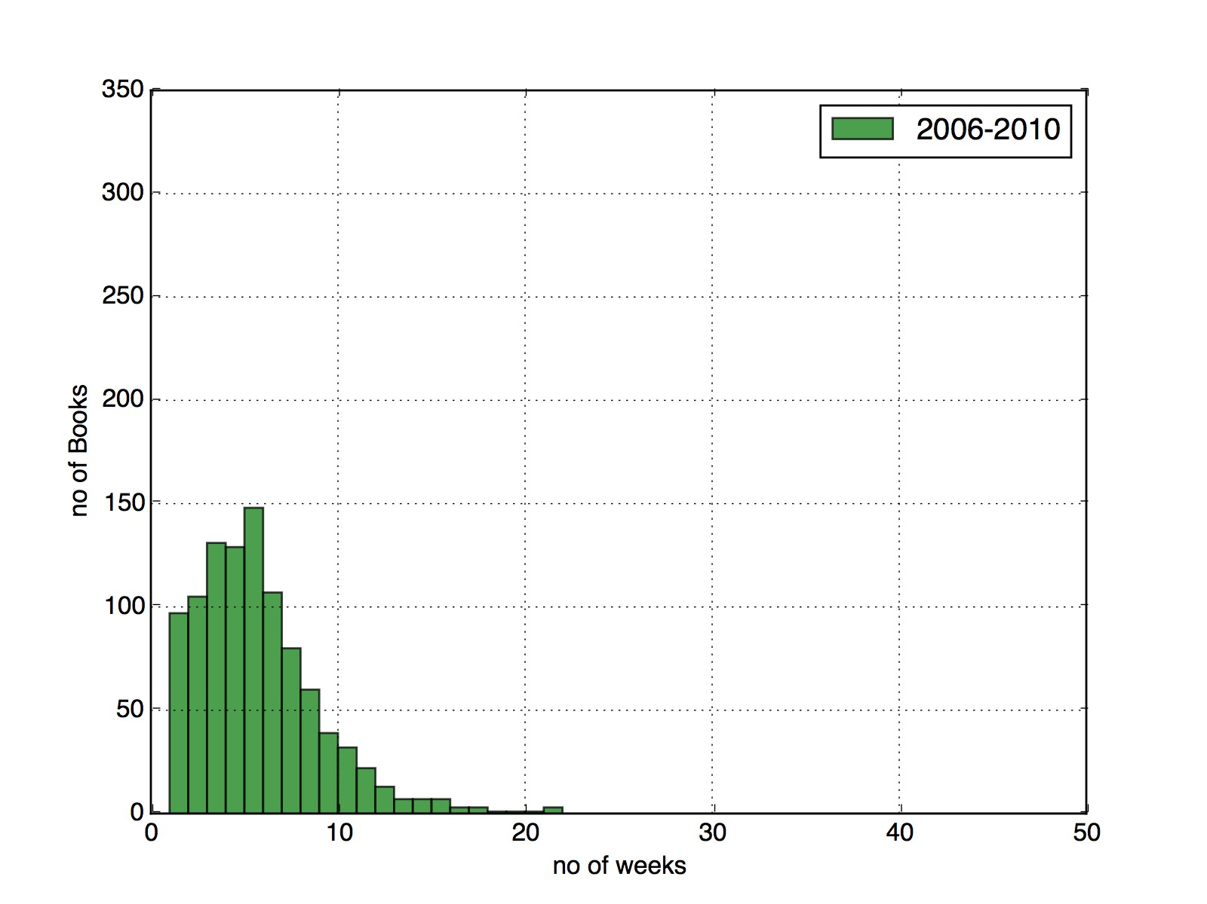
Histograms
Captured Movies spent on chart ( Top 20)

Slide 14

Histograms
Captured Movies spent on chart ( Top 20)

Slide 15
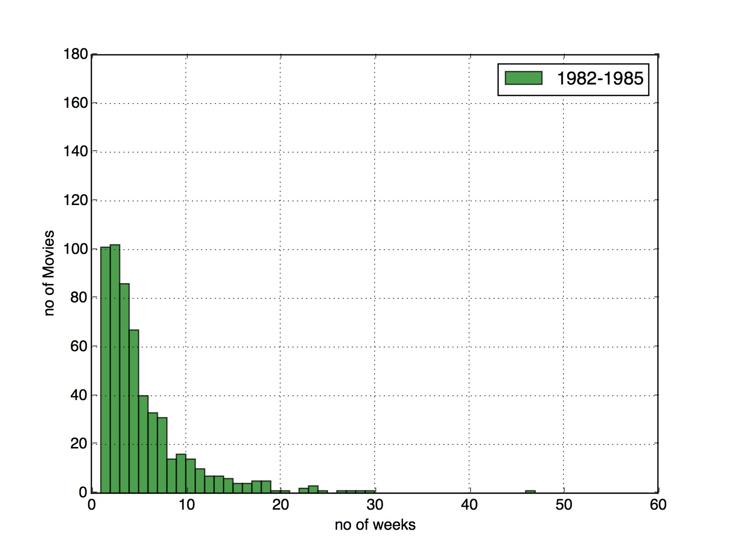
Histograms
Captured Movies spent on chart ( Top 10)

Slide 16
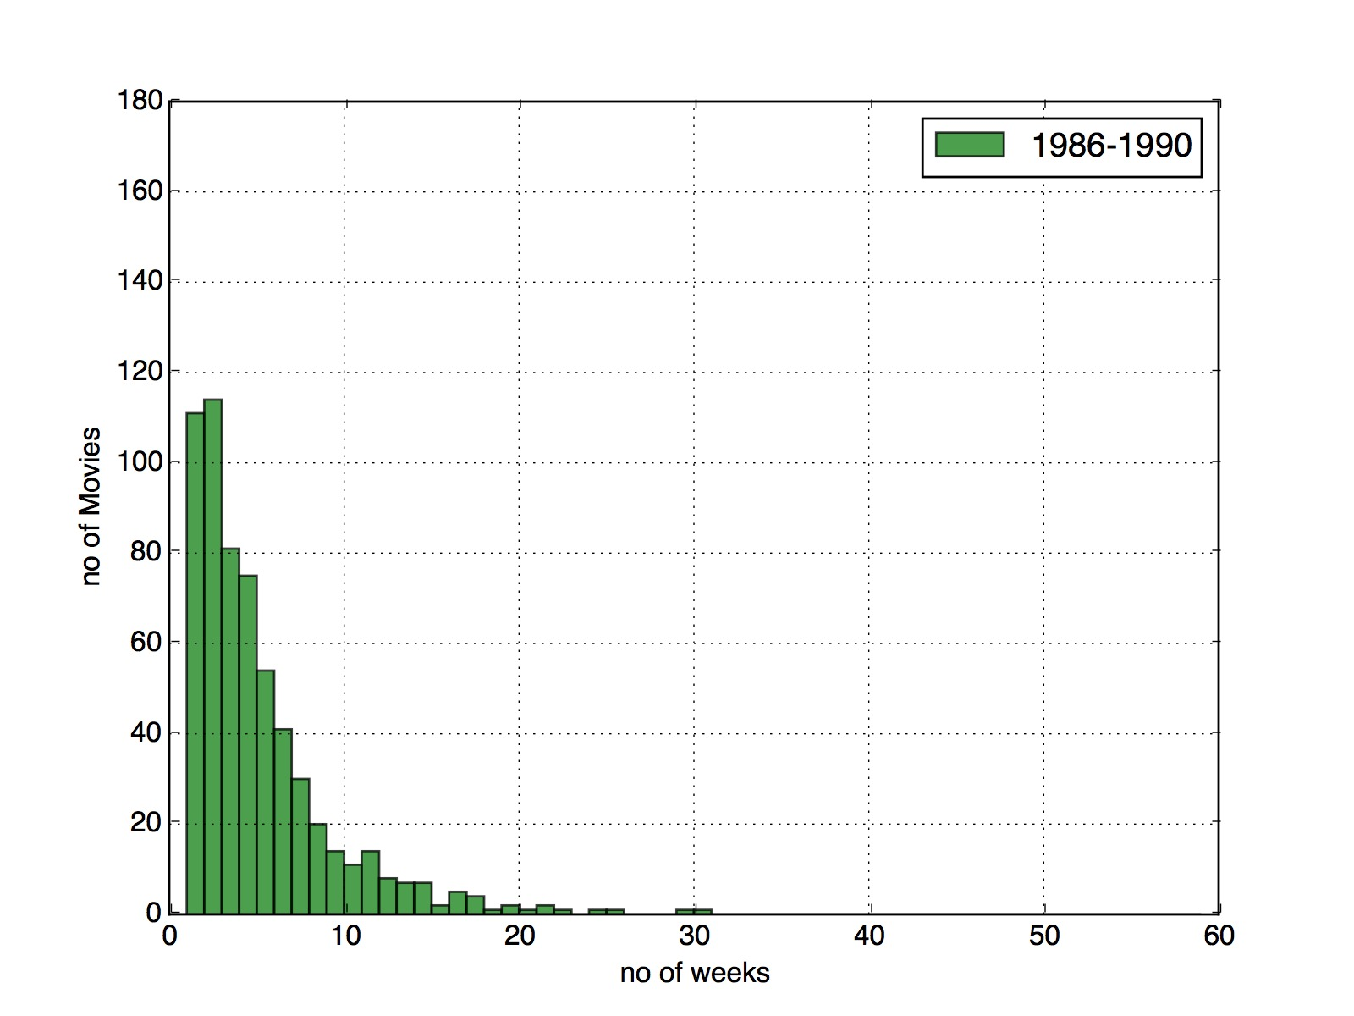
Histograms
Captured Movies spent on chart ( Top 10)

Slide 17
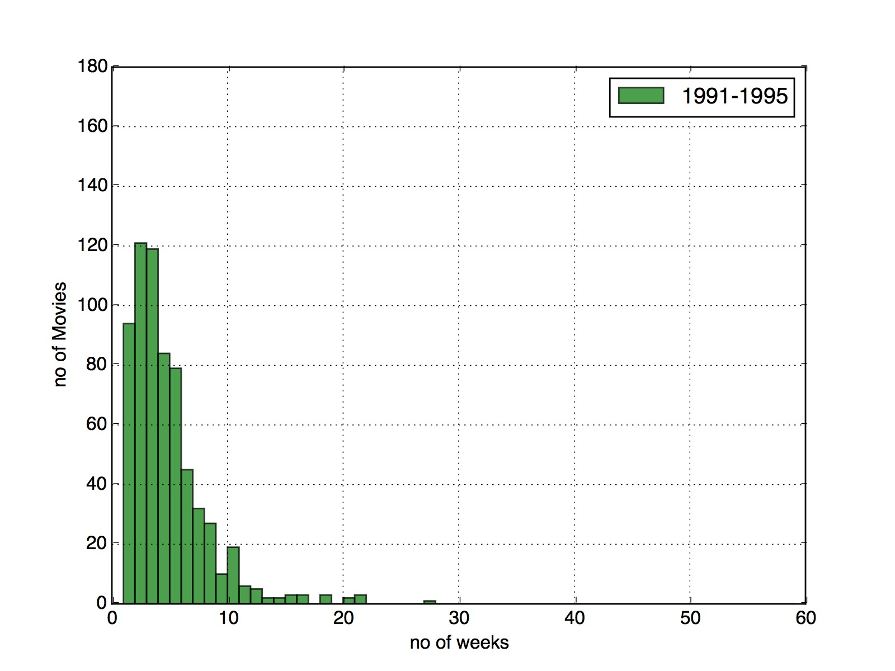
Histograms
Captured Movies spent on chart ( Top 10)

Slide 18

Histograms
Captured Movies spent on chart ( Top 10)

Slide 19
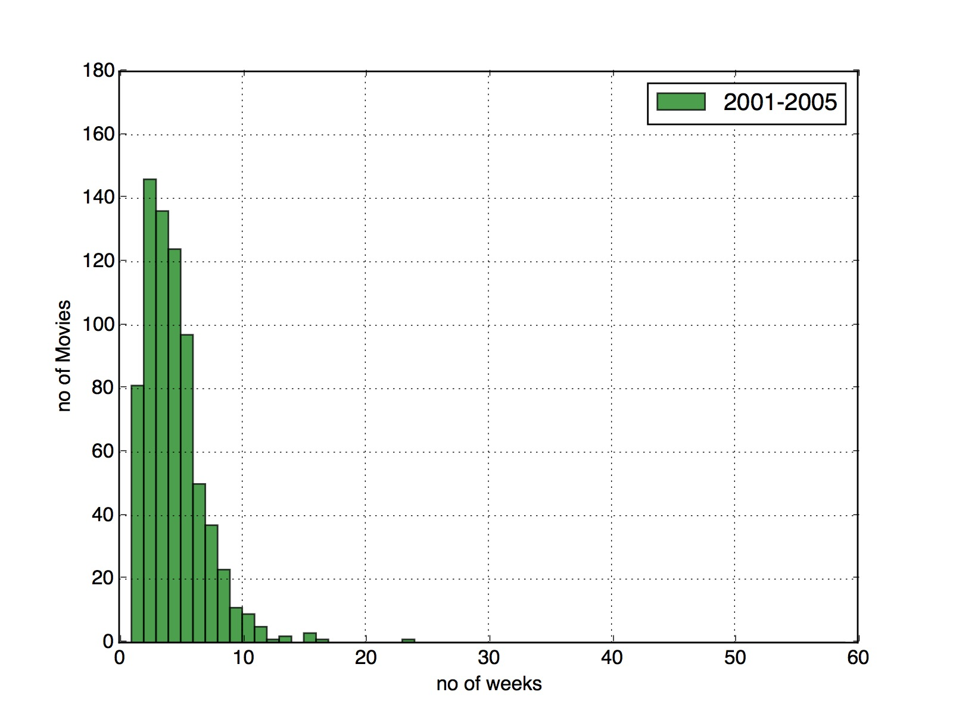
Histograms
Captured Movies spent on chart ( Top 10)

Slide 20
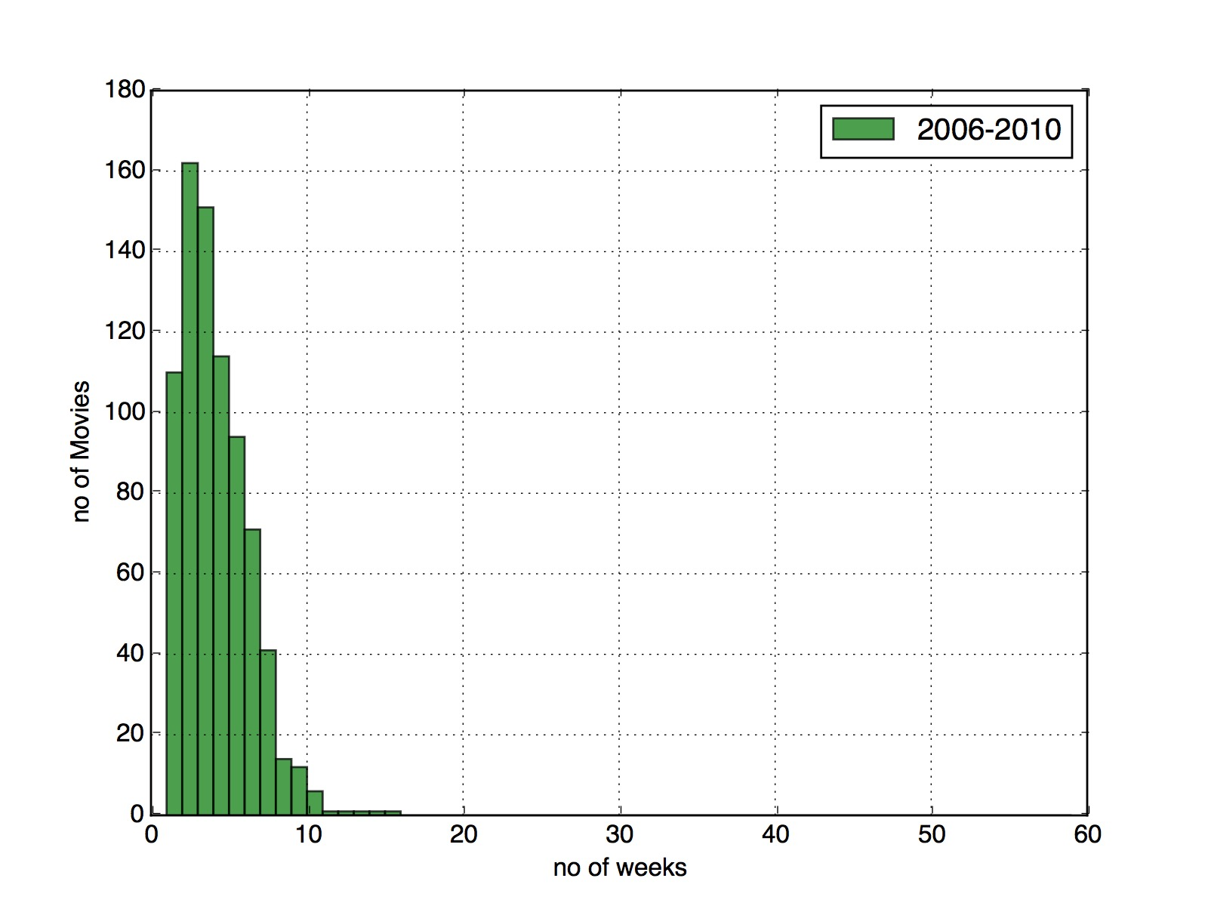
Histograms
Captured Movies spent on chart ( Top 10)

Slide 21
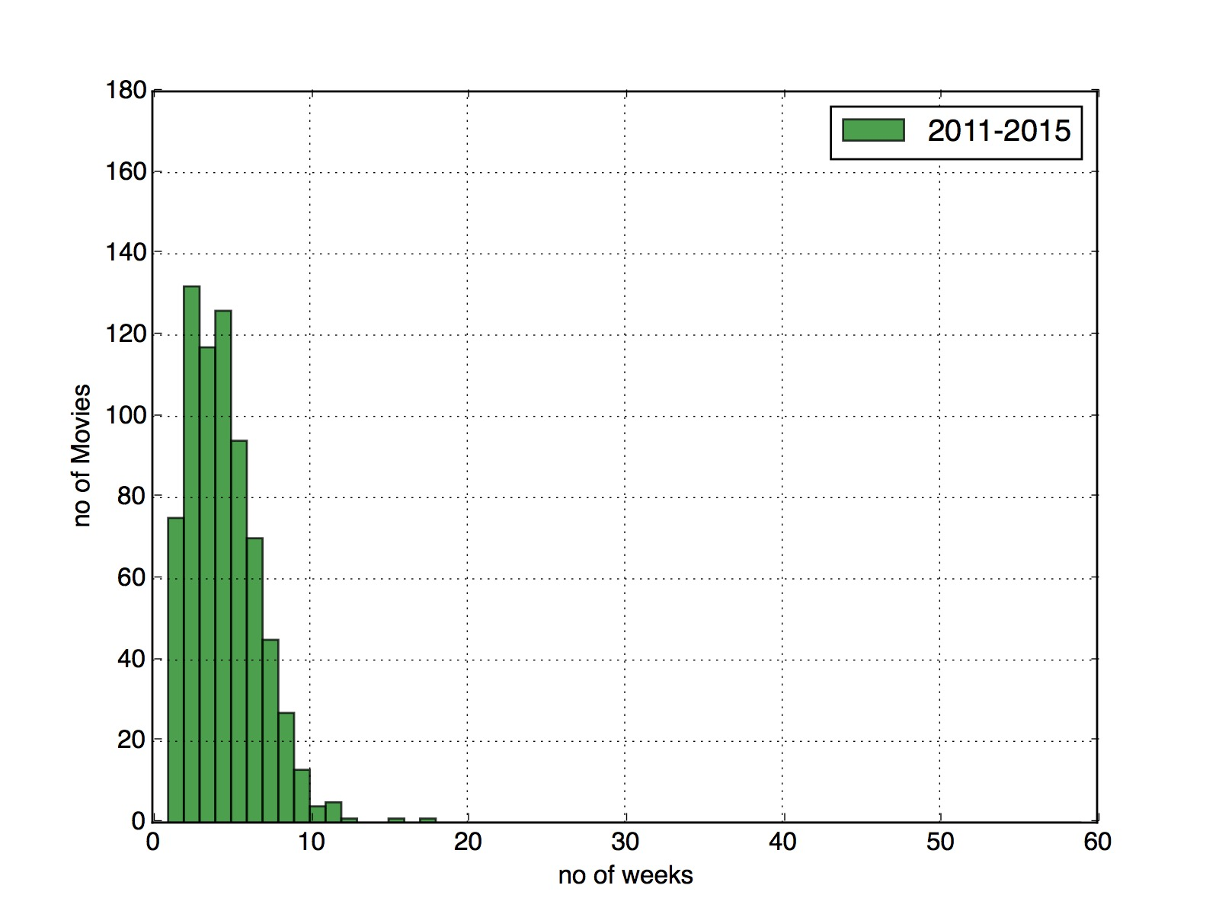
Histograms
Captured Movies spent on chart ( Top 10)

Slide 22
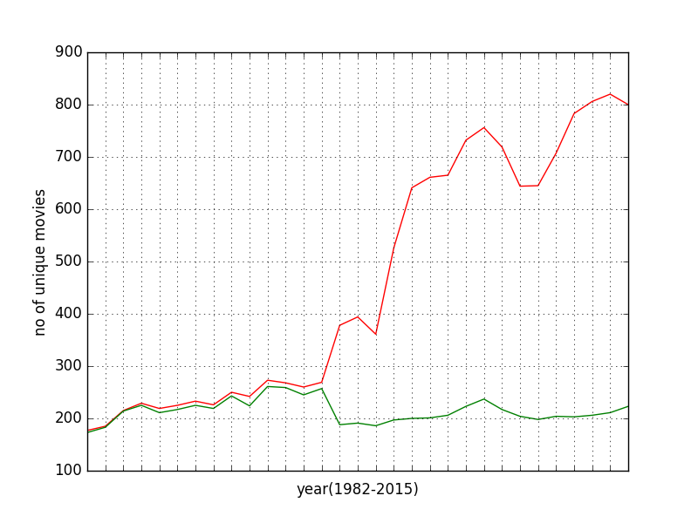
Compare unique Movies over time

Slide 23
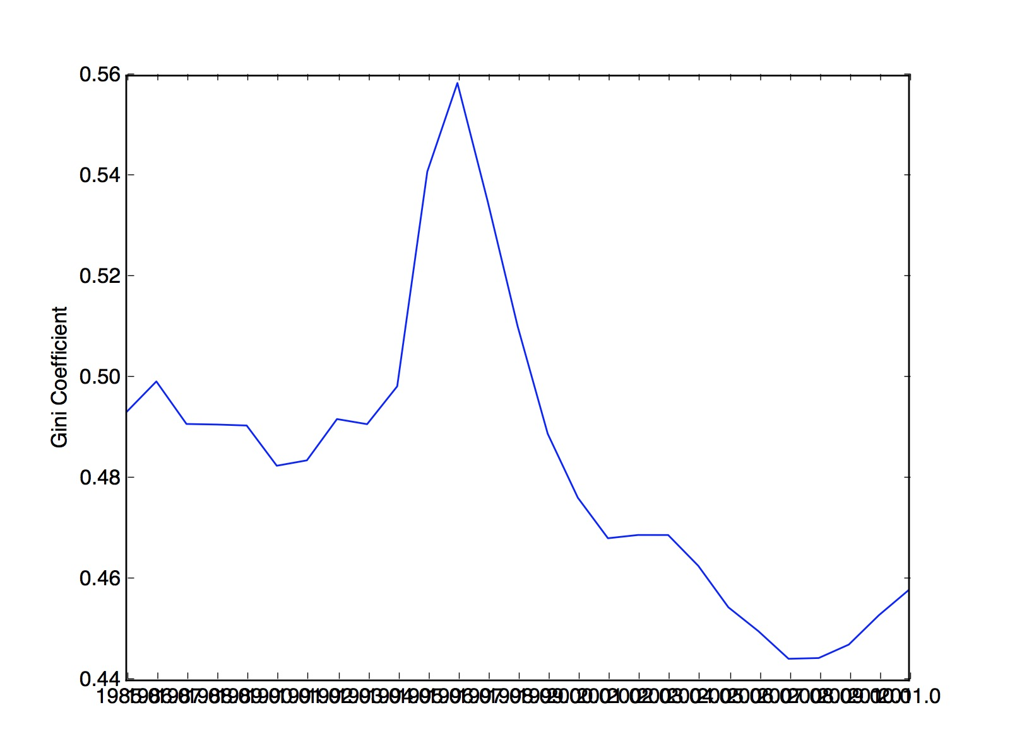
GINI INDEX FOR Movies with rolling average for 1 year

Slide 24
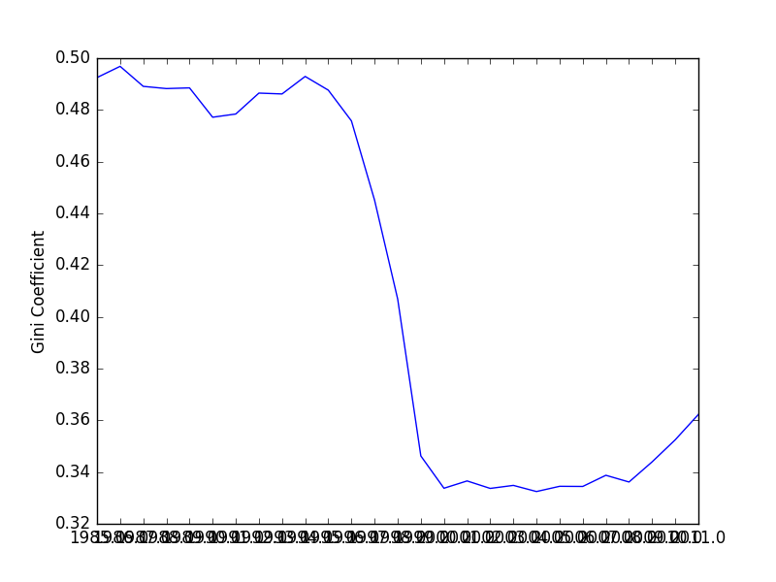
GINI INDEX FOR Songs with rolling average for 1 year (Top 20)

Slide 25
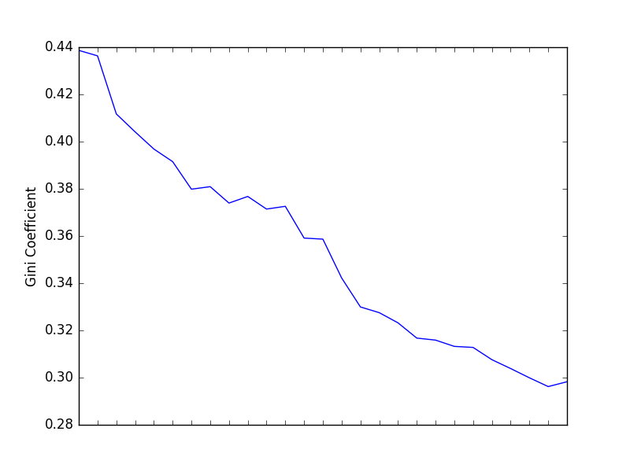
GINI INDEX FOR Songs with rolling average for 1 year (Top 10)

Slide 26
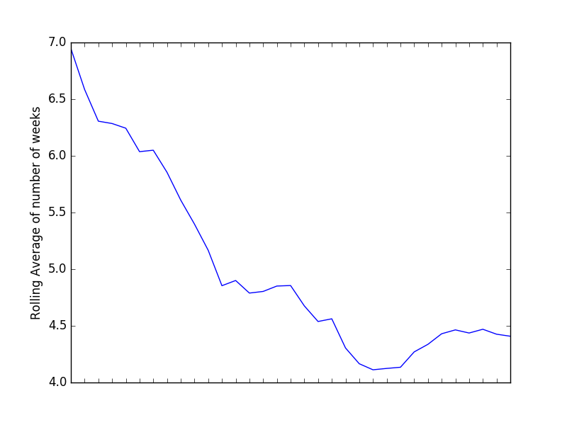
Rolling Average

Slide 27
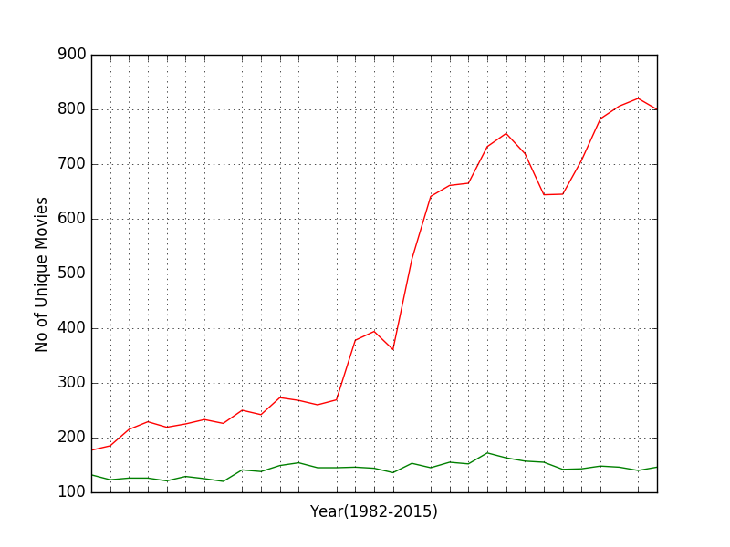
Unique Movies Comparison

Slide 28
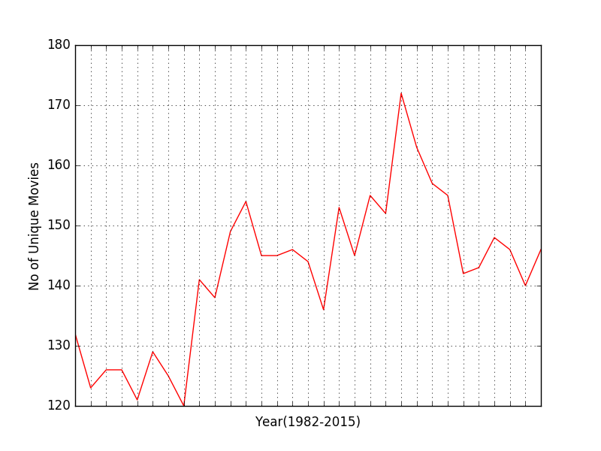
Unique Movies TOP 10

