Slide 1
Analysis on billboard

Slide 2
Data Source
http://www.billboard.com/charts/hot-100 ( from 1959 to 2015 )
Top 100 Songs of week
Top 40 Songs of week
Top 10 Songs of week

Slide 3
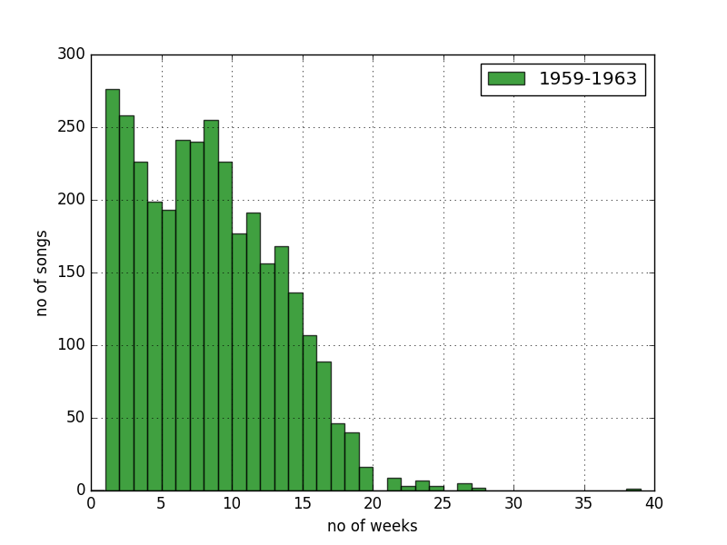
Histograms
Capture Songs spent on chart

Slide 4
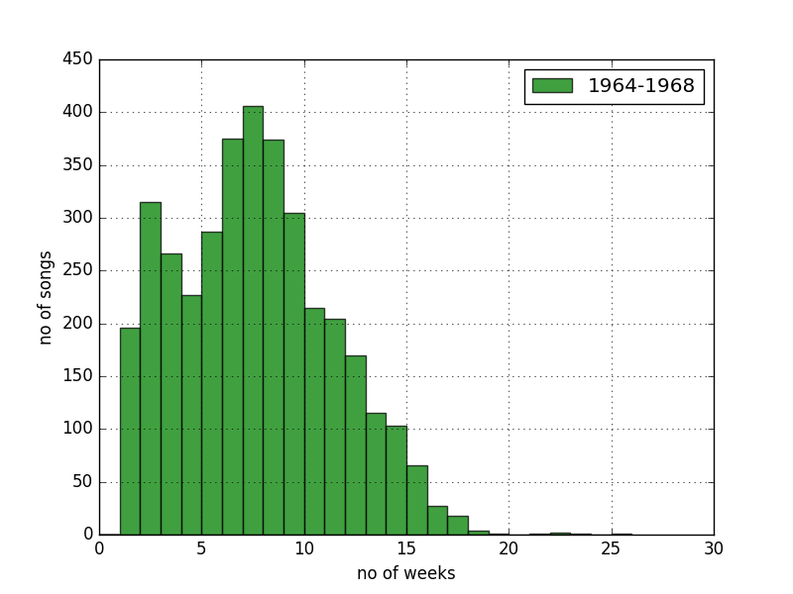
Histograms
Capture Songs spent on chart

Slide 5
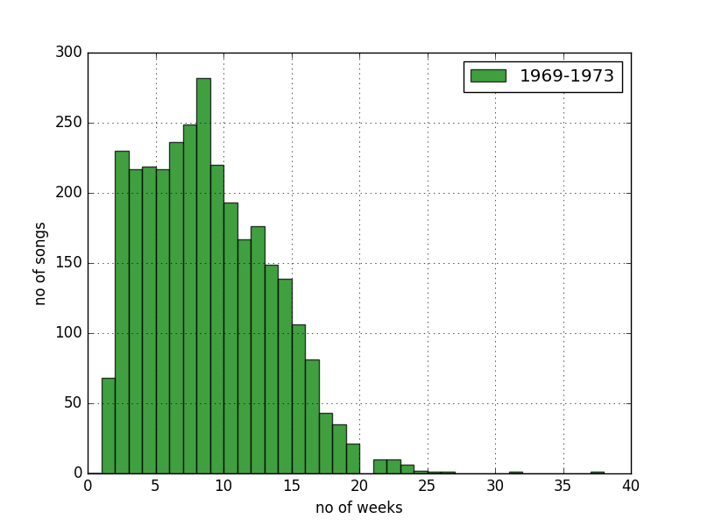
Histograms
Captured Songs spent on chart

Slide 6
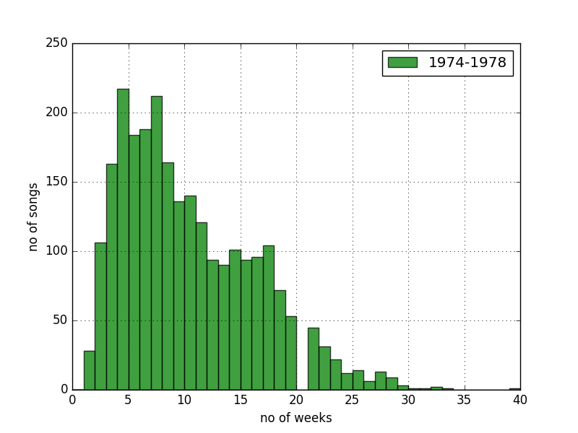
Histograms
Captured Songs spent on chart

Slide 7
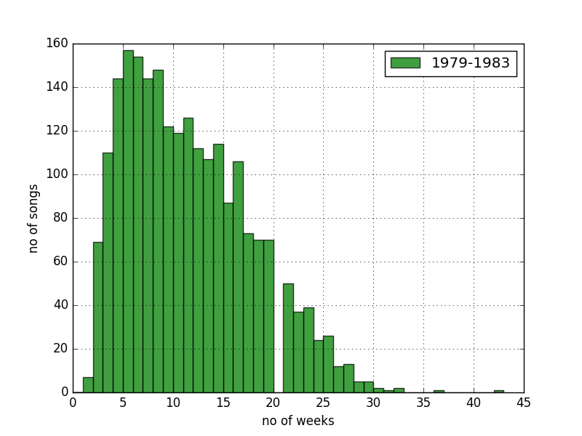
Histograms
Captured Songs spent on chart

Slide 8
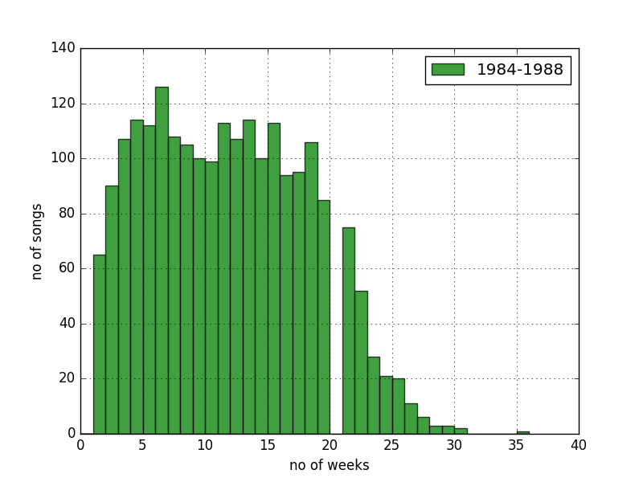
Histograms
Captured Songs spent on chart

Slide 9
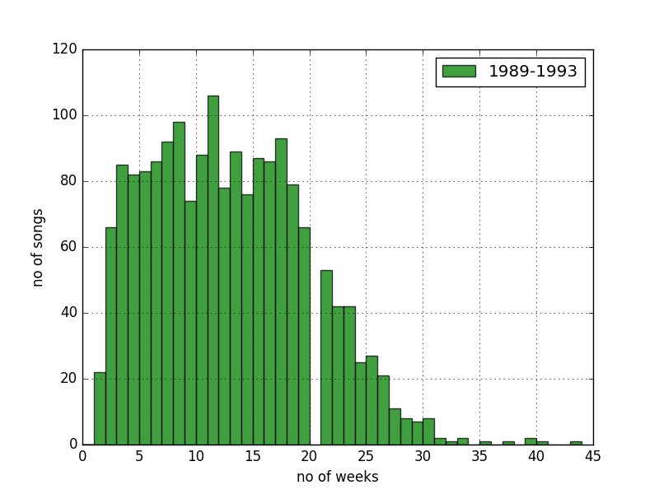
Histograms
Captured Songs spent on chart

Slide 10
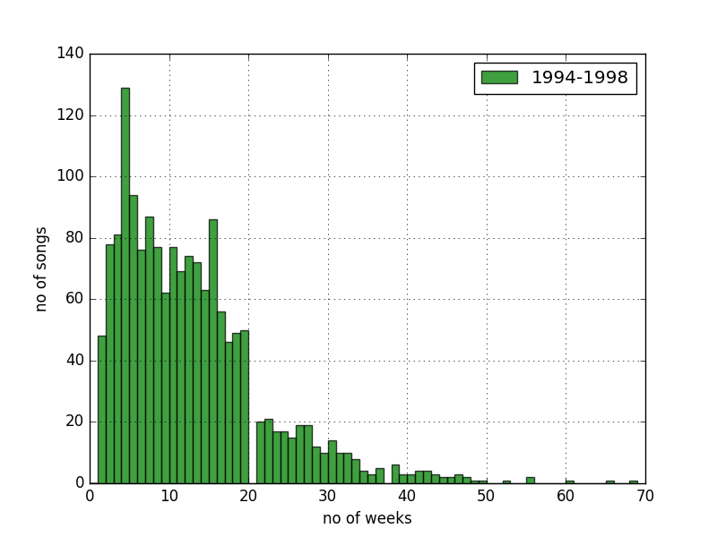
Histograms
Captured Songs spent on chart

Slide 11
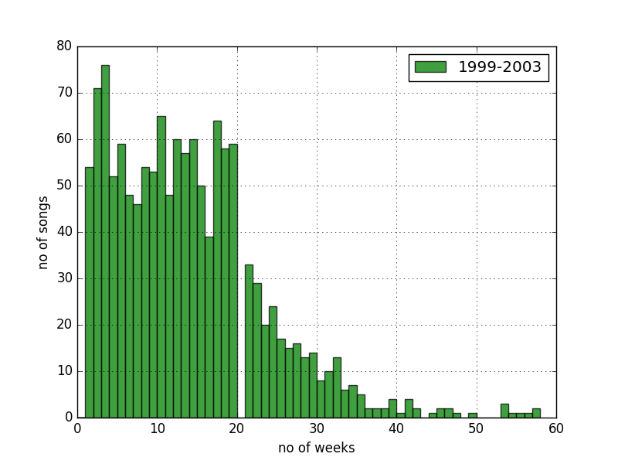
Histograms
Captured Songs spent on chart

Slide 12
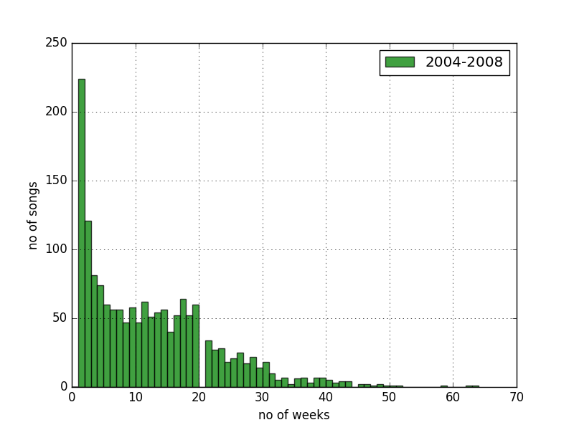
Histograms
Captured Songs spent on chart

Slide 13
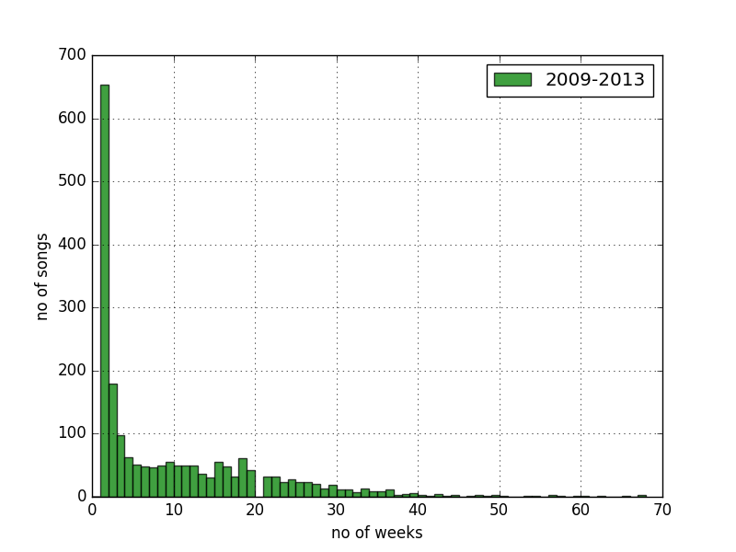
Histograms
Captured Songs spent on chart

Slide 14
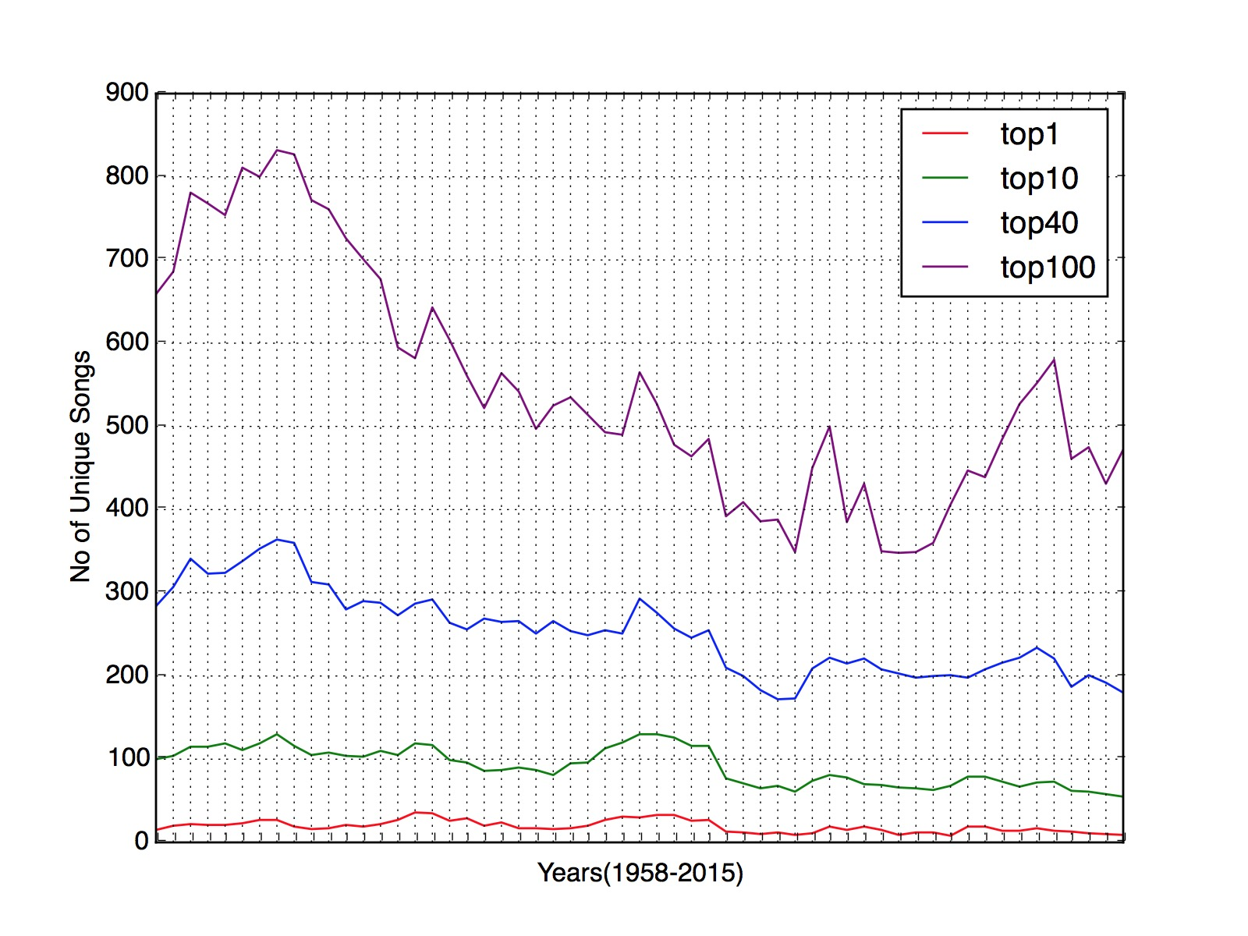
Compare unique songs over time

Slide 15
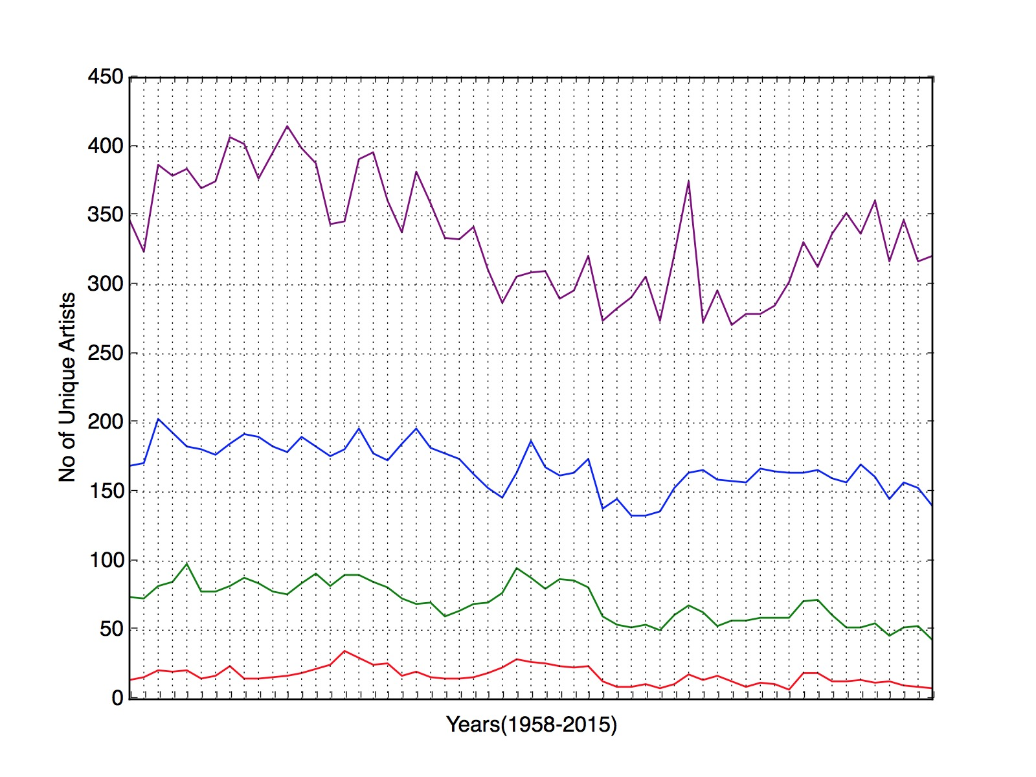
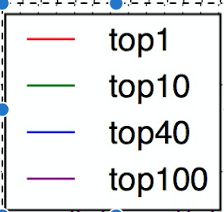
Compare unique Artists over time

Slide 16
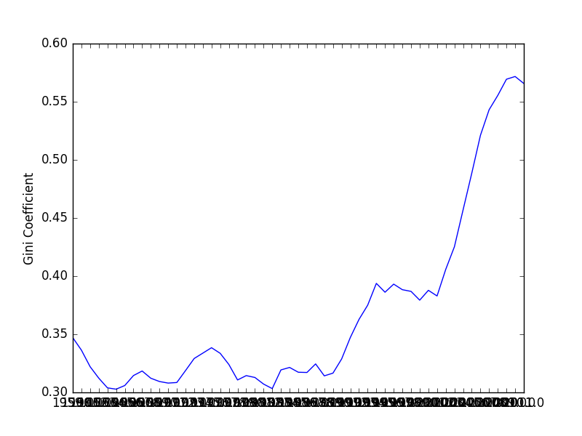
GINI INDEX FOR Songs with rolling average for 1 year (Top 100)

Slide 17
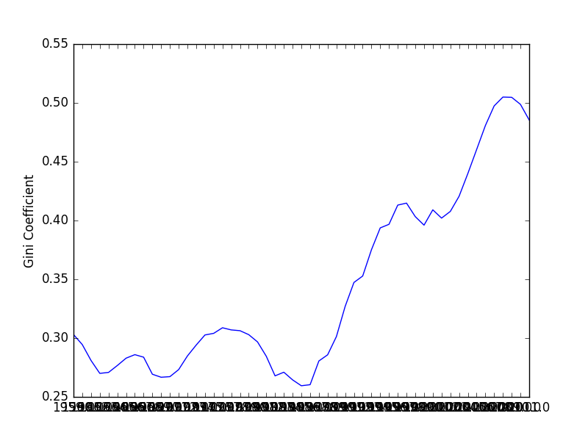
GINI INDEX FOR Songs with rolling average for 1 year (Top 40)

Slide 18
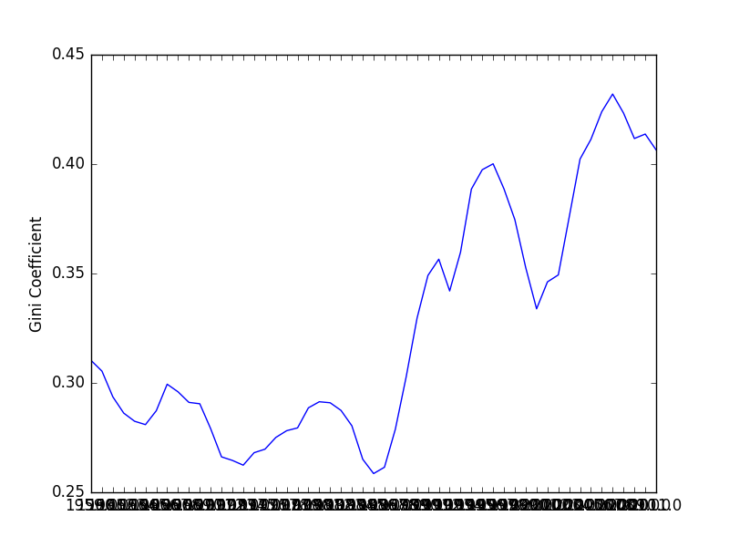
GINI INDEX FOR Songs with rolling average for 1 year(Top 10)

Slide 19
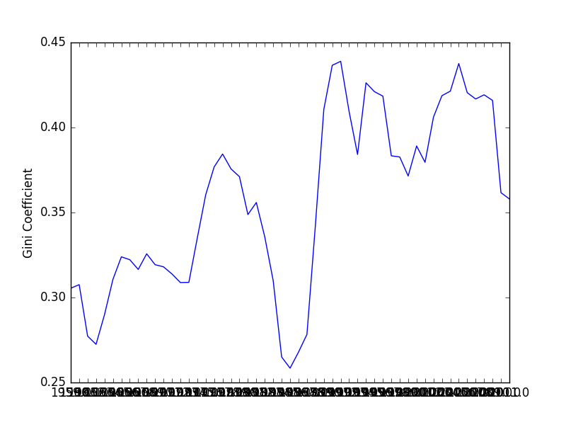
GINI INDEX FOR Songs with rolling average for 1 year(Top 1)

Slide 20
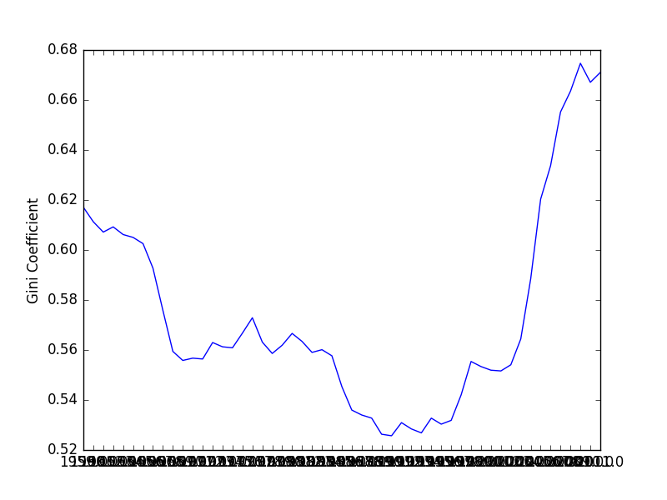
GINI INDEX FOR Artists with rolling average for 1 year (TOP 100)

Slide 21
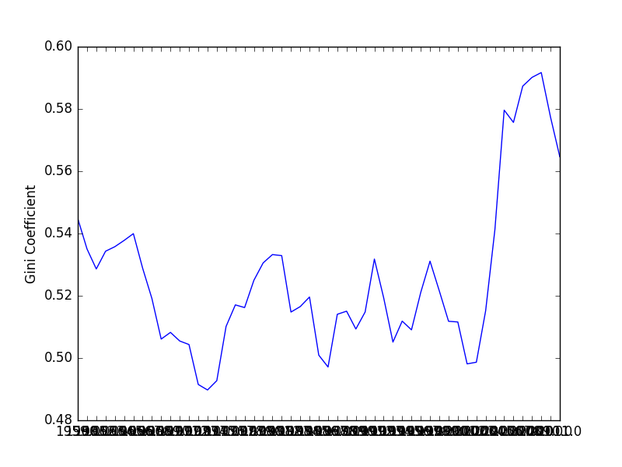
GINI INDEX FOR Artists with rolling average for 1 year(TOP 40)

Slide 22
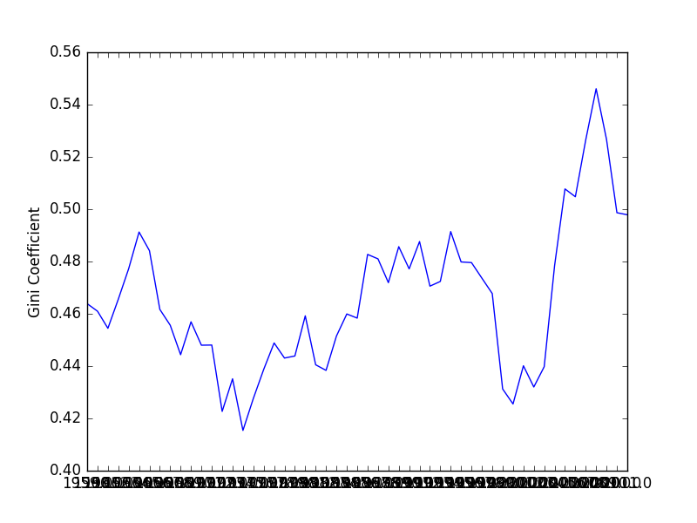
GINI INDEX FOR Artists with rolling average for 1 year (TOP 10)

Slide 23
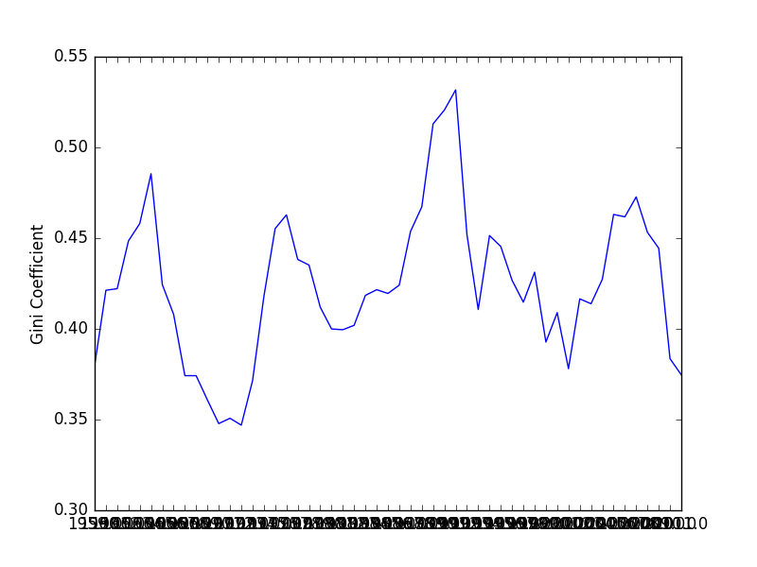
GINI INDEX FOR Artists with rolling average for 1 year (TOP 1)

