Slide 1
Analysis on billboard

Slide 2
Data Source
http://www.billboard.com/charts/hot-100 ( from 1959 to 2015 )
Top 100 Songs of week
Top 40 Songs of week
Top 10 Songs of week

Slide 3
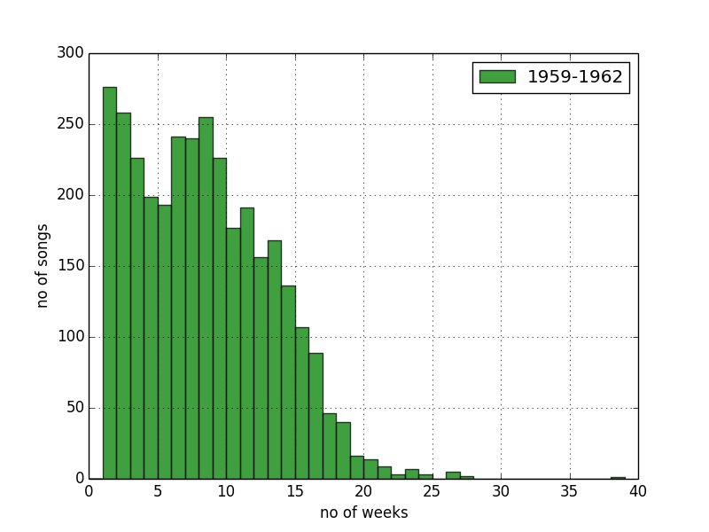
Histograms
Capture Songs spent on chart

Slide 4
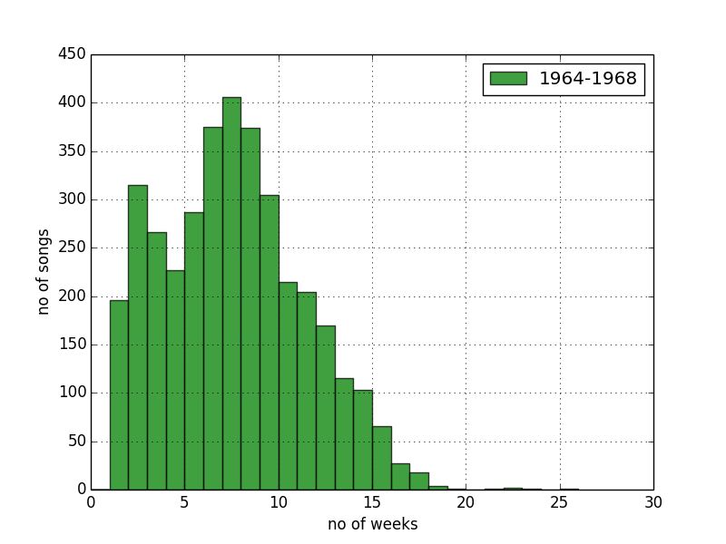
Histograms
Capture Songs spent on chart

Slide 5
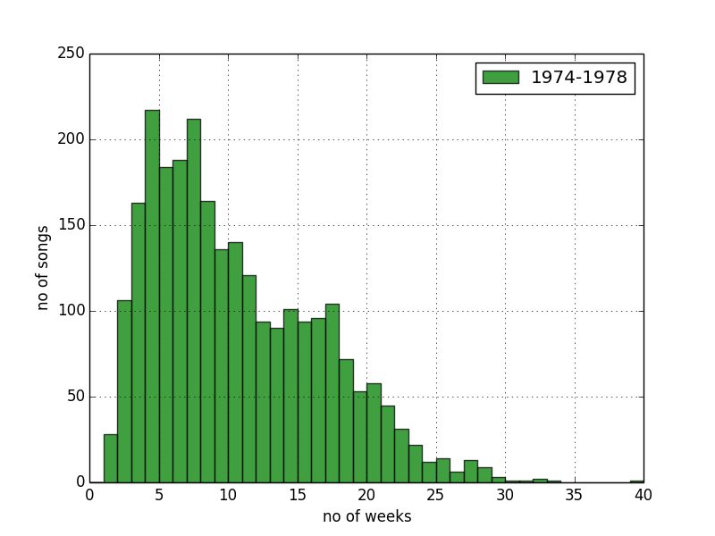
Histograms
Captured Songs spent on chart

Slide 6
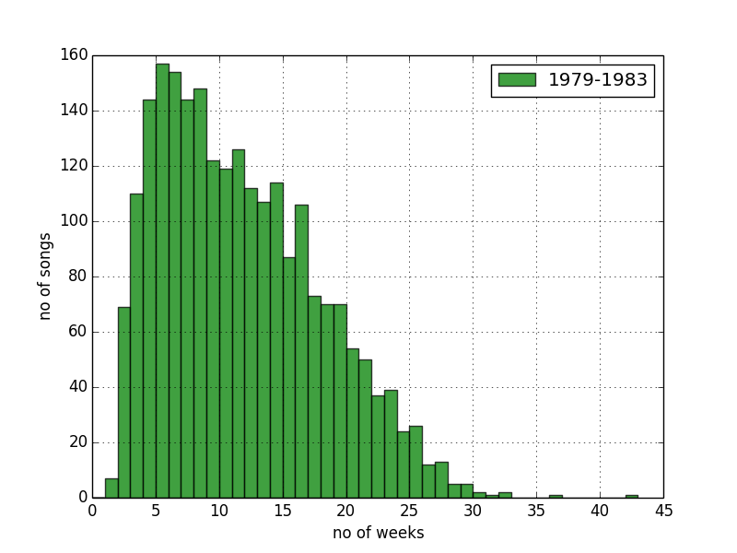
Histograms
Captured Songs spent on chart

Slide 7
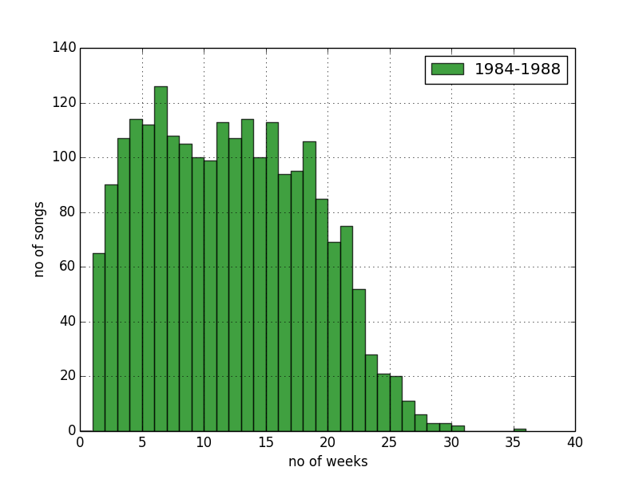
Histograms
Captured Songs spent on chart

Slide 8
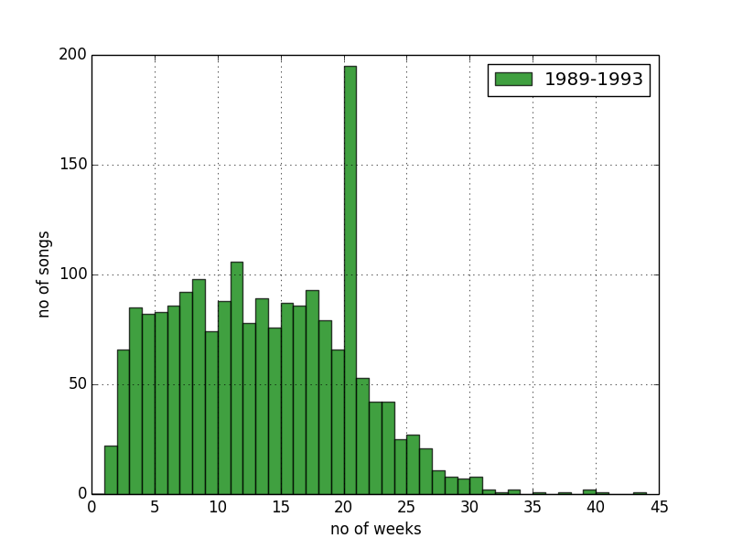
Histograms
Captured Songs spent on chart

Slide 9
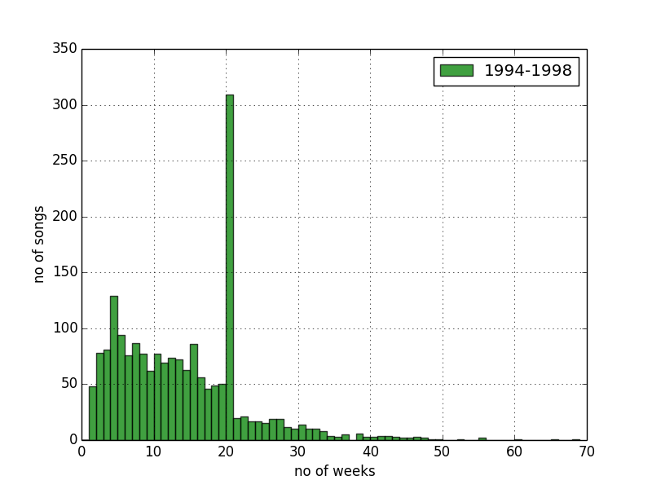
Histograms
Captured Songs spent on chart

Slide 10
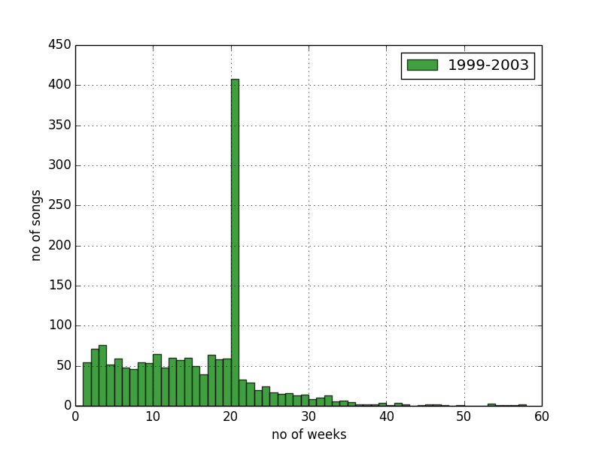
Histograms
Captured Songs spent on chart

Slide 11
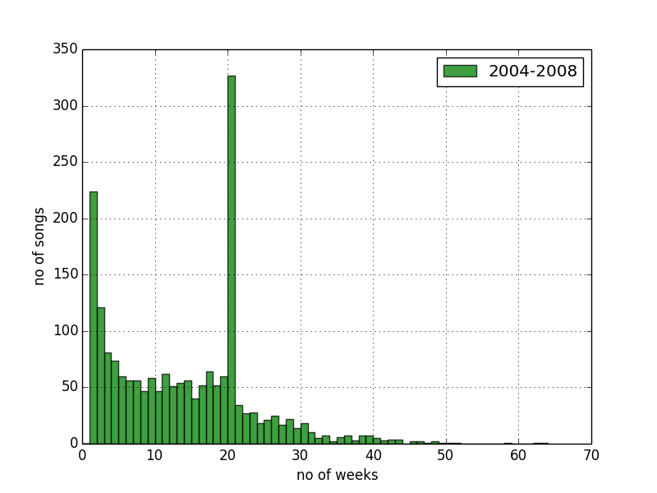
Histograms
Captured Songs spent on chart

Slide 12
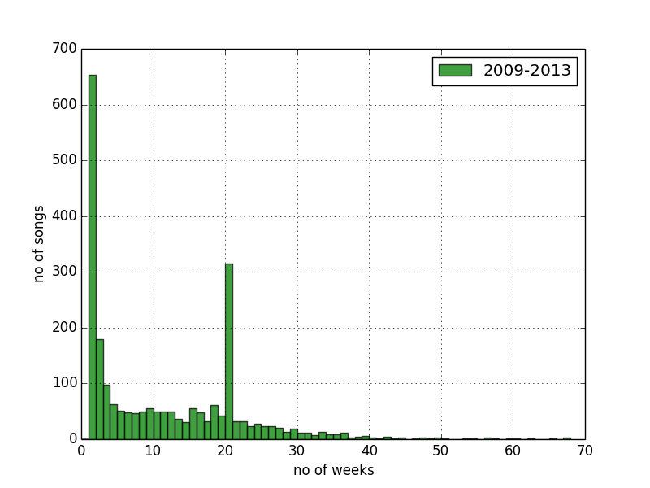
Histograms
Captured Songs spent on chart

Slide 13
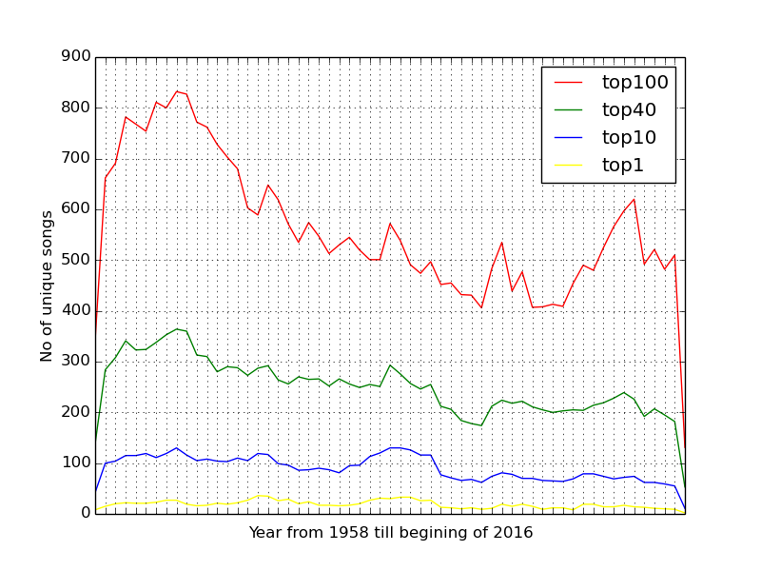
Compare unique songs over time

Slide 14
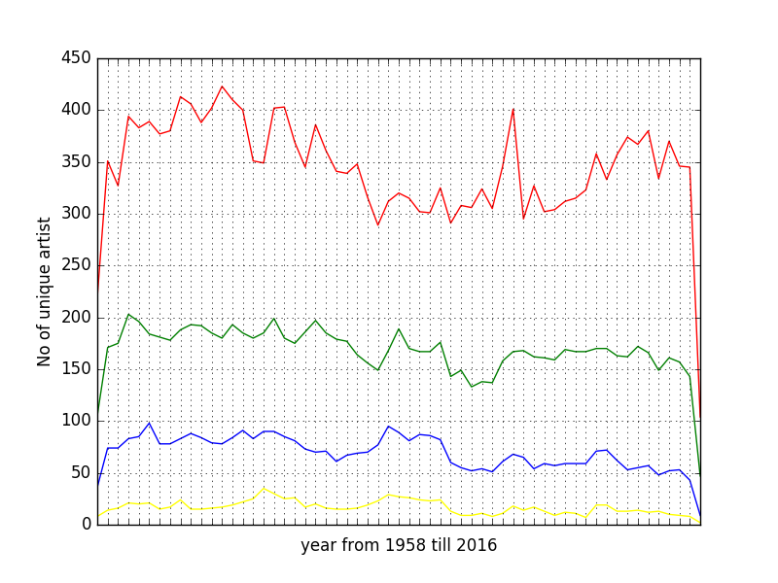
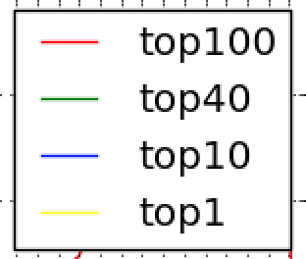
Compare unique Artists over time

Slide 15
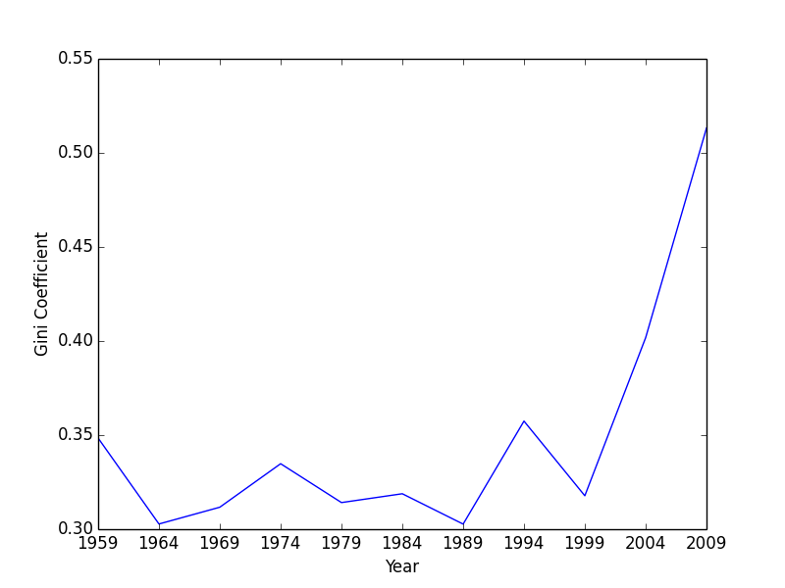
Gini index for Unique songs (1959 – 2004) with 5 year window

Slide 16
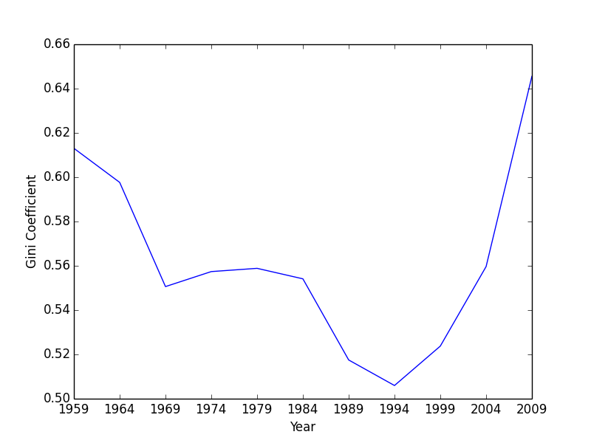
Gini index for Unique Artists(1959 – 2004) with 5 year window

Slide 17
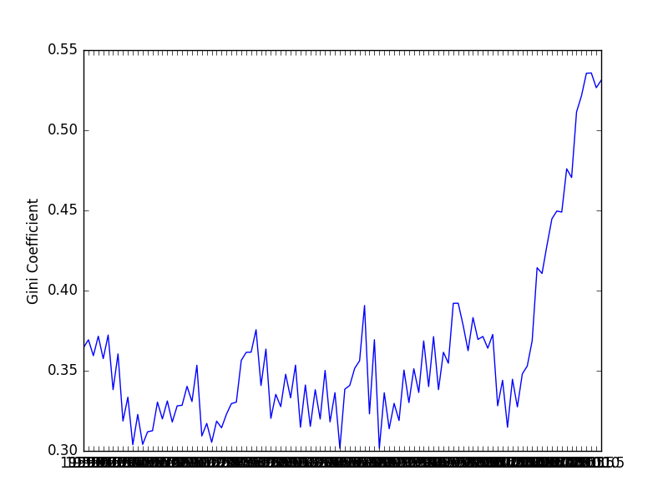
GINI INDEX FOR Songs with rolling average for 6 months (Top 100)

Slide 18
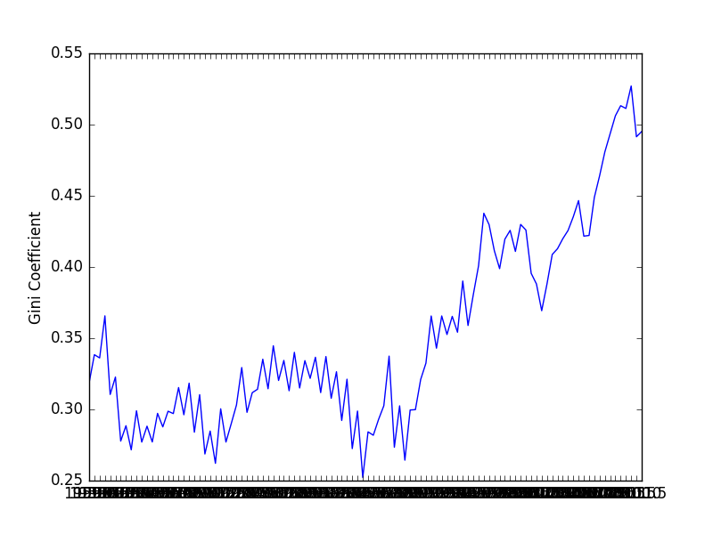
GINI INDEX FOR Songs with rolling average for 6 months (Top 40)

Slide 19
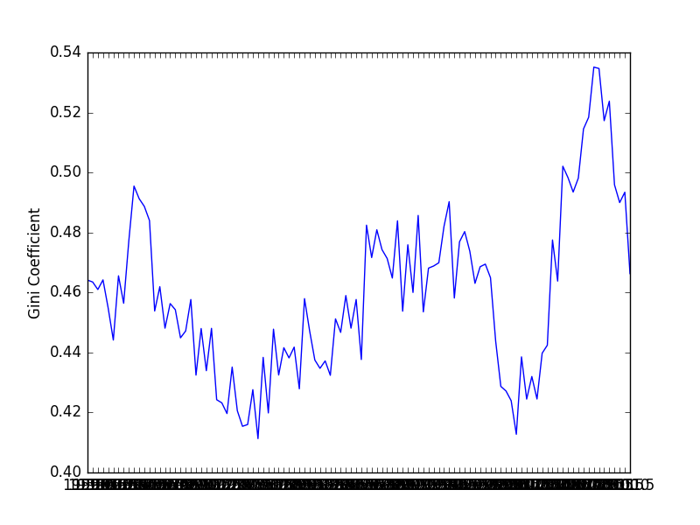
GINI INDEX FOR Songs with rolling average for 6 months (Top 10)

Slide 20
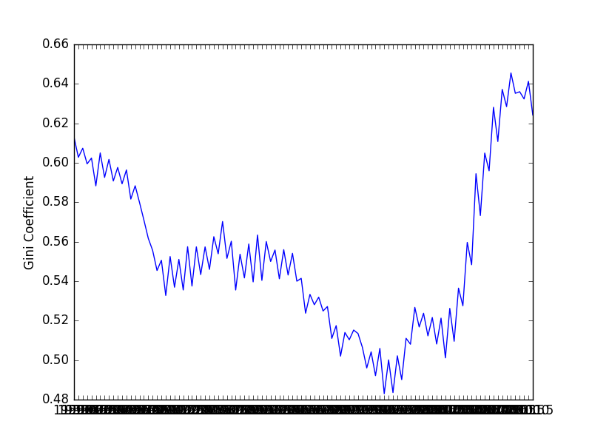
GINI INDEX FOR Artists with rolling average for 6 months(TOP 100)

Slide 21
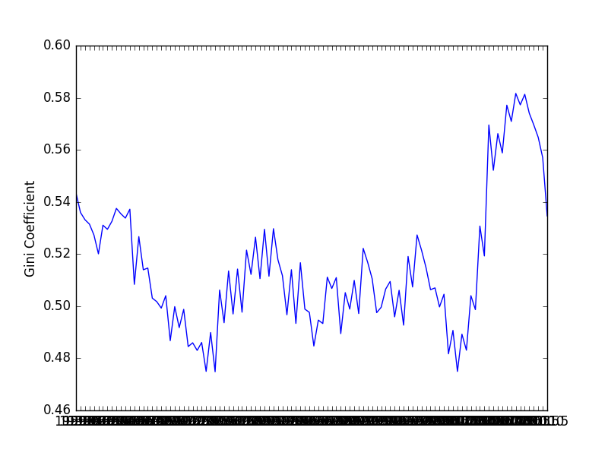
GINI INDEX FOR Artists with rolling average for 6 months(TOP 40)

Slide 22
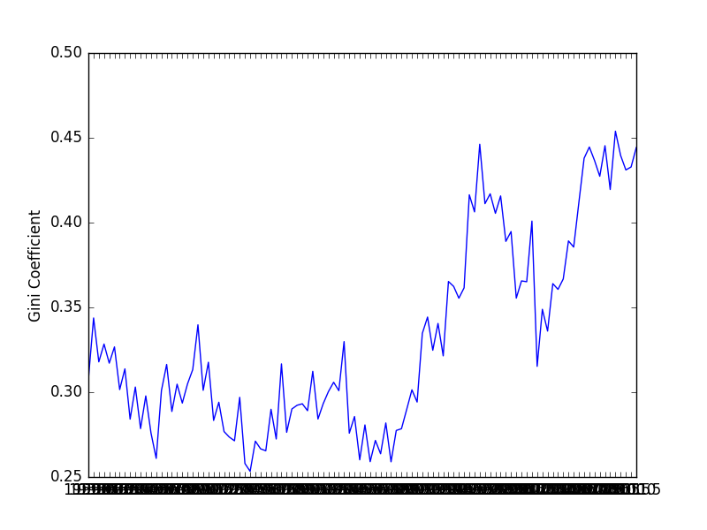
GINI INDEX FOR Artists with rolling average for 6 months(TOP 10)

Slide 23
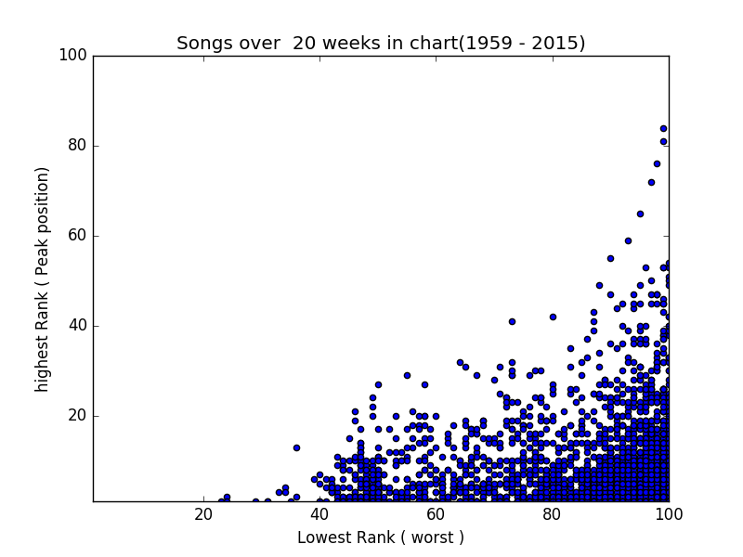
Scatter Plot for songs stayed more than 20 weeks

Slide 24
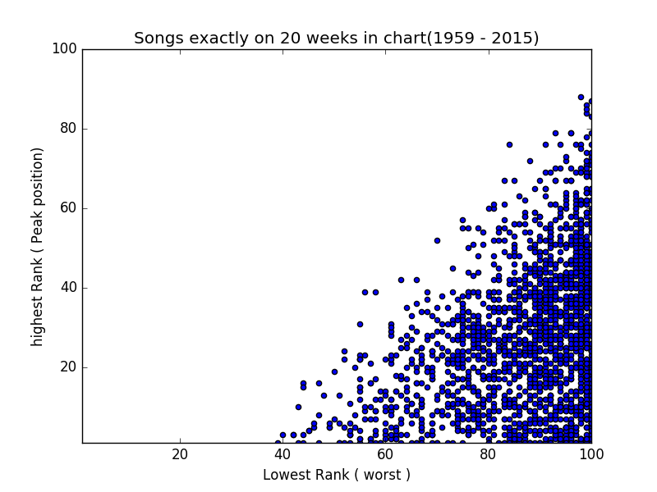
Scatter Plot for songs stayed Exactly 20 weeks

Slide 25
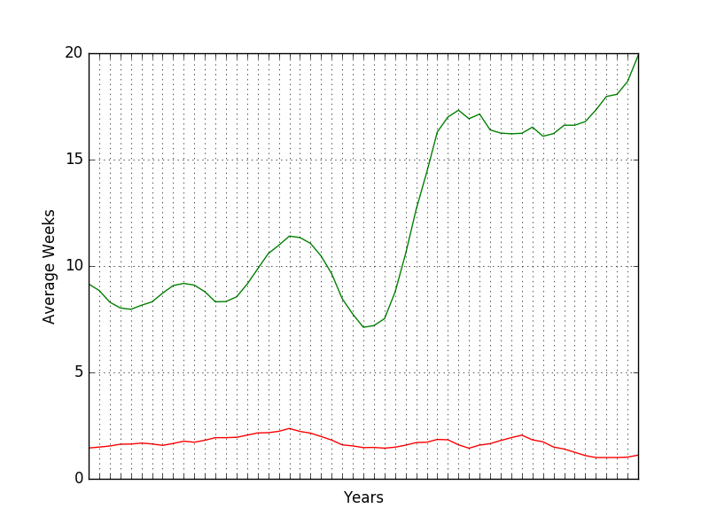
TOP AND Bottom 20% contribution on number of weeks (top 10)

