Slide 1
Analysis on New york’s best seller

Slide 2
Data Source
http://hawes.com/pastlist.htm( from 1950 to 2015 )
The New York times Best Seller List ( Fiction )

Slide 3
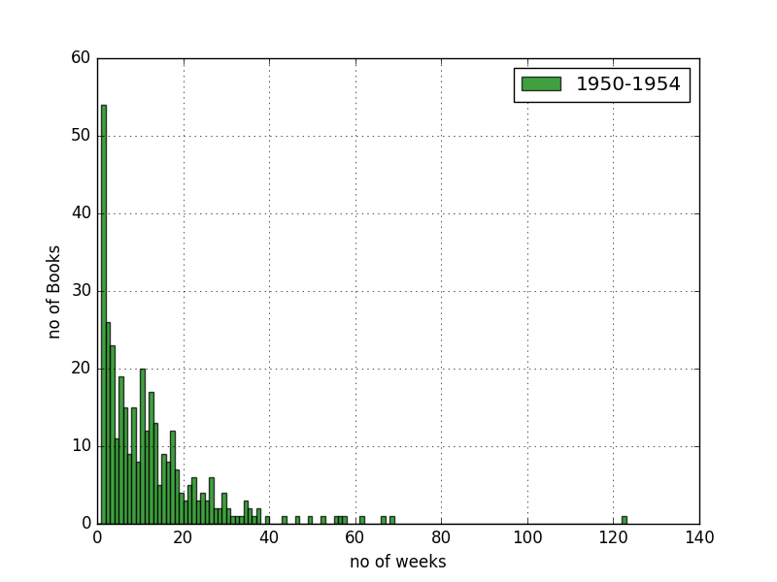
Histograms
Capture Books spent on chart

Slide 4
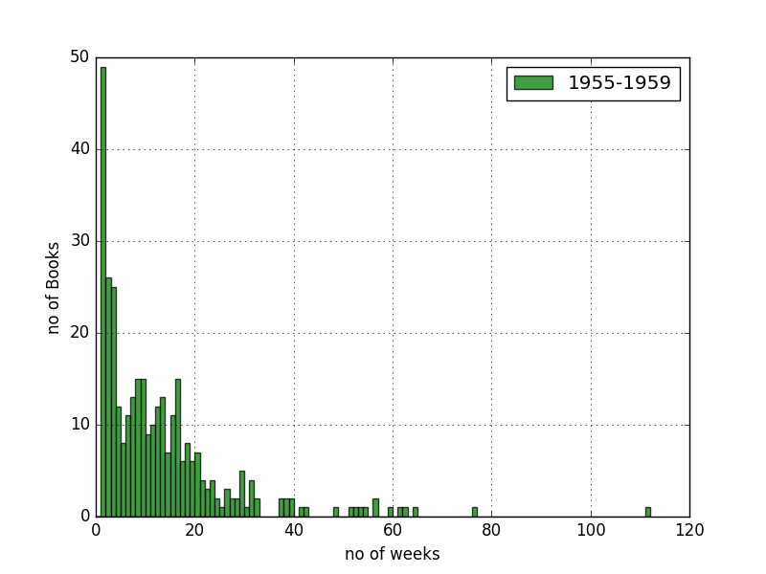
Histograms
Capture Books spent on chart

Slide 5
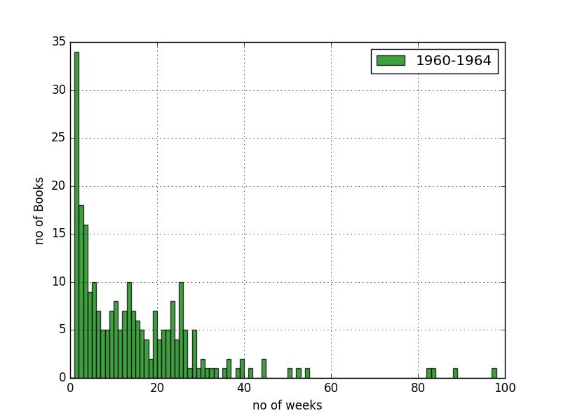
Histograms
Captured Books spent on chart

Slide 6
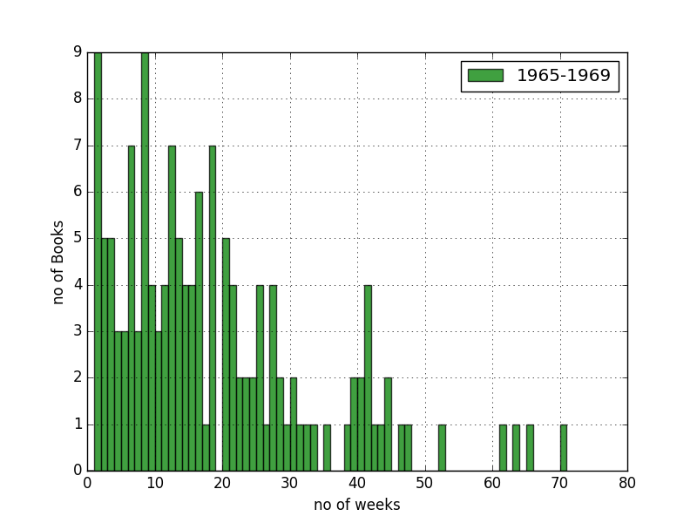
Histograms
Captured Books spent on chart

Slide 7
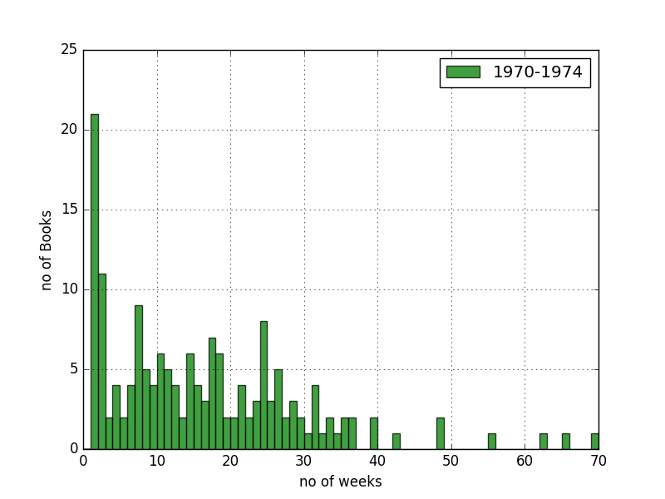
Histograms
Captured Books spent on chart

Slide 8
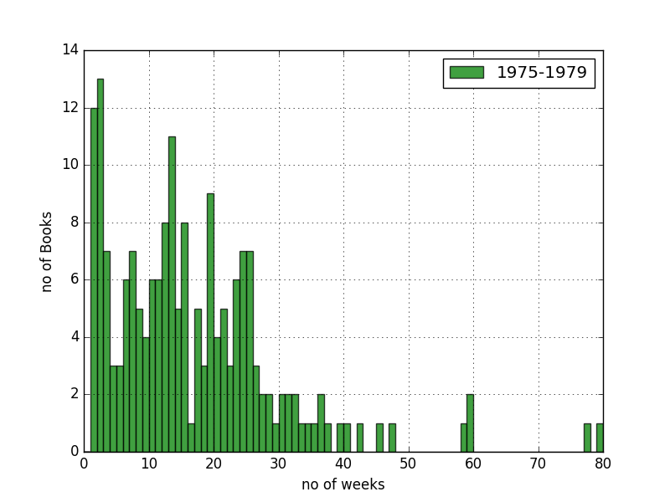
Histograms
Captured Books spent on chart

Slide 9
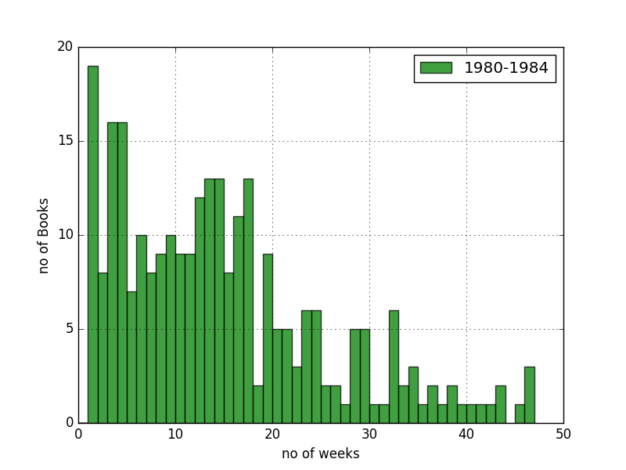
Histograms
Captured Books spent on chart

Slide 10
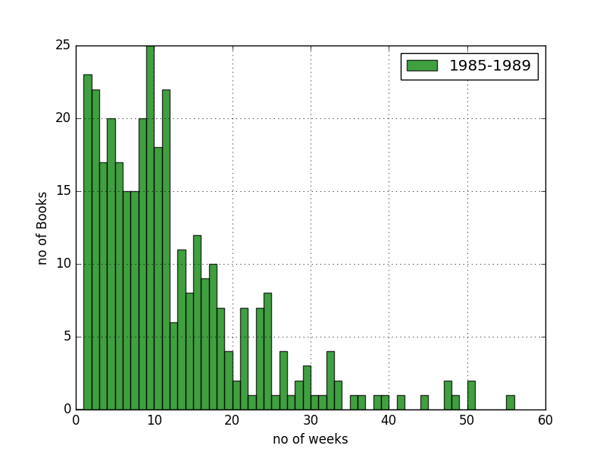
Histograms
Captured Songs spent on chart

Slide 11
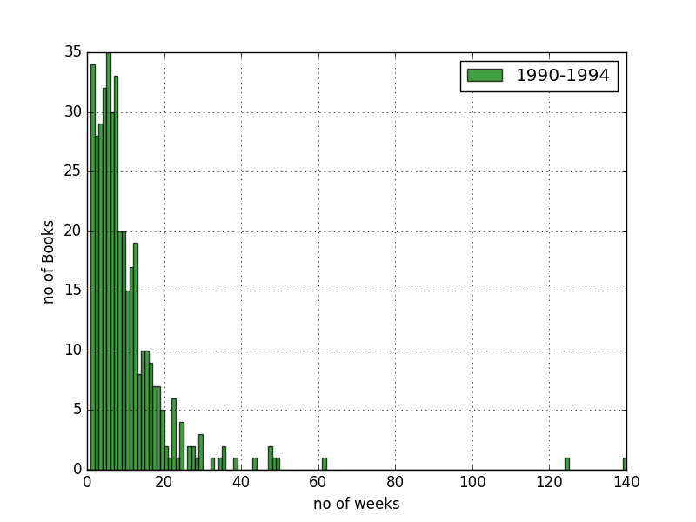
Histograms
Captured Songs spent on chart

Slide 12
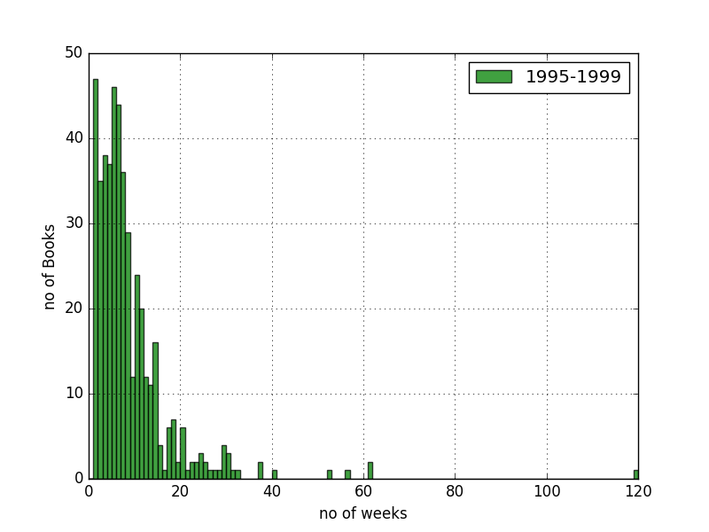
Histograms
Captured Songs spent on chart

Slide 13
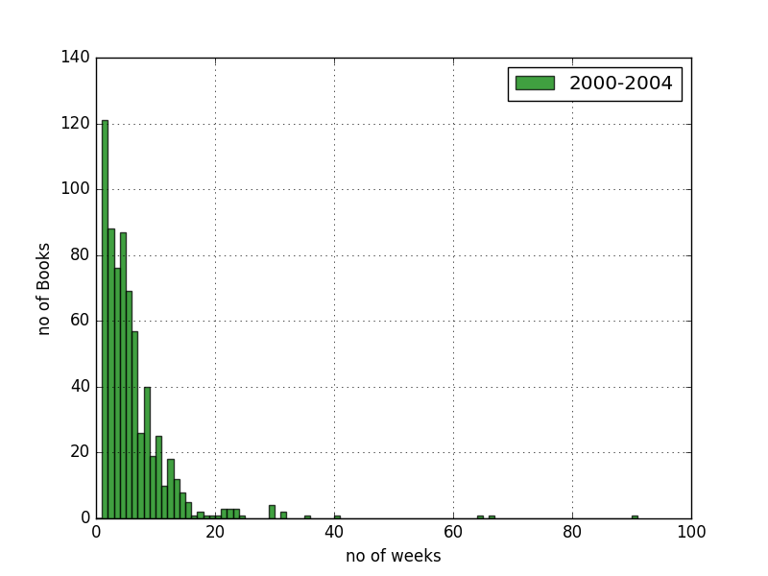
Histograms
Captured Books spent on chart

Slide 14

Histograms
Captured Books spent on chart

Slide 15
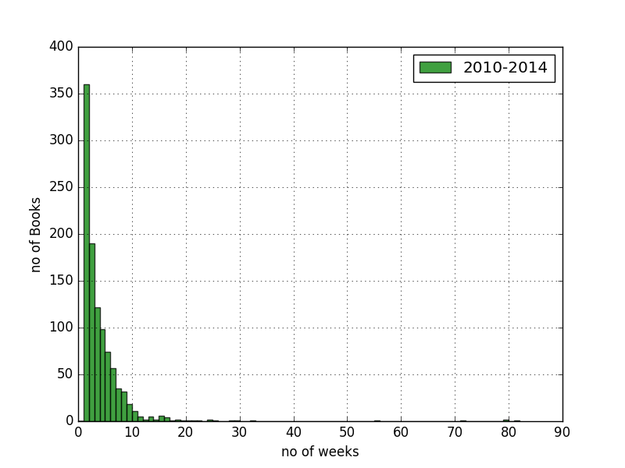
Histograms
Captured Books spent on chart

Slide 16
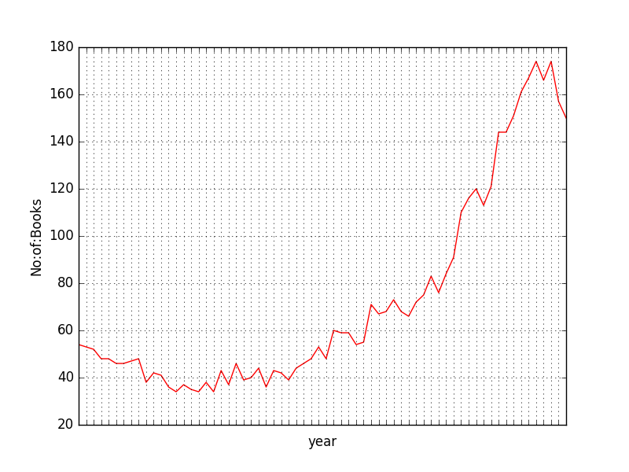
Compare unique Number of Books(Top 10) over time

Slide 17
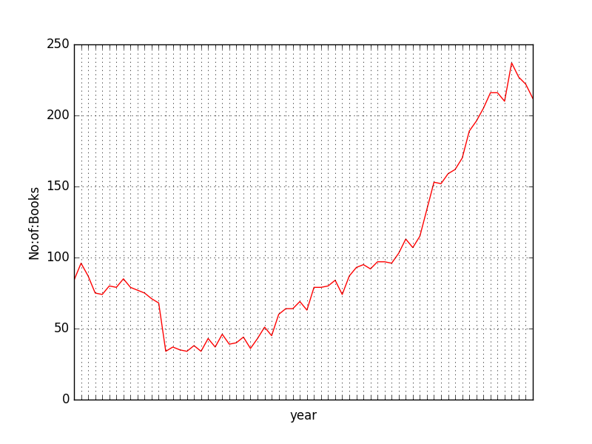
Compare unique Number of Books over time

Slide 18
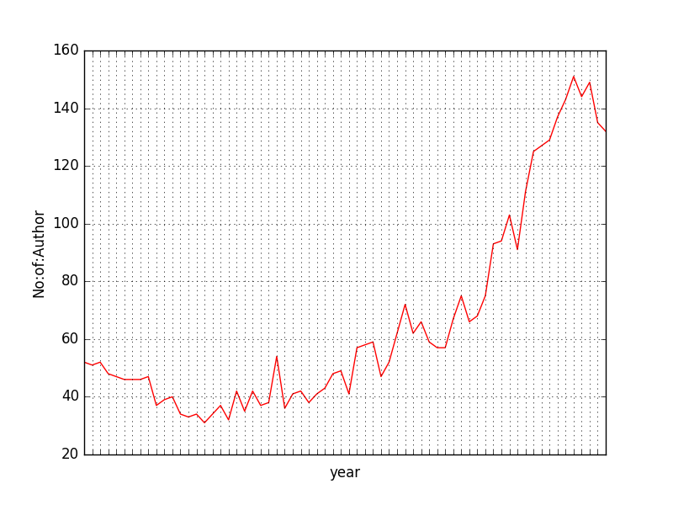
Compare unique Authors(Top 10) over time

Slide 19
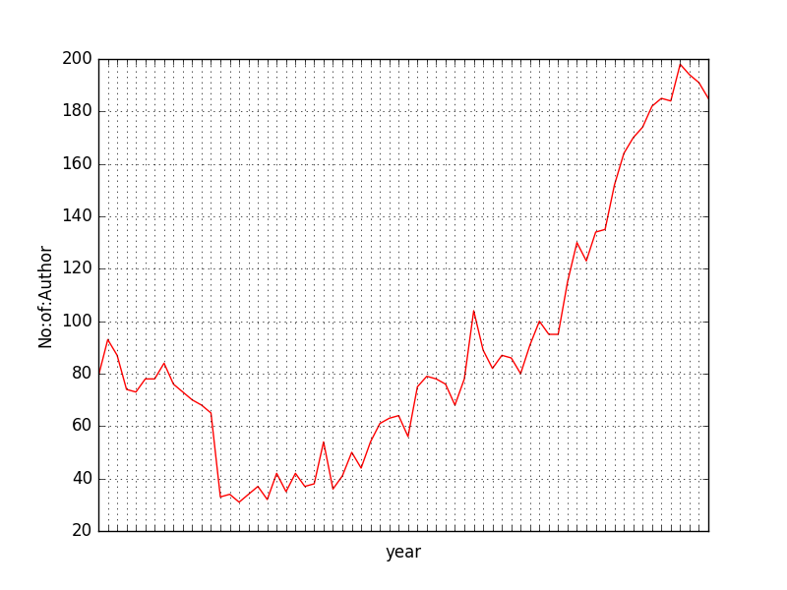
Compare unique Authors over time

Slide 20
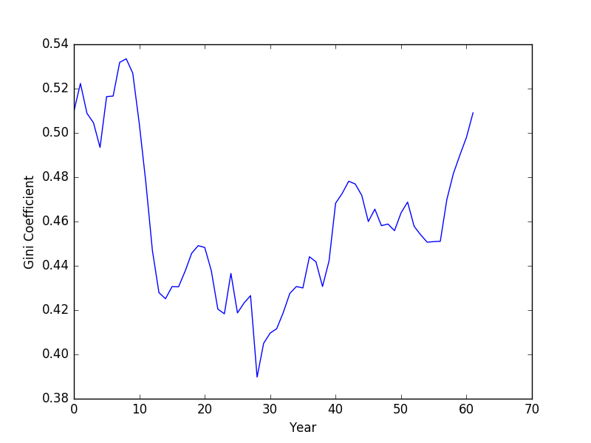
Gini index for Unique BOOKS(1950 – 2011) with 5 year window

Slide 21
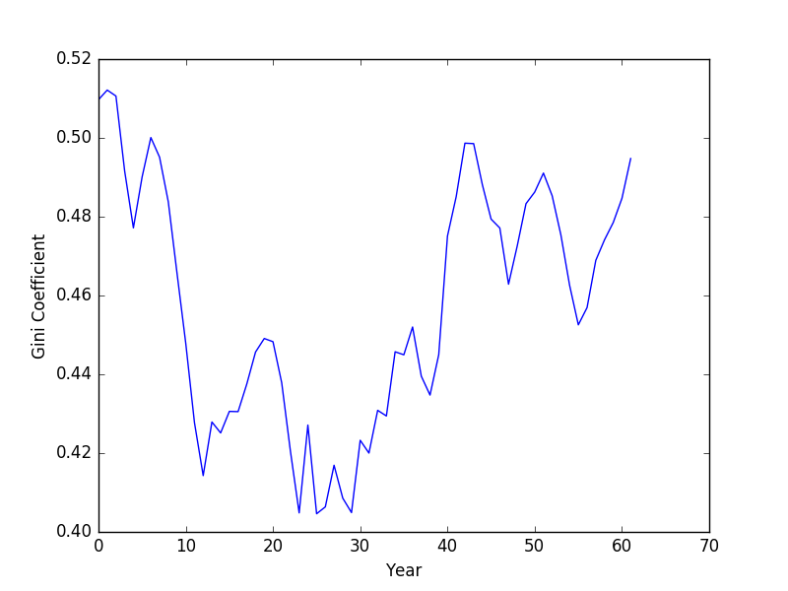
Gini index for Unique BOOKS(1950 – 2011) with 5 year window (Top 10)

Slide 22
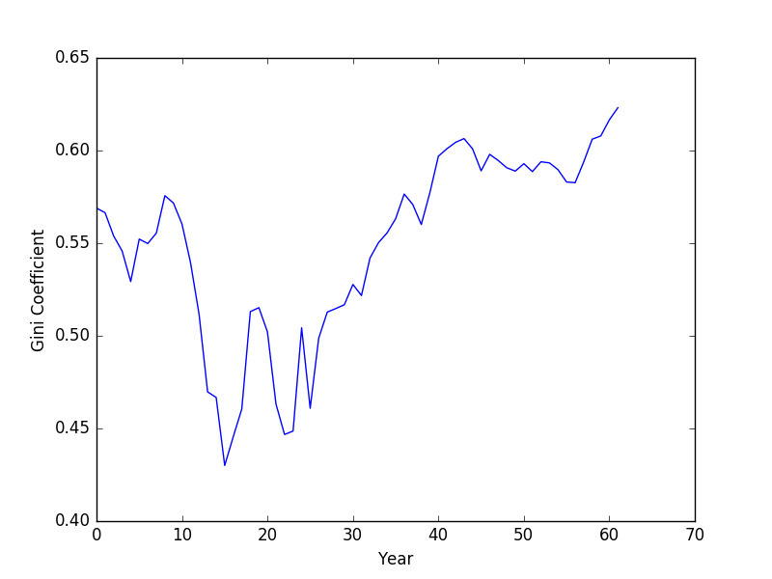
Gini index for Unique Author (1950 – 2011) with 5 year window

Slide 23
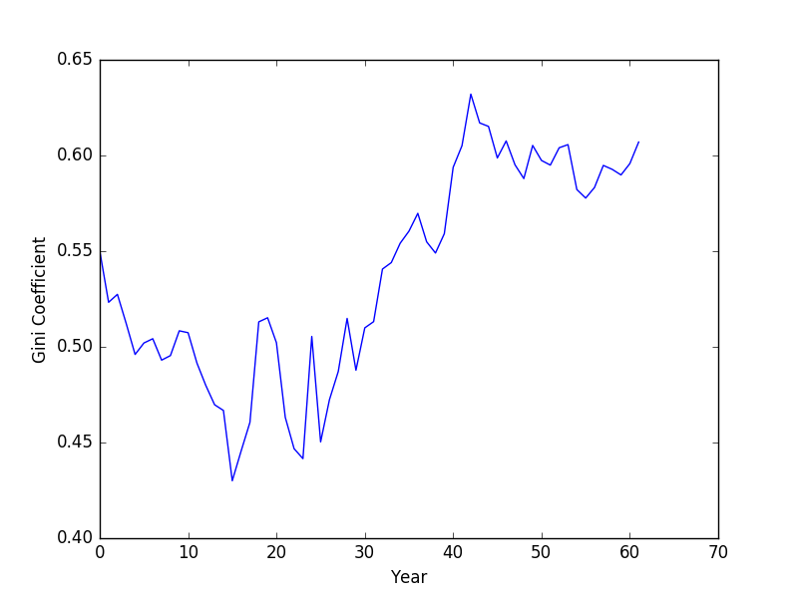
GINI INDEX for Unique Author (1950 – 2011) with 5 year window TOP 10

Slide 24
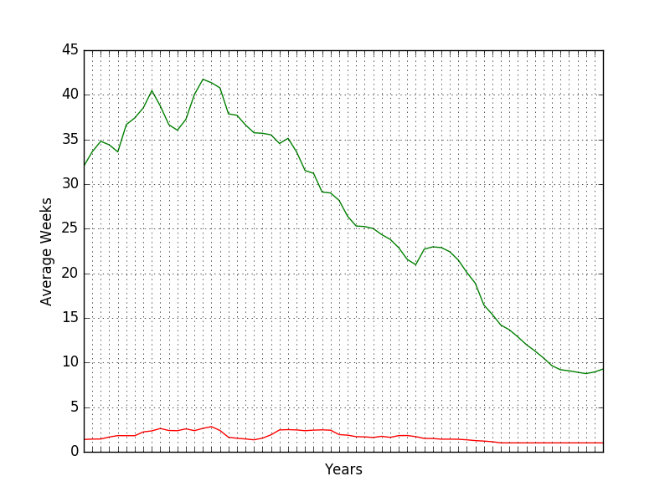
TOP AND Bottom 20% contribution on number of weeks

