Slide 1
Retail Sales Analysis using Python
Tool: Python
Libraries: Pandas, Seaborn, Matplotlib
Data: 1,000 records

Slide 2
Sample Code
Monthly Sales:
Monthly_Sales = rs.groupby('Month')['Total Amount'].sum()
month_order=['January', 'February', 'March', 'April', 'May', 'June', 'July', 'August', 'September', 'October', 'November', 'December']
Monthly_Sales= Monthly_Sales.reindex(month_order)
Age Group based analysis:
bins = [0,18,25,35,45,60,100]
lables= ['<18', '18-25', '26-35', '36-45', '46-60', '>100']
rs['Age group']= pd.cut(rs['Age'], bins=bins, labels=lables)
sales_age_group = rs.groupby (['Age group', 'Product Category'],observed=False) ['Total Amount'].sum().reset_index()

Slide 3
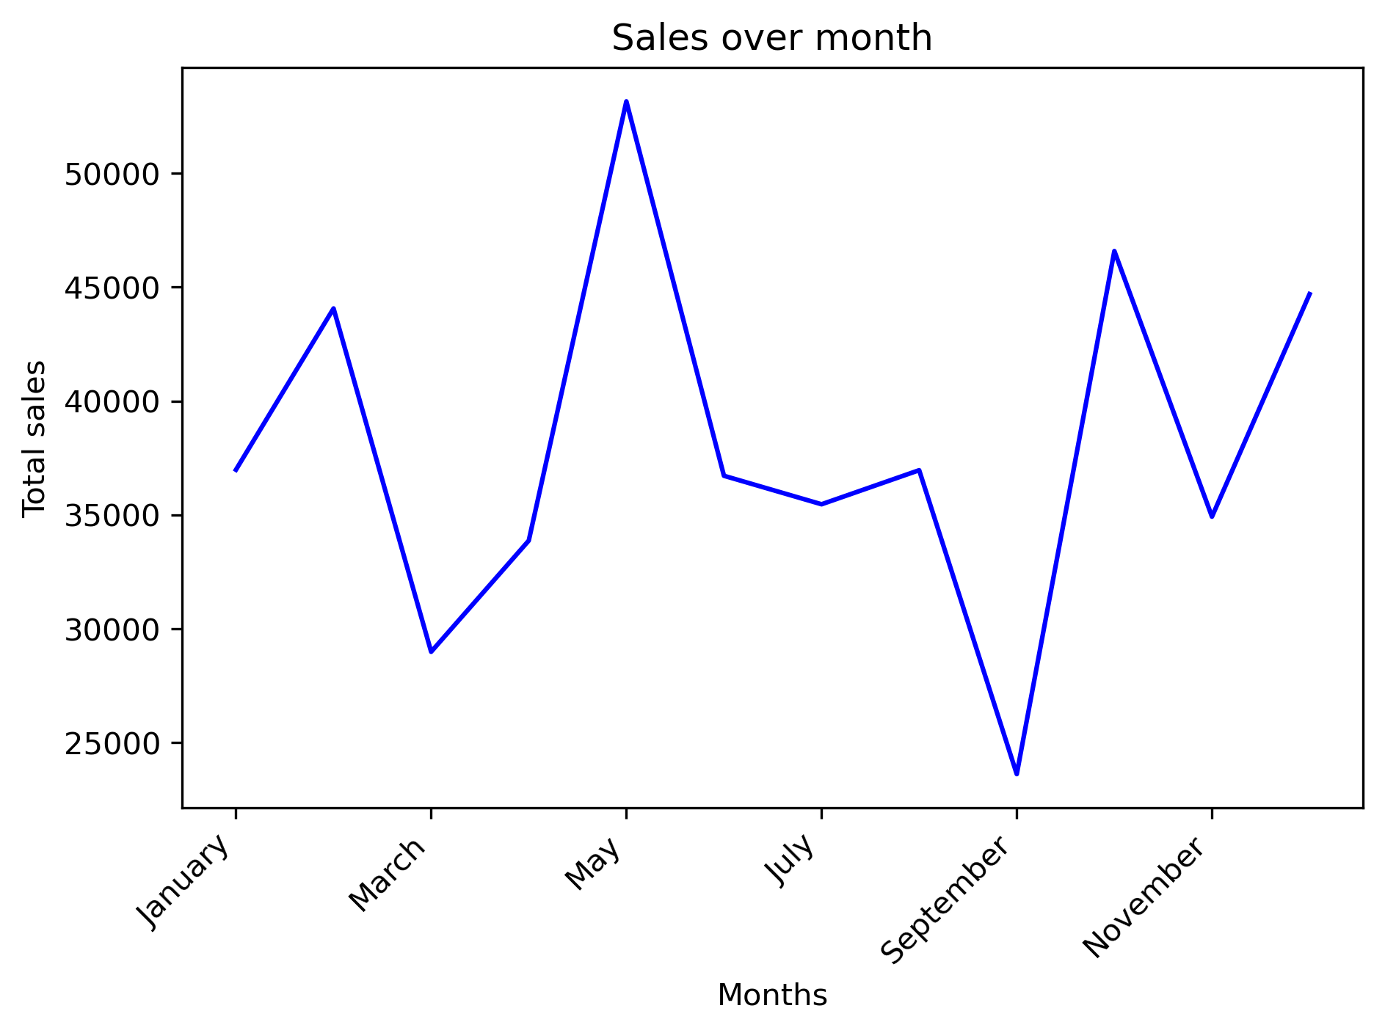
Monthly Sales

Slide 4
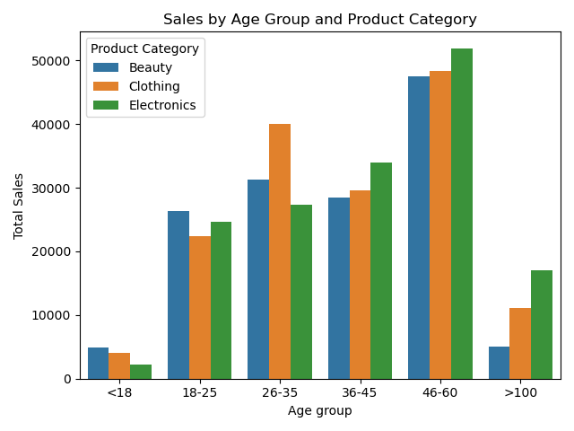
Sales by Age group

Slide 5
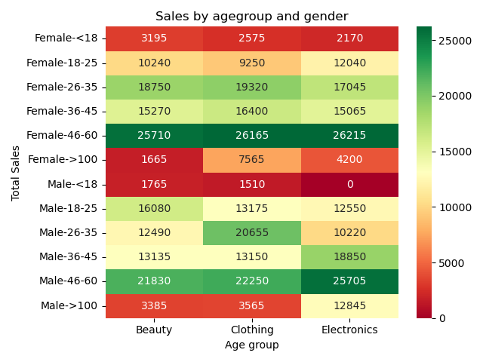
Sales by gender

Slide 6
Summary Insights
Total rows: 1,000
Date range: January 1, 2023 – January 1, 2024
Top month: May
Top product category: Electronics
Top customer: CUST487
Top age group: 46–60

