Slide 1


MIT School of Computing Department of Computer Science & Engineering
MACHINE LEARNING
Class - F.Y. MSc(SEM-II)
Unit I: Introduction to Machine Learning
Name Of the Course Coordinator:
Prof. Vijaya Patil
AY 2025-2026 SEM-II

Slide 2
MIT School of Computing Department of Computer Science & Engineering
Syllabus :UNIT I 9 hours
Introduction to machine learning;
Applications, and motivation;
programming approach vs. machine learning approach in Artificial Intelligence;
components of a learning problem (such as data, model, and error functions);
process of learning (training);
testing, bias and variance error; accuracy, confusion-matrix,
precision-recall; over-fitting; under-fitting;
role of cross validation; regularization; bias-variance analysis

Slide 3
MIT School of Computing Department of Computer Science & Engineering
Definition of Machine Learning:
Machine learning is a branch of artificial intelligence (AI) and computer science which focuses on the use of data and algorithms to imitate the way that humans learn, gradually improving its accuracy.
Definition by Arthur Samuel: Field of study that gives computers the capability to learn without being explicitly programmed
In a very simple terms, Machine Learning(ML) can be explained as automating and improving the learning process of computers based on their experiences without being actually programmed i.e. without any human assistance..

Slide 4
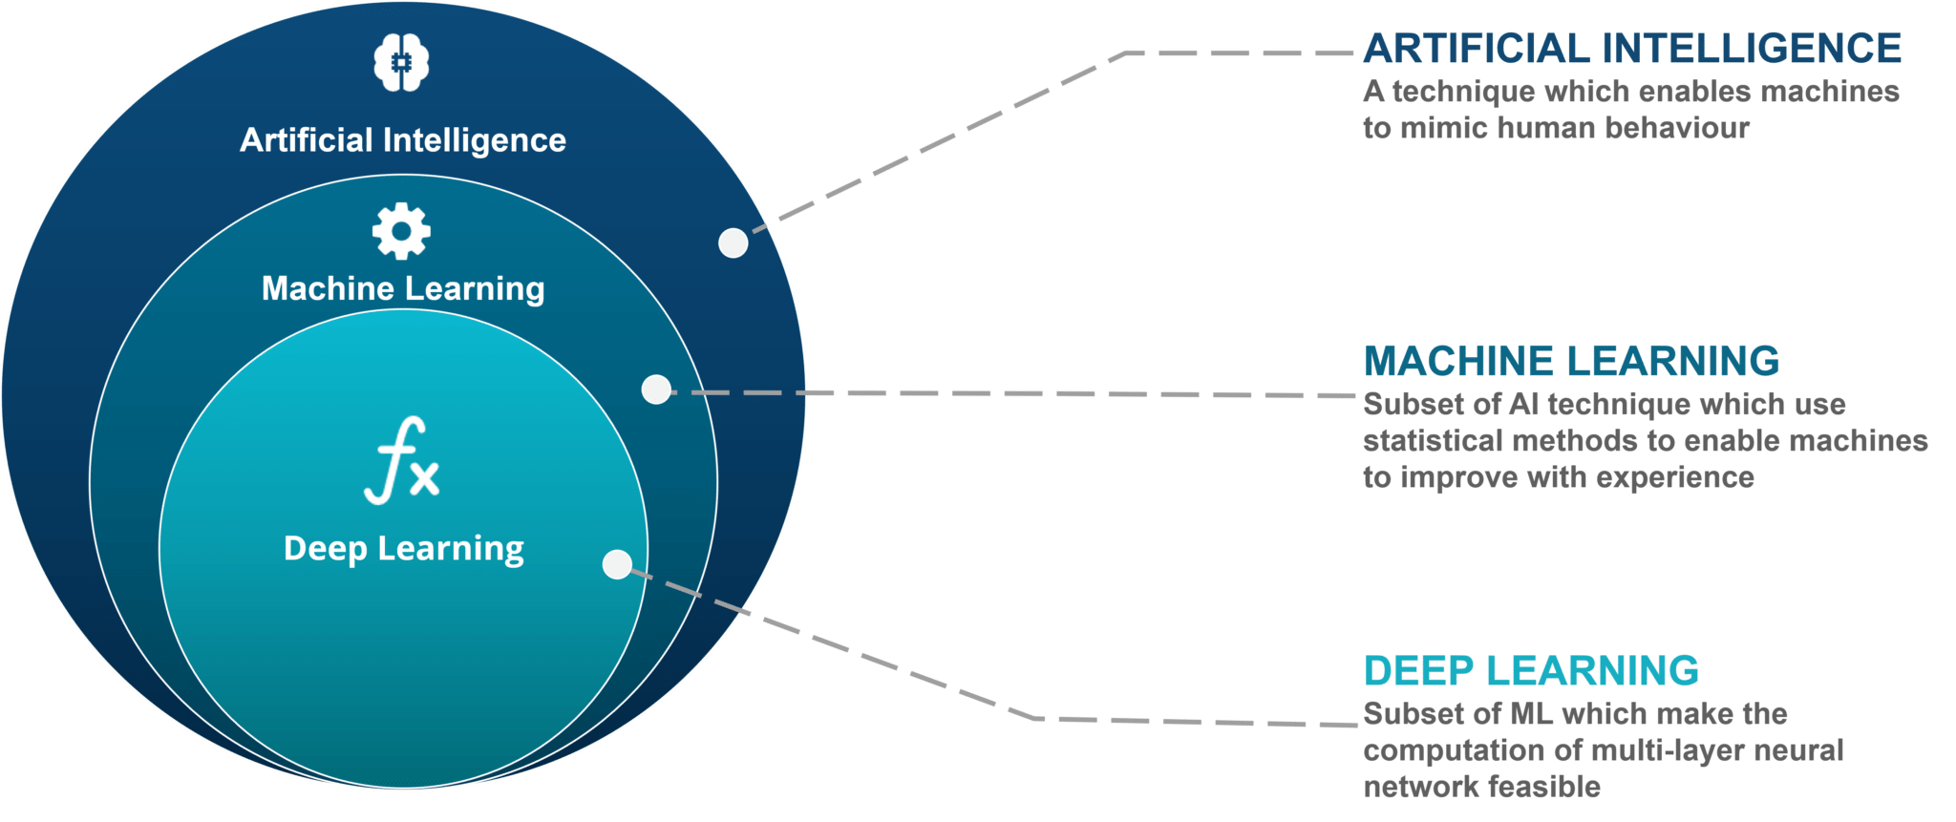
Biggest Confusion: AI Vs ML Vs Deep Learning
MIT School of Computing Department of Computer Science & Engineering

Slide 5
MIT School of Computing Department of Computer Science & Engineering
Machine Learning Terminology
Algorithm: A Machine Learning algorithm is a set of rules and statistical techniques used to learn patterns from data and draw significant information from it.
Model: A model is trained by using a Machine Learning Algorithm.
Predictor Variable: It is a feature(s) of the data that can be used to predict the output.
Response Variable: It is the feature or the output variable that needs to be predicted by using the predictor variable(s).
Training Data: The Machine Learning model is built using the training data. The training data helps the model to identify key trends and patterns essential to predict the output.
Testing Data: After the model is trained, it must be tested to evaluate how accurately it can predict an outcome. This is done by the testing data set.
5

Slide 6

MIT School of Computing Department of Computer Science & Engineering
How does Machine Learning work?
https://www.youtube.com/watch?v=yTwCA7H03cc
6

Slide 7
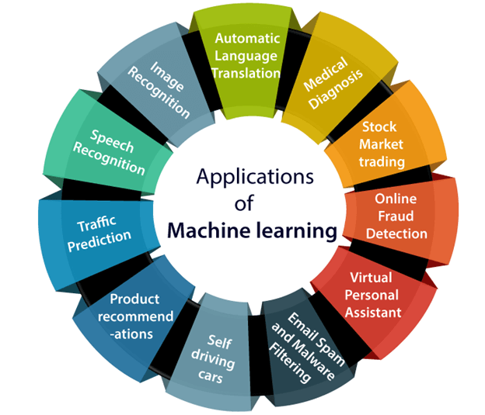
MIT School of Computing Department of Computer Science & Engineering
Applications of Machine Learning
7

Slide 8
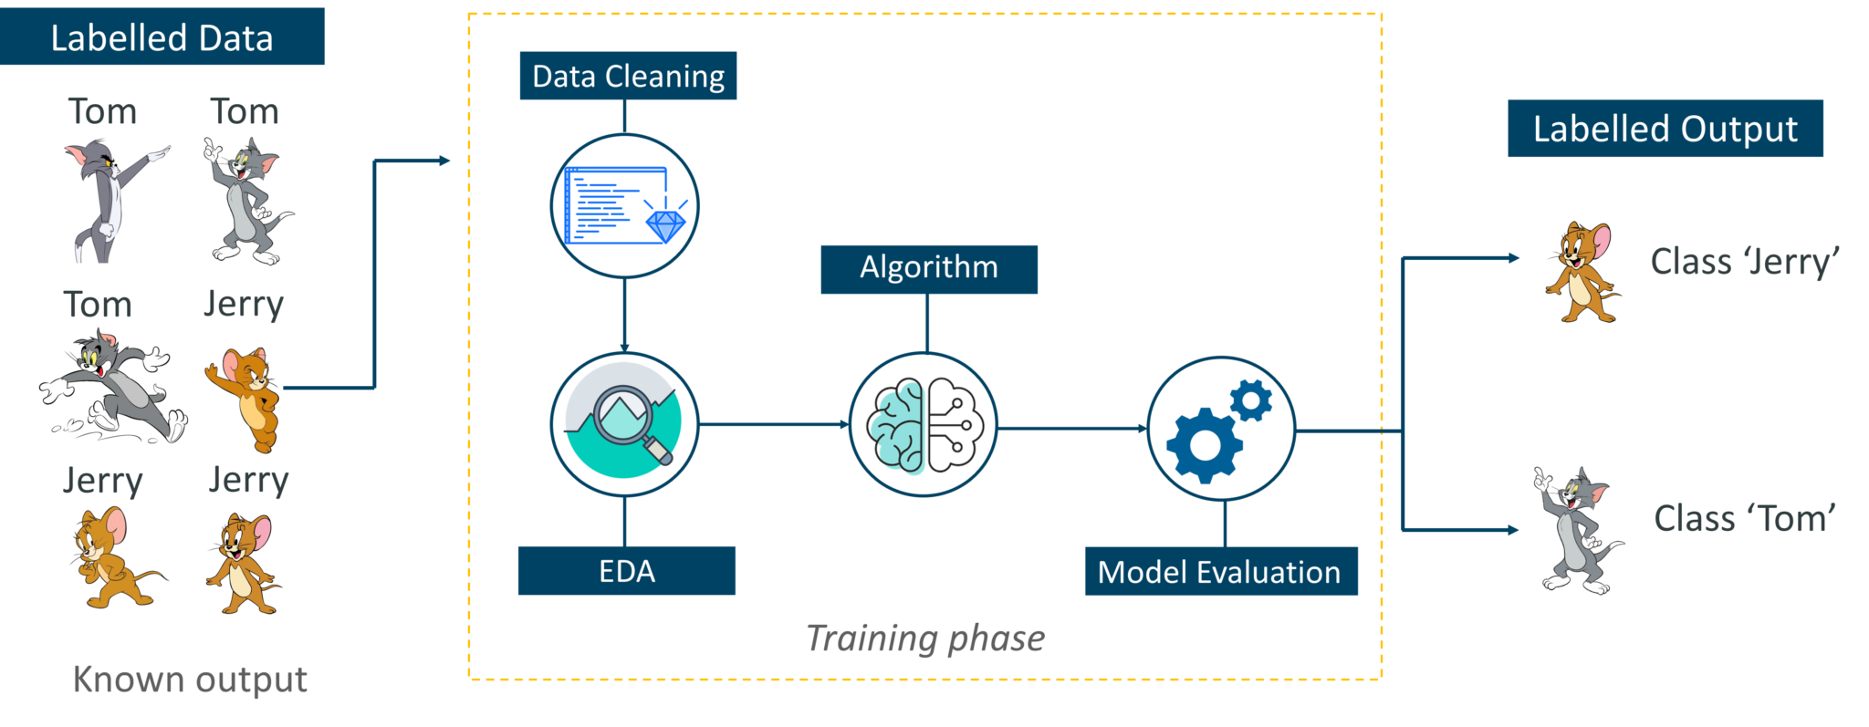
MIT School of Computing Department of Computer Science & Engineering
Types of Machine Learning Algorithm (3 Types)
Supervised Learning: Supervised learning is a technique in which we teach or train the machine using data which is well labeled.
8

Slide 9
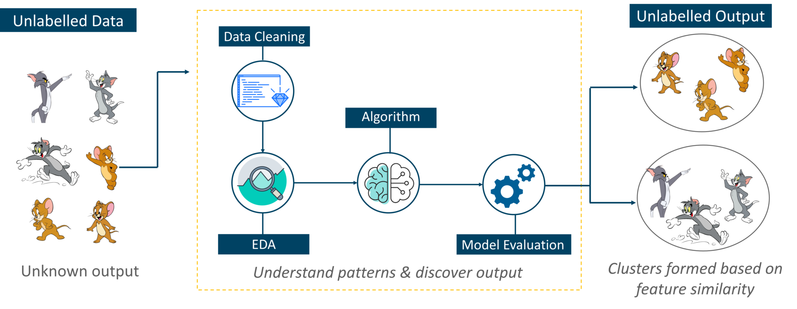
MIT School of Computing Department of Computer Science & Engineering
Cont.…
Unsupervised Learning : Unsupervised learning involves training by using unlabeled data and allowing the model to act on that information without guidance.
9

Slide 10
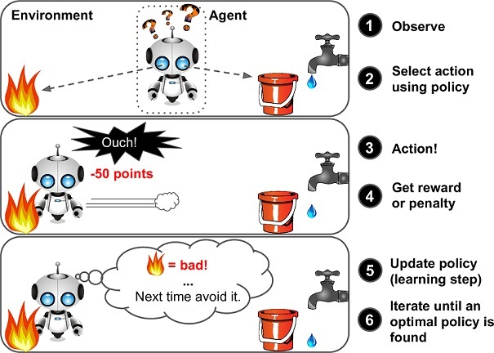
MIT School of Computing Department of Computer Science & Engineering
Cont.…
Reinforcement Learning is a part of Machine learning where an agent is put in an environment and he learns to behave in this environment by performing certain actions and observing the rewards which it gets from those actions.
10

Slide 11
MIT School of Computing Department of Computer Science & Engineering
WHY IS MACHINE LEARNING IMPORTANT?
Data is the lifeblood of all business. Data-driven decisions increasingly make the difference between keeping up with competition or falling further behind. Machine learning can be the key to unlocking the value of corporate and customer data and enacting decisions that keep a company ahead of the competition.
MACHINE LEARNING USE CASES
Manufacturing. Predictive maintenance and condition monitoring
Retail. Upselling and cross-channel marketing
Healthcare and life sciences. Disease identification and risk satisfaction
Travel and hospitality. Dynamic pricing
Financial services. Risk analytics and regulation
Energy. Energy demand and supply optimization

Slide 12

MIT School of Computing Department of Computer Science & Engineering
Why Machine Learning

Slide 13

MIT School of Computing Department of Computer Science & Engineering

Slide 14
MIT School of Computing Department of Computer Science & Engineering
Applications of machine learning.
In the retail business, machine learning is used to study consumer behavior.
In finance, banks analyze their past data to build models to use in credit applications, fraud detection, and the stock market.
In manufacturing, learning models are used for optimization, control, and troubleshooting.
In medicine, learning programs are used for medical diagnosis.
In telecommunications, call patterns are analyzed for network optimization and maximizing the quality of service.
In science, large amounts of data in physics, astronomy, and biology can only be analyzed fast enough by computers. The World Wide Web is huge; it is constantly growing and searching for relevant information cannot be done manually.
In artificial intelligence, it is used to teach a system to learn and adapt to changes so that the system designer need not foresee and provide solutions for all possible situations.
It is used to find solutions to many problems in vision, speech recognition, and robotics.
Machine learning methods are applied in the design of computer-controlled vehicles to steer correctly when driving on a variety of roads.

Slide 15
MIT School of Computing Department of Computer Science & Engineering
programming approach vs. machine learning approach in Artificial Intelligence
Approach to Problem Solving:
Traditional Programming: In traditional programming, a programmer writes explicit rules or instructions for the computer to follow. These rules dictate exactly how the computer should process input data to produce the desired output. It requires a deep understanding of the problem and a clear way to encode the solution in a programming language.
Machine Learning: In machine learning, instead of writing explicit rules, a programmer trains a model using a large dataset. The model learns patterns and relationships from the data, enabling it to make predictions or decisions without being explicitly programmed for each possibility. This approach is particularly useful for complex problems where defining explicit rules is difficult or impossible.
Data Dependency:
Traditional Programming: Relies less on data. The quality of the output depends mainly on the logic defined by the programmer.
Machine Learning: Heavily reliant on data. The quality and quantity of the training data significantly impact the performance and accuracy of the model.

Slide 16
MIT School of Computing Department of Computer Science & Engineering
Flexibility and Adaptability:
Traditional Programming: Has limited flexibility. Changes in the problem domain require manual updates to the code.
Machine Learning: Offers higher adaptability to new scenarios, especially if the model is retrained with updated data.
Problem Complexity:
Traditional Programming: Best suited for problems with clear, deterministic logic.
Machine Learning: Better for dealing with complex problems where patterns and relationships are not evident, such as image recognition, natural language processing, or predictive analytics.
Development Process:
Traditional Programming: The development process is generally linear and predictable, focusing on implementing and debugging predefined logic.
Machine Learning: Involves an iterative process where models are trained, evaluated, and fine-tuned. This process can be less predictable and more experimental.

Slide 17
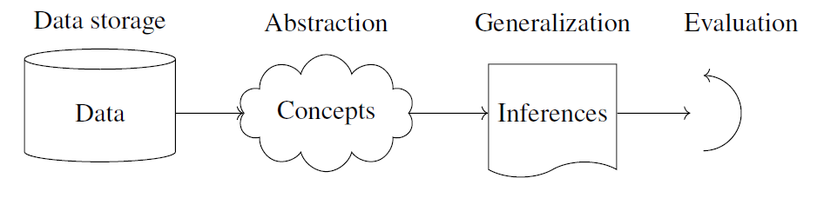
MIT School of Computing Department of Computer Science & Engineering
Components of a learning problem
The learning process, whether by a human or a machine, can be divided into four components, namely, data storage, abstraction, generalization, and evaluation. The figure illustrates the various components and the steps involved in the learning process.

Slide 18
MIT School of Computing Department of Computer Science & Engineering
Machine Learning High Level Steps
1. Collecting Data
2. Preparing the Data
3. Choosing a Model
4. Training the Model
5. Evaluating the Model
6. Parameter Tuning
7. Making Predictions

Slide 19
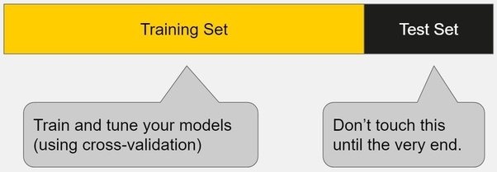
MIT School of Computing Department of Computer Science & Engineering
What Is Training Data?
Training data (or a training dataset) is the initial data used to train machine learning models.
Training datasets are fed to machine learning algorithms to teach them how to make predictions or perform a desired task.
What Is the Difference Between Training Data and Testing Data?
Training data is the initial dataset you use to teach a machine learning application to recognize patterns or perform to your criteria, while testing or validation data is used to evaluate your model’s accuracy.

Slide 20
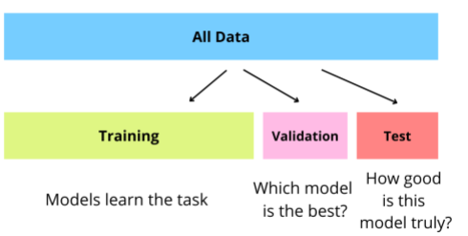
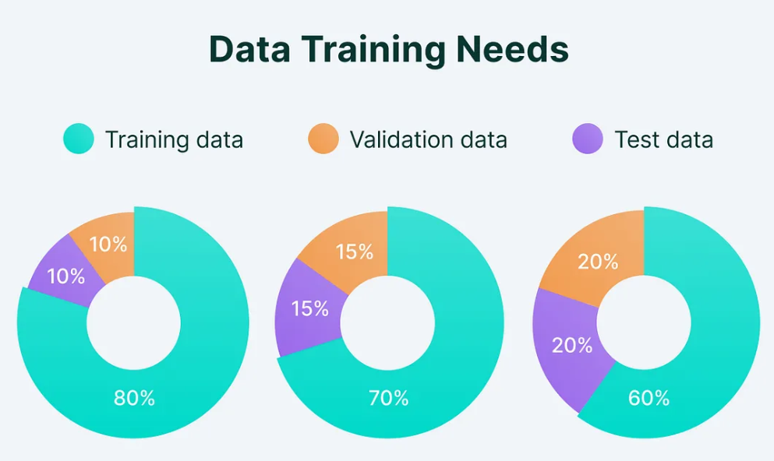
Training, Testing, and Validation Sets
MIT School of Computing Department of Computer Science & Engineering
The training set to actually train the algorithm
The validation set to keep track of how well it is doing as it learns
The test set to produce the final results.
Why use both validation and testing?
Validation helps improve a model's performance before testing
Testing provides a realistic assessment of a model's performance

Slide 21
MIT School of Computing Department of Computer Science & Engineering
What is Cross-Validation?
Cross validation is a technique used in machine learning to evaluate the performance of a model on unseen data. It involves dividing the available data into multiple folds or subsets, using one of these folds as a validation set, and training the model on the remaining folds. This process is repeated multiple times, each time using a different fold as the validation set. Finally, the results from each validation step are averaged to produce a more robust estimate of the model’s performance.
What is cross-validation used for?
The main purpose of cross validation is to prevent overfitting, which occurs when a model is trained too well on the training data and performs poorly on new, unseen data. By evaluating the model on multiple validation sets, cross validation provides a more realistic estimate of the model’s generalization performance, i.e., its ability to perform well on new, unseen data.
Types of Cross-Validation
There are several types of cross validation techniques, including k-fold cross validation, leave-one-out cross validation, and Holdout validation, Stratified Cross-Validation. The choice of technique depends on the size and nature of the data, as well as the specific requirements of the modeling problem.

Slide 22
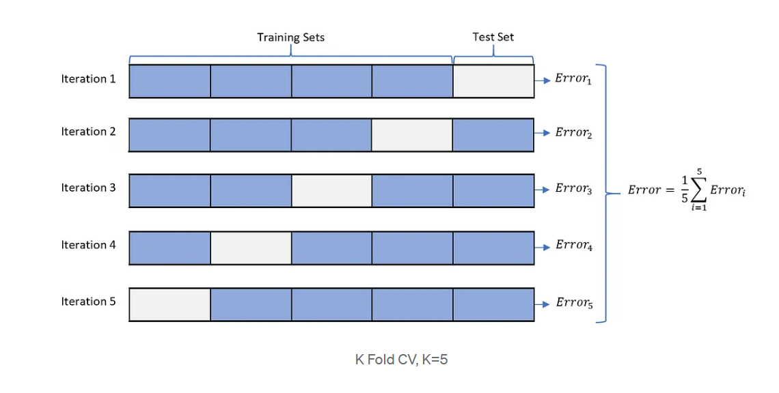
MIT School of Computing Department of Computer Science & Engineering
CROSS VALIDATION (K-FOLD)
Cross-Validation (we will refer to as CV from here on)is a technique used to test a model’s ability to predict unseen data, data not used to train the model. CV is useful if we have limited data when our test set is not large enough. There are many different ways to perform a CV. In general, CV splits the training data into k blocks. In each iteration, the model trains on k-1 blocks and is validated using the last block. We can use multiple iterations of CV to reduce variability. We use the average error over all the iterations to evaluate the model.
It is always preferred to use a model with better CV performance. Similarly, we can also use CV to tune model parameters.
K-fold Cross-Validation Steps:
Split training data into K equal parts
Fit the model on k-1 parts and calculate test error using the fitted model on the kth part
Repeat k times, using each data subset as the test set once. (usually k= 5~20)

Slide 23
MIT School of Computing Department of Computer Science & Engineering
What is Bias?
The bias is known as the difference between the prediction of the values by the Machine Learning model and the correct value.
Being high in biasing gives a large error in training as well as testing data.
It recommended that an algorithm should always be low-biased to avoid the problem of underfitting.
By high bias, the data predicted is in a straight line format, thus not fitting accurately in the data in the data set. Such fitting is known as the Underfitting of Data.

Slide 24

MIT School of Computing Department of Computer Science & Engineering
VARIANCE
When a model performs well on the training data but poorly on unseen (test or validation) data, it indicates that the model has high variance.
It basically tells how scattered the predicted values are from the actual values.
The variability of model prediction for a given data point which tells us the spread of our data is called the variance of the model.
The model with high variance has a very complex fit to the training data and thus is not able to fit accurately on the data which it hasn’t seen before.
As a result, such models perform very well on training data but have high error rates on test data. When a model is high on variance, it is then said to as Overfitting of Data.

Slide 25
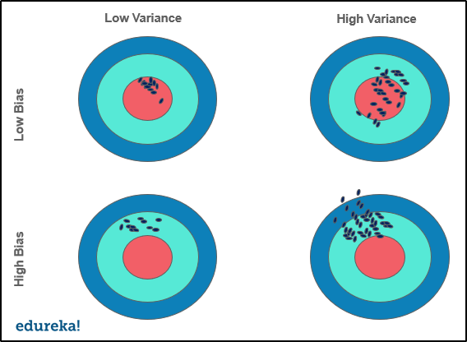
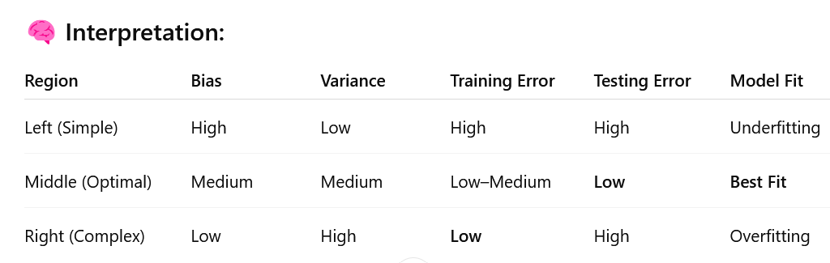
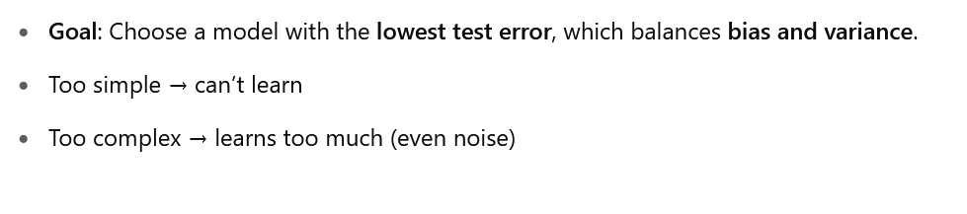
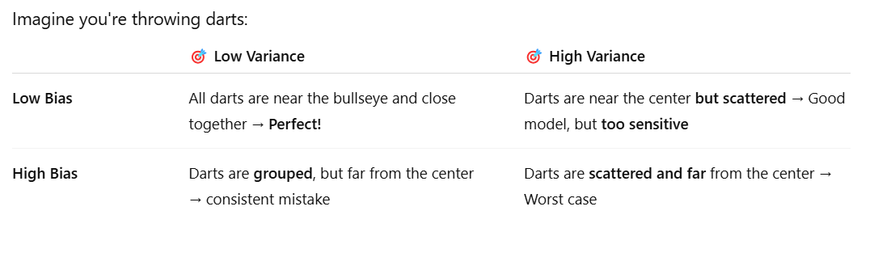
MIT School of Computing Department of Computer Science & Engineering
Bias: Error in training data and Testing Data
Variance: Error in test data

Slide 26
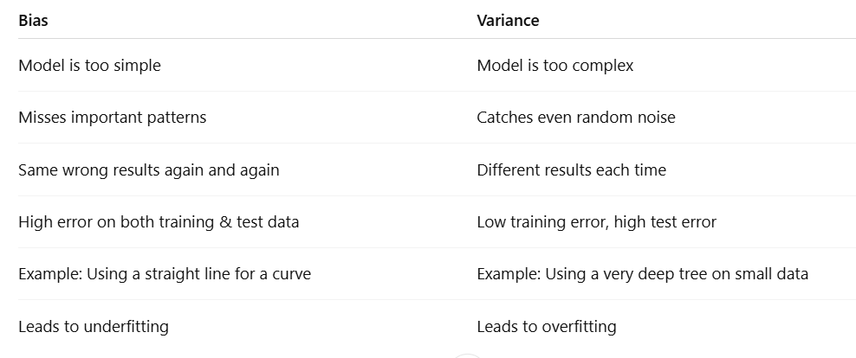
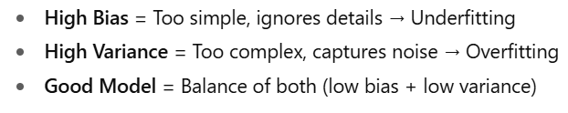
MIT School of Computing Department of Computer Science & Engineering

Slide 27
MIT School of Computing Department of Computer Science & Engineering
Bias-Variance Trade-Off
While building the machine learning model, it is really important to take care of bias and variance in order to avoid overfitting and underfitting in the model.
If the model is very simple with fewer parameters, it may have low variance and high bias.
Whereas, if the model has a large number of parameters, it will have high variance and low bias.
So, it is required to make a balance between bias and variance errors, and this balance between the bias error and variance error is known as the Bias-Variance trade-off.

Slide 28
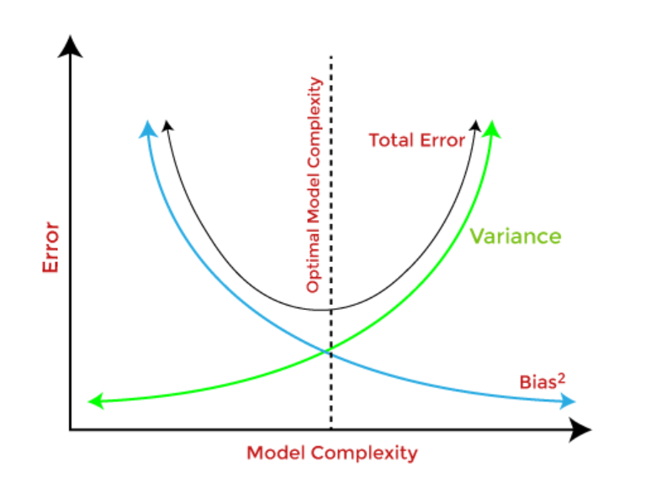
MIT School of Computing Department of Computer Science & Engineering
For an accurate prediction of the model, algorithms need a low variance and low bias. But this is not possible because bias and variance are related to each other:
If we decrease the variance, it will increase the bias.
If we decrease the bias, it will increase the variance.
Bias-Variance trade-off is a central issue in supervised learning. Ideally, we need a model that accurately captures the regularities in training data and simultaneously generalizes well with the unseen dataset. Unfortunately, doing this is not possible simultaneously. Because a high variance algorithm may perform well with training data, but it may lead to overfitting to noisy data. Whereas, high bias algorithm generates a much simple model that may not even capture important regularities in the data. So, we need to find a sweet spot between bias and variance to make an optimal model.
Bias-Variance trade-off is about finding the sweet spot to make a balance between bias and variance errors.

Slide 29
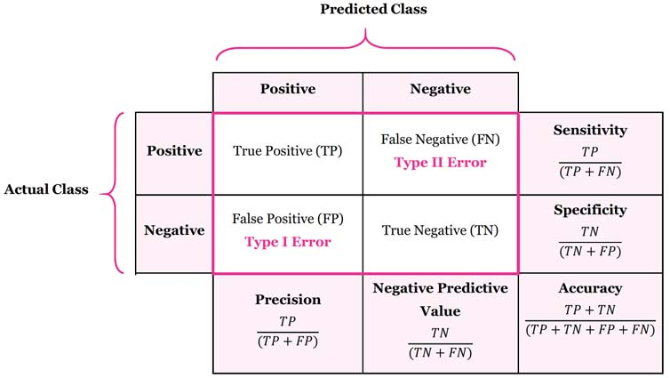
MIT School of Computing Department of Computer Science & Engineering
Confusion Matrix?
A Confusion matrix is an N x N matrix used for evaluating the performance of a classification model, where N is the total number of target classes. The matrix compares the actual target values with those predicted by the machine learning model.

Slide 30
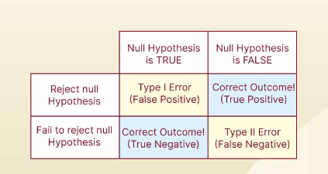
MIT School of Computing Department of Computer Science & Engineering
Type I and Type II Errors:
Type I and Type II errors are very common in machine learning and statistics.
Type I error occurs when the Null Hypothesis (H0) is mistakenly rejected. This is also referred to as the False Positive Error.
Type II error occurs when a Null Hypothesis that is actually false is accepted. This is also referred to as the False Negative Error.
There are two errors that could potentially occur:
Type I error (false positive): the test result says you have coronavirus, but you actually don’t.
Type II error (false negative): the test result says you don't have coronavirus, but you actually do.

Slide 31
MIT School of Computing Department of Computer Science & Engineering
Important Terms in a Confusion Matrix
True Positive (TP) : The predicted value matches the actual value, or the predicted class matches the actual class.
The actual value was positive, and the model predicted a positive value.
True Negative (TN) : The predicted value matches the actual value, or the predicted class matches the actual class.
The actual value was negative, and the model predicted a negative value.
3. False Positive (FP) – Type I Error : The predicted value was falsely predicted.
The actual value was negative, but the model predicted a positive value.
4. False Negative (FN) – Type II Error : The predicted value was falsely predicted.
The actual value was positive, but the model predicted a negative value.

Slide 32
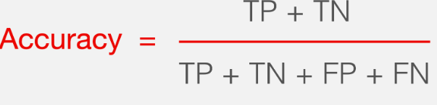
MIT School of Computing Department of Computer Science & Engineering
What is accuracy?
Accuracy is a metric that measures how often a machine learning model correctly predicts the outcome. You can calculate accuracy by dividing the number of correct predictions by the total number of predictions.

Slide 33


MIT School of Computing Department of Computer Science & Engineering
What is precision?
Precision is a metric that measures how often a machine learning model correctly predicts the positive class. You can calculate precision by dividing the number of correct positive predictions (true positives) by the total number of instances the model predicted as positive (both true and false positives).
What is recall?
Recall is a metric that measures how often a machine learning model correctly identifies positive instances (true positives) from all the actual positive samples in the dataset. You can calculate recall by dividing the number of true positives by the number of positive instances. The latter includes true positives (successfully identified cases) and false negative results (missed cases).

Slide 34

MIT School of Computing Department of Computer Science & Engineering
F1 SCORE
F1 score is a weighted average of the recall (sensitivity) and precision.

Slide 35
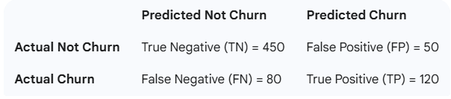
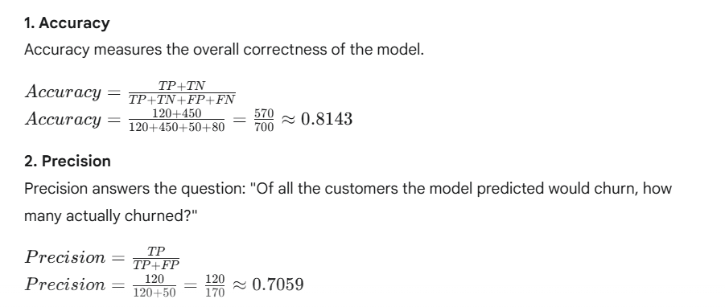
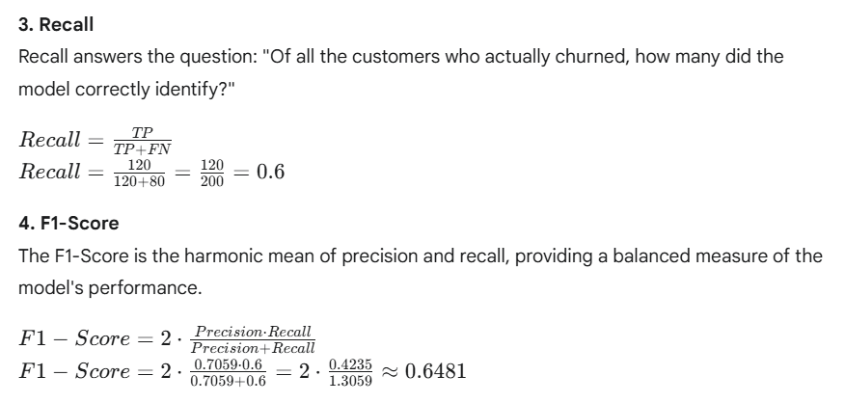
MIT School of Computing Department of Computer Science & Engineering
A classification model predicts whether a customer will churn (leave the service). The model's predictions on a test set are evaluated against the actual outcomes, resulting in the following confusion matrix: Based on this confusion matrix, calculate the following Level 2 metrics:
Accuracy 2. Precision 3. Recall 4. F1-Score

Slide 36
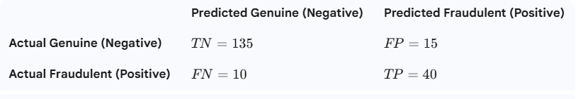
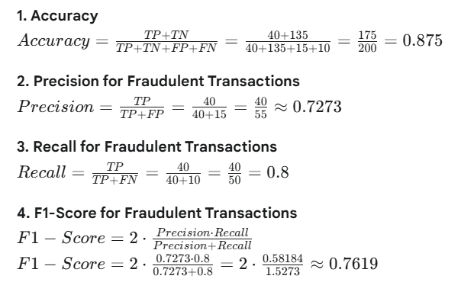
MIT School of Computing Department of Computer Science & Engineering
A bank's machine learning model is designed to detect fraudulent credit card transactions.
A test set of 200 transactions is used to evaluate the model's performance.
Of the 150 genuine transactions, the model correctly identified 135 as genuine.
Of the 50 fraudulent transactions, the model correctly identified 40 as fraudulent.
Based on this information, calculate the following metrics:
1. Accuracy 2. Precision for fraudulent transactions
3. Recall for fraudulent transactions
4. F1-Score for fraudulent transactions
Construct the Confusion Matrix
First, let's identify the four key values (TP, TN, FP, FN) from the provided information.
True Positive (TP): The model correctly predicted fraudulent transactions.
Given: 40 fraudulent transactions were correctly identified.
TP=40
True Negative (TN): The model correctly predicted genuine transactions.
Given: 135 genuine transactions were correctly identified.
TN=135
False Positive (FP): The model incorrectly predicted genuine transactions as fraudulent.
Calculation: Total genuine transactions - correctly identified genuine transactions.
FP=150−135=15
False Negative (FN): The model incorrectly predicted fraudulent transactions as genuine.
Calculation: Total fraudulent transactions - correctly identified fraudulent transactions.
FN=50−40=10

Slide 37
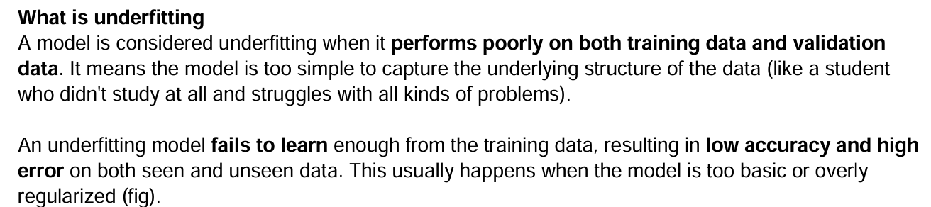
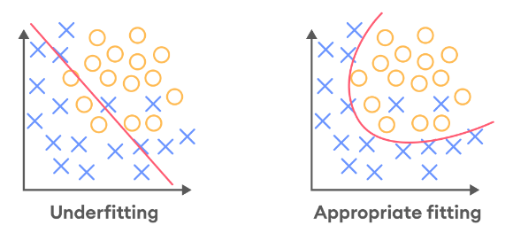
MIT School of Computing Department of Computer Science & Engineering
What is underfitting
Underfitting occurs when a model is not able to make accurate predictions based on training data and hence, doesn’t have the capacity to generalize well on new data. Another case of underfitting is when a model is not able to learn enough from training data (Fig), making it difficult to capture the dominating trend (the model is unable to create a mapping between the input and the target variable).

Slide 38
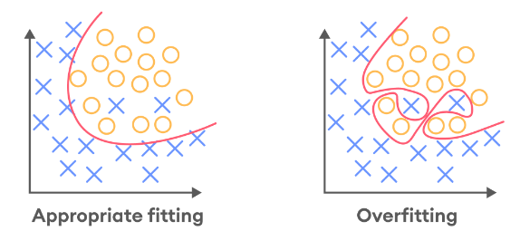
MIT School of Computing Department of Computer Science & Engineering
What is overfitting
A model is considered overfitting when it does extremely well on training data but fails to perform on the same level on the validation data (like the child who memorized every math problem in the problem book and would struggle when facing problems from anywhere else). An overfitting model fails to generalize well, as it learns the noise and patterns of the training data to the point where it negatively impacts the performance of the model on new data (fig).

Slide 39
MIT School of Computing Department of Computer Science & Engineering
Reasons for Under fitting
The model is too simple, So it may be not capable to represent the complexities in the data.
The input features which is used to train the model is not the adequate representations of underlying factors influencing the target variable.
The size of the training dataset used is not enough.
Excessive regularization are used to prevent the overfitting, which constraint the model to capture the data well.
Features are not scaled.
Reasons for Overfitting:
High variance and low bias.
The model is too complex.
The size of the training data.

Slide 40
MIT School of Computing Department of Computer Science & Engineering
How to avoid Overfitting and Underfitting?
To solve the issue of overfitting and underfitting, it is important to choose an appropriate model for the given dataset.
Hyper-performance tuning can also be performed.
For overfitting reducing the model complexity can help similarly for underfitting the model complexity can be increased.
As overfitting is caused due to too many features in the dataset and underfitting is caused by too few features so during feature engineering the numbers of features can be decreased and increased to avoid overfitting and underfitting respectively.

Slide 41
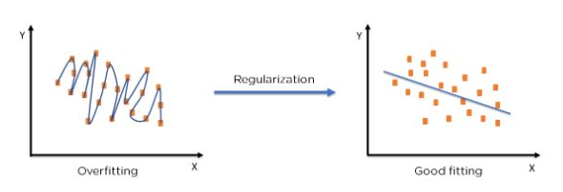
MIT School of Computing Department of Computer Science & Engineering
What is Regularization in Machine Learning?
Regularization refers to techniques that are used to calibrate machine learning models in order to minimize the adjusted loss function and prevent overfitting or underfitting.

Slide 42
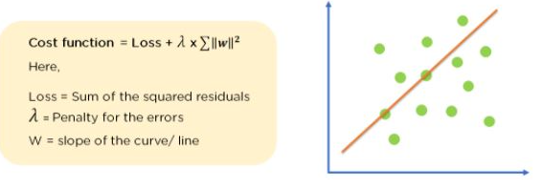
MIT School of Computing Department of Computer Science & Engineering
Regularization Techniques
1. Ridge Regularization :
It modifies the over-fitted or under fitted models by adding the penalty equivalent to the sum of the squares of the magnitude of coefficients.
This means that the mathematical function representing our machine learning model is minimized and coefficients are calculated. The magnitude of coefficients is squared and added. Ridge Regression performs regularization by shrinking the coefficients present. The function depicted below shows the cost function of ridge regression :

Slide 43
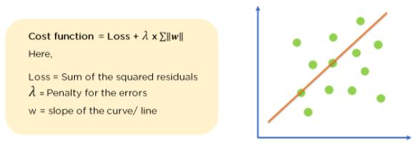
MIT School of Computing Department of Computer Science & Engineering
2. Lasso Regression:
It modifies the over-fitted or under-fitted models by adding the penalty equivalent to the sum of the absolute values of coefficients.
Lasso regression also performs coefficient minimization, but instead of squaring the magnitudes of the coefficients, it takes the true values of coefficients. This means that the coefficient sum can also be 0, because of the presence of negative coefficients. Consider the cost function for Lasso regression :

Slide 44
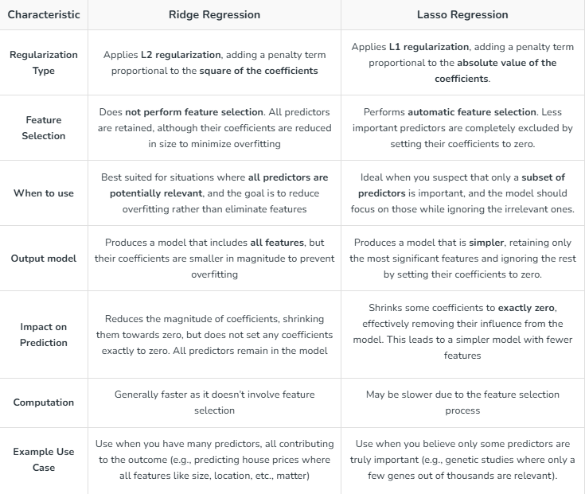
MIT School of Computing Department of Computer Science & Engineering

Slide 45
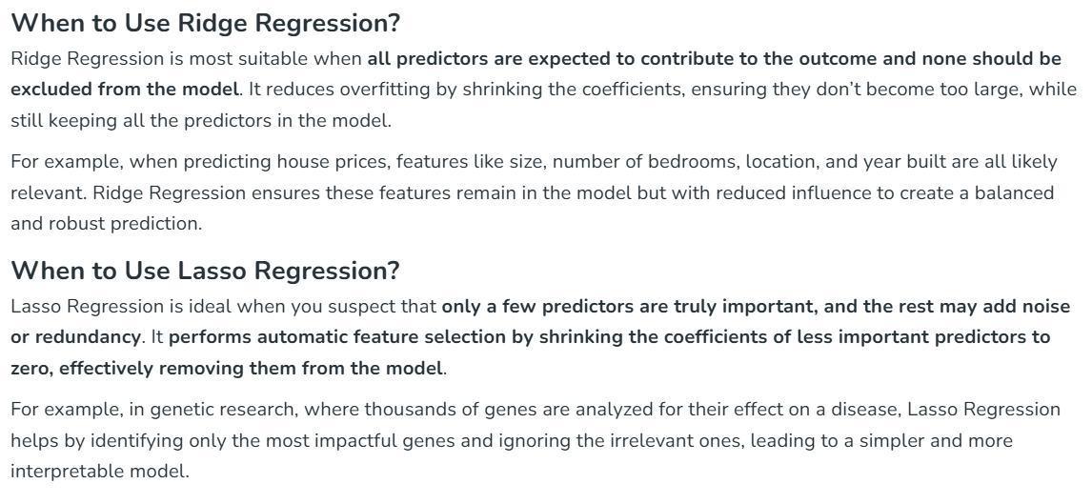
MIT School of Computing Department of Computer Science & Engineering

Slide 46
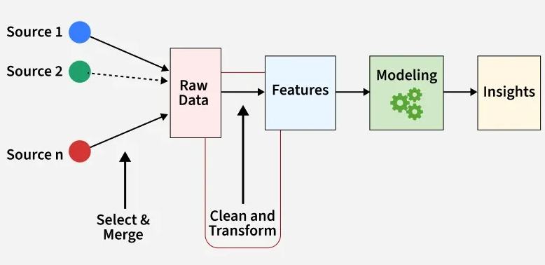
MIT School of Computing Department of Computer Science & Engineering
What is Feature Engineering?
Feature engineering is the process of turning raw data into useful features that help improve the performance of machine learning models. It includes choosing, creating and adjusting data attributes to make the model’s predictions more accurate. The goal is to make the model better by providing relevant and easy-to-understand information.
A feature or attribute is a measurable property of data that is used as input for machine learning algorithms. Features can be numerical, categorical or text-based representing essential data aspects which are relevant to the problem. For example in housing price prediction, features might include the number of bedrooms, location and property age.

Slide 47
MIT School of Computing Department of Computer Science & Engineering
Importance of Feature Engineering
Feature engineering can significantly influence model performance. By refining features, we can:
Improve accuracy: Choosing the right features helps the model learn better, leading to more accurate predictions.
Reduce overfitting: Using fewer, more important features helps the model avoid memorizing the data and perform better on new data.
Boost interpretability: Well-chosen features make it easier to understand how the model makes its predictions.
Enhance efficiency: Focusing on key features speeds up the model’s training and prediction process, saving time and resources.

Slide 48
MIT School of Computing Department of Computer Science & Engineering
Steps in Feature Engineering
Feature engineering can vary depending on the specific problem but the general steps are:
Data Cleansing: Identify and correct errors or inconsistencies in the dataset to ensure data quality and reliability.
Data Transformation: Transform raw data into a format suitable for modeling including scaling, normalization and encoding.
Feature Extraction: Create new features by combining or deriving information from existing ones to provide more meaningful input to the model.
Feature Selection: Choose the most relevant features for the model using techniques like correlation analysis, mutual information and stepwise regression.
Feature Iteration: Continuously refine features based on model performance by adding, removing or modifying features for improvement.

Slide 49
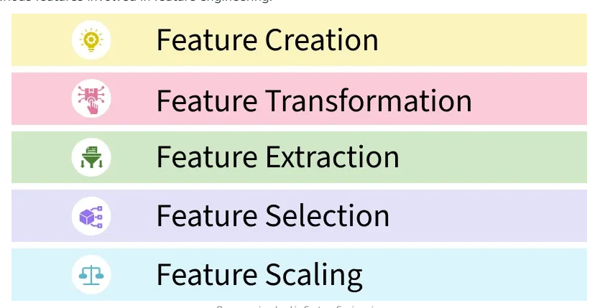
MIT School of Computing Department of Computer Science & Engineering
1. Feature Creation: Feature creation involves generating new features from domain knowledge or by observing patterns in the data. It can be:
Domain-specific: Created based on industry knowledge likr business rules.
Data-driven: Derived by recognizing patterns in data.
Synthetic: Formed by combining existing features.
2. Feature Transformation: Transformation adjusts features to improve model learning:
Normalization & Scaling: Adjust the range of features for consistency.
Encoding: Converts categorical data to numerical form i.e one-hot encoding.
Mathematical transformations: Like logarithmic transformations for skewed data.
3. Feature Extraction: Extracting meaningful features can reduce dimensionality and improve model accuracy:
Dimensionality reduction: Techniques like PCA reduce features while preserving important information.
Aggregation & Combination: Summing or averaging features to simplify the model.
4. Feature Selection: Feature selection involves choosing a subset of relevant features to use:
Filter methods: Based on statistical measures like correlation.
Wrapper methods: Select based on model performance.
Embedded methods: Feature selection integrated within model training.
5. Feature Scaling: Scaling ensures that all features contribute equally to the model:
Min-Max scaling: Rescales values to a fixed range like 0 to 1.
Standard scaling: Normalizes to have a mean of 0 and variance of 1.

