Slide 1
VP MART • TECHNICAL PROJECT PRESENTATION
Multi-Vendor E-Commerce & Hyperlocal Logistics Ecosystem
One marketplace. Many independent shops.
Production Architecture • React 19 & Vite 8 • Express 5 & Node 22 • MongoDB Atlas • Razorpay
Presented by: VIJAYAPRATHAP K

Slide 2
PROJECT FOUNDATION
Problem Statement & Strategic Objectives
The Real-World Retail Dilemma
• Independent Sellers Locked Out: Small retail merchants face high commission fees and rigid policies on legacy platforms.
• No Hyperlocal Logistics: Conventional marketplaces ship via postal couriers taking 3-5 days rather than same-day local dispatch.
• Inventory Overselling: Standard e-commerce apps suffer from race condition inventory conflicts during flash sales.
• Financial Floating Discrepancies: Inaccurate decimal calculations lead to accounting errors and reconciliation losses.
• Fragile Cross-Domain Auth: Deploying separate frontend and backend domains often breaks secure cookie authentication.
VP Mart Engineering Solutions
• Unified Multi-Tenant Platform: Dedicated workflows for Customers, Vendors, Couriers, and Platform Administrators.
• Doorstep OTP Handover: 6-digit cryptographic verification ensures delivery integrity and eliminates courier disputes.
• ACID MongoDB Transactions: Atomic stock reservation prevents race condition overselling under concurrent checkouts.
• Strict Integer Paise Math: 100% of product prices, discounts, and payments use integer paise (zero decimal errors).
• HttpOnly SameSite Defense: Advanced cookie configuration with double-submit CSRF tokens for safe distributed hosting.

Slide 3
BRAND STRATEGY
Brand Identity & Core Platform Pillars
Brand Identity & Vision
• Name: VP Mart (Value & Performance in Unified Retail).
• Tagline: 'One marketplace. Many independent shops.'
• Emblem: Vibrant red 'V', trust blue 'P', and dynamic shopping bag glyph communicating swift local commerce.
• Vision: Empower local and national merchants with enterprise e-commerce capabilities.
• Design: High-impact dark aurora aesthetic, 3D floating feature cards, and motion UI.
Target User Ecosystem
• Customers: Seamless shopping across 18+ departments with live pricing and order tracking.
• Vendors: Fast KYC approval, self-serve catalog management, and automated ledger settlements.
• Delivery Agents: Hyperlocal dispatch acceptance, navigation routing, and OTP customer handover.
• Administrators: Full oversight over platform KYC, moderation, banner scheduling, and audit logs.
Core Engineering Values
• Mathematical Rigor: Zero tolerance for floating-point currency approximations.
• Zero-Trust Security: Tokens stored exclusively in HttpOnly cookies with theft detection.
• High-Performance Build: Sub-second Vite 8 compilation across 509 client modules.
• Graceful Fallback: Resilient offline fallbacks for caching and persistent media storage.

Slide 4
TECHNICAL SPECIFICATION
Full-Stack Technology Stack & Architecture Matrix
Frontend Technologies
• React 19.3 Single Page Application
• Vite 8.3 Compiler & Build Tool
• React Router 7.18 (Role Protected)
• React-Bootstrap 2.10 & Custom CSS
• Socket.IO Client 4.8 & Vitest 5.0
Backend & Security
• Node.js 22 LTS & Express 5.3
• Zod 4.6 Strict Schema Validation
• Helmet 8.3 & Double-Submit CSRF
• Bcrypt 12 Rounds Password Hashing
• Pino 10.4 Production Logging
Persistence & Cloud
• MongoDB Atlas (Replica Set Cluster)
• Mongoose 9.11 ODM with Transactions
• Redis Key-Value Cache (Fallback)
• Sharp 0.35 C++ Image Processing
• PDFKit 0.20 GST Invoice Engine
Payment & Financial Infrastructure
• Razorpay 2.9 Official SDK (UPI, Net Banking, Cards)
• Server-to-Server HMAC SHA256 Webhook Verification
• Integer Paise Currency Engine (Zero Float Approximations)
• Automated Split Commission Calculation for Vendors
DevOps & Production Hosting
• Frontend: Netlify Edge Network (Global CDN & SPA Rewrite)
• Backend: Render Web Service (Node.js 22 Container)
• Database: MongoDB Atlas (3-Node Dedicated Replica Set)
• Monorepo Source Control: GitHub with Continuous Deployment

Slide 5
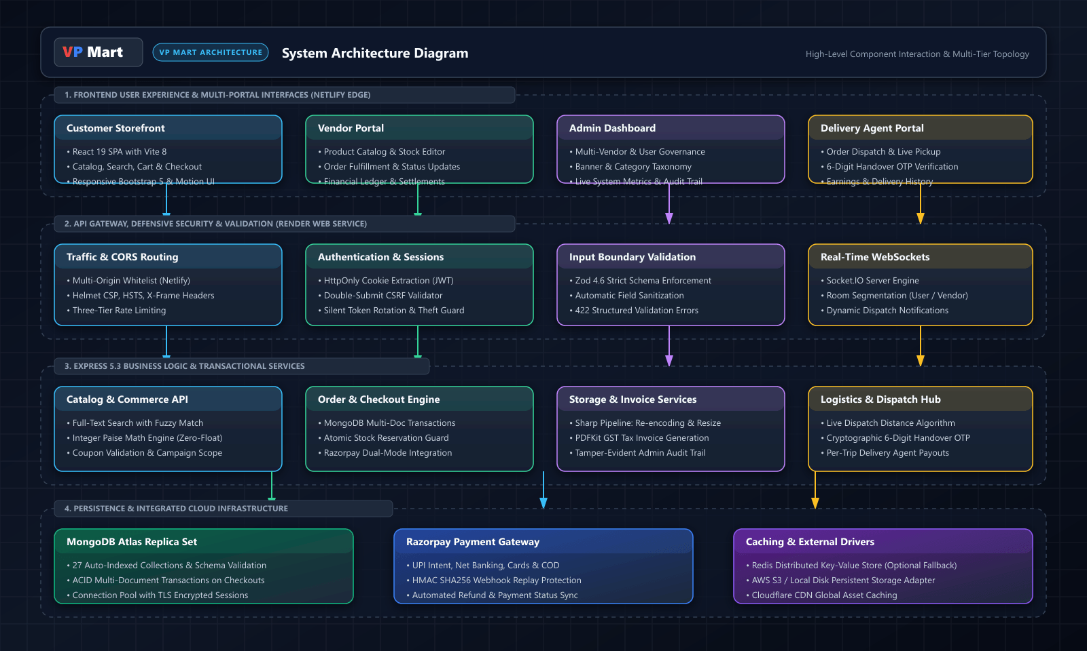
SYSTEM ARCHITECTURE
System Architecture & High-Level Component Topology
Key Architectural Highlights
• Three-tier topology: Client Presentation, Express API Services, and Cloud Persistence.
• Centralized React Context topology: AuthContext, CartContext, SocketContext, ToastContext.
• Defensive middleware pipeline: CORS multi-origin check, Helmet headers, Rate limiting, CSRF validator, and Zod parser.
• Integrated services: Sharp for image processing, PDFKit for tax invoices, and Socket.IO for live dispatches.

Slide 6
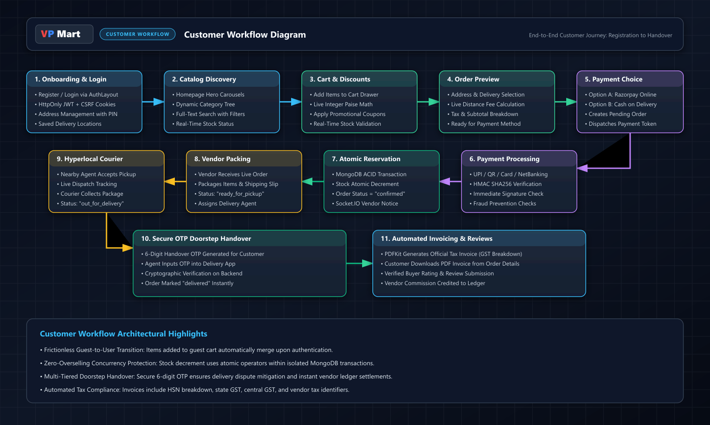
CUSTOMER WORKFLOW
Customer Journey: Catalog Discovery to Doorstep Handover
Key Architectural Highlights
• Dynamic browsing: Hero carousels, responsive category taxonomy, and fuzzy keyword search.
• Real-time cart: Instant quantity updates with integer paise price calculations.
• Checkout preview: Validated address selection, PIN code checks, and promo coupon application.
• Dual payment paths: Instant Razorpay UPI/Card authorization or Cash on Delivery.
• Doorstep OTP handover: 6-digit cryptographic verification marks orders delivered in real-time.

Slide 7
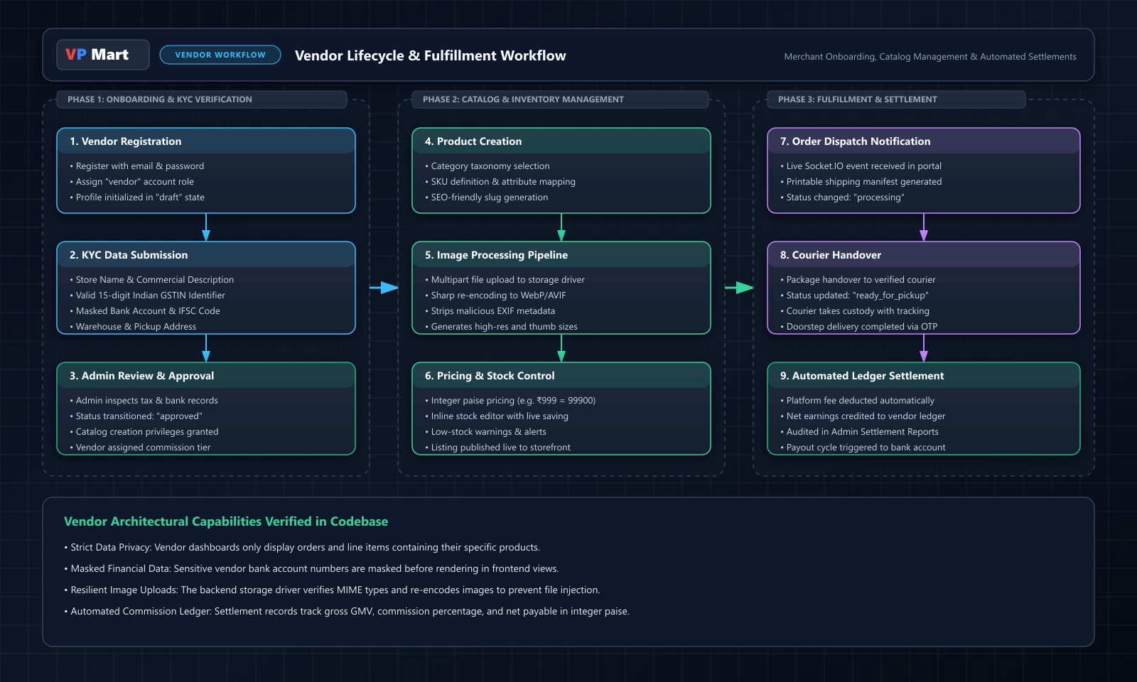
VENDOR WORKFLOW
Vendor Lifecycle: Merchant Onboarding & Order Fulfillment
Key Architectural Highlights
• KYC Onboarding: Merchants submit store profiles, Indian GSTIN, and masked bank accounts.
• Catalog control: Create listings with SKU, specifications, and automated Sharp WebP image compression.
• Real-time dispatch: Live Socket.IO alerts notify vendors the second an order is placed.
• Fulfillment lifecycle: Status progresses from 'processing' to 'ready_for_pickup' to courier handover.
• Ledger settlement: Platform commissions are automatically deducted and net earnings credited.

Slide 8
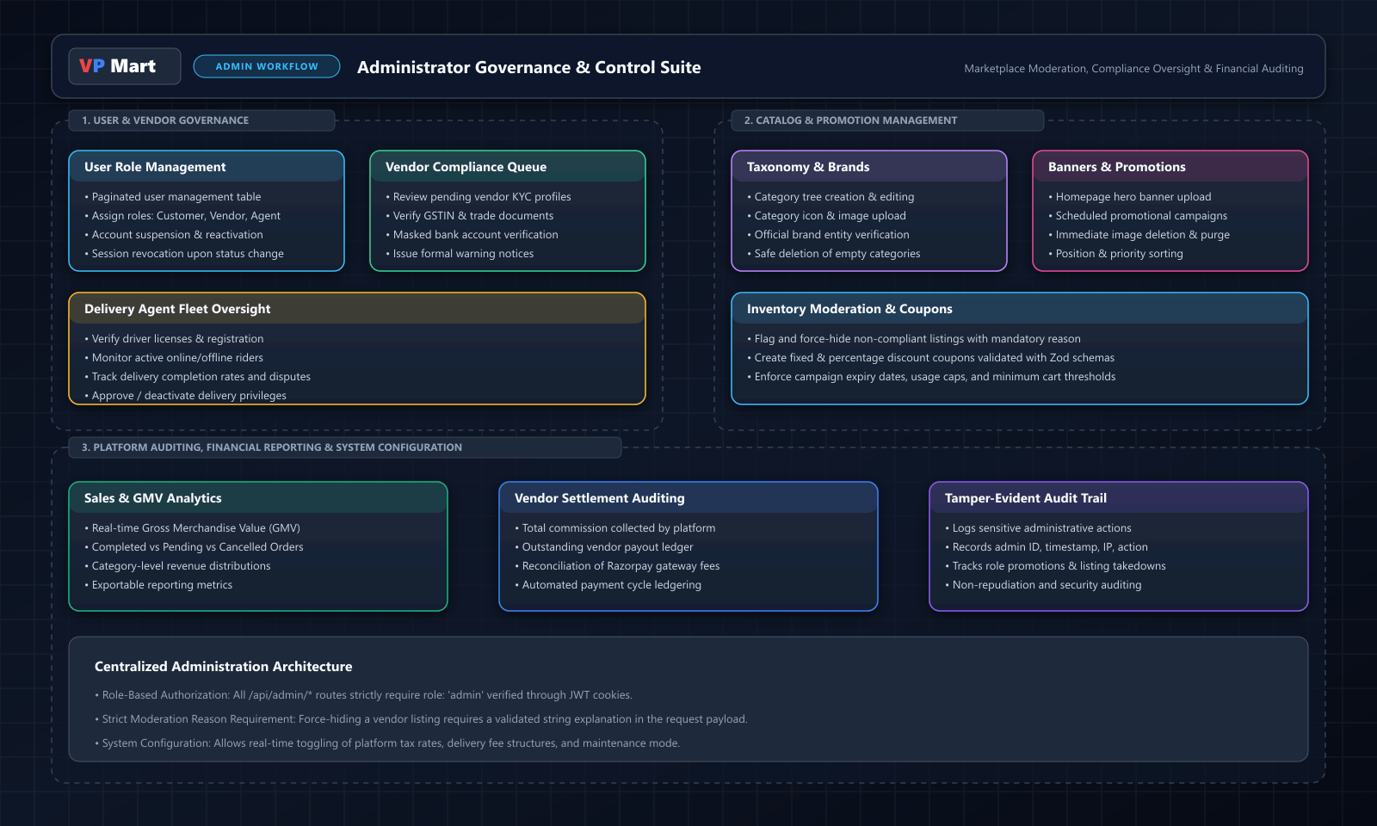
ADMIN WORKFLOW
Admin Governance, Compliance & Logistics Oversight
Key Architectural Highlights
• User & Vendor Governance: Review KYC queues, inspect GST details, and suspend offending accounts.
• Listing Moderation: Force-hide non-compliant marketplace items with mandatory justification reasons.
• Marketing Campaigns: Upload hero banners and create discount coupons with Zod schema validation.
• Logistics Management: Verify delivery agent licenses and monitor active hyperlocal dispatches.
• Audit Trail: Tamper-evident logging records admin actions with timestamps, IPs, and user IDs.

Slide 9
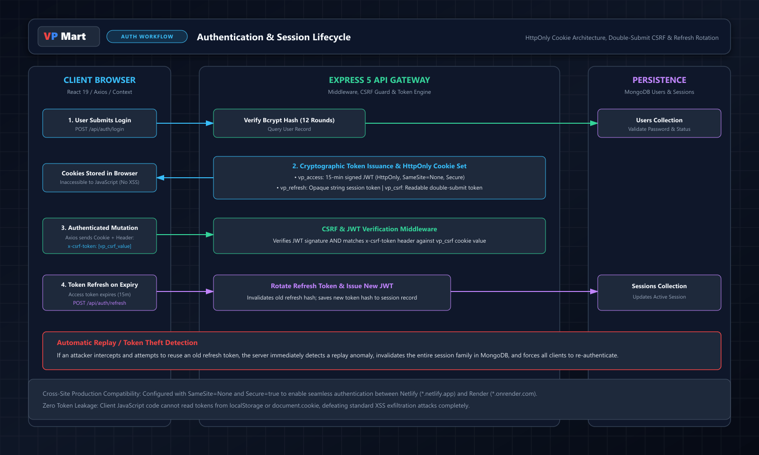
AUTHENTICATION & SECURITY
Security Architecture: HttpOnly Cookies, CSRF & Token Rotation
Key Architectural Highlights
• HttpOnly JWT Tokens: Session tokens are stored in HttpOnly cookies, completely blocking XSS access.
• Double-Submit CSRF: Every state mutation requires matching the 'x-csrf-token' header against the cookie.
• Silent Token Rotation: 15-minute access tokens rotate refresh tokens upon expiration.
• Theft Detection: Replaying an old refresh token immediately invalidates the entire session family.
• Cross-Domain Safety: Configured with SameSite=None and Secure=true for Netlify-to-Render communication.

Slide 10
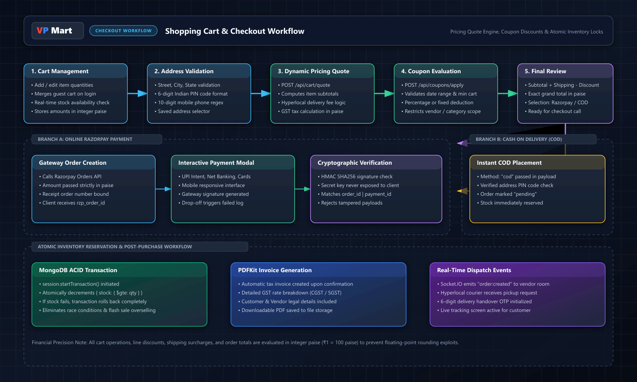
PAYMENTS & CHECKOUT
Checkout, Razorpay Payment & Webhook Replay Protection
Key Architectural Highlights
• Atomic Inventory Reservation: Checkout transactions atomically lock stock in MongoDB sessions.
• Zero Overselling: Concurrency guards prevent flash sale stock conflicts.
• Cryptographic Verification: Server verifies Razorpay payment signatures using HMAC SHA256.
• Asynchronous Webhook Backup: In case of client dropouts, the server webhook listener confirms orders.
• Automated PDF Invoicing: Generates GST-compliant tax invoices with CGST/SGST breakdowns.

Slide 11
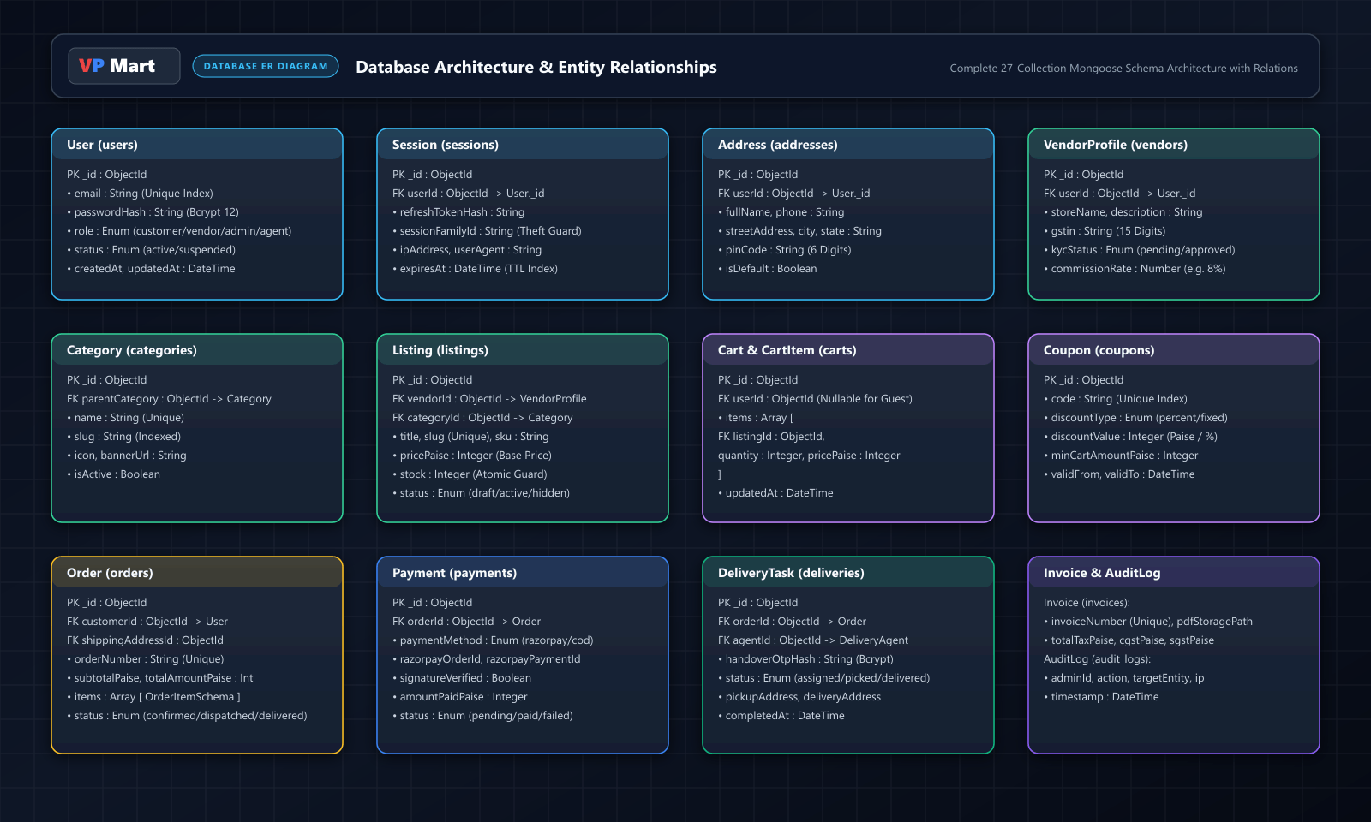
DATABASE ARCHITECTURE
Database Architecture: 27-Collection Mongoose ER Model
Key Architectural Highlights
• 27 Mongoose Collections: Auto-indexed schemas covering Users, Catalog, Cart, Orders, and Logistics.
• Relational integrity: Foreign keys link Users to Vendor and Courier profiles, Orders, and Reviews.
• High-speed querying: Unique indexes on emails, order numbers, slugs, and coupon codes.
• Integer financial storage: All financial attributes stored in paise for zero-rounding accuracy.
• TTL Session Indexing: Inactive authentication sessions expire automatically via MongoDB TTL indexes.

Slide 12
QA & DEPLOYMENT
Testing Verification, QA Sign-Off & Production Deployment
Automated Testing & Build Verification
• 125 / 125 Vitest Tests Passed (100% Success Rate across 11 test suites).
• Verified Test Suites: money.test.js (paise math), validation.test.js (regex), ProtectedRoute.test.jsx (RBAC), Login.test.jsx (auth), storefront.test.jsx (catalog), dashboards.test.jsx (admin).
• Execution Duration: Complete client test run finishes in ~13 seconds.
• Vite Production Build: 509 modules compiled cleanly in 659 milliseconds.
• SPA Routing Rewrite: Verified presence of _redirects rule for seamless deep link navigation on Netlify.
• Backend Integration Catalog: 18 dedicated integration suites ready for automated CI testing.
Production Deployment Architecture
• Frontend Hosting: Netlify Edge CDN (Auto-deployment on GitHub push).
• Backend Hosting: Render Web Service (Node.js 22 LTS container with /api/health probe).
• Database Hosting: MongoDB Atlas 3-node replica set cluster with TLS encryption.
• Cross-Domain CORS Whitelist: Multi-origin configuration supports preview domains and main domain.
• Cold Start Mitigation: Automated health probe pings keep the backend warm.
• Admin Initializer: Interactive npm run seed:admin script seeds the production Super Admin account.

Slide 13
CONCLUSION
Key Challenges Solved, Engineering Roadmap & Conclusion
Key Engineering Challenges Solved
• Cross-Site Cookie Blocking: Resolved by pairing SameSite=None and Secure=true with dynamic CORS parsing.
• CSRF Vulnerability in Cross-Domain Setup: Implemented Double-Submit Cookie defense with header matching.
• Concurrency Race Conditions: Used MongoDB session.startTransaction() with atomic $gte decrement guards.
• Floating-Point Rounding Exploits: Completely eliminated through integer paise financial modeling.
• Image File Injection: Neutralized via Sharp pipeline re-encoding and MIME-type verification.
Future Roadmap & Closing Statement
• Elasticsearch Cluster: Integrate fuzzy typo-tolerant full-text search engine.
• React Native Mobile App: Unified customer and courier client for iOS and Android.
• Two-Factor Authentication: Implement TOTP authenticator app support for Admins and Vendors.
• Live Courier GPS: Real-time rider tracking rendered on Leaflet/Mapbox maps.
• Summary: VP Mart is a resilient, enterprise-ready multi-vendor platform engineered with financial rigor, defensive security, and production-ready cloud deployment.
• Thank you! Open for Questions & Evaluation.

