Slide 1
TESTING calculations WITH QUNIT

Slide 2



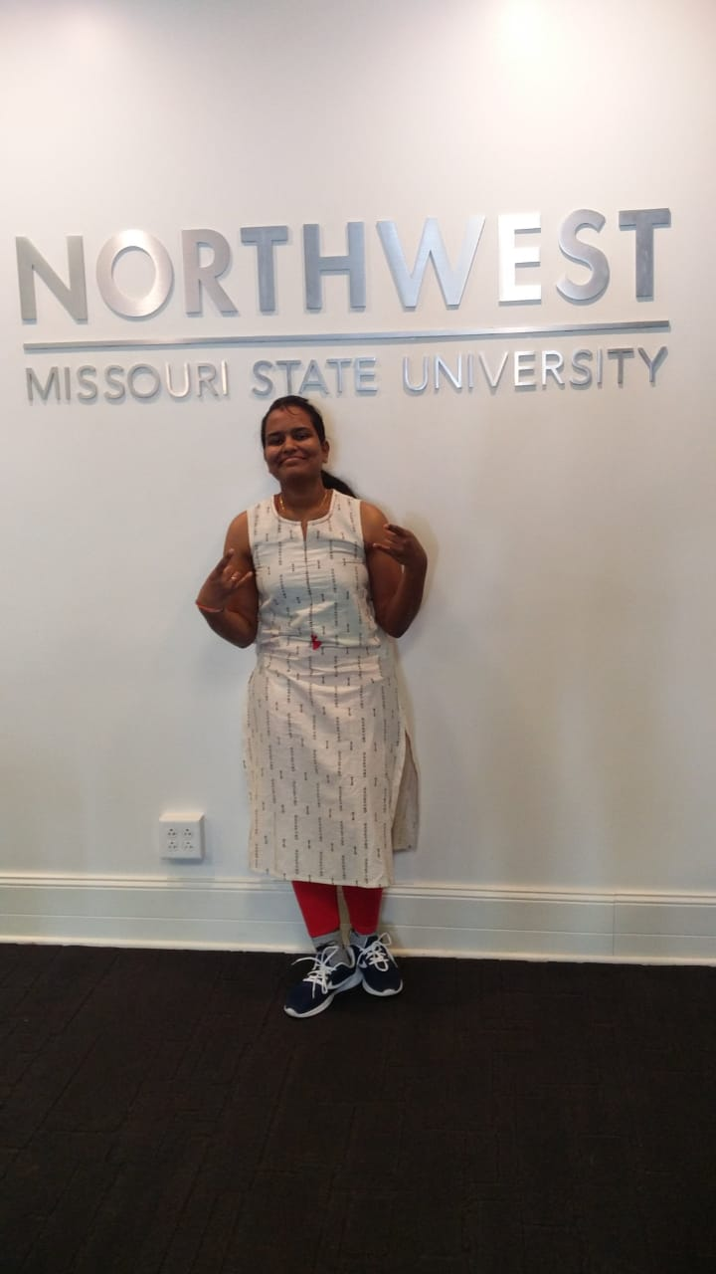
PRASHANTH REDDY NACHANNAGARI
CHITRALEKHA
CHIKKU
VIJAYA RAJA MAYURI AKULA
CHAITRA Vemula

Slide 3
What is QUnit? QUnit is a unit testing framework for JavaScript programming language. What is Javascript? Javascript is a client-side script to interact with the user and make dynamic pages.

Slide 4
JAVASCRIPT
JavaScript is a lightweight, interpreted programming language.
Designed for creating network-centric applications.
Complementary to and integrated with Java.
Complementary to and integrated with HTML.
react to events & create new events
Modify the DOM: change/remove/add all HTML elements & attributes & CSS styles
provide logic, animations, calculations

Slide 5
Advantages of JavaScript
Less server interaction
Immediate feedback to the visitors
Increased interactivity
Richer interfaces
Javascript is case sensitive and always follow the proper cases while using letters.

Slide 6
Javascript code
<html>
<body>
<script language = "javascript" type = "text/javascript">
document.write("Hello World!")
</script>
</body>
</html>
This code will produce the following result −
Hello World!

Slide 7
Variables Declaration
`const` indicates that the identifier won’t be reassigned.
const x = 2;
`let`, indicates that the variable may be reassigned, such as a counter in a loop, or a value swap in an algorithm. It also signals that the variable will be used only in the block it’s defined in, which is not always the entire containing function.
let greeting = "say Hi";
`var` indicates the weakest signal available when you define a variable in JavaScript. The variable may or may not be reassigned, and variable may or may not be used for an entire function, or just for the purpose of a block or loop.
var x = 2;

Slide 8
Operators
Arithmetic Operators
Comparison Operators
Logical (or Relational) Operators
Assignment Operators
Conditional (or ternary) Operators
Control Structures and Loops
If else
Switch
While loop
For loop

Slide 9
Example
<html>
<body>
<script type = "text/javascript">
var a = 33; var b = 10; var c = "Test";
var linebreak = "<br />";
document.write("a + b = ");
result = a + b;
document.write(result);
</body>
<html>
Output
a + b = 43

Slide 10
Functions and Events
Most commonly used Events are :
onclick()
onsubmit
mouseover,mouseout, mousemove, mousedown/up
online, offline (network events)
reset, submit (form events)
focus, blur (when an element gets the focus or loses it)
drag, dragstart,dragend, dragenter, dragleave, drop
<script type = "text/javascript">
function sayHello() {
alert("Hello there");
}
</script>

Slide 11
Dialog Boxes
Alert
An alert dialog box is mostly used to give a message to the users.
Confirm
A confirmation dialog box is mostly used to take user's consent on any option. It displays a dialog box with two buttons: OK and Cancel.
Prompt
The prompt dialog box is very useful when you want to pop-up a text box to get user input. Thus, it enables you to interact with the user. The user needs to fill in the field and then click OK.

Slide 12
What is a Unit Test Case?
A Unit Test Case is a part of code which ensures that another part of the code works as expected.
To achieve the desired results quickly, test framework is required. QUnit is a perfect unit test framework for JavaScript programming language.
A formal written unit test case is characterized by a known input and by an expected output, which is worked out before the test is executed. The known input should test a precondition and the expected output should test a post-condition.
assert.equal( result, "4", "square(2) should be 4." );
There must be at least two unit test cases for each requirement: one positive test and one negative test

Slide 13
Qunit Features
QUnit provides Assertions for testing expected results.
QUnit provides Test fixtures for running tests.
QUnit tests allow to write code faster, which increases the quality.
QUnit is elegantly simple. It is less complex and takes less time.
QUnit tests can be run automatically and they check their own results and provide immediate feedback. There's no need to manually comb through a report of test results.
QUnit tests can be organized into test suites containing test cases and even other test suites.
QUnit shows test progress in a bar that is green if the test is going fine, and it turns red when a test fails.

Slide 14
Qunit used in both
Manual testing | Automated testing
Executing the test cases manually without any tool support is known as manual testing. | Taking tool support and executing the test cases using automation tool is known as automation testing.
Time consuming and tedious. Since the test cases are executed by human resources, it is very slow and tedious. | Fast Automation. Runs test cases significantly faster than human resources.
Huge investment in human resources. As test cases need to be executed manually, more number of testers are required. | Less investment in human resources. Test cases are executed using automation tool hence, less number of testers are required.

Slide 15
Creation of Test case
Make a call to the QUnit.test function, with two arguments.
Name − The name of the test to display the test results.
Function − Function testing code, having one or more assertions.
QUnit.test( "TestSquare", function( assert ) {
var result = square(2);
assert.equal( result, "4", "square(2) should be 4." );
});

Slide 16
To Run the Test
Along with javascript code and test case, We also need to import 2 important files into your qunit folder to run the test in browser.
Import qunit.js
<script src = "https://code.jquery.com/qunit/qunit-2.1.9.js"></script>
Import qunit.css
<script src = "https://code.jquery.com/qunit/qunit-2.1.9.js"></script>

Slide 17
Function and Test case
function square(x)
{
return x * x;
}
QUnit.test( "TestSquare", function( assert ) {
var result = square(2);
assert.equal( result, "4", "square(2) should be 4." );
});

Slide 18
Qunit using Assertions
Few Important Assertions which we use in the Test cases are:
equal()
notequal()
ok()
notok()
deepequal()
notdeepequal()

Slide 19
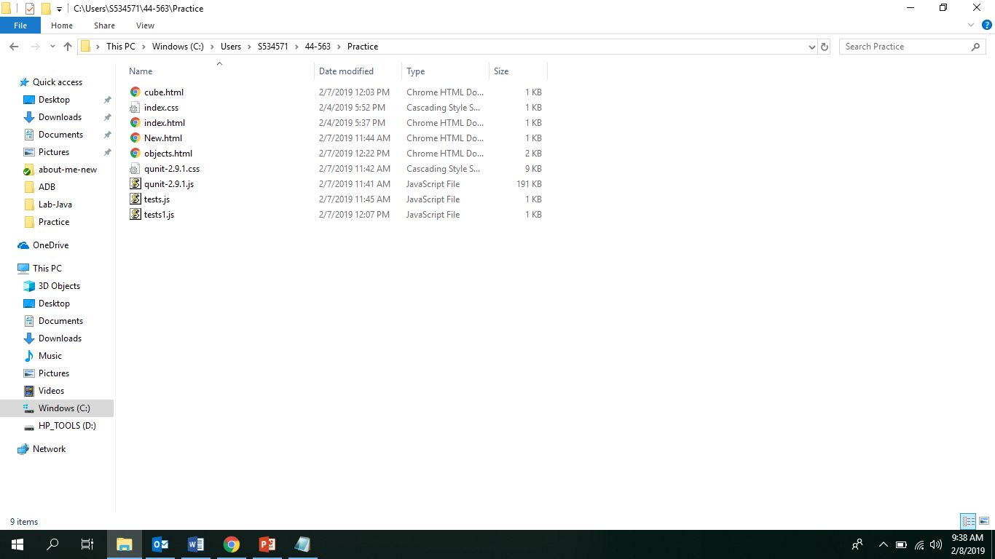
Steps to Run the Testcase

Slide 20
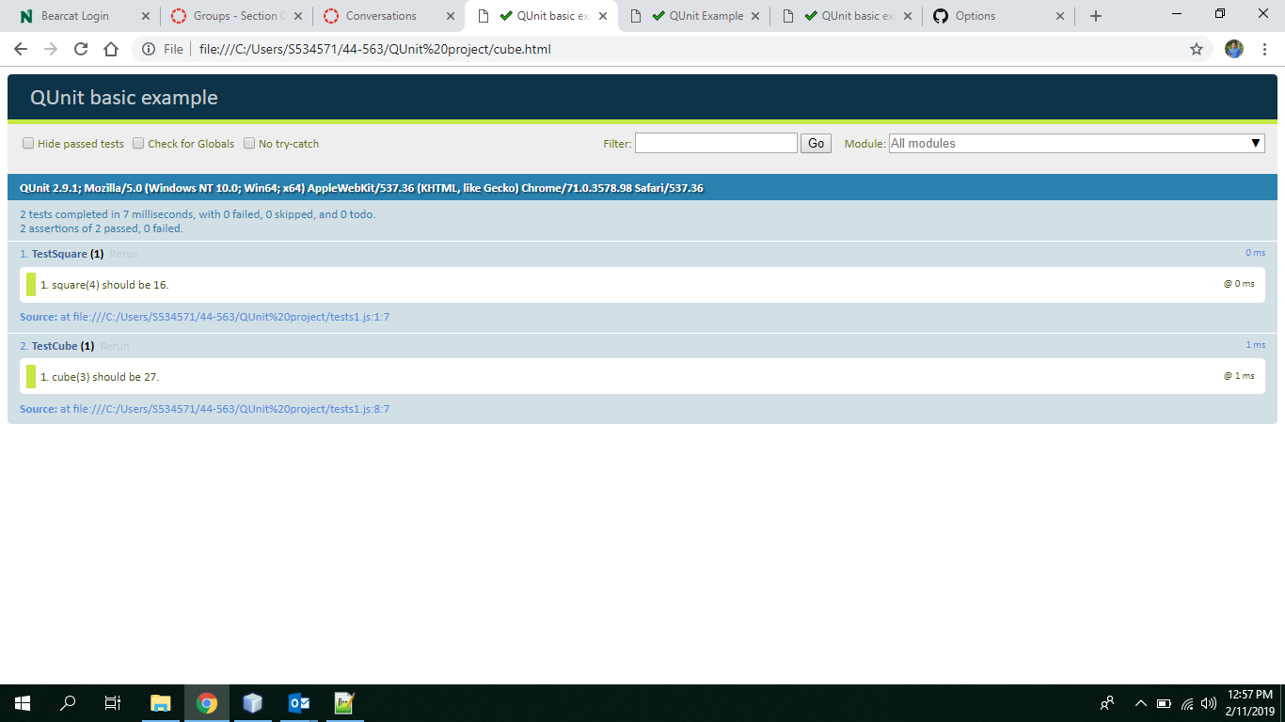

Slide 21
Thank You

