Slide 1

Connected Autonomous Vehicles
ELEC-8900-110
Presented by
Jaiharini Mani 110131837
Vijayarangan Pandurengadurai Raju 110128279
Bharath Suresh 110128856
Mageshwari Palanisamy 110142170

Slide 2
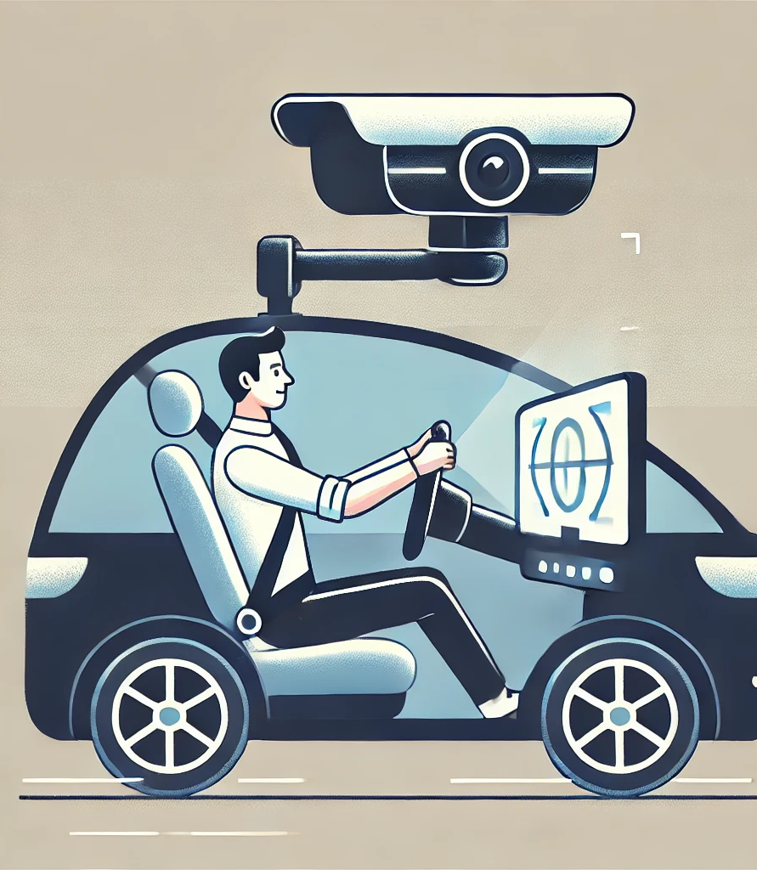
Driver Behaviour Prediction
Using
Computer Vision

Slide 3
Problem Statement
Ensuring driver awareness is critical in autonomous vehicles, especially in emergency situations where the driver may need to take control.
Detecting dangerous behaviours like as texting, chatting, and diversions is a huge challenge.
This project employs image processing and in-car cameras to monitor driver behaviour, detect risky practices, and improve safety via real-time analysis.

Slide 4
Detected Behavior Classes
In this project, five driver behavior classes were identified and monitored using Computer Vision
Talking
Detects if the driver is engaged in conversation, potentially leading to distraction.
Texting
Identifies texting or phone usage while driving, a common distraction.
Turning
Recognizes if the driver is making turns, an essential part of driving behavior.
Drive Safe
Represents safe and focused driving behavior.
Other Activities
Includes various distracting behaviors not falling into the other categories.

Slide 5
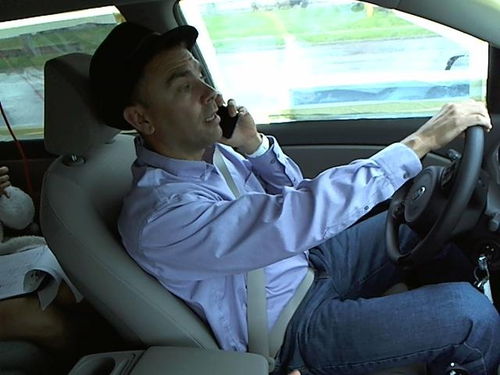
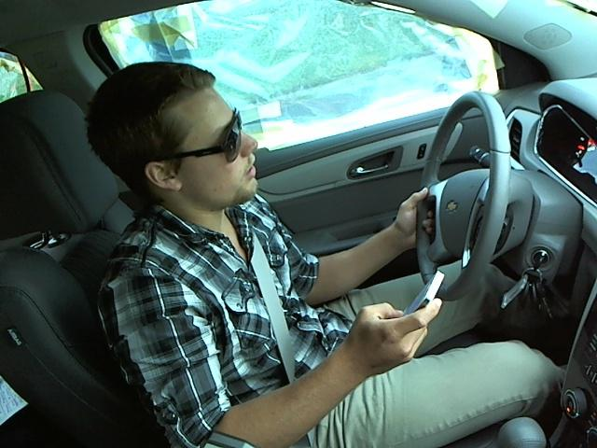
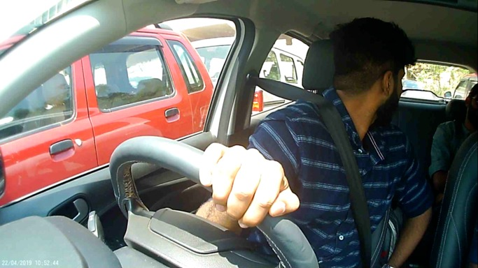
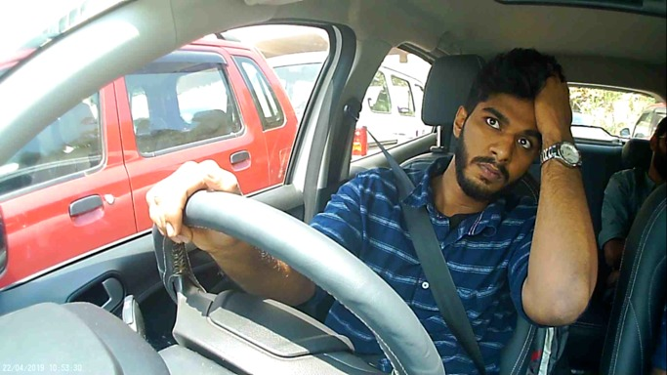
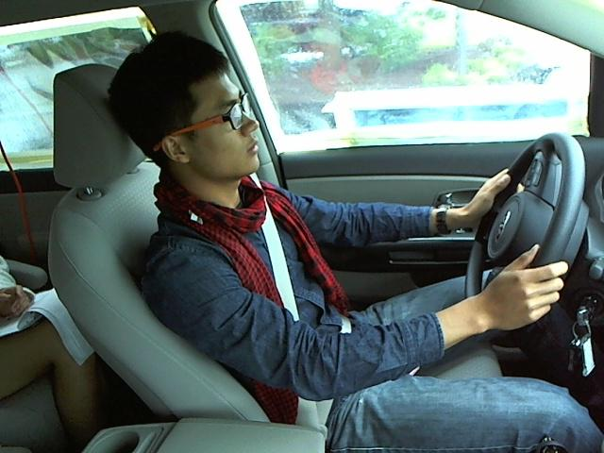
Detected Behavior Classes
Talking
Texting
Turning
Other Activities
Drive Safe

Slide 6
Deep Learning Models
The project utilizes the following four advanced deep learning models for analyzing and classifying driver behavior.
VGG16
A simple convolutional neural network (CNN) that is effective for classifying images.
ResNet50
A deep model that uses shortcuts to help the network learn better and faster.
InceptionV3
A model that uses multiple types of filters to capture different features in images.
Xception
An advanced version of Inception that improves efficiency by using separable convolutions.

Slide 7
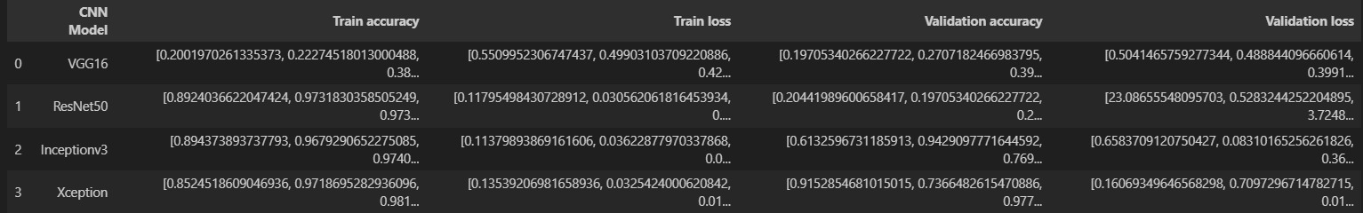
Model Comparison
Observation
Xception is the most suitable model for this dataset, achieving the highest validation accuracy and lowest loss.

Slide 8
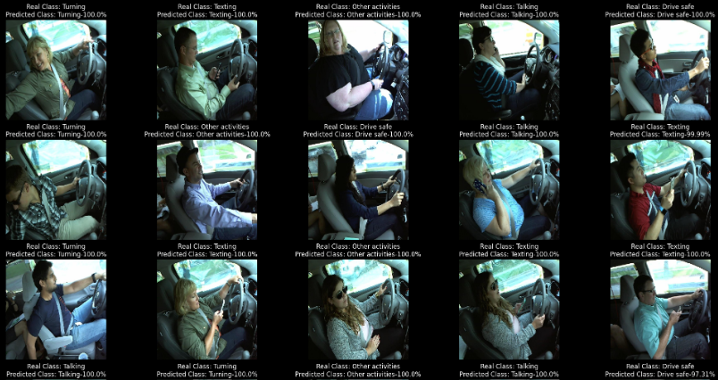
Test Prediction

Slide 9
Reference
[1] RobinReni, “Driver Behavior Dataset,” Kaggle.com, 2019. https://www.kaggle.com/datasets/robinreni/revitsone-5class (accessed Nov. 26, 2024).
‌
[2] Keras, “Keras documentation: VGG16 and VGG19,” keras.io. https://keras.io/api/applications/vgg/
[3] “resnet50 — Torchvision main documentation,” pytorch.org. https://pytorch.org/vision/main/models/generated/torchvision.models.resnet50.html
[4] “tf.keras.applications.InceptionV3 | TensorFlow v2.16.1,” TensorFlow. https://www.tensorflow.org/api_docs/python/tf/keras/applications/InceptionV3
‌
[5] K. Team, “Keras documentation: Xception,” keras.io. https://keras.io/api/applications/xception/

Slide 10
Thank you!

