Slide 1
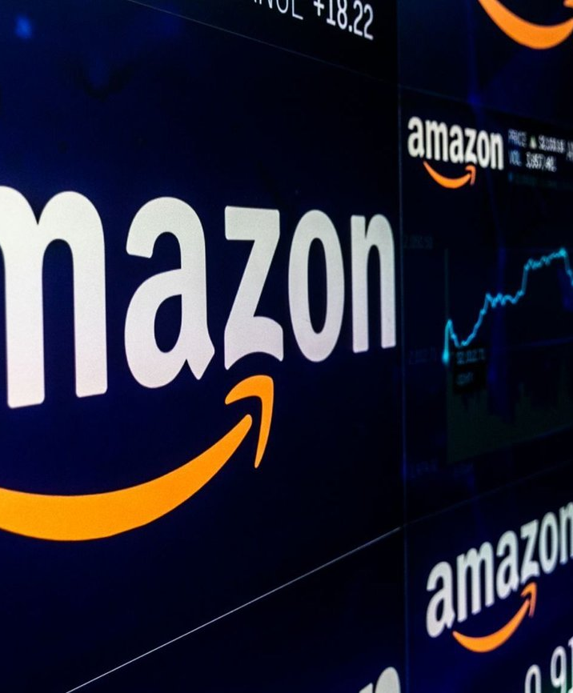
Data-Driven Insights for Amazon Prime Presented by: Vijayasuriya Suresh

Slide 2

Introducing Amazon Prime Video
A key player in the OTT media landscape, part of Amazon.com
Launched in 2006, Amazon Prime Video has evolved to compete with giants like Netflix and Disney+
Unique blend of technology and logistics, reaching audiences globally
ThePhoto by PhotoAuthor is licensed under CCYYSA.

Slide 3

Amazon Prime Video: Streaming with a Purpose
Business Model: Subscription-based digital streaming with on-demand movies, TV shows, and originals
Unique Selling Proposition: Diverse content range, including Amazon Originals, integrated with Prime benefits
Market Position: Global availability, offering a wide array of content to cater to varied tastes
Industry Impact: Innovating in streaming with features like X-Ray and integration with Amazon services
Purpose: To revolutionize the streaming experience, connecting global audiences with diverse, high-quality content and pioneering viewer technologies

Slide 4

Navigating Market Challenges
Despite its strong presence, Amazon Prime Video contends with issues in maintaining viewer engagement and adapting to fast-changing consumer preferences
Faces the challenge of standing out in an intensely competitive industry

Slide 5

Strategic Solution Through Data Analytics
Implement a comprehensive data analytics framework to gain deep insights into viewer behaviors and preferences
Optimize the recommendation engine using machine learning for personalized content discovery
Strategically expand the content library to include globally popular and niche titles
Develop targeted marketing campaigns and community engagement features to enhance user retention and satisfaction, thereby sustaining growth and competitive edge

Slide 6
Revenue Streams
Amazon Prime’s primary revenue comes from subscription fees. In the U.S., the annual fee is $139, or $14.99 monthly. With over 200 million global subscribers. Prime Video offers additional movies and TV shows for rent or purchase, contributing to Amazon’s revenue. Prices. Amazon’s advertising business, which includes ads on Prime Video, generated over $40 billion. Investment in original content for Prime Video attracts and retains subscribers, indirectly contributing to Amazon’s overall revenue. Prime Video helps in keeping subscribers engaged with the broader Amazon ecosystem, potentially leading to increased spending on other Amazon services and products, indirectly boosting overall revenue.

Slide 7
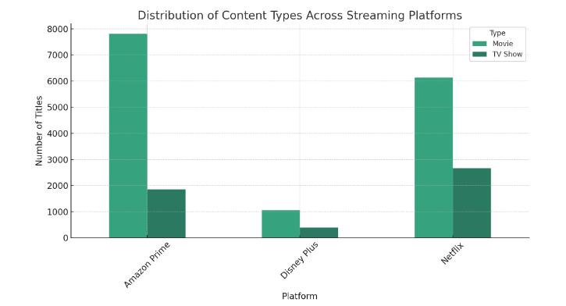
Strategy Framework Summary
Competitive Landscape Analysis

Slide 8
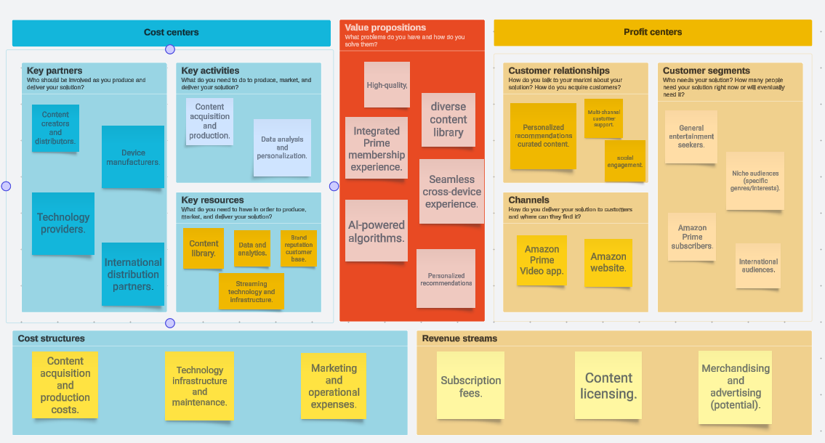
Strategy Frame-work Summary
Business canvas Model

Slide 9
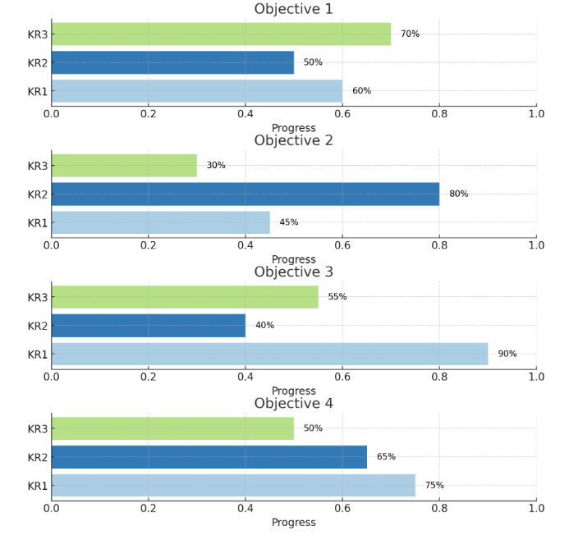
Strategy Framework Summary
OKRs

Slide 10
Recommended OKRs
1 Drive Market Leadership and Subscriber Growth:
Achieve 20% growth in global subscribers year-over-year.
Increase engagement in new markets by 15% within 6 months.
2 Foster Deep User Engagement and Satisfaction:
Boost viewer engagement by 18% through watch time and series completion metrics.
Reduce app crashes and streaming interruptions by 40%.

Slide 11

Analytical Methodologies and Frameworks
Methodological Diversity: Incorporating a mix of data cleansing, dimensional modeling, sentimental analysis and predictive analytics to derive actionable insights
Data Model Architecture: Explaining the star schema design with dimensions such as Genre, Director, and Release Date, and measures like Viewership Count and Engagement Score
Leveraging Predictive Analytics: Using advanced analytics techniques to enhance content recommendations and quantify engagement scores, fostering a proactive content strategy

Slide 12
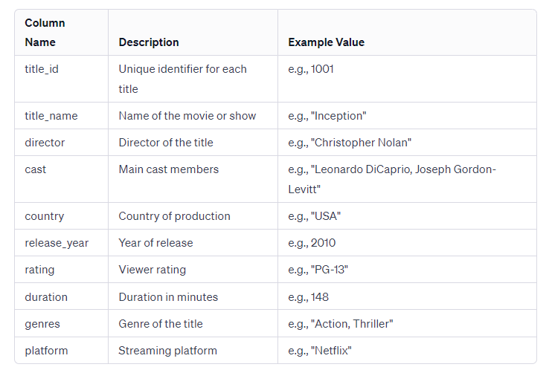
Strategic Approach for Amazon Prime Video
Dataset Overview
Data-Driven Transformation: Implementing an analytics-driven strategy to enhance content curation and viewer engagement
Objective: Gain deep insights into viewer preferences and market trends to inform strategic content decisions
Comprehensive Data Analysis: Utilizing aggregated data from multiple sources including Amazon Prime Video, Netflix, and Disney+, ensuring a broad market perspective

Slide 13

Why This Strategy?
Navigating a Competitive Landscape: Addressing the need for strategic differentiation in the highly competitive streaming market
Informed Decision Making: Emphasizing data analytics to understand and predict viewer behavior, driving content success
Anticipated Impact: Focusing on increased viewer retention and satisfaction, and achieving competitive differentiation through tailored content and personalized viewer experiences

Slide 14

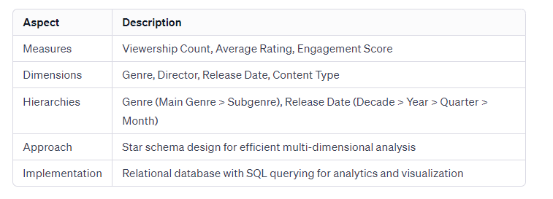
Dimensional Model Overview
Introduction to the Dimensional Model tailored for streaming media analytics
Key Measures: Viewership Count, Average Rating, Engagement Score – indicators of content popularity and viewer engagement
Core Dimensions: Genre, Director, Release Date, Content Type – providing a multi-faceted view of content
Hierarchical Analysis: Allowing exploration from broad categories to specific details
Dimensional Model for Amazon Prime

Slide 15
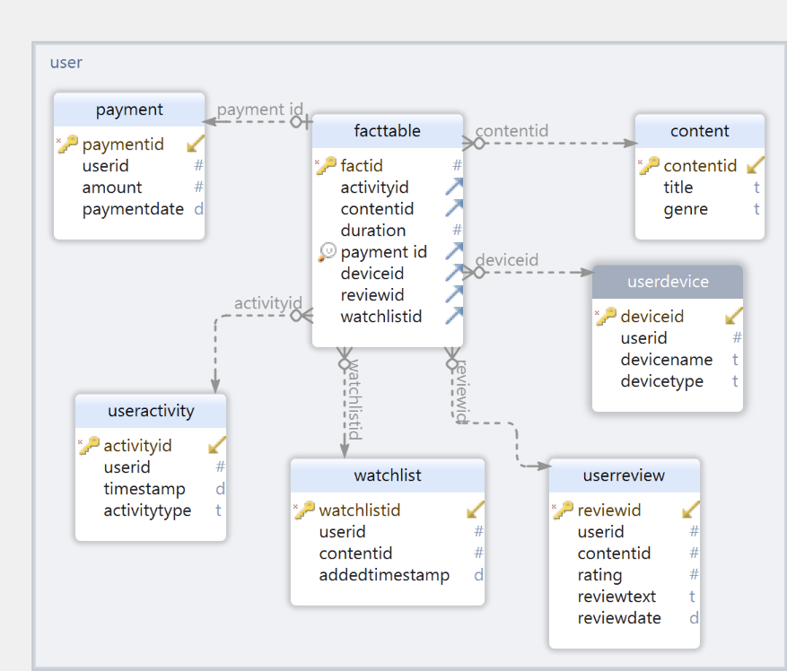
E R Diagram
ER diagram with our data model helps us understand it more visually.

Slide 16
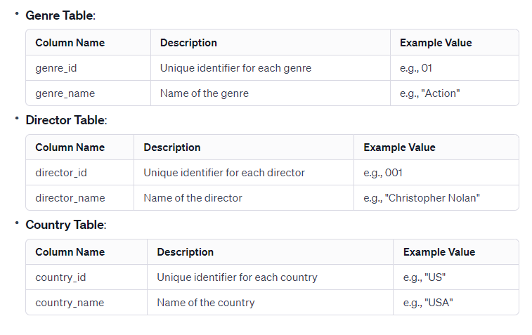
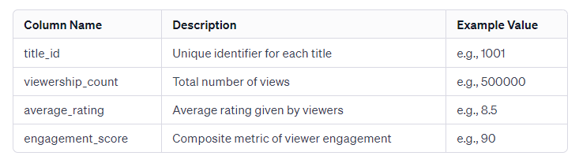
Structure of Our Data Model
Dimensional Table for Amazon Prime
Star Schema Design: Centralizing around fact tables for measures and linked to dimension tables for descriptive data
Fact Table: Contains key metrics like viewership and ratings, serving as the core of analysis
Dimension Tables: Detailed tables for Genre, Director, etc., offering context and granularity
Flexibility for Queries: Model designed for efficient and flexible querying, supporting various business intelligence tasks
Fact Table for viewer engagement analysis

Slide 17
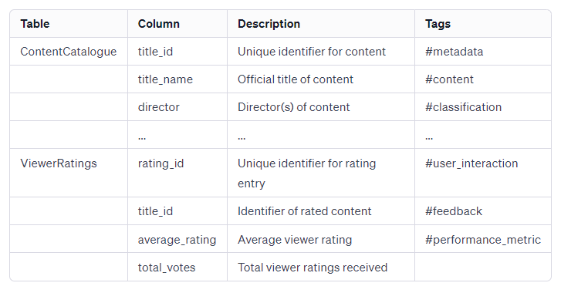
Governance Model & Data Dictionary
Importance of Governance: Ensuring data integrity, clarity, and usability
Data Dictionary Introduction: Central repository detailing elements like TitleID, Director, Genres with tags for easy identification
Highlighting Key Tables: ContentCatalogue and ViewerRatings with their respective roles and attributes
Tags for Streamlined Analysis: Utilization of tags like #metadata, #content, #user_interaction for automated reporting and data management
Dimensional Dictionary Key Tables

Slide 18

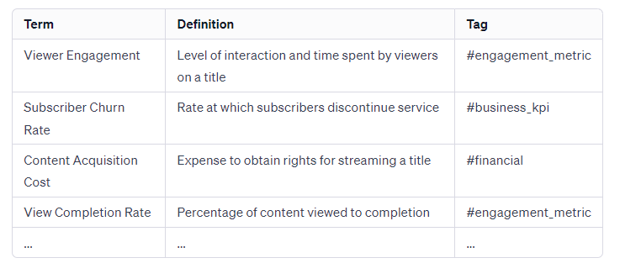
Business Glossary & Tagging System
Business Glossary
Role of Business Glossary: Providing definitions and high-level rules for key terms in analytics
Examples of Glossary Terms: Viewer Engagement, Subscriber Churn Rate, Content Acquisition Cost, each with a specific tag
Tags Enhancing Data Usability: Facilitating searchability and identification within data systems
Practical Application: How the glossary and tagging system simplify data analysis and report automation

Slide 19

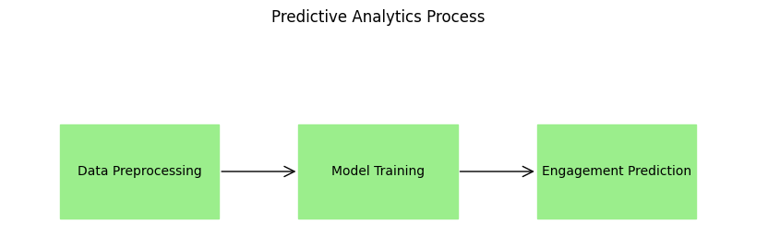
Analytics Use Case and Dataset

Slide 20
Analytics Use Case for Amazon Prime Video
Data Utilization: Leveraging viewership data, content metadata, and user interaction metrics
Predictive Analytics: Employing machine learning models to forecast engagement scores and content popularity
Business Impact: Informing content strategy, optimizing recommendations, and enhancing viewer satisfaction
Use Case Objective: Predicting viewer engagement and content success

Slide 21
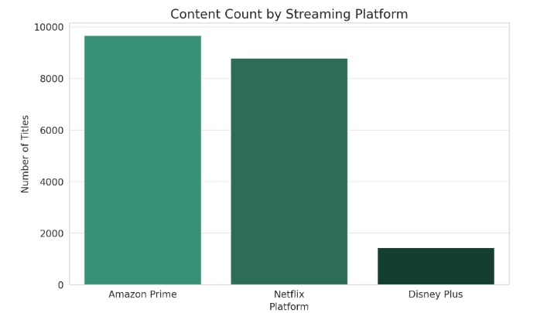
Dataset overview
In our dataset, there are videos from three platforms.
The Amazon Prime has the most videos.

Slide 22
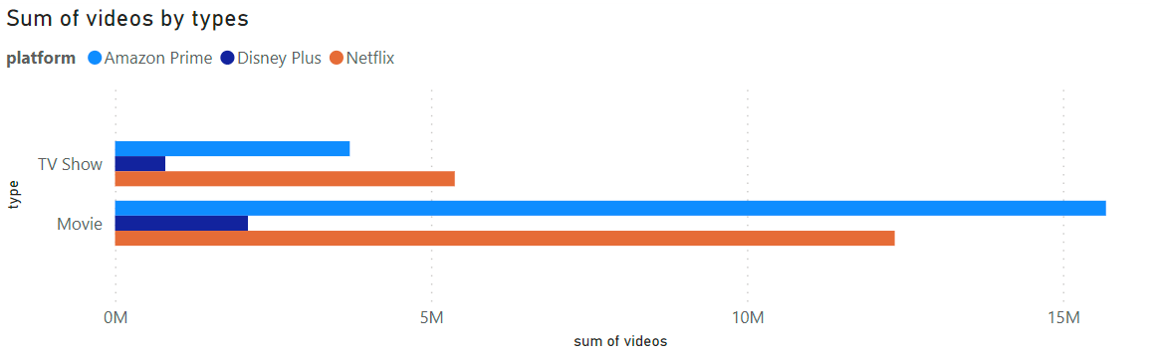
Video types
Two types of videos: TV Show and Movie.
For all three platforms, there are more movies than TV shows.

Slide 23
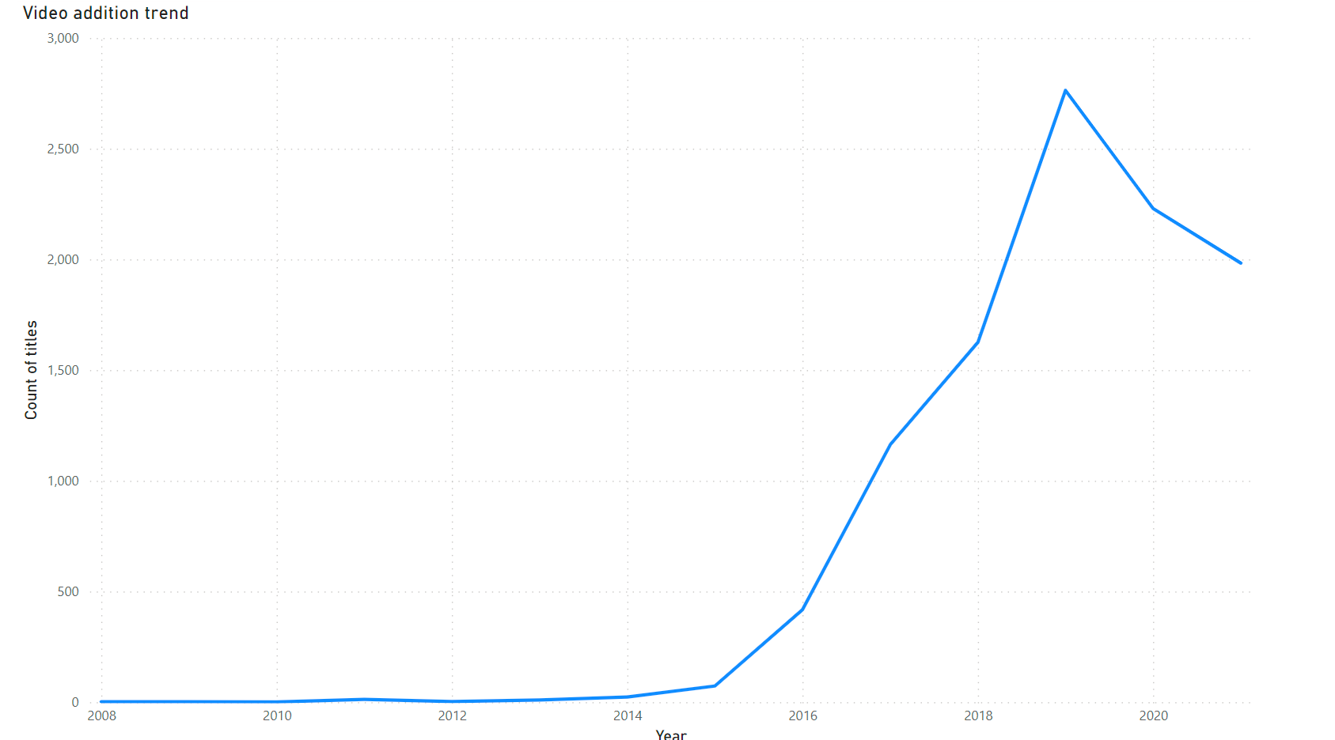
Video additions by year
Show the trend of video additions by year for the entire dataset.
The number of video additions is a growing trend before 2019.
After 2019, the number of video additions is down a little bit.

Slide 24
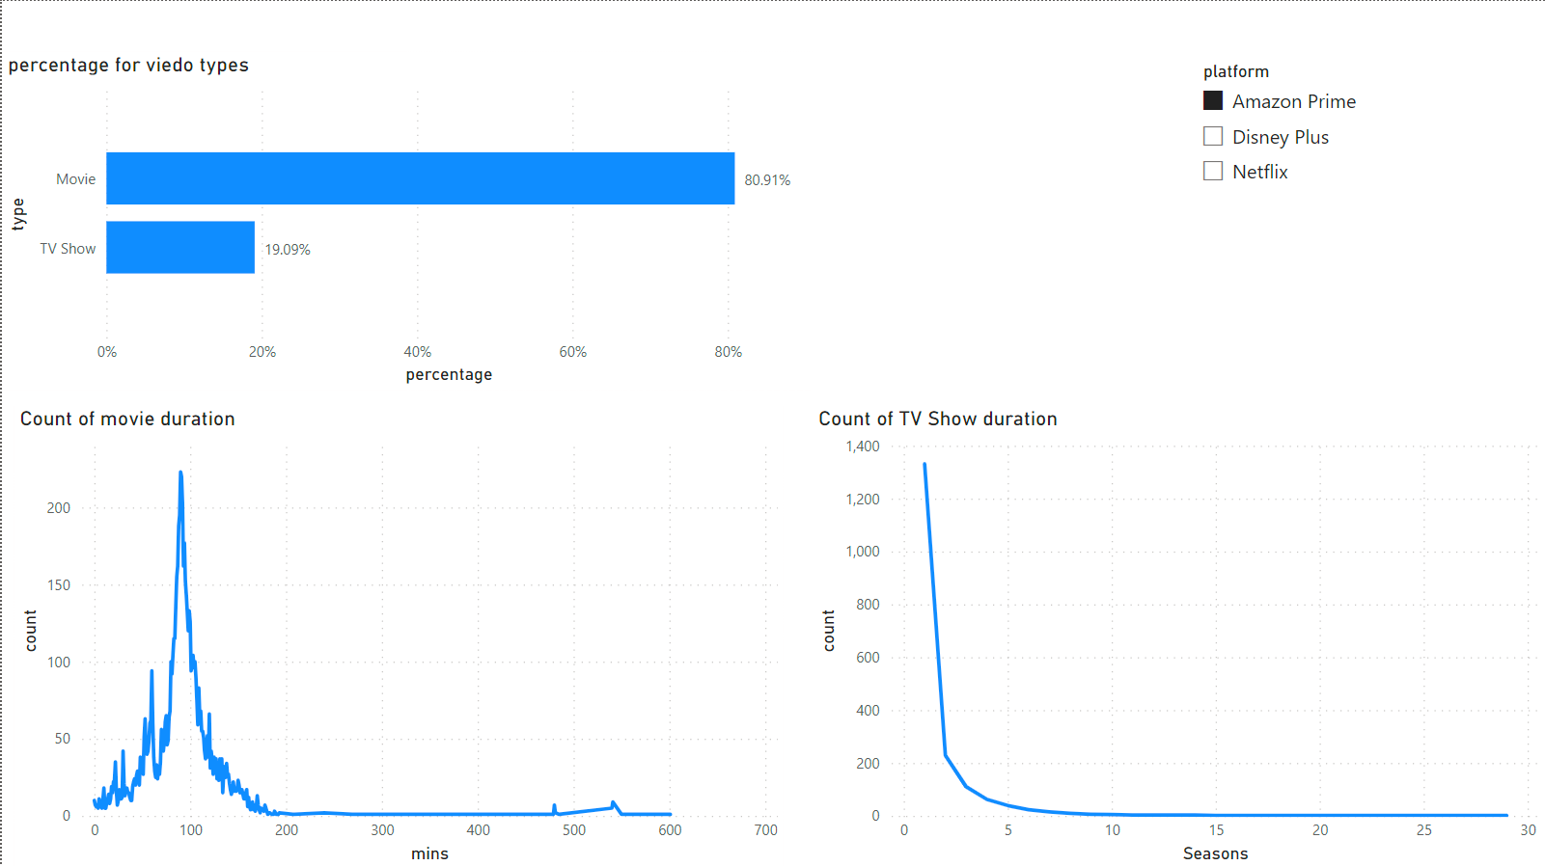
Amazon Prime
About 81% videos are movies in Amazon Prime.
Length of most movies are about 90 minutes.
There are some movies that have very long duration.
Most TV shows have just one season.

Slide 25
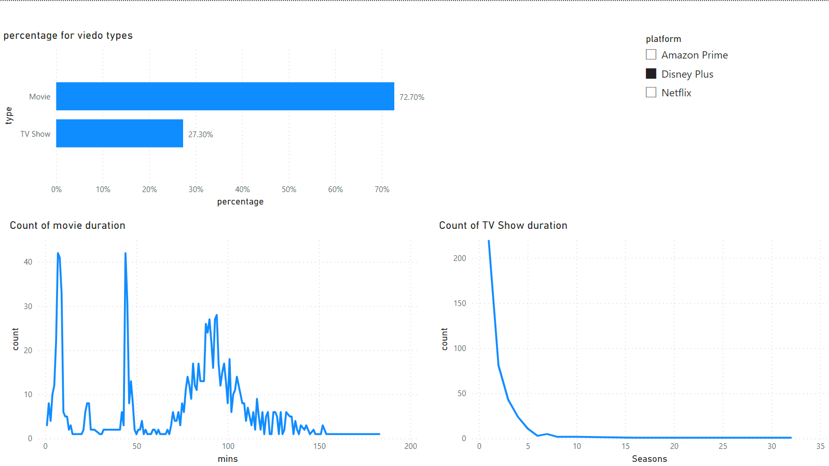
Disney Plus
About 73% videos are movies in Disney Plus.
There are multiple peaks in the movie length curve: 3, 44 and 90 minutes.
Most TV shows have just one season.

Slide 26
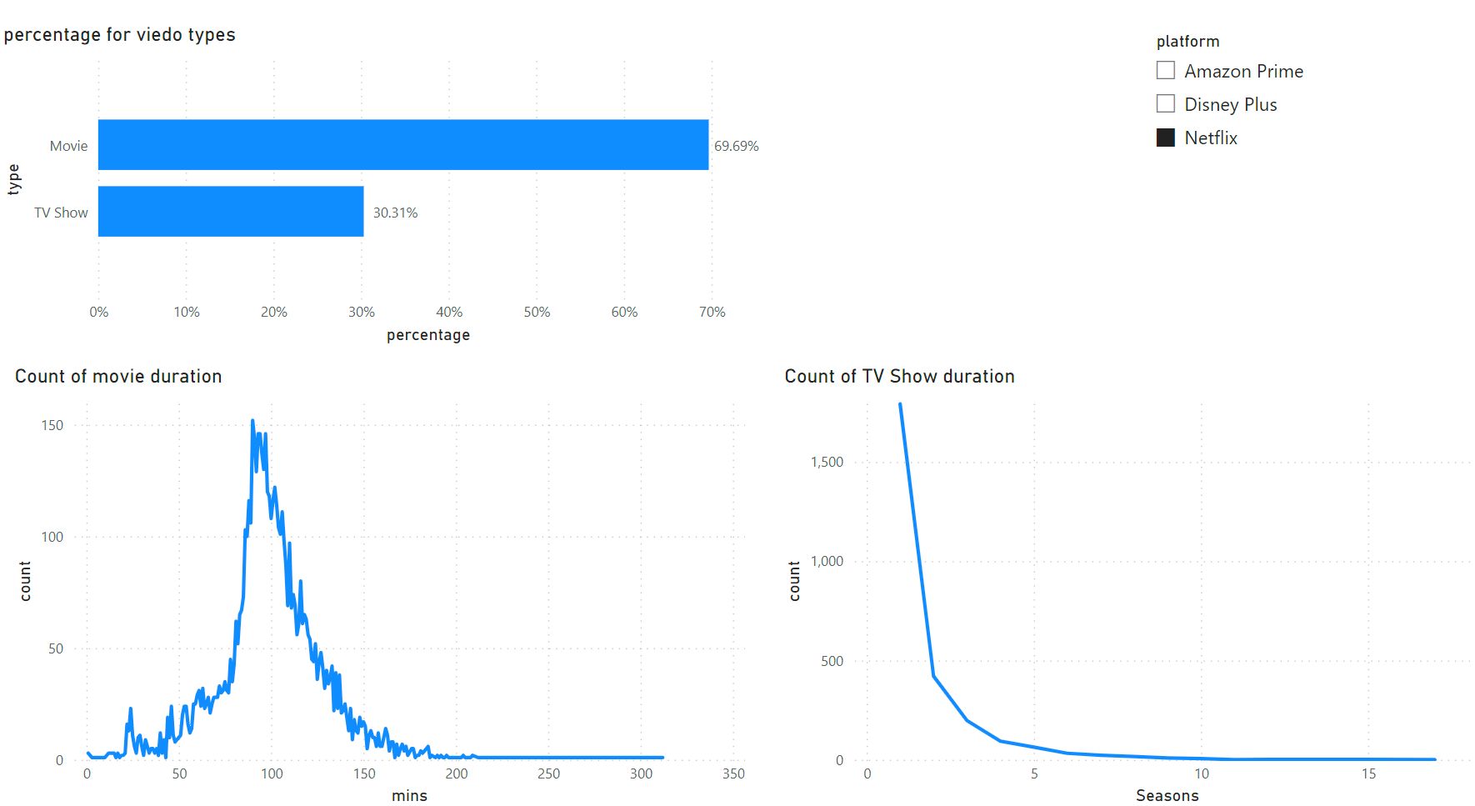
Netflix
About 70% videos are movies in Netflix.
Length of most movies are about 90 minutes.
Most TV shows have just one season.

Slide 27
Visualization: finding and suggestion
Amazon Prime has the most percentage of movies. It can consider to add more TV shows.
For all three platforms, most TV shows have just one season. Amazon Prime can consider to add more long TV shows to differentiate itself from other competitors after analyzing customers’ acceptance of long TV shows.
Amazon Prime can still focus on movies having 90 minutes duration. At the same time，it can also add more shorter movies.

Slide 28

Reflecting on Lessons and Looking Ahead
Embracing Flexibility: Adaptability in data strategies is key to navigating the dynamic streaming sector
Importance of Data Governance: Reinforced the need for robust data management and quality control
Ethical Analytics: Continuous focus on ethical considerations and bias mitigation in data analysis
Future Improvements: Integration of real-time data analytics and enhanced machine learning algorithms for deeper insights
Ongoing Evolution: Commitment to evolving our analytics capabilities in line with industry trends and technological advancements

Slide 29
Challenges Faced How we overcame...
Data Integration Complexities: Managing diverse data sources with varying formats
Ensuring Data Quality: Overcoming issues with data accuracy and completeness
Algorithmic Bias and Ethical Concerns: Addressing potential biases in predictive models
Scalability and Performance: Ensuring the analytics platform scales with growing data volumes
Adapting to Rapid Market Changes: Keeping pace with the fast-evolving streaming industry

Slide 30
Conclusion and Q&A
Project Summary: Successfully leveraged data analytics to analyze viewer engagement and content strategy for Amazon Prime Video.
Thank You for listening and being engaged to our presentation
We are Open for Questions

