Slide 1
PROJECT TITLE
Digital Subsidy &
Grant Administration Platform
Infosys Springboard Internship 7.0 - Batch 7

Slide 2
Project Overview
Why a dedicated platform is needed
1.Digital Government Platform – Manages the complete subsidy and grant lifecycle.
2.Automated Workflow – Streamlines eligibility evaluation and multi-level verification.
3.Controlled Disbursement– Enables milestone-based fund release and utilization tracking.
4.Secure & Transparent – Provides JWT authentication, RBAC, and complete audit trails.
5.Analytics & Monitoring– Offers regional insights and automated compliance monitoring.
🧮 Automated
Eligibility Scoring
🔍 Multi-Level
Verification
📊 Fund Utilization
Tracking
2

Slide 3
Problem Statement
Existing Problems
Need
A centralized and transparent digital platform to manage the complete subsidy lifecycle with automated eligibility, verification, approval, and fund tracking.
1.Manual & Slow Processing – Applications and verification often depend on time-consuming manual processes.
2.Inconsistent Eligibility – Lack of standardized evaluation can result in inconsistent eligibility decisions.
3.Verification & Approval Delays – Multiple verification and approval stages can delay fund distribution.
4.Poor Financial Transparency – Tracking application status, fund movement, and utilization is difficult.
5.Limited Monitoring & Auditability – Overdue milestones, unutilized funds, and regional performance are difficult to monitor centrally.
2

Slide 4
Proposed Solution
Our Solution
1.Centralized Beneficiary & Scheme Management – Digitizes beneficiary registration, KYC details, scheme configuration, budgets, eligibility criteria, and application management in one platform.
2.Automated Eligibility & Verification – Evaluates applications using configurable scoring rules, followed by structured field verification, district review, and finance approval.
3.Secure & Controlled Fund Management – Uses role-based access with JWT authentication and supports milestone-based disbursement with DBT/Treasury transaction tracking.
4.Fund Utilization & Compliance – Tracks expenditure, receipts, and utilization while automatically monitoring overdue milestones, unutilized funds, and compliance issues.
5.Analytics, Reporting & Accountability – Provides regional and scheme-level analytics, CSV reports, and a complete audit trail of applications, decisions, payments, and utilization.
1
2
5
3

Slide 5
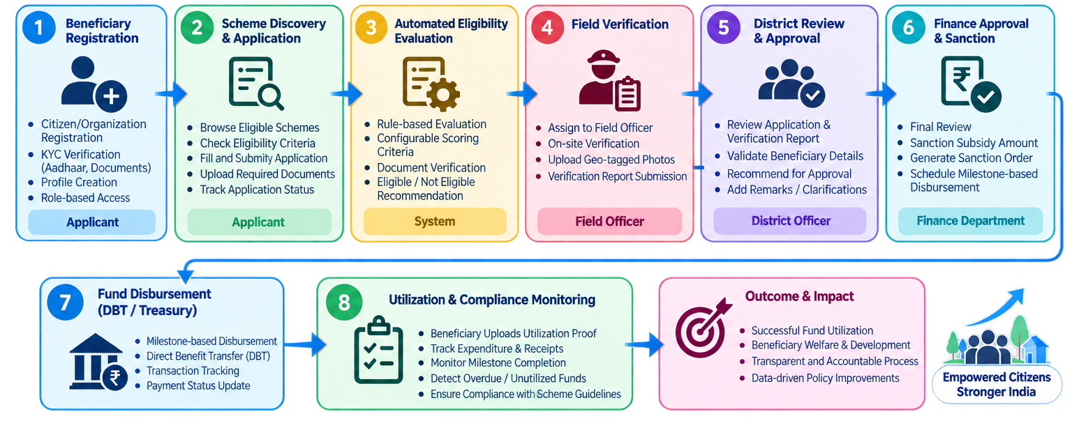
Work Flow
1
2
5
3

Slide 6
Technology Stack
Frontend
React.js
Vite
Tailwind CSS
Security
Spring Security
JWT
BCrypt
Backend
Java 17+
Spring Boot
JPA / Hibernate
REST APIs
Tools
Maven
Git / GitHub
Postman
Database
MySQL
Reporting Tools
CSV Export
8

Slide 7
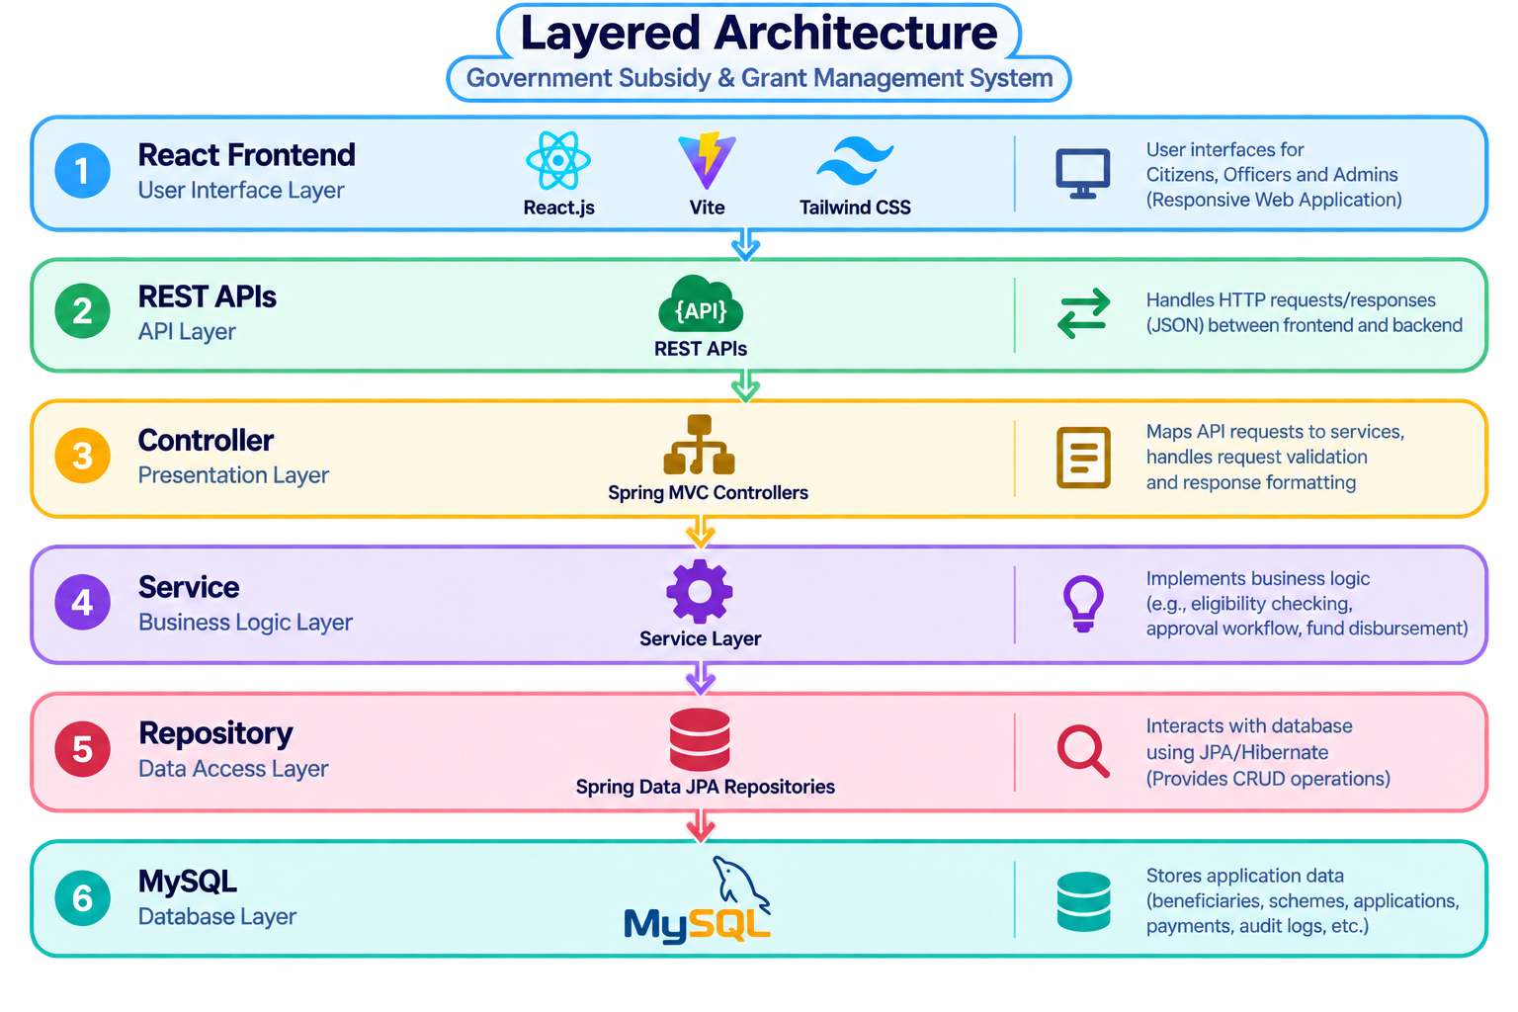
System Architecture
1
2
5
3

Slide 8
Key Features
ID
AI
DB
Single Sign-On Identity
Smart Eligibility Engine
Direct Benefit Transfer
Aadhaar / DigiLocker linked verification for one-time citizen onboarding.
Rule + ML based matching of citizens to applicable schemes automatically.
Real-time bank-linked disbursement with reconciliation and receipt proof.
TR
AU
GR
Live Status Tracking
Audit & Compliance
Grievance Redressal
Dashboard shows live — applied, verified, approved, credited.
Tamper Evident Audit Logs – Maintains traceable records of every important action
Users can raise issues, and unresolved applications are send to officers for quick action.
6

Slide 9
Expected Benefits & Impact
Faster Processing
Better Accuracy
Full Traceability
Easy Tracking
60%+
Zero
100%
24x7
Reduction in average disbursement time
Duplicate beneficiary claims via de-duplication
Fund-flow traceability for audits
Self-service application status access
Beyond efficiency, the platform builds public trust through transparency and equitable access to welfare benefits.
9

Slide 10
Future Scope
Roadmap for scaling and enhancement
1
Mobile Application
Develop a dedicated mobile app for beneficiaries to access schemes and track applications.
2
Multilingual Voice Access
Regional-language voice assistant for low-literacy and rural users.
3
AI & Intelligent Analytics
Introduce AI-based fraud detection and predictive beneficiary eligibility analysis.
4
Real-Time Notifications
Add SMS, email, and in-app alerts for application updates, approvals, and fund releases.
10

Slide 11
Conclusion
• Developed a centralized and controlled subsidy administration platform
• Digitizes the complete application-to-disbursement lifecycle
• Provides consistent application status progression at every stage
• Enables secure, role-based administration across stakeholders
• Supports structured eligibility, verification, approval and disbursement
• Provides a strong foundation for future government payment and digital document integration
11

Slide 12
1
THANK YOU
5
Digital Subsidy & Grant Administration Platform
3

