Slide 1
Express.js: Creating Routes and Handlers
Introduction to Routing in Node.js using Express
Presented by: Suraj Tiwari [04 Jun 2025]

Slide 2
What is Express.js?
A minimal and flexible Node.js web application framework.
Provides robust features for building web and mobile applications.
Helps manage routes, middleware, and more.

Slide 3
What is Routing?
Routing defines how an application responds to a client request to a particular endpoint (URI + HTTP method).
Each route can have one or more handler functions.
Common HTTP methods: GET, POST, PUT, DELETE

Slide 4
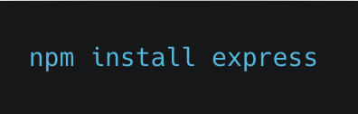
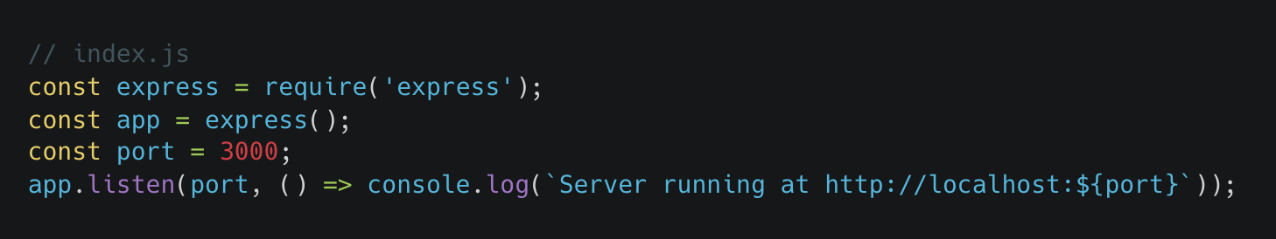
Setting Up Express.js
Installation
Creating First server

Slide 5
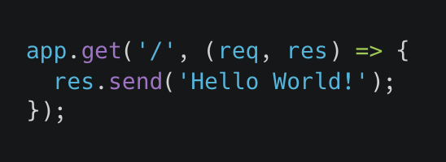
Creating a Simple GET Route
Example:
Responds with "Hello World!" when user accesses the root URL.

Slide 6
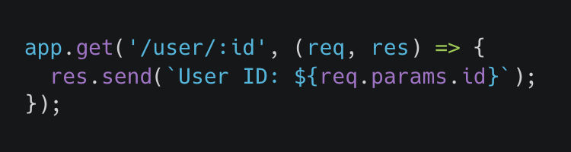
Route with Parameters
Dynamic Routes:
Parameters captured using `req.params`

Slide 7
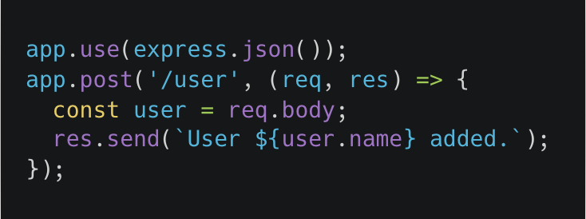
POST Handler Example
Using middleware to parse JSON:

Slide 8
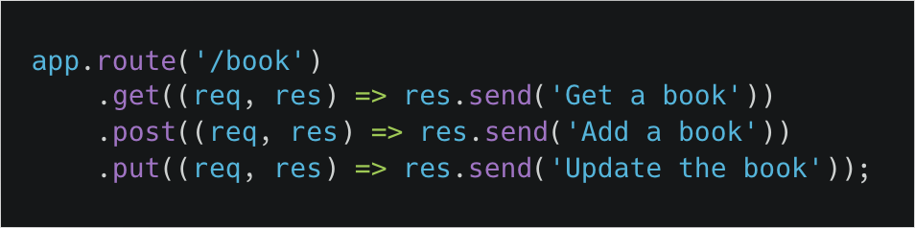
Chaining Route Methods
Cleaner code for multiple methods:

Slide 9
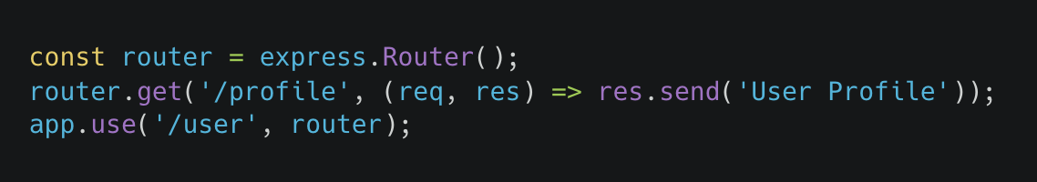
Organizing Routes with Router
Modular routing using `express.Router()`:

Slide 10
Summary
Express routes handle client requests.
Use different methods for different actions (GET, POST, etc.).
Organize code using Router.
Practice is key to mastering Express routing.

