Slide 1


Loan Prediction System Using Machine Learning
Group – 07
By - Shreyas Kalamkar, Vijay Chaudhary
Center Coordinator Project Guide
Mr. Rohit Puranik Dr Shantanu Pathak

Slide 2
Contents
Understanding the problem statement
About the dataset
Load essential Python Libraries
Load Training/Test datasets
Data Preprocessing
Exploratory data analysis (EDA)
Build Machine Learning Model
Making prediction on test datasets
Deployment

Slide 3
Problem Statement
The primary goal of this project is to extract patterns from the credit card transactions data from the dataset and use the trained models to predict eligibility of any customer based on his spending behaviour. Training of the models will be done using two different ML models and after the training is done the ML models will be compared based on their accuracy score and f1-score and the best model will be selected which will then be used to make predictions for the customer. The prediction which is given by our system will give the customer the knowledge whether he is eligible for loan or not.

Slide 4
As mentioned above this is a Binary Classification problem in which we need to predict our Target label which is “Loan Status”.
Loan status can have two values: Yes or NO.
Yes: if the loan is approved
NO: if the loan is not approved
So using the training dataset we will train our model and try to predict our target column that is “Loan Status” on the test dataset.

Slide 5
About the Dataset
In our dataset there are around 21 unique columns in parquet and 3 columns in csv file.
And there are around 27 cr (rows) in our data set
app_id: integer (nullable = true)
amnt: double (nullable = true)
currency: integer (nullable = true)
operation_kind: integer (nullable = true)
card_type: integer (nullable = true)
operation_type: integer (nullable = true)
operation_type_group: integer (nullable = true)
ecommerce_flag: integer (nullable = true)
payment_system: integer (nullable = true)
income_flag: integer (nullable = true)
mcc: integer (nullable = true)

Slide 6
country: integer (nullable = true)
city: integer (nullable = true)
mcc_category: integer (nullable = true)
day_of_week: integer (nullable = true)
hour: integer (nullable = true)
days_before: integer (nullable = true)
weekofyear: integer (nullable = true)
hour_diff: long (nullable = true)
transaction_number: integer (nullable = true)
__index_level_0__: long (nullable = true)
app_id: integer (nullable = true)
product: integer (nullable = true)
flag: integer (nullable = true)

Slide 7
Load essential Python Libraries
import pyspark
from pyspark.sql.types import *
from pyspark.sql import functions
from pyspark.sql.functions import *
from pyspark.ml.feature import VectorAssembler
from pyspark.ml.classification import RandomForestClassifier
from pyspark.ml.tuning import ParamGridBuilder
from pyspark.ml.tuning import TrainValidationSplit
from pyspark.ml.evaluation import BinaryClassificationEvaluator
from pyspark.ml import Pipeline
from sklearn import metrics import matplotlib.pyplot as plt

Slide 8
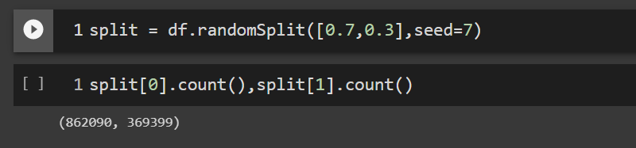
Load Training/Test datasets

Slide 9

Data Preprocessing
dropping the unwanted column :
Identify Missing Values: There are no any missing values in our dataset.

Slide 10
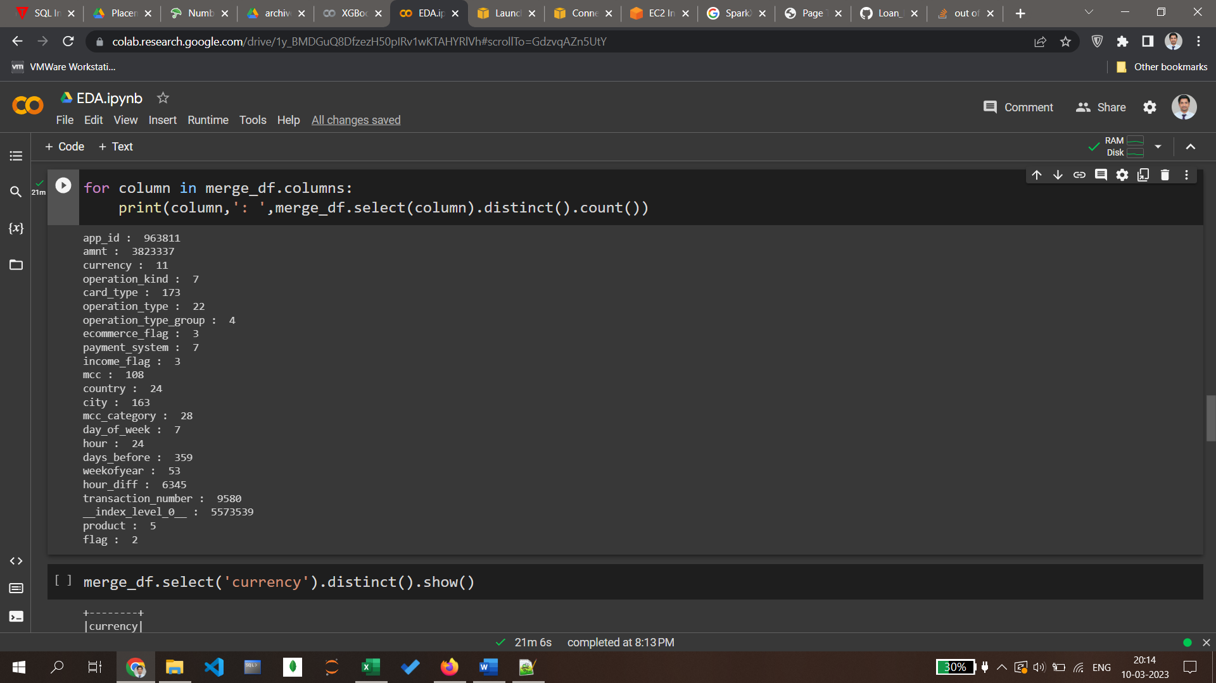
Exploratory data analysis (EDA)
Distinct values in each column of the dataset

Slide 11
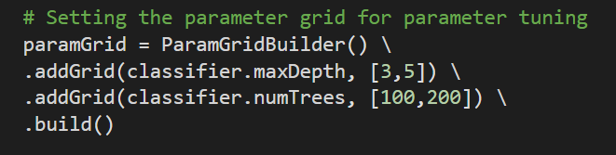
Build Machine Learning Model
In Building ML model we use RandomForset.
We train model on AWS EMR(Elastic MapReduce)
It is based on the concept of ensemble learning, which is a process of combining multiple classifiers to solve a complex problem and to improve the performance of the model.
To fine tuning the parameters we use ParamGridBuilder.

Slide 12
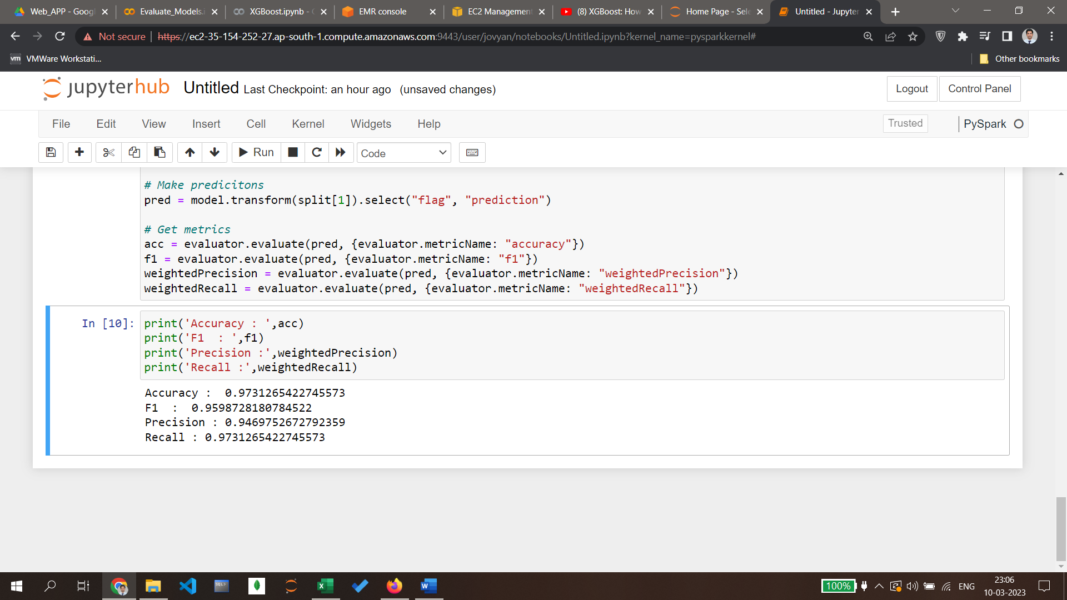
Making prediction on test datasets
After training our model we get accuracy, precision, recall and f1 score as.
Accuracy : 0.9732311608134088
F1 : 0.9600283141563276
Precision : 0.9471788923782151
Recall : 0.9732311608134088
AUC : 0.5

Slide 13
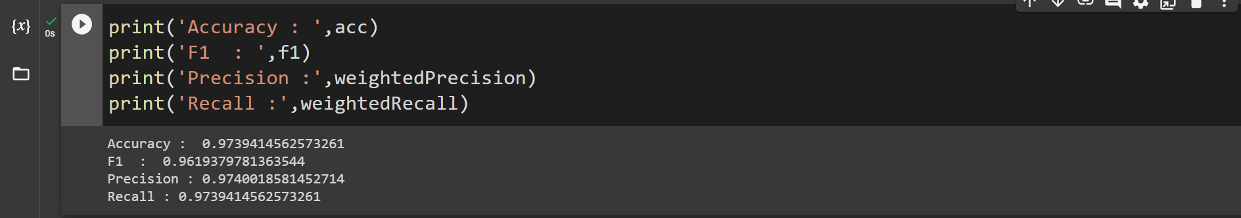
XGBoost
XGBoost is a decision-tree-based ensemble Machine Learning algorithm that uses a gradient boosting framework.

Slide 14
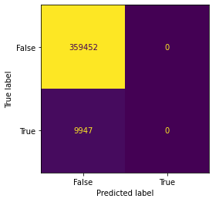
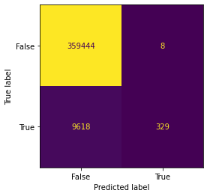
Model Comparison
RandomForest
XGBoost
Accuracy : 0.9732311608134088
F1 : 0.9600283141563276
Precision : 0.9471788923782151
Recall : 0.9732311608134088
AUC : 0.5
Accuracy0.9739414562573261
F1 : 0.9619379781363544
Precision:0.97400185814527
Recall:0.9739414562573261

Slide 15


Deployment
After training our model we make a web application using flask in that we take two value one is customer Id and application ID.
For deployment we create a AWS EC2 instant and here we deploy our web application using docker.
For prediction our model what we take from user we fetch the data from HBase which is on our AWS EC2 install we fetch the data and give to our model
Then our model predict the user is eligible for loan or not.

