Slide 1


K.RAMAKRISHNAN COLLEGE OF TECHNOLOGY
(AUTONOMOUS), TRICHY
SMART PARKING SYSTEM
PRESENTED BY SUPERVISOR
VIJAYESWARAN V S Mr.A. Malarmannan, M.E.,
2303811710421177 AP/CSE.

Slide 2
PRESENTATION OVERVIEW
Objective
Project Introduction
Problem Statement
Methodologies (Programming concepts relevant to problem statement)
Architecture of the proposed system
List of Modules
7. Merits
8. Results and Discussion
9. Queries

Slide 3
OBJECTIVE
The primary objective of a Smart Parking System is to optimize the utilization of parking spaces and enhance the overall parking experience for users. By leveraging advanced technologies such as IoT, sensors, and data analytics, the system aims to reduce the time drivers spend searching for parking, thereby decreasing traffic congestion and lowering vehicle emissions.

Slide 4
PROJECT INTRODUCTION
A smart parking system is an innovative technology that uses sensors, IoT (Internet of Things) devices, and data analytics to optimize the process of parking. It helps drivers locate available parking spaces in real-time, reducing time spent searching for a spot, minimizing traffic congestion, and lowering emissions. The system can also offer features like automated payment, reservation systems, and dynamic pricing.

Slide 5
PROBLEM STATEMENT
Growing urbanization and increasing vehicle numbers lead to a shortage of available parking spaces.
Idle driving in search of parking contributes to higher fuel consumption and increased emissions.
Traditional parking systems lack the ability to provide real-time information about available spaces.
Drivers spend excessive time searching for vacant spots, causing traffic congestion.

Slide 6
METHODOLOGIES
Sensor-Based Monitoring: Uses IoT sensors to detect available parking spots in real-time.
Mobile App Integration: Provides real-time parking info, reservations, and payments through a mobile app.
Cloud Computing & Data Analytics: Analyzes parking data to optimize space usage and enable dynamic pricing.
Automated Payment & Reservation: Enables online booking and automatic payment for a seamless parking experience.

Slide 7
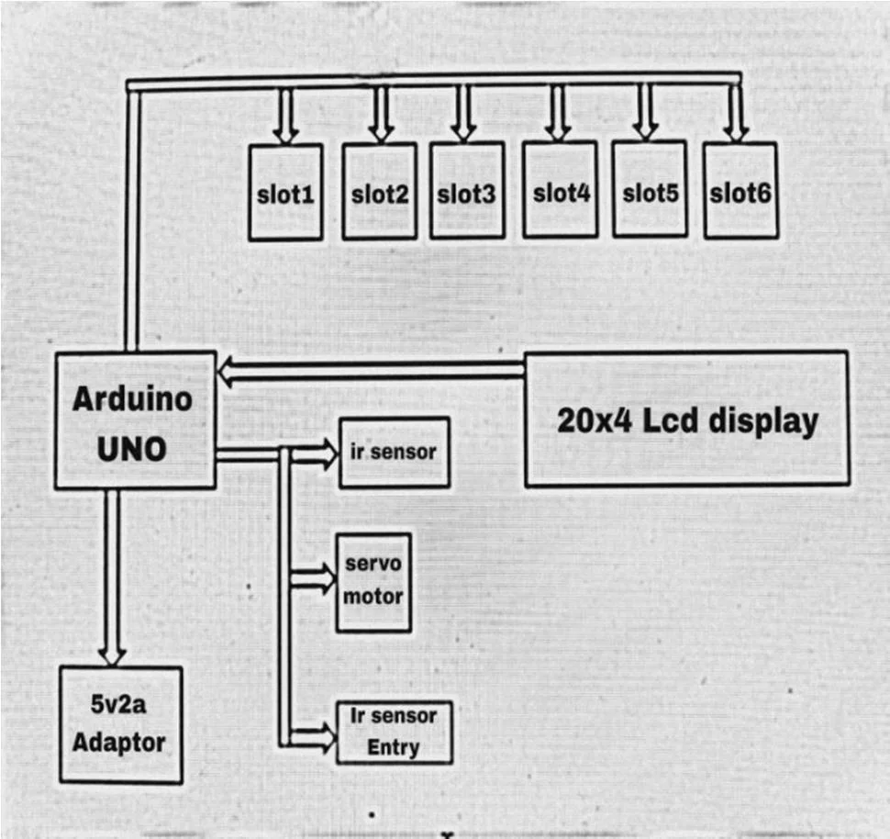
ARCHITECTURE OF THE PROPOSED SYSTEM

Slide 8
LIST OF MODULES
Parking Space Detection Module
User Interface (UI) Module
Payment Gateway Module
Reservation and Booking Module
Parking Analytics Module
Notification System Module
Admin Management Module

Slide 9
MERITS
Minimizes road congestion caused by vehicles circling to find parking.
Optimizes parking space utilization, reducing operational costs for parking operators.
Offers convenient features like mobile reservations and cashless payments.
Decreases fuel consumption and emissions due to reduced search times.
Quickly guides drivers to available parking spots, reducing the time spent searching.

Slide 10
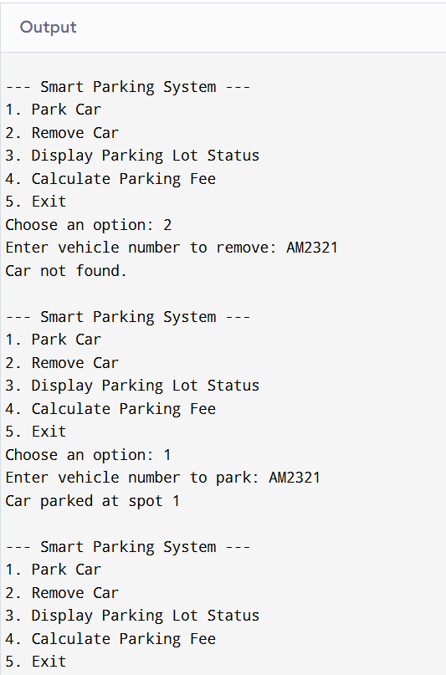
RESULTS AND DISCUSSION

Slide 11
Any Queries ?

