Slide 1

Presented by:
Vinayaka Madhava Shrestha Paka — 2023ebcs755
Vijay Gaurav — 2023ebcs667
Naresh Kumar T — 2023ebcs684
Shravanth V — 2023ebcs703
Farmer Groceries
A Direct Farm-to-Consumer Marketplace Mobile App
BSc CS · Academic Year 2025–26
github.com/Vijaygaurav2004/Farmer_groceries
Under the guidance of
Prof Raj Kumar
Notes:
[0:00 - 0:30] Opening
"Good morning. My capstone is Farmer Groceries - a React Native app that removes the
middlemen between a farmer and the person who eats the food."
One line on why: the farmer keeps a quarter of what you pay; I wanted to see what the
software would have to look like to change that.
Say up front: "I'll spend about five minutes on the problem and design, five on a live
demo, and the rest on results and limitations."

Slide 2
Problem Statement
Background
Produce reaches the plate through 5+ intermediaries: farmer → trader → commission agent → wholesaler → retailer → consumer
Each hop adds margin and a day of transit — nobody in the chain is accountable for freshness.
Gap in the existing system
Grocery apps digitise the retailer, not the grower — inventory is platform-owned, so the farmer has no storefront, no pricing control and no visibility.
Farmer, customer and delivery partner use three unconnected tools, so order state is never shared — trust falls back on phone calls.
Why the problem matters
Farmers keep only 20–25% of the final retail price, while consumers pay a 200–300% markup.
A 3–7 day farm-to-table journey spoils 30–40% of the harvest — income lost at the farm gate and food lost in transit are the same problem.
Notes:
[0:30 - 2:00] Problem (1 min 30)
Anchor the chain in one sentence, then land the three numbers - 20-25% / 200-300% / 30-40%.
The pivot line the panel should remember:
"Existing grocery apps solved the CONSUMER's problem. They digitised the retailer.
The farmer is still a back-end supplier with no shopfront."
Second gap - and this is the one my architecture answers: the three actors never see the
same order. That is what a shared order state model fixes.
Do NOT read the sub-bullets aloud. Speak to the headers.

Slide 3
Objectives & Scope
Objectives
Remove the middlemen — no trader, agent, wholesaler or retailer between farm and household.
Serve all three actors from one codebase — farmer, customer and delivery partner, on Android, iOS and web.
Shorten the chain to farmer → delivery partner → consumer, so the grower sets the price and keeps the margin.
Make the order transparent with a single 8-state lifecycle that all three roles read and write.
Give farmers self-service — list produce, set price and stock, accept and pack orders, track earnings.
Keep every screen working offline, while remaining deployable against a real cloud database.
Scope
In scope: role-based auth and routing; catalogue across 8 produce categories; cart, checkout and payment-method selection; farmer fulfilment; delivery assignment and tracking; earnings dashboards; profiles for all three roles.
Out of scope: real payment settlement, live GPS navigation, push notifications, multi-language and multi-city rollout.
Notes:
[2:00 - 3:00] Objectives & Scope (1 min)
Read only the five bold lead-ins - they are the five objectives.
Objective 5 is worth a beat: "zero backend setup" is why you can run this demo on a
laptop with no internet, and it is a deliberate engineering decision, not a shortcut -
I'll show how the service layer does it on the architecture slide.
State the out-of-scope list plainly and quickly. Naming your own boundaries before the
panel does buys you credibility, and it defuses the obvious questions.

Slide 4
Existing System / Literature Review
Traditional mandi / APMC chain — physical auction at a regulated market. Price discovery favours the licensed trader; the farmer never meets the buyer.
e-NAM (National Agriculture Market) — digitises the mandi auction across states, but the buyer at the other end is still a trader, not the household that eats the food.
Online grocery & q-commerce apps — excellent consumer experience, but inventory is owned by the platform. The farmer is an upstream supplier: no storefront, no pricing control, no order visibility.
FPO and WhatsApp direct-selling groups — genuinely disintermediated and increasingly common, but entirely manual: no catalogue, no stock, no order state, no delivery tracking, no earnings record.
Limitations common to all four
None gives the grower a first-class, self-served storefront with pricing and inventory control.
Delivery is either absent (WhatsApp) or invisible to the seller (marketplaces).
No shared order state across farmer, customer and delivery partner — the gap this project targets.
Notes:
[3:00 - 4:00] Existing System (1 min)
Four rows, one sentence each. The arc is: mandi is offline, e-NAM digitised the wrong
end of the chain, q-commerce digitised the retailer, WhatsApp got the model right but
has no software.
Land the closing line: "Each one solves a piece. None of them puts the farmer, the buyer
and the courier in front of the SAME order."
That sentence is the bridge into the architecture slide - say it and click straight on.

Slide 5
Proposed System Architecture
PRESENTATION
Expo Router 6
(auth)
Login / Sign-up
role select
(customer)
7 screens
browse · cart · track
(farmer)
4 screens
products · orders
(delivery)
4 screens
route · earnings
STATE
React Context
AuthContext
session · role · navigation guard
CartContext
line items · totals · delivery fee
SERVICE
TypeScript
SupabaseService — one API surface for every screen
auth · products & stock · orders · status transitions · earnings
if (isSupabaseConfigured) … else
DATA
runtime switch
Supabase (cloud)
Auth · PostgreSQL · Storage
used when .env is configured
localStore (on-device)
catalogue + orders in AsyncStorage
used when no cloud backend is set
One codebase, three role-scoped apps. A navigation guard routes each signed-in user into their own screen group; every screen talks to a single service layer, and that layer picks its backend at runtime — so every screen keeps working offline and the same code still deploys against a real cloud database.
Notes:
[4:00 - 6:00] Architecture (2 min) - the slide the panel will grade you on
Walk it TOP DOWN, one sentence per tier:
1. PRESENTATION - Expo Router gives file-based routing. Each folder in brackets is a
route group: (auth), (customer), (farmer), (delivery). 18 screens in total.
2. STATE - two React contexts. AuthContext holds session + role and drives the guard
that decides which group you're allowed into. CartContext holds the basket.
3. SERVICE - every screen calls SupabaseService. No screen touches a database directly.
That single seam is what makes the next line possible.
4. DATA - the service checks isSupabaseConfigured. Configured -> Supabase Postgres.
Not configured -> demoStore, seeded data persisted with AsyncStorage.
The one-sentence takeaway if you only get to say one thing:
"The service layer is the seam. Because every screen goes through it, I can swap the
entire backend at runtime without touching a single screen - that is what you're
about to see running with no internet."
Likely question: "Why not just always use Supabase?"
Answer: reproducibility. The demo has to run identically on any machine, offline, with
no credentials - and the seam costs nothing, because the screens were already isolated.

Slide 6
Tools & Technologies
Layer | Technology
Language | TypeScript 5.9 — fully typed domain model (User, Product, Order, Delivery)
Framework | React Native 0.81.5 on Expo SDK 54 — single codebase, three targets
Navigation | Expo Router 6 — file-based routing with typed routes and route groups
UI & styling | NativeWind 4 (Tailwind for RN), 12 shared components, Expo Vector Icons
Animation | Moti + React Native Reanimated 4 — transitions on the UI thread
State | React Context — AuthContext (session + role), CartContext (basket)
Backend | Supabase — Auth, PostgreSQL, Storage (optional, enabled via .env)
On-device data | AsyncStorage-backed local store — catalogue and orders survive restarts
Tooling | Metro bundler, Expo Go, Git & GitHub (43 commits), VS Code
Targets | Android · iOS · Web — from the same source tree
Testing | Puppeteer + Chrome DevTools Protocol — 40 automated end-to-end cases (npm test)
Notes:
[6:00 - 6:45] Tools & Technologies (45 sec) - move fast, this is a reference slide
Do not read the table. Say three things and click on:
"TypeScript end to end - the domain model is typed, so an order status is a union type,
not a string, and an invalid transition fails at compile time."
"React Native on Expo - one codebase compiles to Android, iOS and web."
"Supabase is optional. That's the runtime switch from the last slide."
If asked why Expo over bare React Native: managed workflow, Expo Go means a grader
scans a QR code instead of installing a toolchain, and expo-router gives typed
file-based routing out of the box.

Slide 7
Implementation / Demo
Live demo — one device, one order, three roles
1. Customer — browse 8 categories → open a product → add to cart → address and payment method → place the order
2. Farmer — the new order appears on the dashboard → confirm → pack → stock and earnings update live
3. Delivery partner — accept the order → Picked Up → Out for Delivery → Delivered → earnings credited
4. Back to the customer — the 7-step tracker has followed every one of those moves
What to watch while I click
A single order object moving through a shared 8-state lifecycle — placed → confirmed → packed → assigned → picked up → out for delivery → delivered (plus cancelled).
Stock decremented on the farmer side by the exact quantity the customer bought; cart total, ₹30 delivery fee (free over ₹500) and the farmer’s payout all reconcile.
Full walk-through recording (13:34): https://youtu.be/nWjFOKCmPD8
Notes:
[6:45 - 11:30] LIVE DEMO (4 min 45) - the centre of the presentation
BEFORE YOU START: app already running, on the role-select screen, notifications off,
screen mirroring confirmed. Have the app pre-warmed - never boot Metro in front of a panel.
Narrate the ROLE SWITCH each time - it is the thing that makes the demo legible:
"Same device. I'm now the farmer looking at the order I just placed as a customer."
Timing guide:
Customer ~1:45 browse -> product detail -> cart -> checkout -> place order.
Pause on the cart: point at the free-delivery progress bar.
Farmer ~1:15 dashboard -> confirm -> pack. Point at stock dropping.
Delivery ~1:15 accept -> picked up -> out for delivery -> delivered -> earnings.
Customer ~0:30 reopen the tracker. Seven steps, all filled in. Land the point.
Closing line of the demo: "One order, three roles, one shared state - and every screen
you just saw was reading through that same service layer."
IF SOMETHING BREAKS: don't debug live. Say "let me show you the state it reaches" and
move to the already-seeded delivered order (FG-1001). Recovery beats fixing.

Slide 8
Results & Analysis
18
screens across
3 role modules
~5,400
lines of
TypeScript
8
order states,
shared by all roles
43
commits over
6 months
Verified end to end by 40 automated cases (25 functional, 15 validation): an order placed as a customer is confirmed and packed by the farmer, delivered by the partner and reflected in the customer’s 7-step tracker. Cart total, ₹30 delivery fee (waived over ₹500), stock decrement and farmer payout reconcile at every step.
Modelled impact of removing the intermediaries
Measure | Traditional chain | Farmer Groceries
Intermediaries between farm and plate | 5 or more | 1 — the delivery partner
Share of final price kept by the farmer | 20–25% | Farmer sets the price; only delivery is deducted
Farm-to-table time | 3–7 days | Same or next day
Order visibility for the three actors | Phone calls; no shared record | One order, 8 shared states, live to all three
The right-hand column is the design target of the delivered system, not a measured field trial; the left-hand figures are the widely reported ranges for the Indian produce chain. Field validation with a real farmer cohort is the next step.
Notes:
[11:30 - 13:00] Results & Analysis (1 min 30)
Split this cleanly into WHAT I BUILT and WHAT IT WOULD MEAN - and be explicit that they
are different kinds of claim. That distinction is what separates a good capstone from
an overclaimed one, and a panel will reward you for drawing it yourself.
Built (the tiles + the verified line): 18 screens, ~5,400 lines of TypeScript, an
8-state order model, working end to end offline on one device. That is measured.
Modelled (the table): the right-hand column is what the ARCHITECTURE implies - one
intermediary instead of five, the farmer setting the price. Say the words out loud:
"I want to be precise here - the right-hand column is a design target, not a field
trial. I have not put this in front of a real farmer cohort yet. That's next."
Expected question: "How do you know farmers would get more?"
Answer: I don't, yet - what I can show is that the software removes the structural
reason they get less. Validating it needs a pilot, which is in future work.

Slide 9
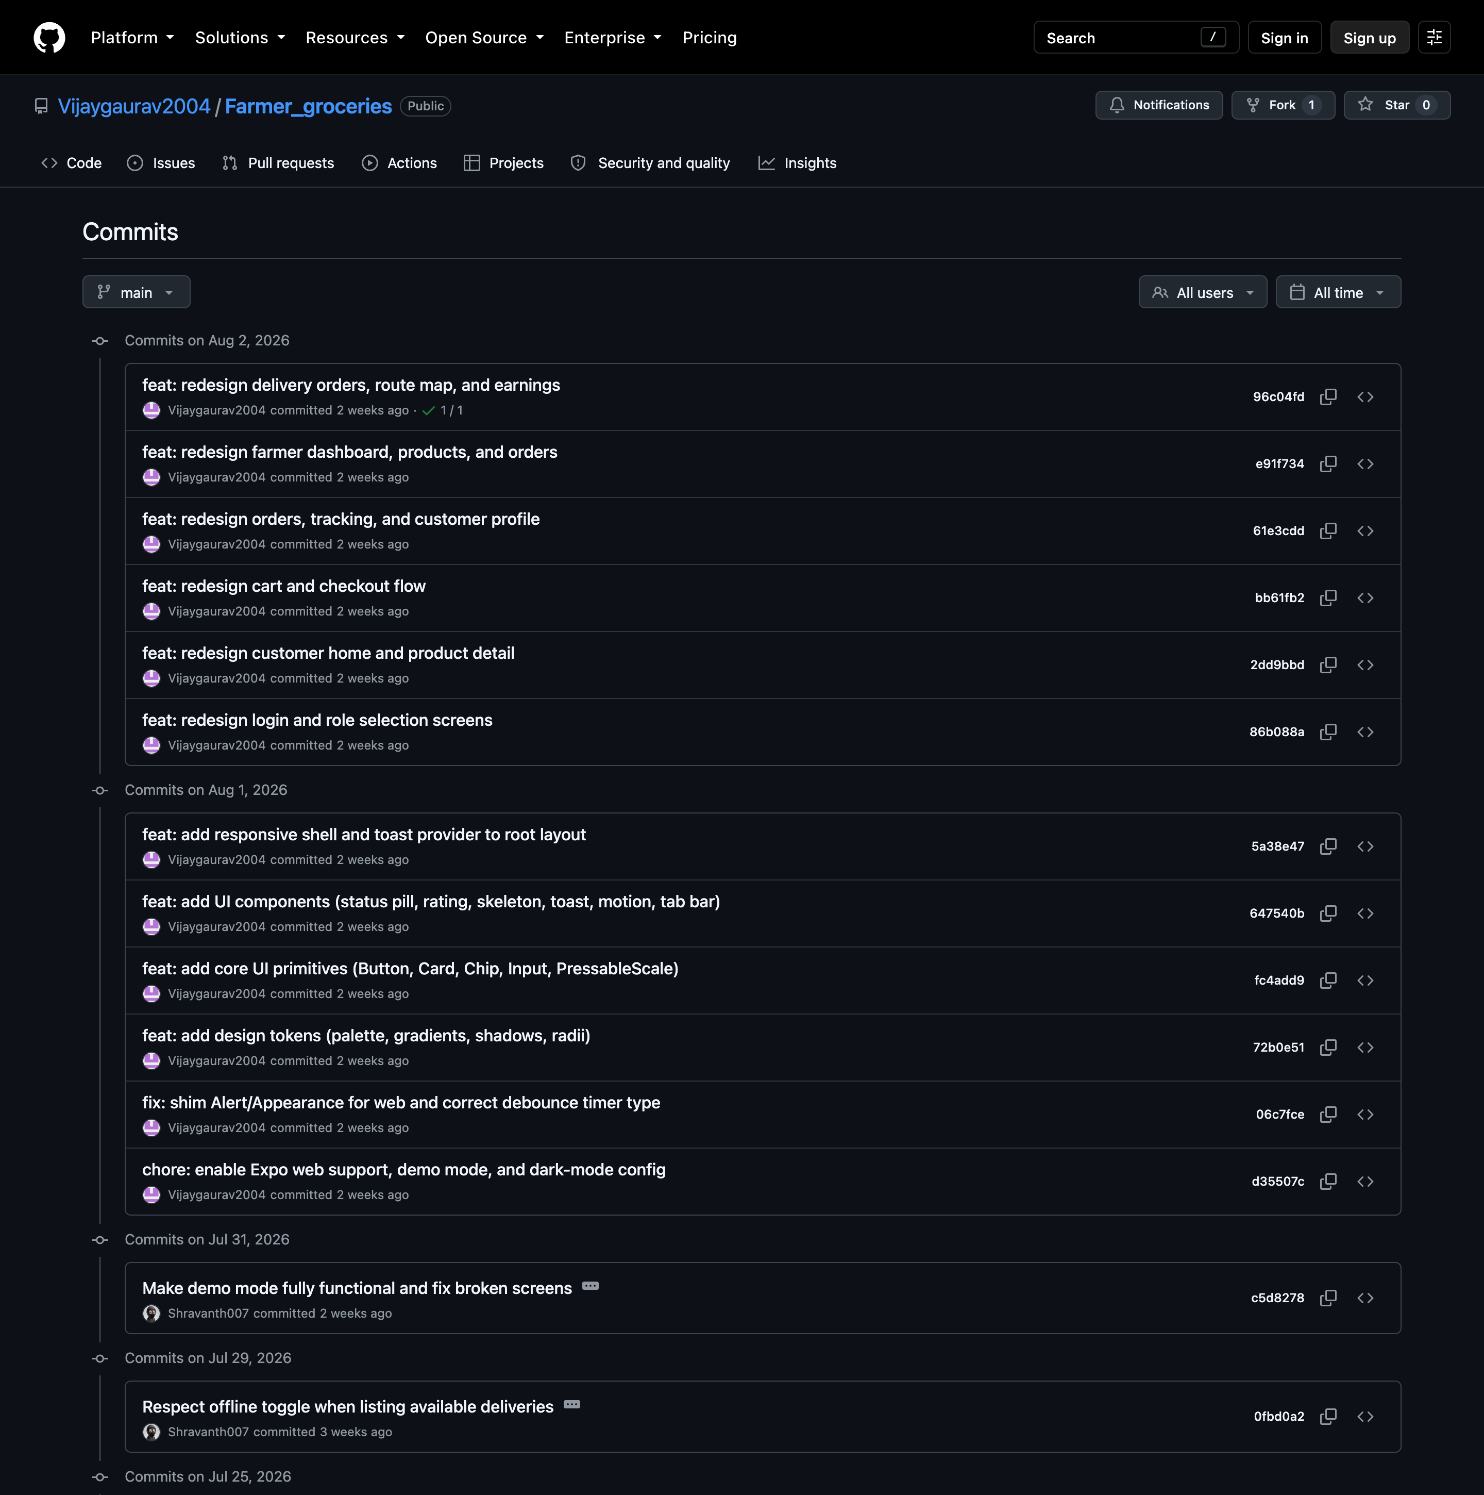
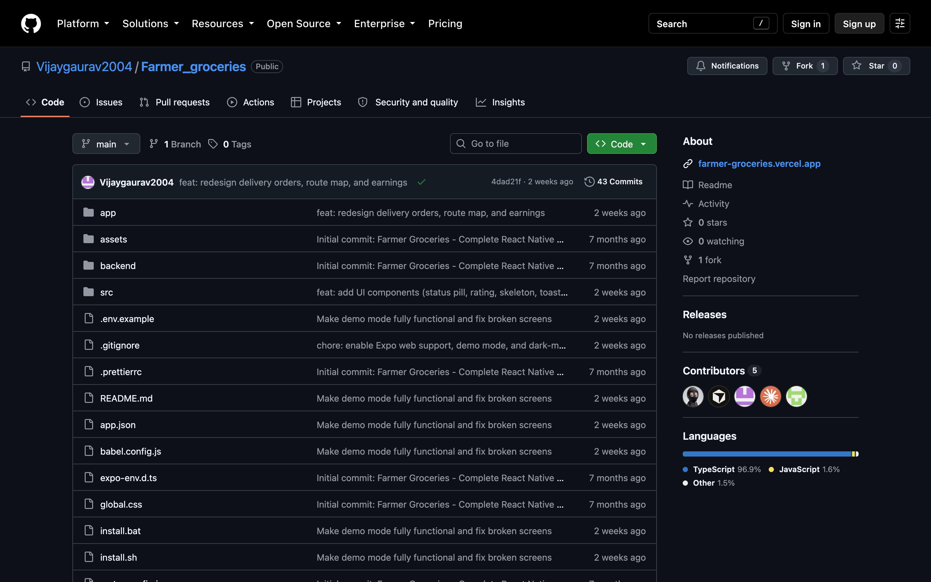
Version Control Evidence
43 commits over 6 months, on
main — public repository
5 contributors · TypeScript 96.9%
Every feature in this deck traces to a dated commit
github.com/Vijaygaurav2004/Farmer_groceries

Slide 10
Challenges & Limitations
Technical challenges
Role-based navigation guard — redirecting between login, role-select and three route groups produced redirect loops; solved with a segment-aware guard that early-returns when the user is already in the correct group.
Backend optionality — every call had to behave identically with and without Supabase, forcing all data access behind one service.
Web and native parity — Alert.alert does not exist in the browser, so it is shimmed; the web build is constrained to a 430 px column so the phone UI is not stretched across a desktop.
Known limitations
Payment method is selected but not settled — no gateway integration.
The Route screen shows pickup and drop details, not live GPS; with no push notifications, order state refreshes on screen focus.
Coverage is integration-level — 40 automated end-to-end cases drive the full three-role cycle, but there is no unit test runner yet for the pure helper functions.
Notes:
[13:00 - 14:00] Challenges & Limitations (1 min)
Pick TWO challenges to actually narrate - the navigation guard and backend optionality.
Both have a clean problem -> decision -> consequence shape, which is what examiners
listen for. Skim the other two.
Guard: "Expo Router redirects on every segment change. Naively, login -> role-select ->
customer home each re-triggered the guard and it looped. The fix was to make the guard
segment-aware and return early when you're already where you belong."
Then read the limitations list at a steady pace and do not soften it. Saying "no
automated tests yet, verification has been manual" before the panel asks is worth more
than any hedge. If they ask what you'd do first with another month: tests, then the
Supabase pilot.

Slide 11
Conclusion & Future Work
Conclusion
A single React Native codebase can serve all three actors of a disintermediated produce chain — the shared 8-state order model is what keeps farmer, customer and delivery partner looking at the same truth.
The current version is complete and demonstrable: auth and role routing, catalogue, cart and checkout, farmer fulfilment, delivery workflow, earnings and profiles — running end to end with zero backend setup.
Routing every screen through one service layer proved to be the decision that mattered: it is what let the backend become a runtime choice rather than a rewrite.
Future work
Upcoming — push notifications for order updates, live GPS tracking on the route screen, product image upload, ratings and reviews, in-app chat between customer and delivery partner.
Backend — enable Supabase with per-role row-level security, real UPI/card settlement, and unit tests around the order state machine alongside the existing end-to-end suites.
Scale — multi-city and multi-language support, subscription boxes for recurring produce, farmer-facing analytics, and a pilot with a real farmer cohort to validate the margin claim.
Notes:
[14:00 - 15:00] Conclusion & Future Work (1 min) - then stop talking
Three closing beats, then hand over:
1. What was proved: one codebase, three roles, one shared order state - working.
2. The engineering point worth remembering: the service-layer seam turned the backend
into a runtime choice instead of a rewrite. That is the transferable lesson.
3. What's next, in honest order: tests and a Supabase pilot before any new features -
because the margin claim needs a real farmer cohort, not more screens.
Close on: "Thank you - happy to take questions, and the app is still running if you'd
like to see any part of it again."
Then STOP. Leave the demo on screen. Don't fill silence.

