Slide 1


APEXPLANET / DATA ANALYTICS INTERNSHIP
Statistical Storytelling
Do average recorded transaction sales differ by gender?
Customer-level analysis • Welch’s t-test • Sensitivity check
TASK 4 | BUSINESS NARRATIVE & STATISTICAL VALIDATION
Notes:
Introduce the business question: do male and female customers differ in their average recorded transaction sales? Explain that this presentation uses customer-level averages, a two-sided Welch t-test, and a sensitivity check for a repeated Order_ID.

Slide 2
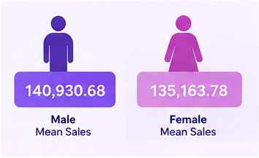
01 / EXECUTIVE SUMMARY
The observed difference is not statistically significant
The sample mean is higher for male customers, but the evidence is not strong enough to conclude a population mean difference.
MALE CUSTOMER MEAN
FEMALE CUSTOMER MEAN
MEAN DIFFERENCE
WELCH TEST P-VALUE
140,930.68
135,163.78
5,766.91
0.4399
468 customers
445 customers
Male − female
α = 0.05
DECISION
Fail to reject the null hypothesis
The result does not prove the group means are equal.
Metric: each customer’s mean of recorded Total_Sales values.
APEXPLANET DATA ANALYTICS INTERNSHIP • TASK 4
02
Notes:
Summarize the result before going into the method. The male mean is 140,930.68 and the female mean is 135,163.78. The p-value is 0.439854, above the preselected 0.05 threshold. Therefore, fail to reject the null; this is not proof of equality.

Slide 3

02 / BUSINESS QUESTION
A focused question, tested with customer-level observations
The analysis compares each customer’s average recorded transaction sales—not total sales by gender.
BUSINESS QUESTION
NULL HYPOTHESIS • H₀
Do male and female customers differ in mean customer-level average recorded transaction sales?
The population means are equal.
ALTERNATIVE HYPOTHESIS • H₁
TEST DESIGN
The population means are different.
Two-sided Welch independent-samples t-test • α = 0.05
Unit of analysis: one customer, represented by their mean recorded Total_Sales.
APEXPLANET DATA ANALYTICS INTERNSHIP • TASK 4
03
Notes:
Define the hypotheses explicitly. The null states equal population means; the alternative states different population means. The test is two-sided because the question asks whether there is a difference in either direction.

Slide 4
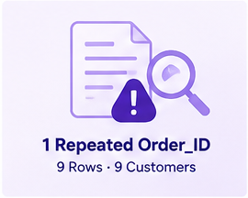
03 / DATA & QUALITY
Validate the data before interpreting the result
Source: ApexPlanet cleaned sales workbook used in Task 3 and Task 4.
SOURCE ROWS
UNIQUE CUSTOMERS
UNIQUE ORDER IDS
GENDER INCONSISTENCY
1,000
947
992
34
13 columns loaded
Customer_ID count
One ID repeated across 9 rows
Customers excluded from test
QUALITY CHECKS COMPLETED
No missing values in the required analysis fields: Order_ID, Customer_ID, Gender, Total_Sales.
One Order_ID (ORD100050) appears in nine rows, each linked to a different transaction and customer.
The nine rows were retained in the primary analysis; the identifier anomaly alone did not justify deletion.
Data limitation: the dataset’s currency and the business meaning of Order_ID were not independently verified.
APEXPLANET DATA ANALYTICS INTERNSHIP • TASK 4
04
Notes:
Explain that data-quality checks found 1,000 rows and 947 unique customers. There were 992 unique Order_IDs because ORD100050 appears nine times. The same identifier appears with nine different transaction IDs and customers. The records were not deleted without evidence. Thirty-four customers with inconsistent gender labels were excluded.

Slide 5
04 / RESULTS
The observed gap is small relative to the uncertainty
Mean customer-level average recorded transaction sales; uncertainty shown as the 95% CI for the difference.
GROUP MEANS
Male
140,930.68
Female
135,163.78
95% CI FOR MEAN DIFFERENCE (MALE − FEMALE)
−8,878.91 to 20,412.73
The interval includes zero.
Observed difference: 5,766.91 | p = 0.439854 | t = 0.7728
APEXPLANET DATA ANALYTICS INTERNSHIP • TASK 4
05
Notes:
Walk through the two means and the observed difference. The 95% confidence interval for the male-minus-female mean difference includes zero, which aligns with the non-significant p-value. The chart is descriptive; do not overstate the visual gap.

Slide 6
05 / METHODOLOGY
How the statistical test was constructed
A reproducible workflow designed to avoid treating repeated transactions from one customer as independent people.
01
Validate
Check required fields, sales values, duplicate identifiers, and gender consistency.
02
Aggregate
Calculate mean recorded Total_Sales for each customer.
03
Filter
Exclude customers with conflicting gender labels.
04
Test
Run a two-sided Welch t-test; do not assume equal group variances.
05
Interpret
Compare p-value with 0.05 and report the 95% CI for the mean difference.
Interpretation rule: p < 0.05 → reject H₀; otherwise, fail to reject H₀.
APEXPLANET DATA ANALYTICS INTERNSHIP • TASK 4
06
Notes:
Describe the reproducible pipeline. The unit of analysis is one customer, using the average of that customer's recorded sales. Welch's t-test is suitable when equal variances should not be assumed. The chosen alpha level is 0.05.

Slide 7

06 / ROBUSTNESS CHECK
The conclusion remains unchanged in the sensitivity scenario
Nine rows associated with the repeated Order_ID were excluded temporarily for comparison—not deleted from the source.
Measure | All rows retained | Flagged rows excluded
Male / female customers | 468 / 445 | 463 / 444
Mean difference | 5,766.91 | 5,488.23
Welch t-statistic | 0.7728 | 0.7339
Two-sided p-value | 0.439854 | 0.463171
95% confidence interval | [-8,878.91, 20,412.73] | [-9,187.41, 20,163.87]
Both p-values exceed 0.05; both confidence intervals include zero.
APEXPLANET DATA ANALYTICS INTERNSHIP • TASK 4
07
Notes:
Compare the main and sensitivity analyses. The p-value changes from 0.439854 to 0.463171, and both confidence intervals include zero. The decision remains fail to reject the null hypothesis. This is evidence of robustness to this one exclusion scenario, not proof that the dataset has no other issues.

Slide 8
07 / BUSINESS IMPLICATIONS
Use the finding carefully—and investigate what drives sales
The evidence does not support treating gender as a reliable differentiator for average recorded transaction sales in this dataset.
RECOMMENDED NEXT STEPS
LIMITATIONS TO DISCLOSE
Explore product category, purchase frequency, and customer segment as possible drivers.
Observational data cannot establish causation.
Check Order_ID generation rules with the data owner before deduplicating.
34 customers with inconsistent gender labels were excluded.
Validate gender labels and document exclusions in future refreshes.
The repeated Order_ID is an unresolved data-quality anomaly.
Use confidence intervals and effect sizes alongside p-values in reporting.
Currency and business definitions were not independently verified.
Avoid using this result alone to make gender-based targeting or policy decisions.
APEXPLANET DATA ANALYTICS INTERNSHIP • TASK 4
08
Notes:
Recommend further analysis of product mix, purchase frequency, and customer segments rather than overinterpreting gender. Disclose the limitations: observational data, gender inconsistencies, unresolved Order_ID anomaly, and unverified currency/business definitions.

Slide 9
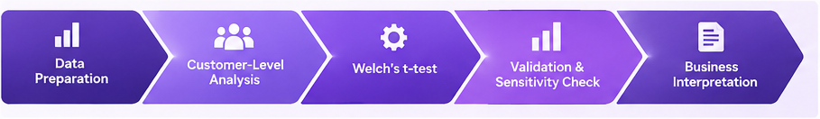
CONCLUSION
No statistically significant
difference was detected.
The male-group mean was higher in this sample, but the evidence was insufficient to conclude that the population means differ.
Thank you
p = 0.439854 • α = 0.05 • 95% CI includes zero
APEXPLANET • TASK 4
Notes:
Close by restating the defensible conclusion: no statistically significant difference was detected at alpha 0.05. The sensitivity analysis produced the same decision. Emphasize that failure to reject the null is not proof of equality, and further business analysis is warranted.

