Slide 1
Consensus HLA Analysis
Sample01-ConsensusHLA

Slide 2
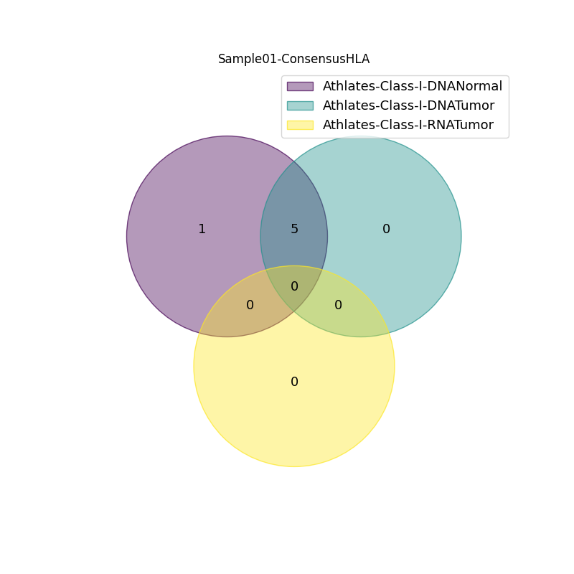
Sample01-ConsensusHLA
Athlates Class I
04/06/2023
DNA-Normal | DNA-Tumor | RNA-Tumor | Consensus
HLA-A*12:11 | HLA-A*12:11 | nan | HLA-A*12:11
HLA-A*12:89 | HLA-A*12:11 | nan | HLA-B*05:12
HLA-B*05:12 | HLA-B*05:12 | nan | HLA-B*15:11
HLA-B*15:11 | HLA-B*15:11 | nan | HLA-C*03:13
HLA-C*03:13 | HLA-C*03:13 | nan | HLA-C*17:07
HLA-C*17:07 | HLA-C*17:07 | nan | nan

Slide 3
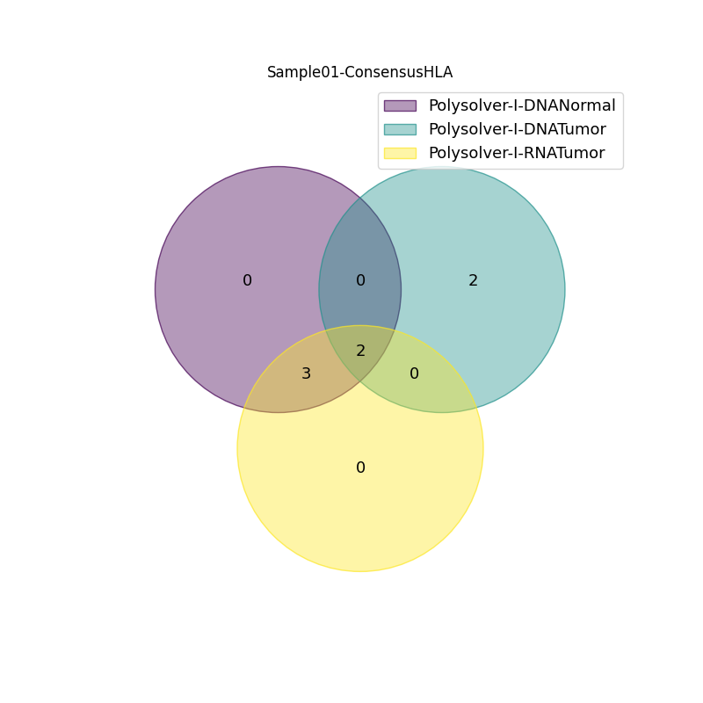
Sample01-ConsensusHLA
Polysolver Class I
04/06/2023
DNA-Normal | DNA-Tumor | RNA-Tumor | Consensus
HLA-A*12:11 | HLA-A*12:11 | HLA-A*12:11 | HLA-A*12:11
HLA-A*12:11 | HLA-A*12:11 | HLA-A*12:11 | HLA-B*05:12
HLA-B*05:12 | HLA-B*05:12 | HLA-B*05:12 | HLA-B*15:11
HLA-B*15:11 | HLA-B*08:12 | HLA-B*15:11 | HLA-C*03:13
HLA-C*03:13 | HLA-C*07:02 | HLA-C*03:13 | HLA-C*17:07
HLA-C*17:07 | HLA-C*07:02 | HLA-C*17:07 | nan

Slide 4
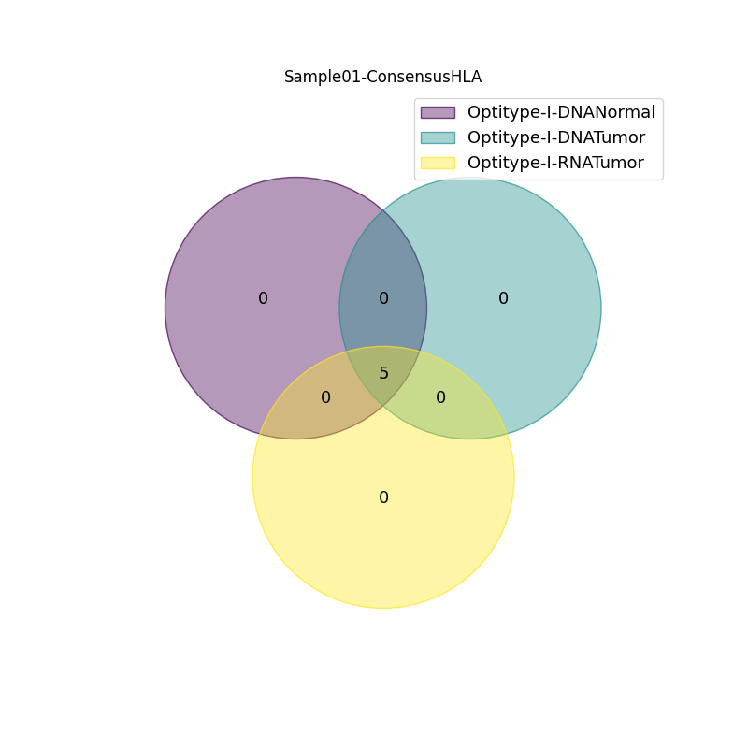
Sample01-ConsensusHLA
Optitype Class I
04/06/2023
DNA-Normal | DNA-Tumor | RNA-Tumor | Consensus
HLA-A*12:11 | HLA-A*12:11 | HLA-A*12:11 | HLA-A*12:11
HLA-A*12:11 | HLA-A*12:11 | HLA-A*12:11 | HLA-B*05:12
HLA-B*05:12 | HLA-B*05:12 | HLA-B*05:12 | HLA-B*15:11
HLA-B*15:11 | HLA-B*15:11 | HLA-B*15:11 | HLA-C*03:13
HLA-C*03:13 | HLA-C*03:13 | HLA-C*03:13 | HLA-C*17:07
HLA-C*17:07 | HLA-C*17:07 | HLA-C*17:07 | nan

Slide 5

Sample01-ConsensusHLA
Seq2HLA Class I
04/06/2023
DNA-Normal | DNA-Tumor | RNA-Tumor | Consensus
HLA-A*12:11 | HLA-A*12:11 | HLA-A*12:11 | HLA-A*12:11
HLA-A*12:11 | HLA-A*26:45 | HLA-A*12:11 | HLA-B*05:12
HLA-B*05:12 | HLA-B*05:12 | HLA-B*05:12 | HLA-B*15:11
HLA-B*15:11 | HLA-B*15:11 | HLA-B*15:01 | HLA-C*03:04
HLA-C*03:04 | HLA-C*03:04 | HLA-C*03:13 | HLA-C*17:07
HLA-C*17:07 | HLA-C*17:07 | HLA-C*17:07 | nan

Slide 6

Sample01-ConsensusHLA
Athlates Class II
04/06/2023
DNA-Normal | DNA-Tumor | RNA-Tumor | Consensus
DPA1*11:04 | DPA1*11:04 | nan | DPA1*11:04
DPA1*11:04 | DPA1*11:04 | nan | DPB1*04:09
DPB1*04:09 | DPB1*04:09 | nan | DQA1*07:02
DPB1*04:09 | DPB1*04:09 | nan | DQB1*05:08
DQA1*07:02 | DQA1*07:02 | nan | DRA*01:01
DQA1*07:02 | DQA1*07:02 | nan | DRA*01:02
DQB1*03:02 | DQB1*05:08 | nan | DRB1*05:01
DQB1*05:08 | DQB1*05:08 | nan | DRB1*14:04
DRA*01:01 | DRA*01:01 | nan | nan
DRA*01:02 | DRA*01:02 | nan | nan
DRB1*05:01 | DRB1*05:01 | nan | nan
DRB1*14:04 | DRB1*14:04 | nan | nan

Slide 7

Sample01-ConsensusHLA
Seq2HLA Class II
04/06/2023
DNA-Normal | DNA-Tumor | RNA-Tumor | Consensus
DPA1*11:04 | DPA1*11:04 | DPA1*11:04 | DPA1*11:04
DPA1*11:04 | DPA1*11:04 | DPA1*11:04 | DPB1*04:09
DPB1*04:09 | DPB1*04:09 | DPB1*04:09 | DQA1*07:02
DPB1*04:09 | DPB1*04:09 | DPB1*384:01 | DQB1*05:08
DQA1*07:02 | DQA1*07:02 | DQA1*03:02 | DRA*01:01
DQA1*07:02 | DQA1*07:02 | DQA1*07:02 | DRB1*05:01
DQB1*05:08 | DQB1*05:08 | DQB1*05:08 | nan
DQB1*05:08 | DQB1*05:08 | DQB1*05:08 | nan
DRA*01:01 | DRA*01:01 | DRA*01:02 | nan
DRA*01:01 | DRA*01:01 | DRA*01:02 | nan
DRB1*14:04 | DRB1*05:01 | DRB1*04:04 | nan
DRB1*15:01 | DRB1*16:01 | DRB1*05:01 | nan

Slide 8
Sample01-ConsensusHLA
All Class I consensus HLA
04/06/2023
Athlates | OptiType | Polysolver | Seq2HLA | HLAMiner | Consensus
HLA-A*12:11 | HLA-A*12:11 | HLA-A*12:11 | HLA-A*12:11 | nan | HLA-A*12:11
HLA-B*05:12 | HLA-B*05:12 | HLA-B*05:12 | HLA-B*05:12 | nan | HLA-B*05:12
HLA-B*15:11 | HLA-B*15:11 | HLA-B*15:11 | HLA-B*15:11 | nan | HLA-C*03:13
HLA-C*03:13 | HLA-C*03:13 | HLA-C*03:13 | HLA-C*03:04 | nan | HLA-C*17:07
HLA-C*17:07 | HLA-C*17:07 | HLA-C*17:07 | HLA-C*17:07 | nan | HLA-B*15:11

Slide 9
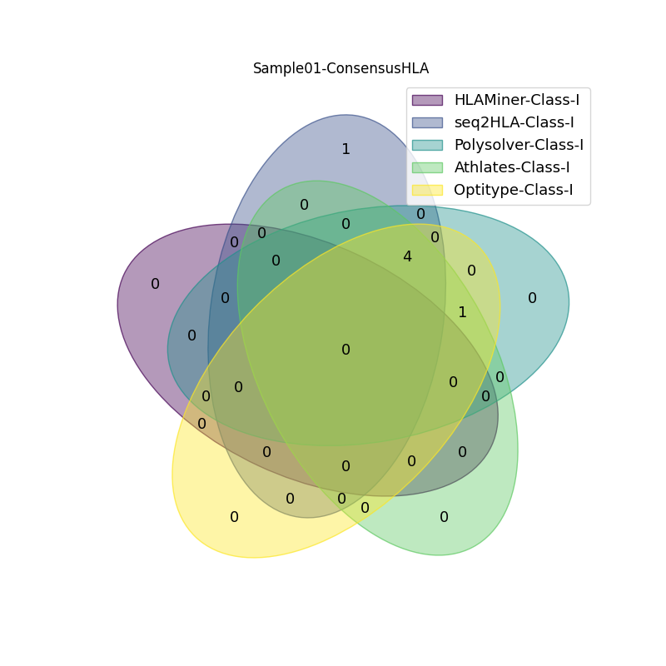
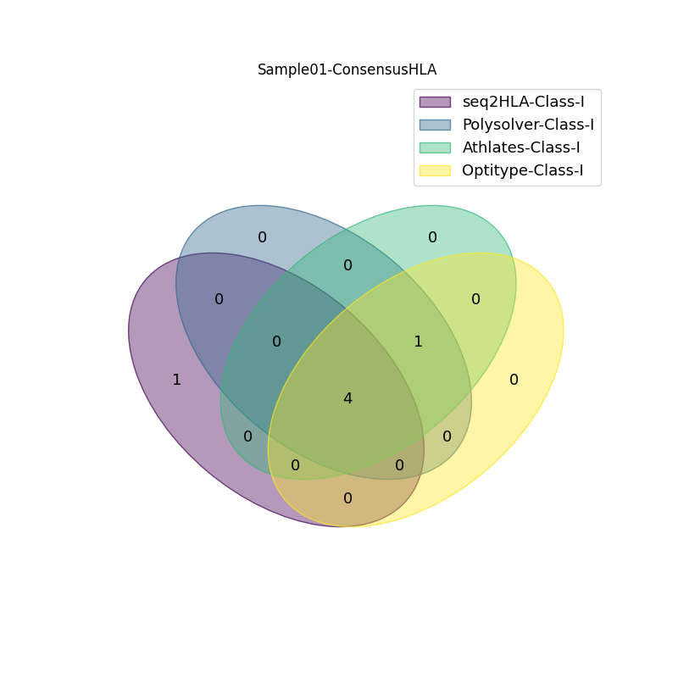
Sample01-ConsensusHLA
All Class I consensus HLA
04/06/2023
All Class I consensus HLA: [HLA-A*12:11, HLA-B*05:12, HLA-C*03:13, HLA-C*17:07, HLA-B*15:11]

Slide 10
Sample01-ConsensusHLA
All Class II consensus HLA
04/06/2023
Athlates | Seq2HLA | HLAMiner | Consensus
DPA1*11:04 | DPA1*11:04 | nan | DPA1*11:04
DPB1*04:09 | DPB1*04:09 | nan | DPB1*04:09
DQA1*07:02 | DQA1*07:02 | nan | DQA1*07:02
DQB1*05:08 | DQB1*05:08 | nan | DQB1*05:08
DRA*01:01 | DRA*01:01 | nan | DRA*01:01
DRA*01:02 | DRB1*05:01 | nan | DRB1*05:01
DRB1*05:01 | nan | nan | nan
DRB1*14:04 | nan | nan | nan

Slide 11
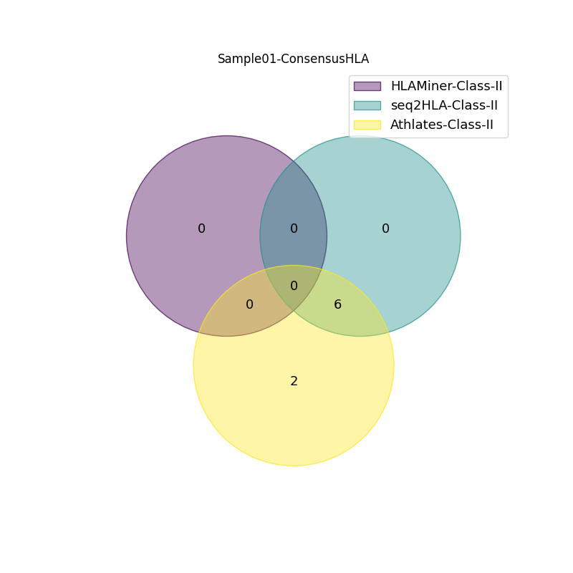
Sample01-ConsensusHLA
All Class II consensus HLA
04/06/2023
All Class II consensus HLA: [DPB1*04:09, DRB1*05:01, DQA1*07:02, DRA*01:01, DPA1*11:04, DQB1*05:08]

