Slide 1

Leveraging Deep Learning for
Malarial Parasite Detection using Blood Smear Images
Team Members
Guided By
Raavi Vijay Krishna (224003154)
Dunna Harshavardhan (224003036)
Thutte Sai Goutham (224003099)
Dr. R. Thanuja
Assistant Professor-II
Srinivasa Ramanujan Centre
SASTRA Deemed to be University

Slide 2
Abstract:
Malaria is a disease spread through the bite of female Anopheles mosquitoes, which are infected with the Plasmodium parasite.
When a person is bitten by an infected mosquito, the parasite multiplies in their liver and begins to destroy red blood cells.
Traditionally, diagnosis of malaria involves visually examining blood under a microscope, But this method can vary based on the expertise and experience of the pathologist.
To improve diagnosis in effective manner different types of deep learning techniques have been used to detect infected blood cells automatically.
However, these methods often require expert knowledge to adjust features for detection.
The proposed system of tuning the features using deep learning techniques that can accurately detect malaria without the need for hand-crafted features. This will be tested on a publicly available dataset(Blood Smear Images) from the National Institute of Health.

Slide 3
Problem Statement:
The traditional method of diagnosing malaria, which involves visual examination of blood smears under a microscope, is subjective and depends on the expertise and experience of pathologists.
This can lead to variability in diagnostic reports from different laboratories and a potential for human error. There is a need for a more accurate and consistent method of diagnosing malaria, particularly in resource-limited settings where the disease is prevalent and access to experienced pathologists is limited.

Slide 4
Proposed Framework:
The application of deep learning techniques for the spontaneous detection of blood smears presents an opportunity to address this issue.
The proposed work is to develop and evaluate an automated diagnostic tool that utilizes deep learning algorithms to accurately identify infected red blood cells and provide a consistent and reliable diagnosis of malaria.

Slide 5
Literature Survey:
Year | Title | Algorithm/ Techniques | Journal
2017 | Malaria Parasite Detection From Peripheral Blood Smear Images Using Deep Belief Networks | DBN | IEEE Access
2020 | Automated Complete Blood Cell Count and Malaria Detection Using CNN | CNN | IEEE Xplore
2020 | Unsupervised Deep Learning CAD Scheme for the Detection of Malaria in Blood Smear Microscopic Images | Computer-aided diagnosis(CAD)/K-fold cross-validation | IEEE Access
2020 | A Novel Stacked CNN for Malarial Parasite Detection in Thin Blood Smear Images | Stacked CNN | IEEE Access

Slide 6
Methodology:
Data Collection: Collecting the dataset of blood smear images containing both infected and uninfected red blood cells. We ensure that the dataset is large and diverse enough to capture the range of variation in blood smear images. Also, we labeled the images to indicate whether they are infected or uninfected.
Data Preprocessing: We preprocess the blood smear images to standardize the image sizes, color spaces, and pixel values. This can include resizing the images, normalizing the pixel values, and converting the images to grayscale or RGB color space.
CNN Model Development: A CNN model is developed which is trained on the preprocessed image dataset. The CNN model is optimized for malaria detection by selecting appropriate hyperparameters and adjusting the architecture of the network. The model is designed to identify infected red blood cells in the images.

Slide 7
Training and Validation of the CNN Model: Training the CNN model using the preprocessed image dataset and validating the performance of the model using a separate validation set. The CNN model is fine-tuned to achieve the highest possible accuracy in identifying infected red blood cells. The training and validation process also include adjusting the hyperparameters of the model, such as learning rate and number of epochs.
Performance Evaluation: Evaluating the performance of the CNN model using a separate test set of blood smear images. The accuracy of the CNN model was calculated by comparing the predicted labels of the infected and uninfected cells with the true labels. Other performance metrics, such as precision, recall, and F1 score, can also be calculated.

Slide 8
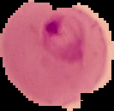
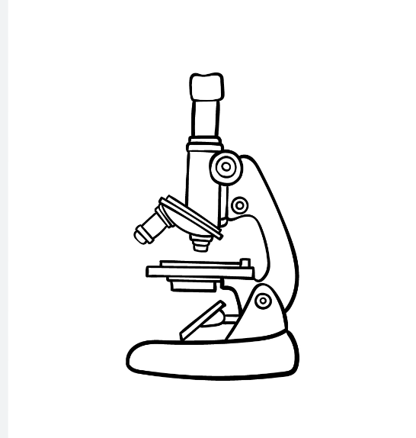
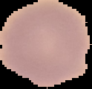

System Architecture:
Parasitized
CNN
Image Preprocessing
Uninfected

Slide 9
Explanation of the system architecture:
Stained Blood Smear Images: The system takes in a set of stained blood smear images, containing both parasitized and uninfected red blood cells.
Image Preprocessing: The images are preprocessed to standardize the sizes, color spaces, and pixel values. This can include resizing the images, normalizing the pixel values, and converting the images to grayscale or RGB color space.
CNN Model: The system uses a CNN model to classify the preprocessed images as either parasitized or uninfected. The CNN model consists of multiple convolutional and pooling layers, which extract features from the images. The output of the CNN model is then fed to one or more fully connected layers, which perform the final classification.
Parasitized or Uninfected Classification: The output of the stacked CNN model is a probability distribution of the input image belonging to either the parasitized or uninfected class. The final classification is determined by selecting the class with the highest probability.

Slide 10
Image Preprocessing:
Summary of the preprocessing steps that were applied to the malaria images:
Resample the images to a fixed size of 40 x 40 pixels.
Scaling down Images to 0 to 1.
Normalize the image to equalize intensity values.
These preprocessing steps are applied to the images before any training or testing was done, to standardize the image sizes and improve the quality of the images for classification or other tasks

Slide 11
# Importing necessary libraries
import numpy as np
import cv2
# Defining a function to preprocess an image
def preprocess_image(image_path):
# Loading the image
image = cv2.imread(image_path)
# Resizing the image to a fixed size of 40 x 40 pixels
resized_image = cv2.resize(image, (40, 40))
# Converting the image to floating point values between 0 and 1
scaled_image = resized_image.astype("float") / 255.0
# Normalizing the image to equalize intensity values
normalized_image = cv2.equalizeHist(scaled_image)
# Returning the preprocessed image
return normalized_image
Pseudo Code for Image Preprocessing:

Slide 12
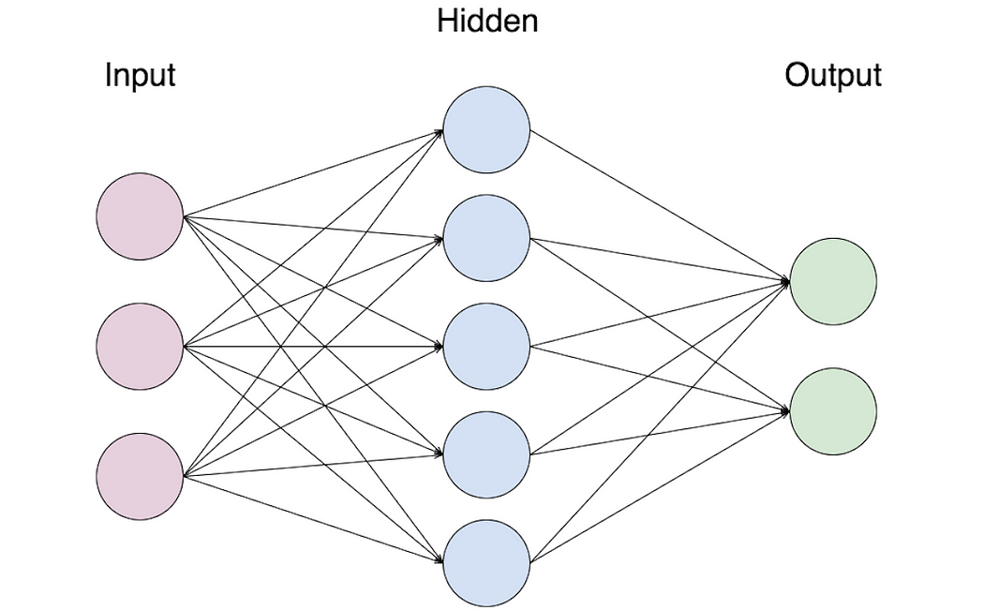
CNN Architecture:
Parasitized
Uninfected
Sigmoid(y)
Input
(40,40,3)
Conv2D
128@3*3
Max pooling
2*2
3 Fully Connected Dense Layers
Flatten the Matrix into 1D Array

Slide 13
Explanation of CNN architecture:
Input(40,40,3): This refers to the input shape of the images that are fed into the CNN model. The input images are 40 pixels wide, 40 pixels tall, and have 3 color channels (RGB).
Conv2D 128@3*3: This is the first convolutional layer of the CNN model, which consists of 128 filters that are 3x3 in size. The purpose of this layer is to extract low-level features from the input images.
Max pooling 2*2: This is a pooling layer that follows the second convolutional layer. It reduces the spatial dimension of the feature maps by selecting the maximum value within a 2x2 window.
Flatten: Converting the obtain Matrix into one dimensional array.
3 fully connected dense layer: These are the final layers of the CNN model, which are fully connected and dense. They take in the output of the previous layers and perform the final classification of the input images as either parasitized or uninfected.
Parasitized or Uninfected: This is the final output of the CNN model, indicating whether the input image is parasitized or uninfected based on the classification performed by the fully connected dense layer.

Slide 14
Overall, this CNN architecture consists of multiple convolutional and pooling layers that extract and process features from the input images, followed by fully connected dense layers that perform the final classification. The goal of the architecture is to accurately identify and classify the parasitized and uninfected red blood cells in the blood smear images.
The Accuracy and Loss for the CNN model with single (or) multiple layers are tabulated below:l
MODEL with multiple layers | Accuracy | Loss
CNN with Single Layer | 91.116 | 23.812
CNN with Dual Layer | 95.388 | 23.253
CNN with Triple Layer | 96.194 | 12.075

Slide 15
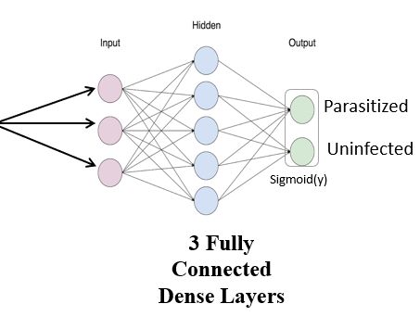
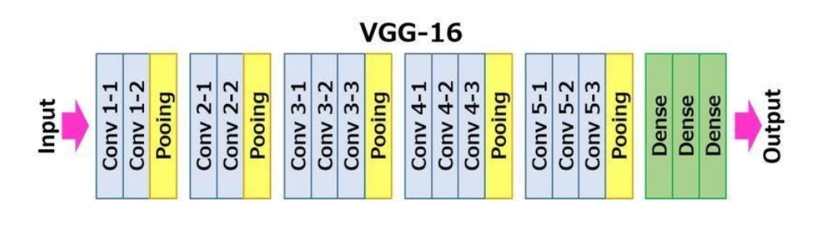
VGG16 Architecture:
Input
(40,40,3)
The VGG16 architecture is characterized by its use of small (3x3) convolutional filters, which are stacked on top of each other to create deeper representations of the input data. This allows the model to capture more complex patterns in the data
The VGG16 architecture also includes max pooling layers, which are used to downsample the spatial dimensions of the feature maps, and fully connected layers, which are used to classify the input data.
One of the strengths of the VGG16 architecture is its simplicity and ease of implementation. The use of small convolutional filters and max pooling layers makes it easier to train the model and reduces the number of parameters in the model.
However, one of the limitations of the VGG16 architecture is its high computational cost, due to its large number of parameters. This can make it difficult to train the model on large datasets or on devices with limited computational resources.

Slide 16
Residual Network Architecture:
ResNet (Residual Network) is a deep neural network architecture designed to address the vanishing gradient problem.
Skip connections: ResNet introduces skip connections, also known as identity mappings, which allow the gradient to flow directly to shallower layers without passing through the deeper layers. This helps in avoiding the vanishing gradient problem, and allows for better training of deep neural networks.
Residual blocks: The ResNet architecture is made up of residual blocks, each consisting of a set of convolutional layers and skip connections. The skip connections add the input of a block to its output, which is then passed through an activation function, allowing the network to learn residual features.
Deep network: ResNet is a deep neural network architecture that has been shown to achieve state-of-the-art results on a variety of computer vision tasks, including image classification, object detection, and segmentation.
Variants: There are several variants of the ResNet architecture, such as ResNet-50, ResNet-101, and ResNet-152, that differ in the number of layers they have. The deeper variants have been shown to have better performance on complex tasks, but require more computational resources for training.

Slide 17
Results:
Overall, this DeepCNN architectures and CNN architecture consists of multiple convolutional and pooling layers that extract and process features from the input images, followed by fully connected dense layers that perform the final classification. The goal of the architecture is to accurately identify and classify the parasitized and uninfected red blood cells in the blood smear images.
The Accuracy and Loss for the CNN model with single (or) multiple layers and deep CNN models are tabulated below:l
Model Name | Accuracy | Loss
CNN with One layer | 91.116% | 23.812
CNN with two layers | 95.388% | 23.253
CNN with three layers | 96.194% | 12.075
VGG16 model | 85.67% | 32.45
ResNet Model | 69.83% | 58.73

Slide 18
The CNN with 3 layers model had the highest accuracy, indicating that increasing the number of layers and filters can improve performance. However, this model had the highest number of parameters, which can lead to overfitting on small datasets.
VGG16 and ResNet performed similarly, suggesting that deeper models can improve performance, but also require more computational resources.
The CNN with 2 layers and CNN with 1 layer models had also higher accuracies and also more computationally efficient, making them suitable for applications with limited resources.
Overall, our results show that deep learning models can be effective for malaria parasite detection, and the choice of model should be based on the available resources and specific application requirements.

Slide 19
Conclusion:
All the models evaluated in this study shown high accuracy rates, with the simpler CNN models outperforming the VGG16 and ResNet models.
However, each model has its strengths and limitations. The simpler CNN models require less computational power and are easier to train, making them suitable for smaller datasets or lower-end hardware.
On the other hand, the VGG16 and ResNet models are more complex and require more computational resources but have demonstrated superior performance on the test set.
The study shows that the potential of deep learning models for the detection of malaria parasites in thin blood smear images.
The simpler CNN models outperformed the VGG16 and ResNet models, but each model has its strengths and limitations.
The findings conclude that deep learning models could be used as an effective tool in the diagnosis of malaria, providing medical professionals with a reliable and efficient means of detecting the parasite.

Slide 20
THANK YOU!

