Slide 1
🤖 AI Powered Code Reviewer

Slide 2
Problem Statement
Manual code review is time-consuming
Developers often miss:
Missing docstrings
Poor code structure
Lack of beginner-friendly tools
Need for fast & smart code feedback

Slide 3
Objectives
Analyze Python code automatically.
Identify functions and classes.
Detect missing docstrings.
Generate docstrings using AI.
Provide simple visual insights.

Slide 4
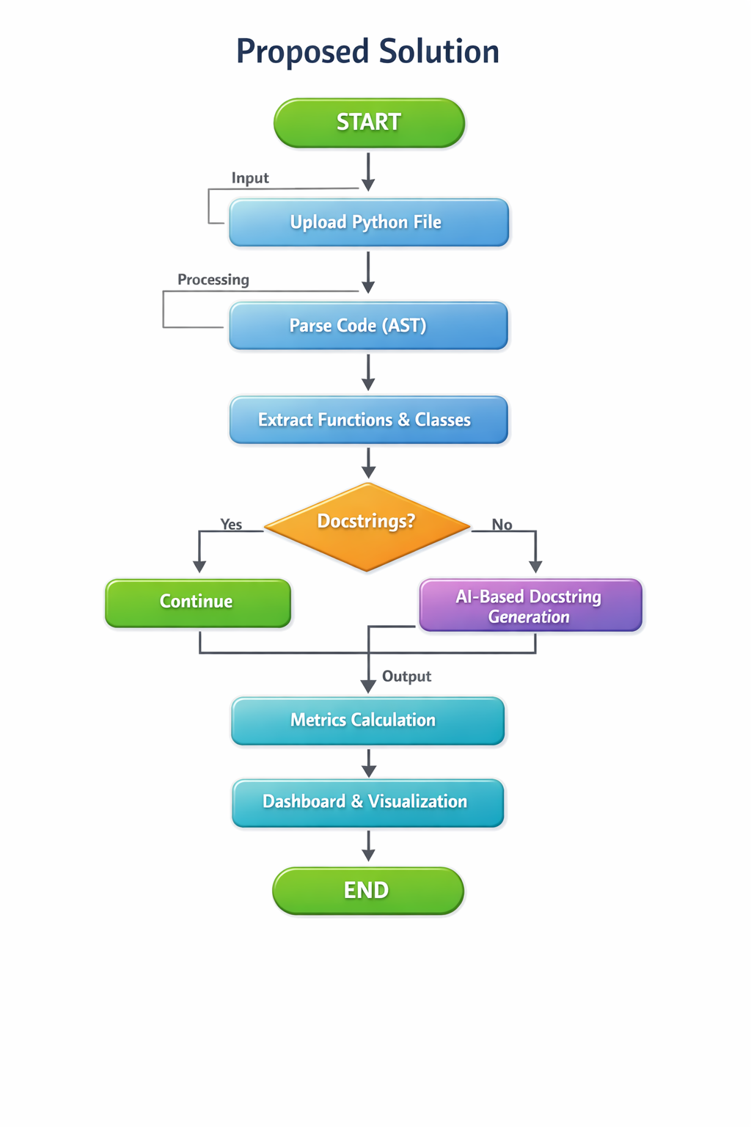
Proposed Solution
Upload a Python file.
Analyze code using AST.
Detect missing docstrings.
Generate docstrings using AI.
Display results in dashboard.

Slide 5
Technologies Used
Python
Streamlit
Pandas
Matplotlib / Plotly
AST
AI model
System Architecture
Input: Python file
Processing: AST + AI
Output: Metrics and graphs

Slide 6
Advantages
The system significantly reduces the time required for manual code review.
It helps improve overall code quality and readability.
It is easy to use and suitable for beginners.
The process is automated, reducing human effort.

Slide 7
Conclusion
Developed an AI-based code reviewer system successfully .
It automates the process of analyzing and improving code quality.
The project demonstrates the effective use of AI in software development

Slide 8
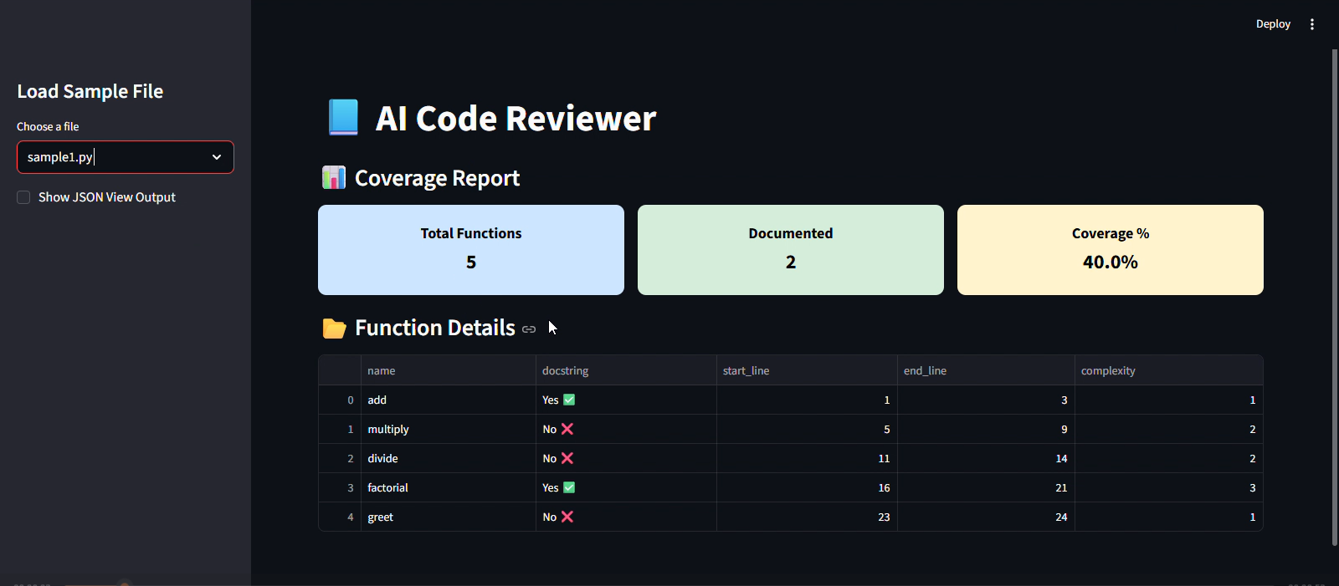
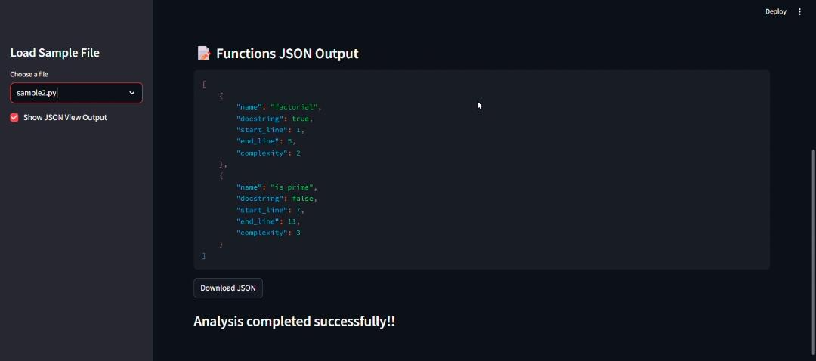
Milestone 1 – File Upload & Initial Processing
Implemented file upload feature using Streamlit interface.
Users can easily upload the Python files or folder for analysis.
The coverage report of the functions will be displayed.
The function details can be extracted.
The JSON view report of the functions can also be downloaded.

Slide 9
Milestone 2 – Metrics, Validation & Dashboard
Developed a metrics section to summarize code analysis results.
Calculated key values like number of functions and missing docstrings.
Implemented validation to ensure uploaded files are correctly processed.
Handled errors and invalid inputs to improve system reliability.
Updated the dashboard to display results in a clear and structured format.
Integrated charts and tables for better visualization of analysis results.

Slide 10
Milestone 3 – Docstring Generation & Formatting
Implemented automatic docstring generation for functions.
Converts existing or missing docstrings into structured formats.
Provided support for multiple docstring styles:
Google style
NumPy style
reStructuredText (reST) style
Improved code readability and standardization

Slide 11
Milestone 4
Developed a complete multi-view application.
Implemented multiple sections for analysis, validation, and visualization.
Connected with multiple LLM models for improved docstring generation.
Integrated a testing suite to ensure accuracy and reliability of results.
Enhanced the UI with better layout and navigation.
Added export functionality to download newly accepted docstrings applied.

Slide 12
Key Challenges and Solutions
Challenges | Solutions
Handling different formats of uploaded Python files | Implemented file validation and proper error handling
Parsing complex code structures using AST | Used AST traversal methods to accurately extract functions and classes
Detecting missing or inconsistent docstrings | Applied checks using AST to identify absent docstrings
Generating meaningful docstrings | Integrated LLM models to generate context-based docstrings
Making the system scalable and flexible | Integrated multiple LLM models and modular design

