Slide 1
QUAD COPTER WITH PARAGLIDER APPLICATIONS

Slide 2
What our project is ?
Basically there are 2 modes:
Autonomous .
manual .
Autonomous control in retracting and opening of parafoil , obstacle avoidance , camera online streaming.
Manually controlled maneuverability of quad

Slide 3
Why is our project ?
Actually main idea was to build a vehicle for surveillance .
Tricopter + parafoil .
Quad + parafoil would add to its stability and new .

Slide 4
Quad
Raspberry Pi
Arduino due
Electronics
Parafoil
Transceiver
Base station
Arduino mega
electronics
MRF
Transmitter
Transceiver

Slide 5
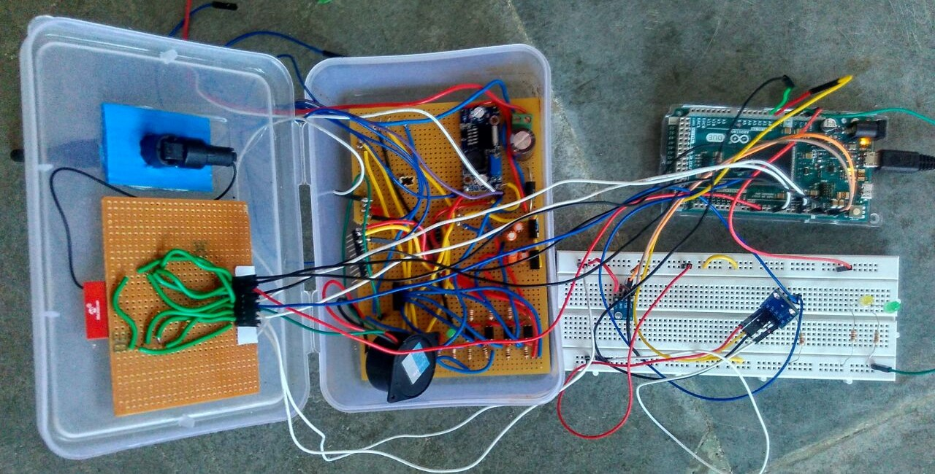
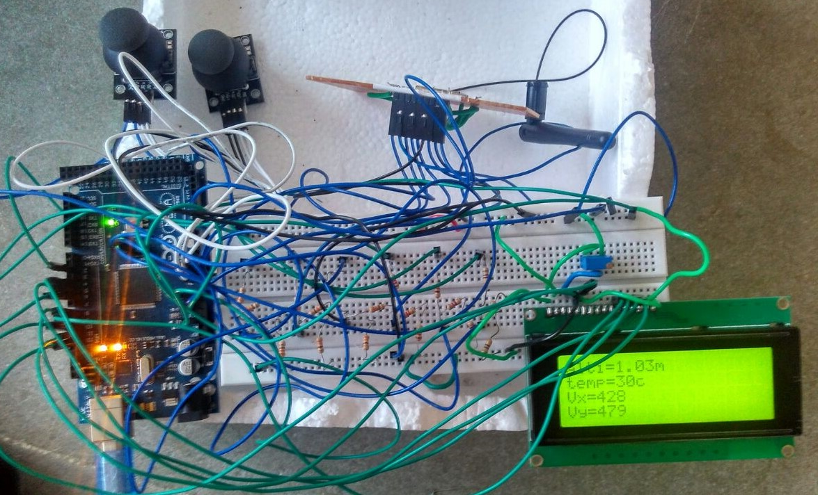
Transmitter
Receiver

Slide 6
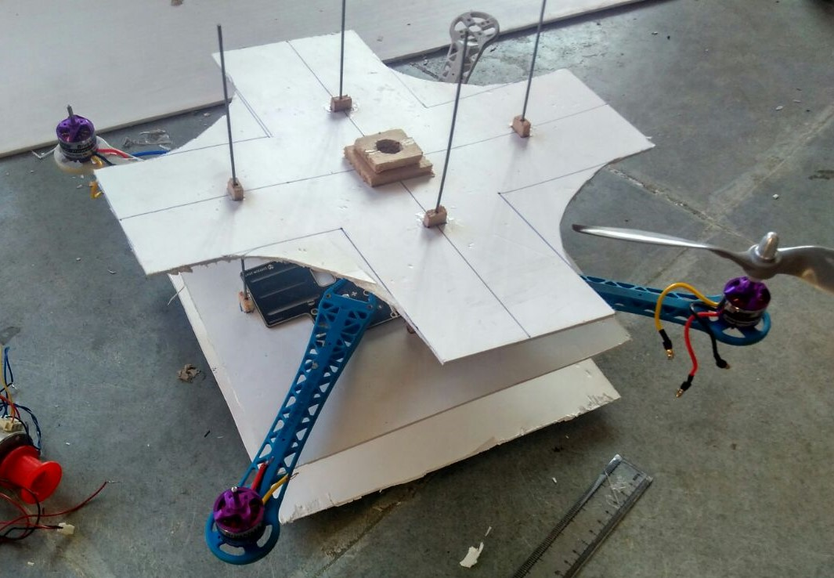
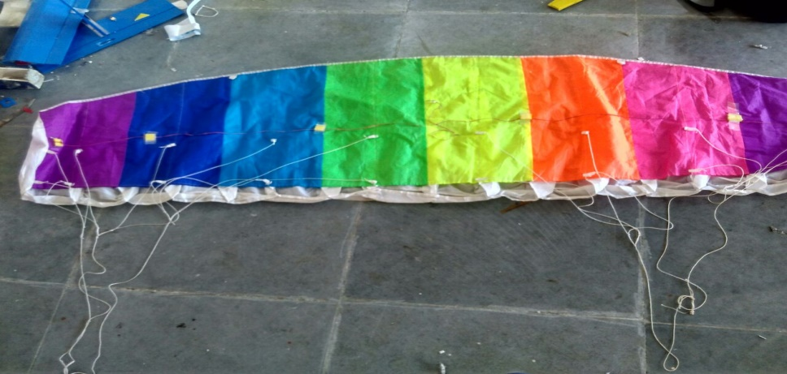
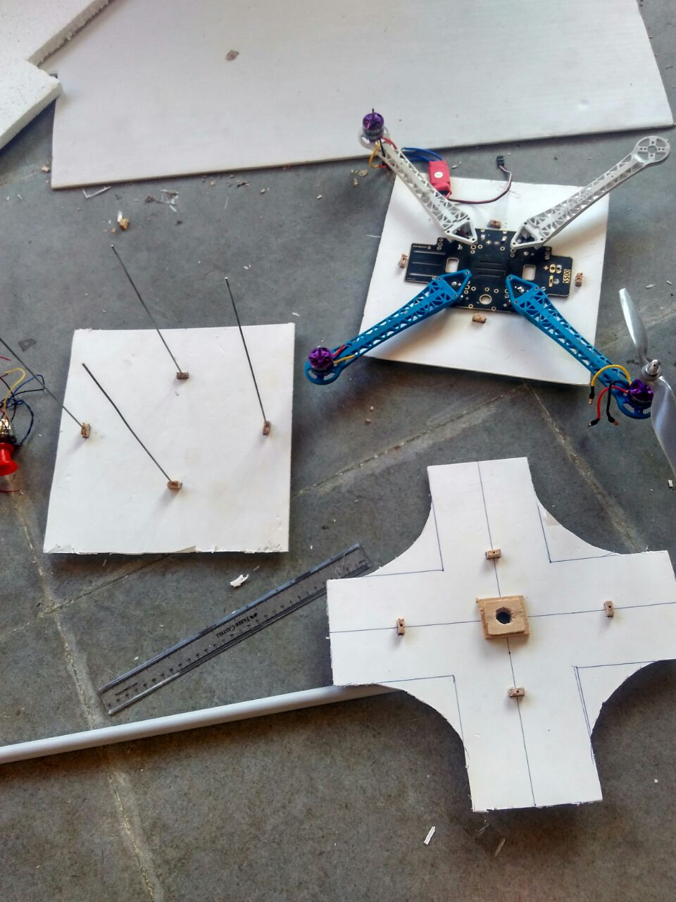
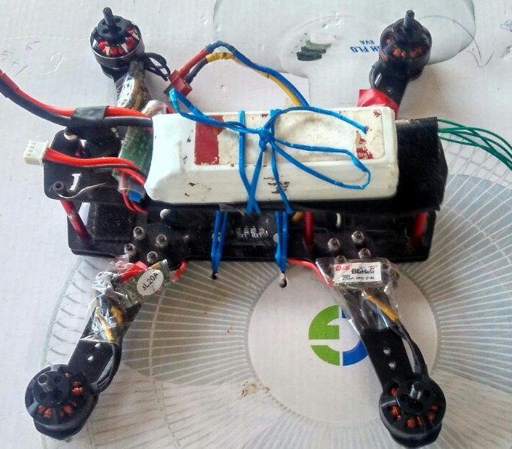
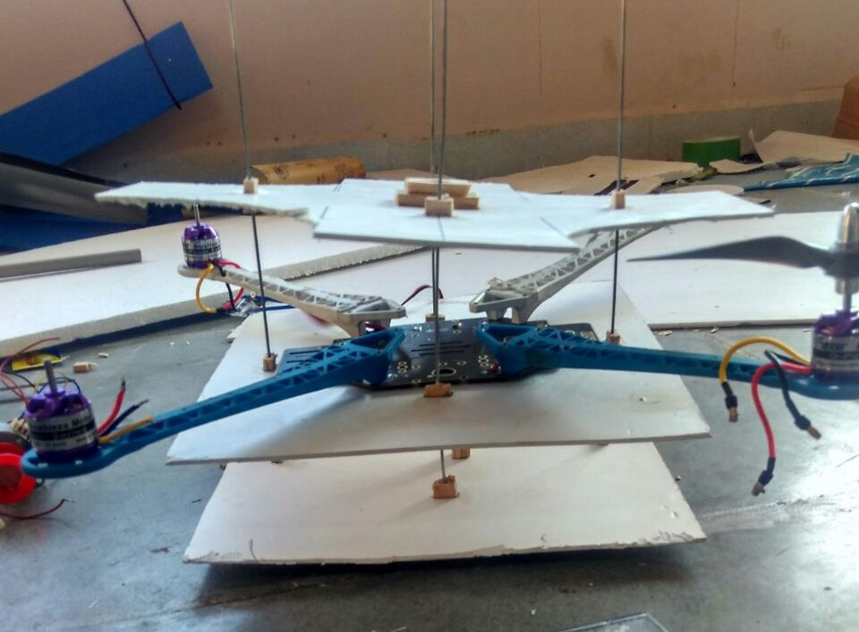

Slide 7
Features
MRF transceiver.
Longer Range
Control implemented.
LCD display on ground station
Paraglider mechanism

Slide 8
Features
Altitude hold.
Autonomous
Rasperry Pi cam including WiFi stream.
Gives values of various parameters.

Slide 9
How is our project advantageous?
There is no hybrid of quad and paraglider.
Low power consumption .
High flight time.

