Slide 1
DATA SCIENCE SQL MINI PROJECT – L1
NAME: VIJAY PRAKASH
BATCH: CAPDS-05

Slide 2
contents
Introduction
Project Overview
Dataset Overview
Methodology
Insights
Conclusion

Slide 3
INTRODUCTION
The automotive industry stands at the intersection of innovation and consumer demand, constantly evolving to meet the dynamic needs of buyers. In this context, data-driven insights play a pivotal role in understanding market trends, consumer behavior, and operational efficiency. Our SQL mini-project delves into the vast realm of car transactions using the Cars24 dataset, aiming to extract valuable insights and inform strategic decision-making within the automotive sector.

Slide 4
Project Overview
The Cars24 dataset serves as the foundation for our analysis. It encompasses a wealth of information, including details about various car models, their attributes, transaction histories, and customer feedback. Collected over a period of time, this dataset encapsulates the diverse landscape of the automotive market.

Slide 5
Dataset overview
name: The name or model of the car.
year: The manufacturing year of the car.
selling_price: The price at which the car was sold.
km_driven: The number of kilometers driven by the car.
fuel: The type of fuel the car uses.
seller_type: The type of seller (individual, dealer, or Trustmark dealer).
transmission: The type of transmission (manual or automatic).
owner: The number of previous owners of the car.
engine [CC]: The engine displacement in cubic centimeters (CC).
max_power: The maximum power output of the car's engine.
mileage: The mileage of the car in kilometers per liter.
seats: The number of seats in the car.

Slide 6
METHODOLOGY
The project employs SQL queries to extract, filter, and analyze data from the Cars24 dataset. These queries range from basic retrieval operations to more complex aggregations, enabling us to derive meaningful conclusions. Additionally, the project emphasizes the potential for future work, exploring avenues such as predictive modeling, customer segmentation, and dynamic pricing strategies.

Slide 7
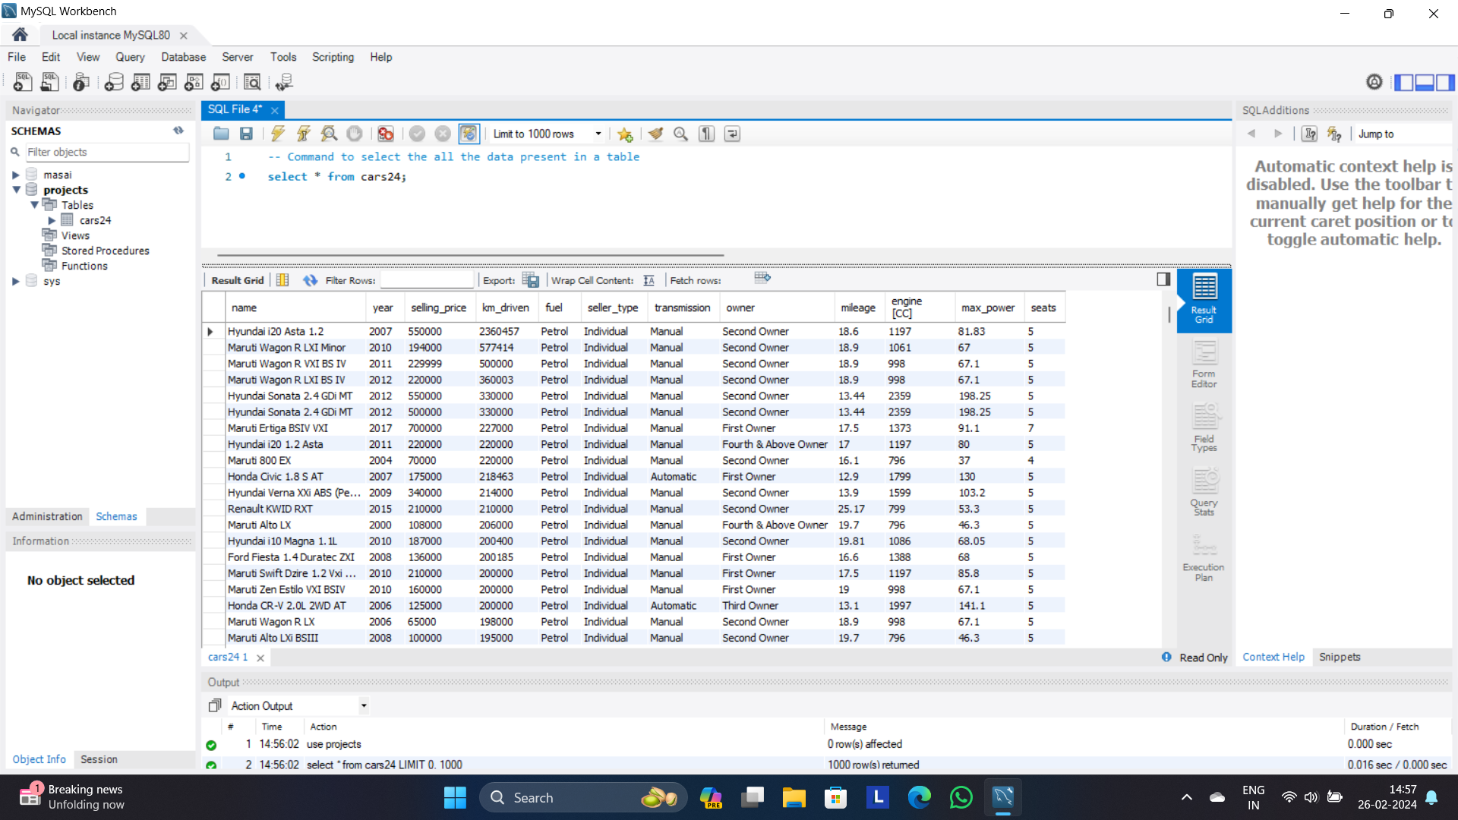
MAJOR KEY INSIGHTS
QUERY: Select * from cars24;
Explanation: Find the all records present in the cars24 dataset.
Output:

Slide 8
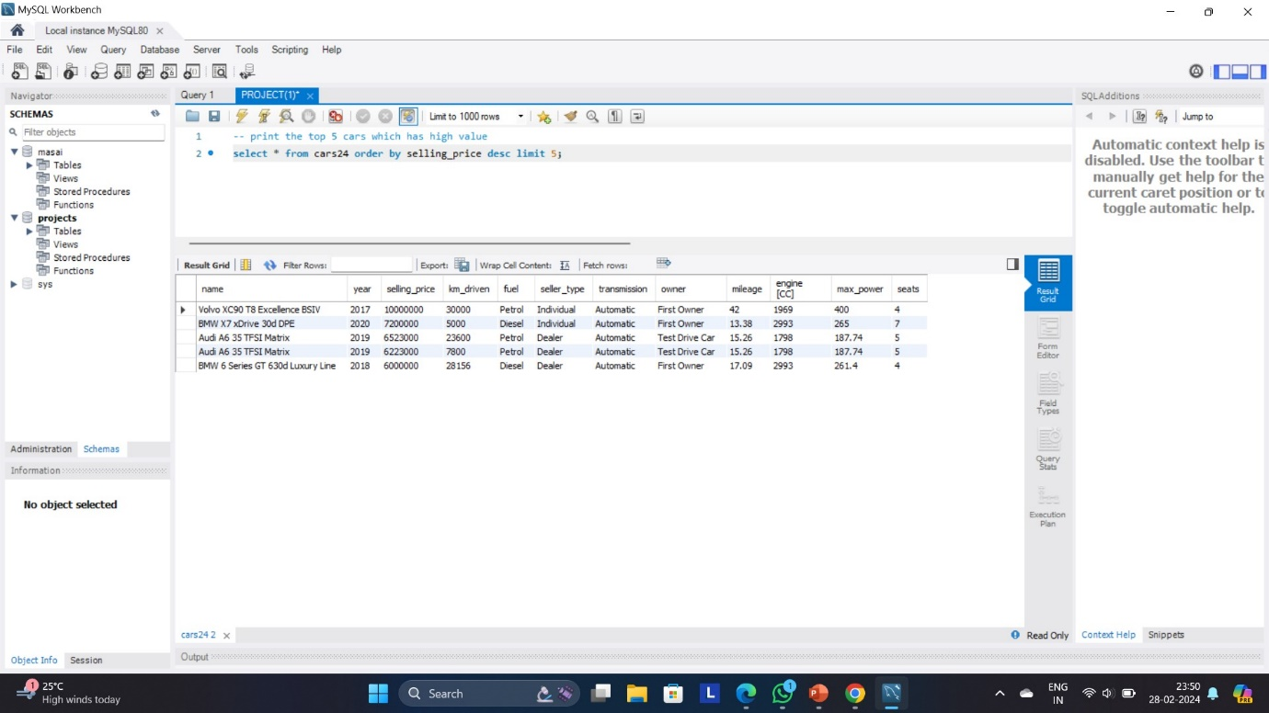
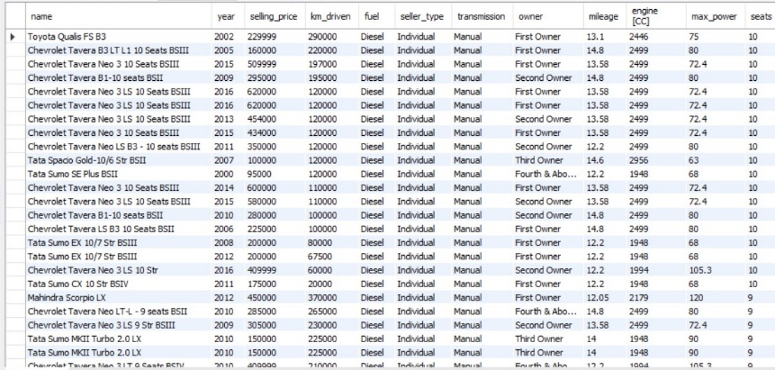
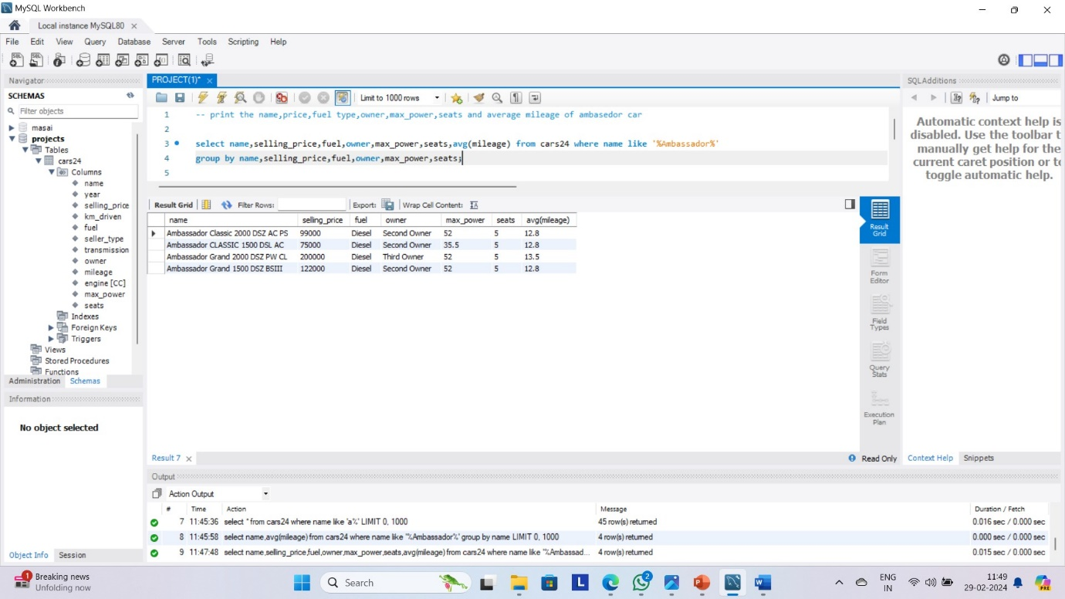
QUERY: select * from cars24 order by selling_price desc limit 5;
EXPLANATION: To Print the top 5 expensive cars in the table.
QUERY: select * from cars24 where transmission=’manual’ and fuel=’diesel’ and seats between 7 and 10 order by seats desc;
EXPLANATION: print the manual diesel cars which has seating
capacity between 7-10 sort the output by highest seat capacity first.
QUERY: select name, selling_price ,fuel, owner,max_power, seats, avg(mileage) from cars24 where name like '%Ambassador%' group by name, selling_price, fuel, owner, max_power,seats;
EXPLANATION: print the name, price, fuel type, owner, max_power, seats and average mileage of ambassador car.

Slide 9
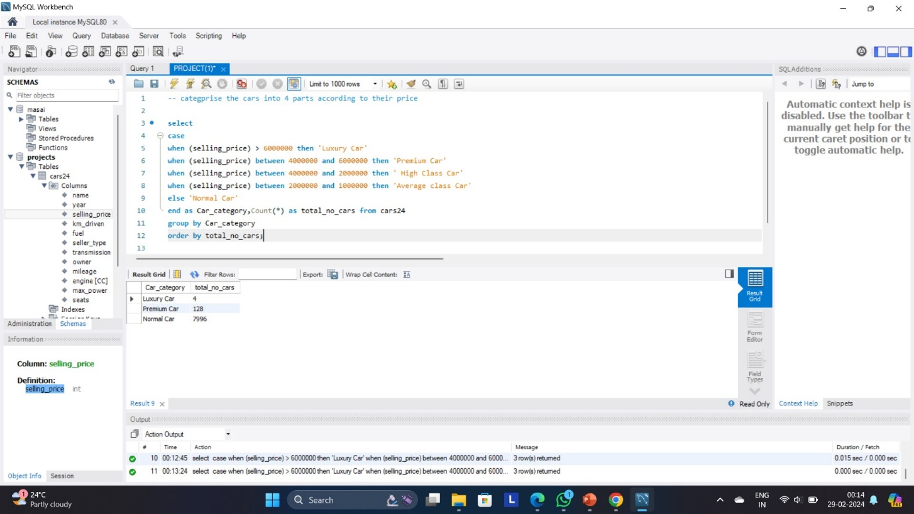
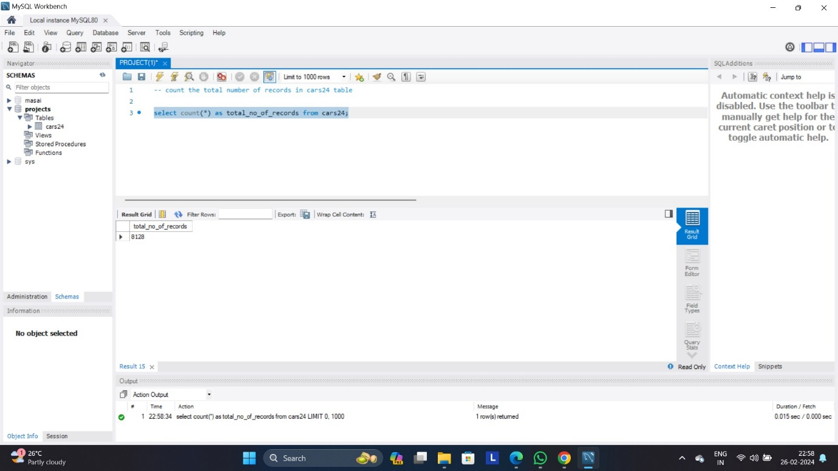
QUERY: select Case When the selling_price>6000000 then ‘luxury car’ When the selling_price between 4000000 and 6000000 then ‘premium car’ When the selling_price between 4000000 and 2000000 then ‘High class car’ When the selling_price between 2000000 and 1000000 then ‘Average class car’ Else ‘Normal Car’ End as car_category,count(*) as total_no_of_cars from cars24 group by car_category order by total_no_of_cars;
EXPLANATION:categorize the cars into 4 parts according to selling,When the price>6000000 then ‘luxury car’,When the price between 4000000 and 6000000 then ‘premium car’,When the price between 4000000 and 2000000 then ‘High class car’,When the price between 2000000 and 1000000 then ‘Average class car’,Else normal car and sort the result in ascending order.
QUERY: select count(*) as total_no_of_records from cars24;
EXPLANATION: count the number of records present in the cars24 dataset;

Slide 10
Conclusion
In this mini-project, we delved into the Cars24 dataset using SQL to extract valuable insights about the automotive industry. The dataset, comprising information on various car models, their attributes, and transaction details, provided a rich source for analysis.
Our SQL queries allowed us to perform a range of operations, from basic data retrieval to more complex aggregations and transformations. Through these queries, we gained a deeper understanding of the dataset's structure and content.

Slide 11
THANK YOU
VIJAY PRAKASH
CAPDS-05

